Slide 1
Chapter 8
Communicating Customer Value: Integrated Marketing Communications Strategy

Slide 2
Communicating Customer Value: Integrated Marketing Communications Strategy
Topic Outline
The Promotion Mix
Integrated Marketing Communications
A View of the Communications Process
Steps in Developing Effective Marketing Communication
Setting the Total Promotion Budget and Mix
Socially Responsible Marketing Communication

Slide 3
The Promotion Mix
The promotion mix is the specific blend of advertising, public relations, personal selling, and direct-marketing tools that the company uses to persuasively communicate customer value and build customer relationships

Slide 4
The Promotion Mix
The Promotion Mix
Advertising is any paid form of non-personal presentation and promotion of ideas, goods, or services by an identified sponsor
Broadcast
Print
Internet
Outdoor

Slide 5
The Promotion Mix
The Promotion Mix
Sales promotion is the short-term incentive to encourage the purchase or sale of a product or service
Discounts
Coupons
Displays
Demonstrations
Notes:
Note to Instructor
Discussion Question
What sales promotions have you seen in the last two months?
They will often mention similar coupon books, fast food contests, and demonstrations in stores.

Slide 6
The Promotion Mix
The Promotion Mix
Public relations involves building good relations with the company’s various publics by obtaining favorable publicity, building up a good corporate image, and handling or heading off unfavorable rumors, stories, and events
Press releases
Sponsorships
Special events
Web pages
Notes:
Note to Instructor
This link is to McDonald’s Web page for press releases. Before clicking you might ask the students what kind of information McDonald’s might issue press releases about. You can then see the press releases which talk about finances, marketing strategies, and organizational issues.

Slide 7
The Promotion Mix
The Promotion Mix
Personal selling is the personal presentation by the firm’s sales force for the purpose of making sales and building customer relationships
Sales presentations
Trade shows
Incentive programs

Slide 8
The Promotion Mix
The Promotion Mix
Direct marketing involves making direct connections with carefully targeted individual consumers to both obtain an immediate response and cultivate lasting customer relationships—through the use of direct mail, telephone, direct-response television, e-mail, and the Internet to communicate directly with specific consumers
Catalog
Telemarketing
Kiosks

Slide 9
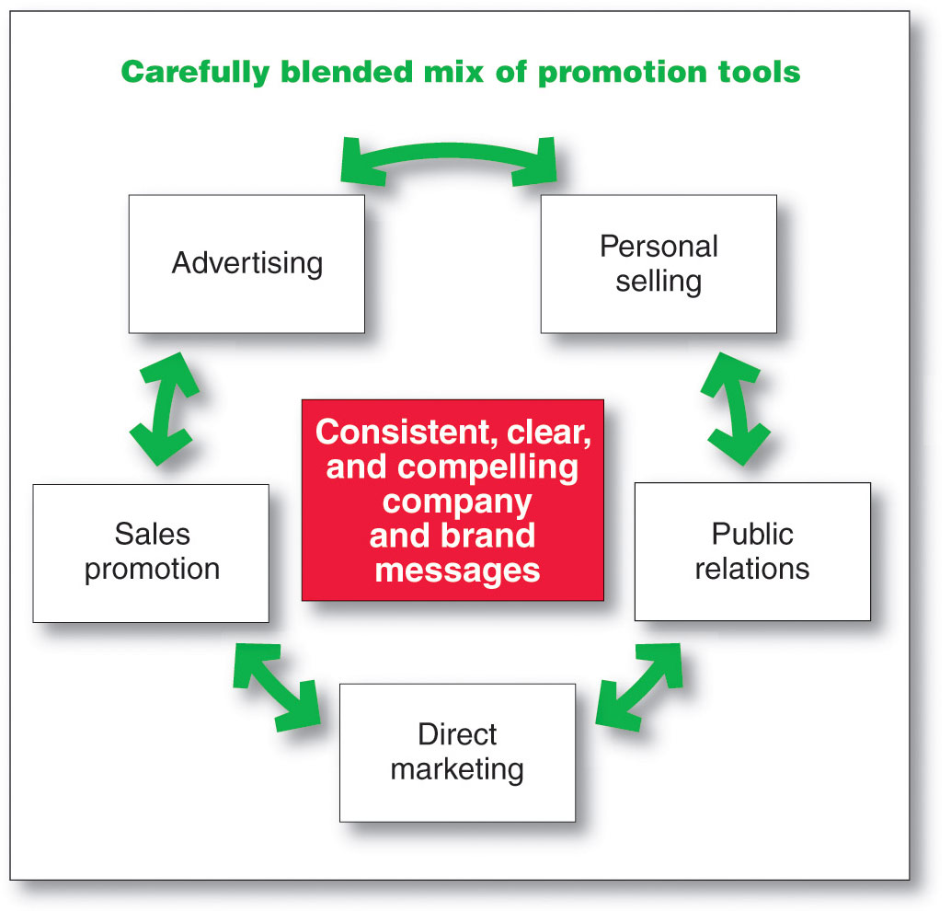
Integrated Marketing Communications Strategy
Notes:
Note to Instructor
Discussion Question
Which of these do you think is most effective?
They will realize that different tools are better for different targets, products, stages in the product life cycle, and goals of the marketer.

Slide 10
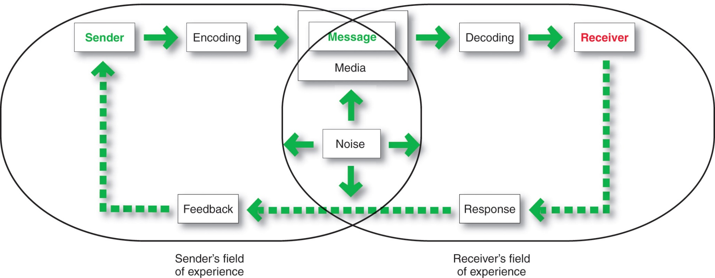
A View of the Communication Process
The Communication Process
Notes:
Sender is the party sending the message to another party.
Encoding is the process of putting thought into symbolic form.
Message is the set of symbols the sender transmits.
Media is the communications channels through which the message moves from sender to receiver.
Decoding is the process by which the receiver assigns meaning to the symbols.
Receiver is the party receiving the message sent by another party.
Response is the reaction of the receiver after being exposed to the message.
Feedback is the part of the receiver’s response communicated back to the sender
Noise is the unplanned static or distortion during the communication process, which results in the receiver’s getting a different message than the one the sender sent.

Slide 11
Steps in Developing Effective Marketing Communication
Identify the target audience
Determine the communication objectives
Design the message
Choose the media
Select the message source
Notes:
Note for Instructor
For a message to be effective, the sender’s encoding must mesh with the receiver’s decoding process.
Best messages consist of words and other symbols that are familiar to the receiver.
Marketers may not share their consumer’s field of experience but must understand the consumer’s field of experience.

Slide 12
Steps in Developing Effective Marketing Communication
Determining the Communication Objectives
Marketers seek a purchase response that results from a consumer decision-making process that includes the stages of buyer readiness

Slide 13
Steps in Developing Effective Marketing Communication
Collecting Feedback
Involves the communicator understanding the effect on the target audience by measuring behavior resulting from the behavior

Slide 14
Setting the Total Promotion Budget and Mix
Setting the Total Promotion Budget
Affordable budget method sets the budget at an affordable level
Ignores the effects of promotion on sales

Slide 15
Setting the Total Promotion Budget and Mix
Setting the Total Promotion Budget
Percentage of sales method sets the budget at a certain percentage of current or forecasted sales or unit sales price
Easy to use and helps management think about the relationship between promotion, selling price, and profit per unit
Wrongly views sales as the cause rather than the result of promotion

Slide 16
Setting the Total Promotion Budget and Mix
Setting the Total Promotion Budget
Competitive-parity method sets the budget to match competitor outlays
Represents industry standards
Avoids promotion wars

Slide 17
Setting the Total Promotion Budget and Mix
Shaping the Overall Promotion Mix
The Nature of Each Promotion Tool
Sales promotion includes coupons, contests, cents-off deals, and premiums that attract consumer attention and offer strong incentives to purchase, and can be used to dramatize product offers and to boost sagging sales

Slide 18
Setting the Total Promotion Budget and Mix
Shaping the Overall Promotion Mix
The Nature of Each Promotion Tool
Public relations is a very believable form of promotion that includes news stories, features, sponsorships, and events
Direct marketing is a non-public, immediate, customized, and interactive promotional tool that includes direct mail, catalogs, telemarketing, and online marketing

Slide 19
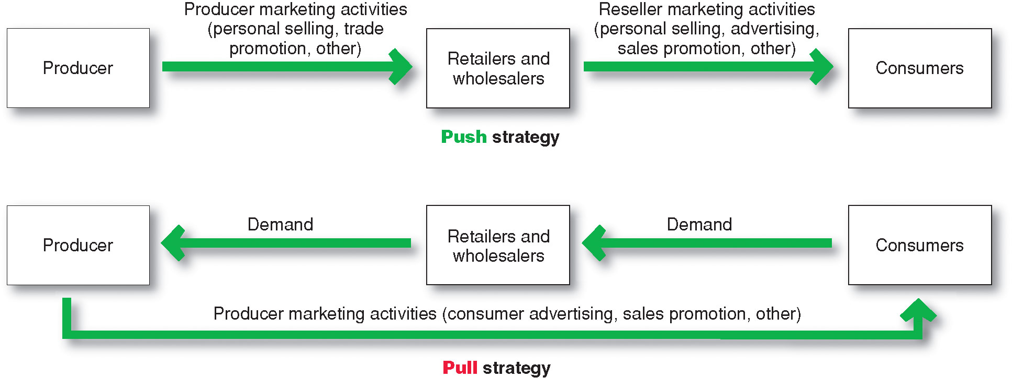
Shaping the Overall Promotion Mix
Promotion Mix Strategies
Notes:
Note to Instructor
Push strategy involves pushing the product to the consumers by inducing channel members to carry the product and promote it to final consumers.
Pull strategy is when the producer directs its marketing activities toward final consumers to induce them to buy the product and create demand from channel members.

Slide 20
Socially Responsible Marketing Communication
Communicate openly and honestly with consumers and resellers
Avoid deceptive or false advertising
Avoid bait-and-switch advertising
Conform to all
federal,
state, and
local regulations

Slide 21
All rights reserved. No part of this publication may be reproduced, stored in a retrieval system, or transmitted, in any form or by any means, electronic, mechanical, photocopying, recording, or otherwise, without the prior written permission of the publisher. Printed in the United States of America.
Copyright © 2012 Pearson Education, Inc.
Publishing as Prentice Hall

