Slide 1
King Saud University College of Engineering IE – 341: “Human Factors Engineering” Fall – 2016 (1st Sem. 1437-8H)
Human Capabilities
Part – C. Speech Communications (Chapter 7)
Prepared by: Ahmed M. El-Sherbeeny, PhD

Slide 2
Lesson Overview
Introduction
The Nature of Speech
Criteria for Evaluating Speech
Components of Speech Communication Systems

Slide 3
Introduction
Speech is form of “display”
i.e. form of auditory information
Source of speech
Mostly human (focus of this lesson)
Could also be synthesized
i.e. machine; e.g. voice mail, access confirmation)
Receiver of speech
Mostly human
Could also be machine: “voice recognition”
not advanced as synthesized sound

Slide 4
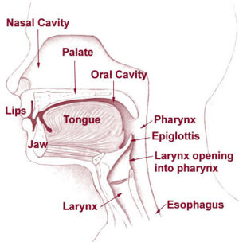
The Nature of Speech
Speech: closely associated with breathing
Organs associated with speech:
Lungs
Larynx
contains vocal cords
Pharynx
channel bet. larynx & mouth
Mouth (AKA: oral cavity):
tongue, lips, teeth, velum
Nasal cavity
Watch the following video: “how speech works” https://youtu.be/C2lRhe_Fc04
Velum

Slide 5
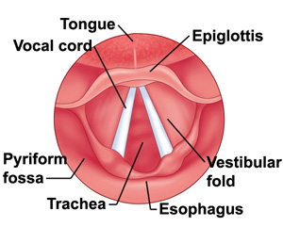
Cont. The Nature of Speech
Vocal cords
Contains vibrating folds
Opening between folds: glottis / epiglottis
Vibrates 80-400 times/sec.
Rate of vibration of vocal cords: controls freq. of resulting speech sounds
Watch the following video on vocal cords: https://youtu.be/P2pLJfWUjc8
Speech/sound waves:
Produced by: vocal cords
Further modified by “resonators”:
pharynx, oral cavity, nasal cavity
Further articulated by “manipulators”:
Mouth: tongue, lips, velum
Nasal cavity: velum, pharynx muscles
Notes:
Also watch “Vocal Cords in Action”: https://youtu.be/iYpDwhpILkQ

Slide 6
Cont. The Nature of Speech
Types of Speech sounds
Phonemes
Basic unit of speech
Def^{n}: “shortest segment of speech which, if changed, would change the meaning of a word”
Phonemes in English language:
Vowel sounds: 13 (e.g. u sound in put, u sound in but)
Consonant sounds: 25 (e.g. g sound in gyp, g in gale)
Diphthongs (i.e. sound combinations): e.g. oy sound in boy; ou sound in about
Can you compare these to Arabic phonemes?
Combining phonemes:
Phonemes form syllables ⇒ syllables form words (e.g. ac·a·dem·ic) ⇒ words form sentences
Note Phonemes > letters (why?): since phonemes change when combined together (e.g. d in di different than du)
Notes:
* Can you find the number of diphthongs in the English / Arabic languages?

Slide 7
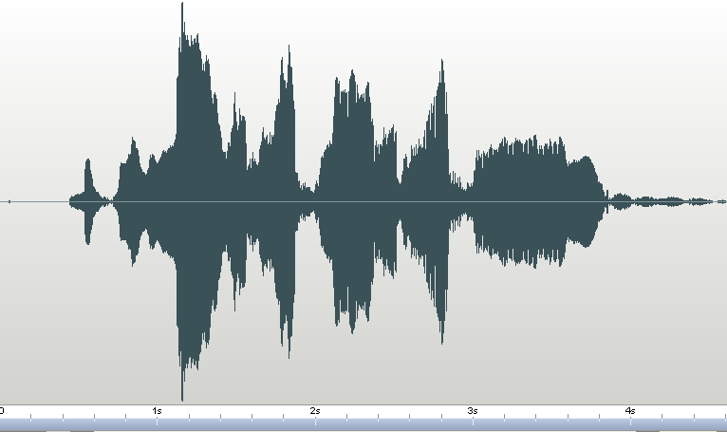
Cont. The Nature of Speech
Depicting Speech
Sound is generated by variations in air pressure
This is represented in several graphical ways
Method 1: waveform
Shows intensity variation over time (relative scale)
Listen to file below for verse “بسم الله الرحمن الرحيم”*
Notes:
*The clip shown was created using program “Wavepad Sound Editor”; clip is by Sh. Abdul-Bassitt Abdul-Samad

Slide 8
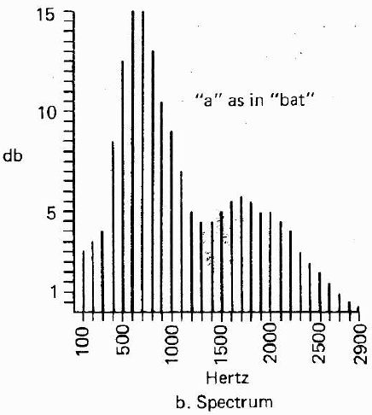
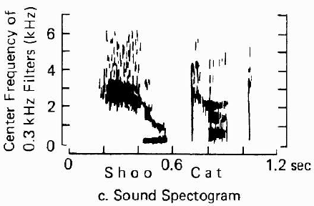
Cont. The Nature of Speech
Cont. Depicting Speech
Method 2: spectrum
Shows for given phoneme / word: intensity of various frequencies in that sound sample (see right)
Which freq. has highest intensity in shown figure?
Method 3: sound spectrogram
Frequency: vertical scale
Time: horizontal scale
Intensity: degree of darkness on plot (see right)
Notes:
* note, the figure states c. Sound Spectogram; the correct spelling is Spectrogram

Slide 9
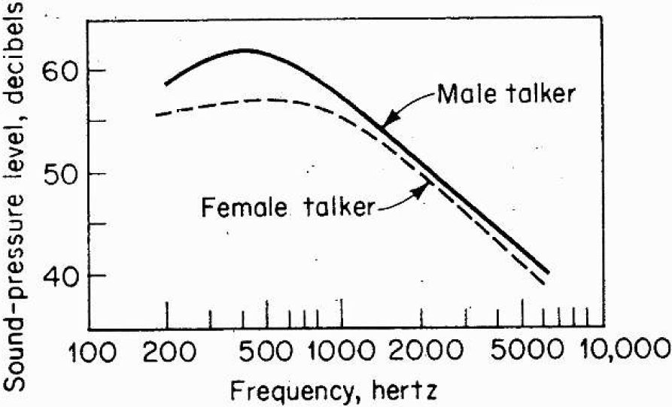
Cont. The Nature of Speech
Intensity of Speech (AKA “Speech Power”)
Variation among phonemes
Vowels speech power » consonants
e.g. a in “talk” has speech power: 680 times > th in then (i.e 28 dB difference)
Variation among speech types
conversational speech: 45-55 dBA*
Telephone/lecture speech: 65 dBA
Loud speech: 75 dBA
Shouting: 85 dBA
Variation: Male & Female
Male > female by 3-5 dB (in general)
Men in lower freq. has higher intensity than women (see right)
Notes:
*note: A in dBA: most widely used sound filter (i.e. used to control noise in sound); sound level meter is thus less sensitive to very high and very low frequencies; C filter is used for v. high sounds (dBC)

Slide 10
Criteria for Evaluating Speech
Speech Intelligibility
Def^{n}: “degree/percentage to which a speech message (e.g. group of words) is correctly recognized”
This’s major criterion for evaluating speech
Assessment of speech intelligibility:
Either repeating back read material
Or answering questions regarding material
Speech Intelligibility tests:
Nonsense syllables (e.g. un, us, mus, sub, sud, …)
these have least intelligibility
Phonetically balanced (PB) word lists
Nonsense syllables < words Intelligibility < sentences
Complete sentences
These have highest intelligibility, even when some words are not recognized (i.e. depends on context)
e.g. “Did you go to the store” may sound as “Dijoo …”
Watch the following videos regarding speech intelligibility:
Measuring speech intelligibility : https://youtu.be/pPS3Z11Wf7Q
Research study on speech intelligibility: https://youtu.be/hR7PeFEhnG0
Notes:
* What level of hearing is speech intelligibility: detectability, discriminability, identification?

Slide 11
Cont. Criteria for Evaluating Speech
Speech Quality
Another criterion for evaluating speech
May be important in identifying a specific speaker e.g. on phone (i.e. absolute identification)
Also important to choose bet. different products e.g. speaker phone on home phones, mobile phones
Assessment of speech quality
Usually done using rating system
e.g. people listen to speech and asked to rate quality: excellent, fair, poor, unacceptable, etc.
May also be done by comparing to some standard speech quality

Slide 12
Components of Speech Communication Systems
Components
Speaker
Message
Transmission System
Noise Environment
Hearer
Discussed here in terms of
Effects on intelligibility of speech communications
Methods to improve intelligibility of system

Slide 13
Cont. Speech Communication Systems
Speaker
Intelligibility of speaker usu. called “enunciation”
Research found higher intelligibility is caused by:
Longer syllable duration
Speaking with high intensity
Making use of speech time with spoken words and little pauses
Variation of speech frequencies
Differences bet. Intelligibilities generate from:
Structure of articulators (sound-producing organs)
Speech habits that people acquire
Speech training may improve speech intelligibility (but not very much)
Watch the following video on improving enunciation: https://youtu.be/pBDS6Li2WQM

Slide 14
Cont. Speech Communication Systems
Message
Affected by: phonemes used, words, context
Phoneme Confusions
Some speech sounds more easily confused than others
e.g. letters in each group (consonants) can be confused with each other: DVPBGCET, FXSH, KJA, MN
Avoid using single letters in presence of noise
Word Characteristics: for higher intelligibility use:
More familiar words
Longer words: for longer words even if part of word is dropped, rest can still be figured out
e.g. “word-spelling” alphabet: alpha, bravo, Charlie, delta, … instead of A, B, C, D

Slide 15
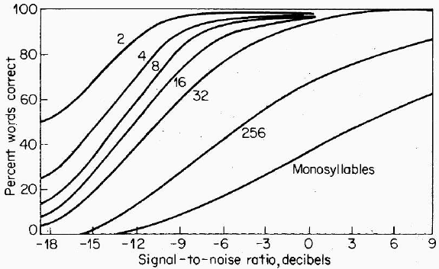
Cont. Speech Communication Systems
Cont. Message
Context features: for higher intelligibility use:
Sentences (rather than words)
Meaningful sentences (rather than non-sense phrases)
e.g. “This book is great” rather than “is great book this”
Less vocabulary (words) in the presence of noise
More words with noise ⇒ less intelligibility (see below)
Note, -ve SNR means noise is more intense than signal
Also note, monosyllable: words with only one syllable (e.g. hit, ant, cube, fish)
Notes:
* thus, in the presence of noise it’s best to use 1-2 meaningful words (e.g. help me; calling someone by their First and Last Names)

Slide 16
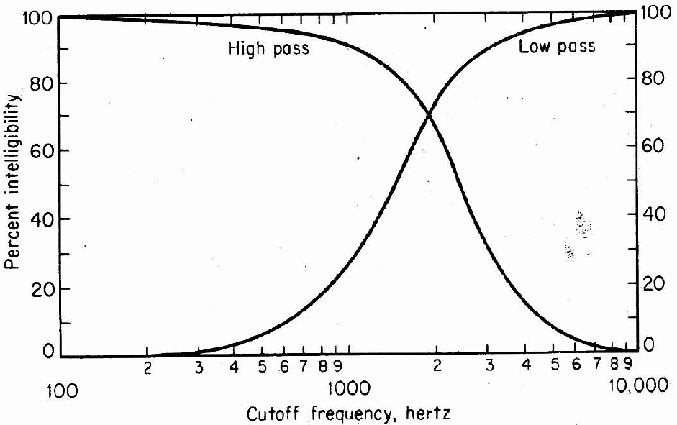
Cont. Speech Communication Systems
Transmission System
Transmission Systems
Natural: air
Artificial: telephone, radio, etc.
Artificial systems cause distortions, e.g.
Amplitude distortion
Frequency distortion
Filtering
Low-pass filter: eliminates freq. above some level
High-pass filter: eliminates freq. Below level
Filtering: freq. > 4000 Hz, < 600 Hz: little effect on intelligibility; but how about > 1000 Hz, < 3000 Hz?
Notes:
Filtering freq. > 4000 Hz ⇒ low pass filter ⇒ (from figure above) intelligibility > 90%; Filtering freq. < 600 Hz ⇒ high pass filter ⇒ (from figure above): intelligibility > 90%
why? A: remember –simply– we hear high-sensitivity sounds between 1-3 kHz (use this to answer the second question shown above)

Slide 17
Cont. Speech Communication Systems
Noise Environment
causes biggest harm to speech intelligibility
SNR (signal to noise ratio):
Simplest way to evaluate impact of noise on intelligibility
Study: for noise level of 35-100 dB ⇒ SNR = 12 dB for threshold of intelligibility (what to do for loud noise?)
However, SNR does not take frequency into consideration (only intensity)
Other measures (taking freq. into consideration):
Articulation index (AI): a measure (0-1) of speech intelligibility while knowing the noise environment
Preferred-octave speech interference level (PSIL): rough measure of effect of noise on speech reception
Preferred noise criteria (PNC) curves: suggest acceptable noise level for different work environments (e.g. offices)
Notes:
A: Shouting is required for loud noise since SNR = 12 dB @ noise = 100 dB ⇒ signal = 112 dB

Slide 18
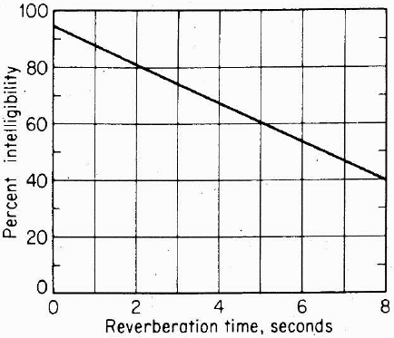
Cont. Speech Communication Systems
Cont. Noise Environment
Reverberation:
Bouncing effect of noise from walls, floor, ceiling in a closed room
Greatly decreases speech intelligibility (e.g. classrooms)
In general, the longer the reverberation time, the more the speech intelligibility decreases
Examine the linear relation (right) for a decaying 60 dB noise

Slide 19
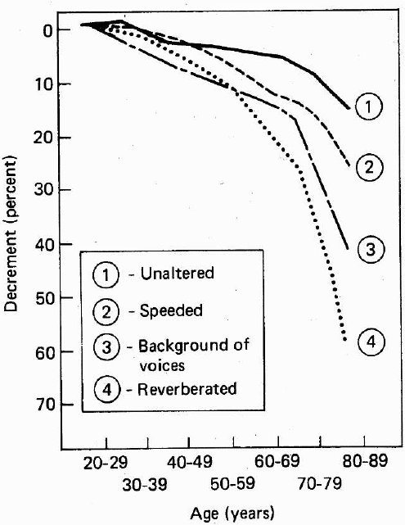
Cont. Speech Communication Systems
Hearer
To receive speech under noise: hearer should
Have normal hearing
Be trained to receive messages
Be able to withstand stress of situation
Age
Also affects speech reception (i.e. intelligibility); see right
20-29 age group: base level
Note, unaltered speech: 120 wpm vs. speeded speech: 300 wpm
Hearing protection
Prevents hearing loss
May improve SI for noise >80 dBA
Decreases SI for noise <80 dBA
Notes:
Note the large SI drop at the 60 year mark

Slide 20
References
Human Factors in Engineering and Design. Mark S. Sanders, Ernest J. McCormick. 7th Ed. McGraw: New York, 1993. ISBN: 0-07-112826-3.

