Slide 1
By Dr. Saied Darwish (Prof. Industrial Engineering Department, KSU)
The Selection of
Manufacturing Engineering Processes

Slide 2
CONTENTS
CHAPTER ONE: Fits and Tolerances
CHAPTER TWO: Fundamental of metal cutting
CHAPTER THREE: Mechanics of metal cutting
CHAPTER FOUR: Tool wear and tool life
CHAPTER FIVE: Drilling
CHAPTER SIX: Milling
CHAPTER SEVEN : Grinding
CHAPTER EIGHT: Broaching

Slide 3
CHAPTER SIX: Milling Operation
6
CHAPTER SIX
MILLING OPERATIONS
CONTENTS

Slide 4
CHAPTER SIX: Milling Operation
6.1 Milling operation
Milling is a machining operation in which a workpiece is fed past a rotating cylindrical tool with multiple cutting edges.
This cutting tool in milling is known as the milling cutter and the machine tool that traditionally performs the operation is called a milling machine.
Milling is an interrupted cutting operation, the teeth of the milling cutter enter and exit the work during each revolution.

Slide 5
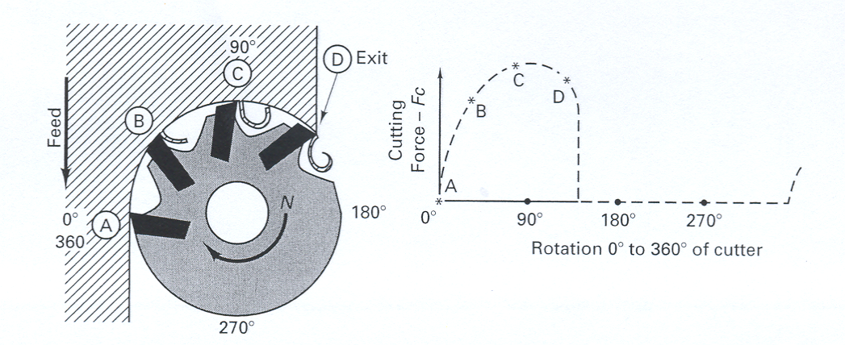
CHAPTER SIX: Milling Operation
Figure 6.1: Conventional face milling with cutting force diagram for Fc, showing the interrupted nature of the milling process.

Slide 6
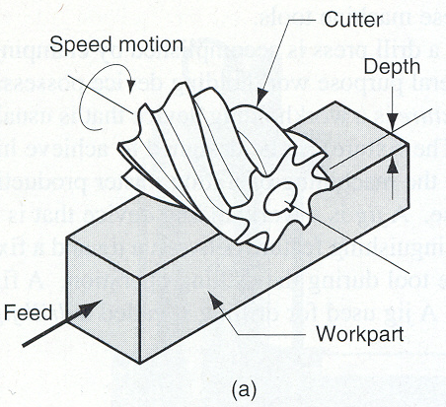
CHAPTER SIX: Milling Operation
6.2 Types of milling operations
There are two basic types of milling operations: slab/peripheral milling and face milling.
6.2.1 Peripheral or slab milling:
In this milling operation the axis of tool is parallel to the surface being machined. In this operation there are two opposite directions of rotation that the cutter can have with respect to the work.
Figure 6.2: Peripheral milling operation.

Slide 7
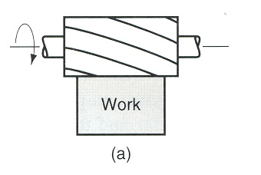
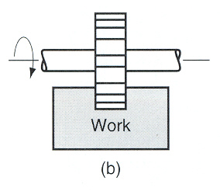
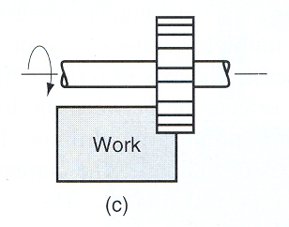
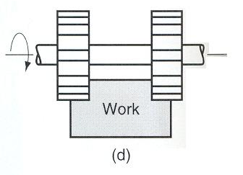
CHAPTER SIX: Milling Operation
Figure 6.3: Peripheral milling operations: (a) slab milling, (b) slotting, (c) side milling, and (d) straddle milling.

Slide 8
CHAPTER SIX: Milling Operation
6.2.1.1 Up milling: In up milling the direction of motion of the cutter teeth is opposite to the feed direction. In this type of milling operation, the chip formed by each cutter tooth starts out very thin and increases in thickness during the sweep of the cutter. The chip length is longer than in down milling.
The cutter tends to push the work along and lift it upward from the table, therefore greater clamping force must be employed. In up milling, chips can be carried into the newly machined surface, causing the surface finish to be poorer..

Slide 9
CHAPTER SIX: Milling Operation
6.2.1.2 Down milling: In down milling, the direction of motion of the cutter teeth is same as the feed direction. In this operation each chip starts out thick and reduces in thickness throughout the cut.
The length of the chip in down milling is less than in up milling. This tends to increase tool life. The cutter force direction is downwards, tending to hold the work against the work table.

Slide 10
CHAPTER SIX: Milling Operation
Figure 6.4: Two forms of milling with a 20-tooth cutter: (a) up milling and (b) down milling.

Slide 11
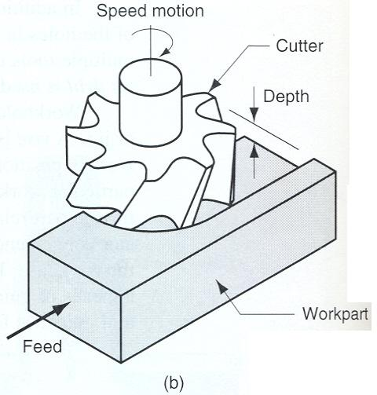
CHAPTER SIX: Milling Operation
6.3 Face milling
In face milling the axis of the cutter is perpendicular to the surface being milled, as shown in the figure 6.5.
Figure 6.5: Face milling.

Slide 12
CHAPTER SIX: Milling Operation

Slide 13
CHAPTER SIX: Milling Operation
6.4 Cutting conditions in milling
The cutting speed is determined at the outside diameter of a milling cutter. This can be converted to spindle rotation speed.
Where
N = spindle speed in rpm
V = cutting speed
D = diameter of milling cutter

Slide 14
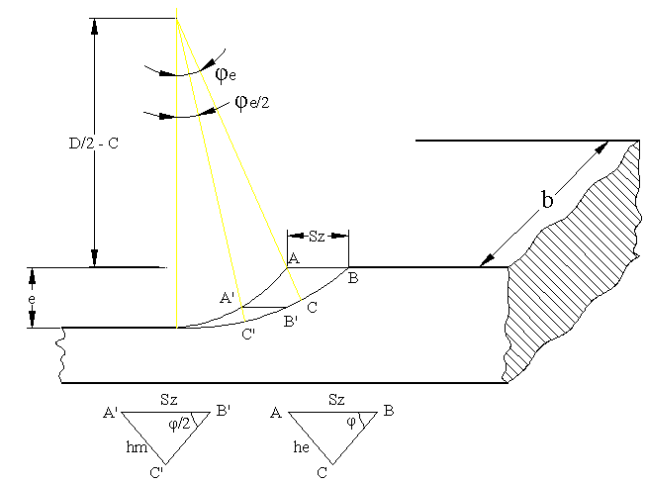
CHAPTER SIX: Milling Operation
6.5 Chip thickness in milling
In face milling the axis of the cutter is perpendicular to the surface being milled, as shown in the figure 6.5.
Figure 6.7: Chip thickness detail in milling operation.

Slide 15
CHAPTER SIX: Milling Operation
The milling operation is characterized by the changing of chip thickness as the cutting proceeds.
Therefore the maximum and mean values of chip thickness are to be calculated. Since the chip thickness is an important factor for calculating the cutter forces and power, therefore the maximum and mean values of chip thickness will be calculated.
Where
Sz = feed of workpiece/tooth = U/(n-z)
φ_{e} = angle of rotation of milling cutter during which each tooth remains
engaged in workpiece material
U = feed of workpiece/min.
n = rotational speed of cutter in rpm
z = number of teeth on cutter
since φ_{e} is small such that sin φ_{e} = φ_{e}
e = depth of cut, D = outside diameter of milling cutter

Slide 16
CHAPTER SIX: Milling Operation
6.6 Cutting forces and power in milling
the resultant force R acting on a single tooth in peripheral milling operation can be resolved into tangential and radial components (P_{s}, P_{r}) or horizontal and vertical components (P_{h}, P_{v}).
Therefore

Slide 17
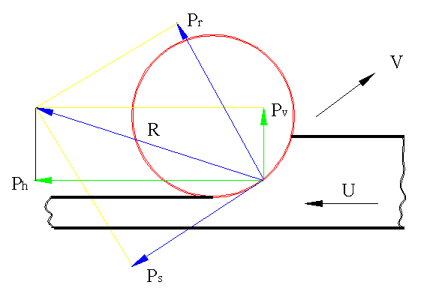
CHAPTER SIX: Milling Operation
Figure 6.8: Cutting force components in milling operation.

Slide 18
CHAPTER SIX: Milling Operation
6.7 The main cutting force “P_{s}” in peripheral milling
h = momentary chip thickness changing from zero to “h_{e}” in up milling
or from “h_{e}” to zero in down milling

Slide 19
CHAPTER SIX: Milling Operation
The total mean tangential force is:
Where
Z_{e} = number of cutting teeth in the same moment

Slide 20
CHAPTER SIX: Milling Operation
6.8 The cutting power in peripheral milling
The main chipping power “N_{s}” can be calculated as follows:
(kW)
(kW)

Slide 21
CHAPTER SIX: Milling Operation
The feed power “N_{f}” is given by:
(kW)
The total power is:
(approximately)
(kW)

Slide 22
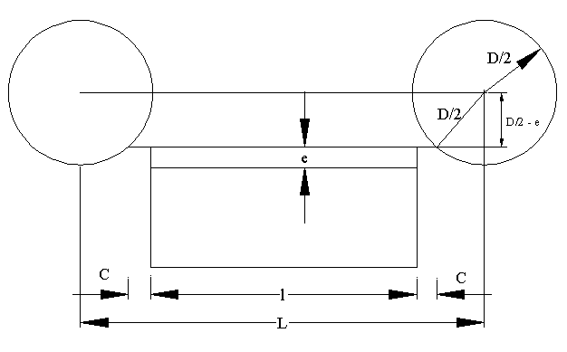
CHAPTER SIX: Milling Operation
6.9 Machining time in peripheral milling
From figure, it can be noted,
Where
U = feed of the workpiece per minute

Slide 23
CHAPTER SIX: Milling Operation
6.10 Material removal rate
Material removal rate can be calculated as following:
Where
L = length of the cut
W= width of the cut
e = depth of the cut
t = machining time

Slide 24
CHAPTER SIX: Milling Operation
Problems

Slide 25
CHAPTER SIX: Milling Operation
Problems

Slide 26
CHAPTER SIX: Milling Operation
Problems

