Slide 1
Qualitative tests of Lipids -II-
BCH302 [Practical]

Slide 2
Classification of Fatty Acids:
Saturated Fatty Acids:
➔ Fatty acids have no double bonds ,side chain are (alkane).
a) Short chain:
From 4 to 10 Carbon atoms ,and present as liquid in room Temperature e.g butyric acid.
b) Long chain:
More than 10 Carbone atoms, present in solid at room Temp. e.g. Palmatic (16) acid and Stearic(18) acid.
Single bond only

Slide 3
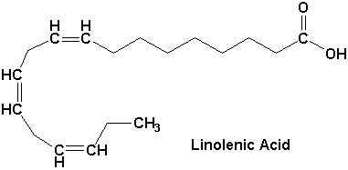
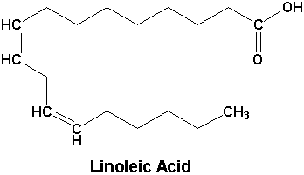
Classification of Fatty Acids:
Unsaturated Fatty Acids:
➔ have one or more double bonds between carbon atoms (side chain has at least one double bond).
a) Essential Fatty acids:
linolenic acid18-C, 3 double bond (ω-3).
Linoleic acid 18-C, 2 double bond (ω-6).
b) Non essential Fatty acids:
Can be synthesized in the body: Oleic acid.
2
ω
3
1

Slide 4
Note:
Omega-3 fatty acids (also called ω-3 fatty acids or n-3 fatty acids):
Are polyunsaturated fatty acids (PUFAs) with a double bond(C=C) at the third carbon atom from the end of the carbon chain.
The fatty acids have two ends, the carboxylic acid (-COOH) end, which is considered the beginning of the chain, thus "alpha", and the methyl (CH₃) end, which is considered the "tail" of the chain, thus "omega."
The way in which a fatty acid is named is determined by the location of the first double bond, counted from the methyl end, that is, the omega (ω-) or the n- end.
2
ω
3
1

Slide 5
Practical part

Slide 6
Qualitative tests of lipids
Copper acetate test.
Liebermann - Burchard Test: For cholesterol.
Unsaturation Test.
Acrolein test: for glycerol or fats.
1
2
3
4

Slide 7
Experiment 1 : Copper acetate test
Objective:
This test is used to distinguish between oil [neutral fat] and fatty acid [saturated and unsaturated].
Principle:
The copper acetate solution does not react with the oils (or fats), while fatty acids [saturated and unsaturated ] react with copper acetate to form copper salt.
➔Copper salt formed in the case of fatty acids can only be extracted by petroleum ether.
Notes:
Sucrose is non-reducing :
http://upload.wikimedia.org/wikipedia/commons/1/1c/Reducing_or_non_reducing_sugar.jpg

Slide 8
Experiment 1 : Copper acetate test
Method:
Take two test tubes add 3 ml of petroleum ether and an equal volume of a solution of copper acetate.
Add 0.5 ml of each sample (olive oil, oleic acid) in each tube
Shake the tube and leave it for some time.
Results:
Observation | Tube
 | Olive oil
 | Oleic acid
Olive oil
(-)
Oleic acid (+)

Slide 9
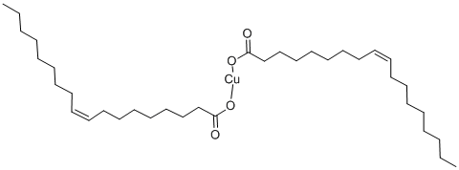
Olive oil: notice that petroleum ether upper lay containing the dissolved oil and appears colorless, aqueous solution remains blue in the bottom.
Oleic acid: the upper layer of petroleum ether becomes green as a result of copper oleate (cupper salt). The lower layer becomes less in blue.
copper oleate
petroleum ether and dissolved oil
copper oleate in the petroleum ether
copper acetate
copper acetate

Slide 10
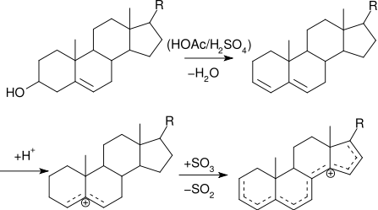
Experiment 2 : Qualitative estimation of Cholesterol by Liebermann - Burchard Test
Objective:
To detect the presence of cholesterol.
Principle:
Liebermann - Burchard test , is a chemical estimation of cholesterol, the cholesterol is react as a typical alcohol with a strong concentrated acids and the product are colored substances.
Acetic anhydride are used as solvent and dehydrating agents.
Sulfuric acid is used as dehydrating and oxidizing agent.
A positive result is observed when the solution becomes red or pink , then purple , blue, and finally bluish –green color.

Slide 11
Experiment 2 : Qualitative estimation of Cholesterol by Liebermann - Burchard Test
Method:
Dissolve a few crystals of cholesterol in 2 ml of chloroform in a dry test tube.
Now add 10 drops of acetic anhydride.
Add 2 to 3 drops of conc. sulfuric acid.
Record your result .
Repeat the reaction with olive oil and Record your results.
Results:
Observation | Tube
 | Olive oil
 | Cholesterol
Olive oil
(-)
Cholesterol
(+)

Slide 12
Experiment 3 : Unsaturation Test
Objective:
Determine the degree of saturation of different types oils.
Principle:
All neutral contain glycerides of some unsaturated fatty acids.
These unsaturated fatty acids become saturated by taking up iodine.
If the fat contains more unsaturated fatty acids, it will take up more iodine.
Halogens ( I, Br ) will add across the double bonds and thus the decolorization of an iodine or bromine solution will indicate the presence of unsaturated fatty acids.
Notes:
Heating only can’t brake the glycosidic bond, there is should be an acid to act on.
Sucrose is non-reducing :
http://upload.wikimedia.org/wikipedia/commons/1/1c/Reducing_or_non_reducing_sugar.jpg

Slide 13
Experiment 3 : Unsaturation Test
Method:
Equally into 2 flask Add 10 ml of Chloroform then 10 drops of iodine reagent ,the chloroform shows pink color due to presence of iodine.
To one test flask add the oil sample drop by drop shaking the tube vigorously for about 30 seconds after addition of each until the pink color is discharged and count the number of drops. (The pink color is discharged owing to the taking up of iodine by the unsaturated fatty acids of the oil).
Repeat the experiment using butter.
Compare unsaturation , it should be remembered that more the number of drops required to discharge the pink color, the less is the unsaturation.
Results:
Number of drops | Tube
 | Olive oil
 | Butter
pink color formed
pink color discharged

Slide 14
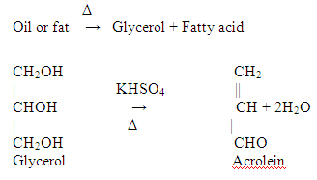
Experiment 3 : Acrolein test
Objective:
To detect glycrol or fats (Most lipid are found in the form of triglycerides, an ester formed from glycerol and fatty acids).
Principle:
When a fat is heated strongly in the presence of a dehydrating agent such as KHSO₄ [potassium bisulphate], the glycerol portion of the molecule is dehydrated to form the unsaturated aldehyde, acrolein CH2=CH-CHO.
Which can be distinguished by its irritating acrid smell and as burnt grease.
Notes:
Heating only can’t brake the glycosidic bond, there is should be an acid to act on.
Sucrose is non-reducing :
http://upload.wikimedia.org/wikipedia/commons/1/1c/Reducing_or_non_reducing_sugar.jpg

Slide 15
Another way to detect lipids :
Other way to detect lipids is by dye Sudan IV (general dye for lipid ), which produce red color with lipid.
Sudan IV (general dye for lipid )
Notes:
. Fat soluble dyes used for biochemical staining of triglycerides, fatty acids, and lipoproteins

