Slide 1
Beer's- Lambert Law and Standard Curves
BCH 312 [practical]

Slide 2
- The spectrophotometer: it can be used to measure the amount of light absorbed by a solution. How?
- It consist of two parts spectrometer and photometer.
- By using the spectrophotometer, we can quantitatively measure absorbance, and this information can be used to determine the concentration of the absorbing molecule.
- More concentrated solution will absorb more light and transmits less.
So, the more concentrated solution → high absorbance value.
And Less concentrated solution → less absorbance value.

Slide 3
Wavelength in this instrument divided into:
1. Invisible range-ultraviolet (from 100 to 360 nm).
2. Visible range (above 360 nm -700 nm)
- Blank: contain every thing expect the substance that we want to measure.

Slide 4
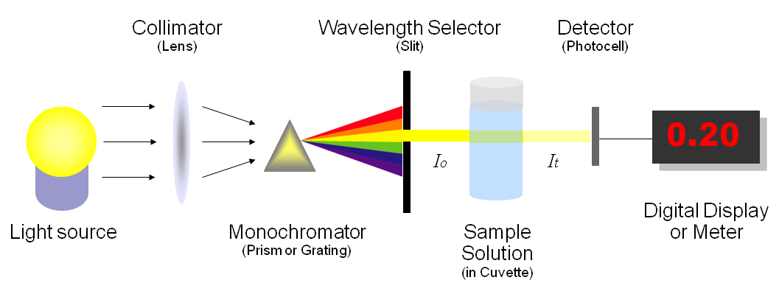
How a spectrophotometer works

Slide 5
- Beer-Lambert law:
- Principle:
The absorption of light by a solution is described by the Beer-Lambert law as:
- There is linear relationship between absorbance and concentration of an absorbing species.
A = a_{m} x c x l
A= is the absorbance of the solution [Ab].
a_{m} = the molar extinction(absorption) coefficient.
l = length of the light path through the solution.
c = concentration of the absorbing substance.

Slide 6
From this law we observe :
1- There are direct proportional between C and Ab.
2- Also, there is direct proportional between l and Ab.
- So, what does standard curve of concentrations mean?

Slide 7
- A standard curve for concentrations:
It is a graph that shows the relationship between different known concentrations of a substance and the absorbance at a specific wave length.
If we plot absorbance against concentration, we get a straight line.
-Standard curve are most commonly used to determine the concentration of a substance, using serial dilution of solutions of known concentrations.
-So, what is the principle of a standard curve???
- What is standard solutions???

Slide 8
- Standard solution:
- It is a solution containing a precisely known concentration of an element or a substance.
- A series of known standard solutions can be prepare by diluting the stock known solution.
- We should calculate the concentration of mixture after diluted by the formula: C1 X V1 = C2 X V2

Slide 9
- Notes:
1- The Ab of solution with “unknown concentration” preferred to be lower than highest Ab value in the standard Curve.
[ the absorbance of solution with “unknown concentration”, is within the rang of absorbance values of solution with “known concentration solutions”].
2- If your unknown sample had an absorbance higher the highest absorbance recorded by standard [out of the rang].
- How will you determine its concentration correctly?
- I have two choice :
1- Increase the concentration of standard solution.
2- Dilute the solution with “unknown concentration” →measure the Ab → After dilution then determine its concentration from the curve →then multiply the value by Dilution factor.

Slide 10
How to determine unknown concentration
of a solution with known absorbance value?

Slide 11
- If the unknown concentration of a solution has absorbance value =0.45,
the conc. From the curve will be ......??
Absorbance of the
” solution with unknown concentration”
Concentration of the
” solution with unknown concentration”

Slide 12
- To determine the concentration of a solution with “an unknown concentration”:
- From standard curve:
- Measure the absorbance of the “solution with unknown concentration” in order to determine the concentration.
Beer-Lambert law:
- Using available information of any standard solution to determine the “ε”,
- Then using these information to get the unknown concentration.
- Using: A = εlc
- Note: “ε” will changed when the weave length changed.
Notes:
the molecular absorption coefficient,

Slide 13
Practical part

Slide 14
- Objectives:
To understand the concept of Beer-Lambert law and its application.
Getting familiar with standard curve.
Determination of an unknown concentration for a solution.

Slide 15
- Method:
- You are provided by:
1. Standard solution (Stock solution) of Copper Sulfate with 0.1 M [known concentration].
2. Solution with Unknown concentration "A".
3. Solution with Unknown concentration "B".

Slide 16
- Method:
- Set up 8 test tubes, as following table:
Tube | 0.1M Copper Sulfate Standard Solution (ml) | d.H2O(ml) | Solutions with unknown concentration (ml)
Blank | - | 10 ml | -
A | 2ml | 8ml | -
B | 4ml | 6ml | -
C | 6ml | 4ml | -
D | 8ml | 2ml | -
E | 10ml | - | -
Solution "A" | - | - | 10 ml
Solution "B" | - | - | 10 ml
Mix the contents using the vortex.
Measure the absorbance of each tube at 600 nm against the blank [..….].

Slide 17
- Result:
Calculate the concentrations of the series of known standard solutions.
Plot the standard curve (Absorbance vs. Concentration), determine the concentration of unknown from graph.
Determine the concentration of Solution "A" and "B".
Tube | Absorbance at 600nm | Concentration M
A
B
C
D
E
Solution "A" |  | From the curve=
Solution "B" |  | From the curve=

