Slide 1
King Saud University College of Engineering IE – 341: “Human Factors” Fall – 2016 (1st Sem. 1437-8H)
Visual Displays of Dynamic Information
(Chapter 5)
Prepared by: Ahmed M. El-Sherbeeny, PhD

Slide 2
Lesson Overview
Uses of Dynamic Information
Quantitative Visual Displays
Qualitative Visual Displays

Slide 3
Uses of Dynamic Information
Dynamic information: i.e. changing info; e.g:
Natural phenomena (e.g. temperature, pressure)
Vehicle speed
Traffic lights
Frequency, intensity of sounds, etc.
Dynamic displays:
Displays used to display dynamic information
Types of dynamic displays, type of info. presented:
Quantitative: precise numeric value of some variable (e.g. “pressure is 125 psi”)
Qualitative: approximate value/rate of change/change in direction (e.g. “pressure is increasing”)
Status/check: determines if readings are normal (e.g. “pressure is normal”)
Representational: situation awareness; e.g. radar display predicts where plane will be in 5 or 10 minutes

Slide 4
Quantitative Visual Displays
Types of variables in QVD’s:
Changing/dynamic variables (e.g. temp., pressure)
Static variables (rare): length, weight of objects
Basic Design of Quantitative Displays
Mechanical displays (see next slide)
Fixed scale with moving pointer (analog): a-e
Moving scale with fixed pointer (analog): f-i
Digital display: j
Electronic displays (see slide 6)
Analog scales: k,l
Digital scale: m

Slide 5
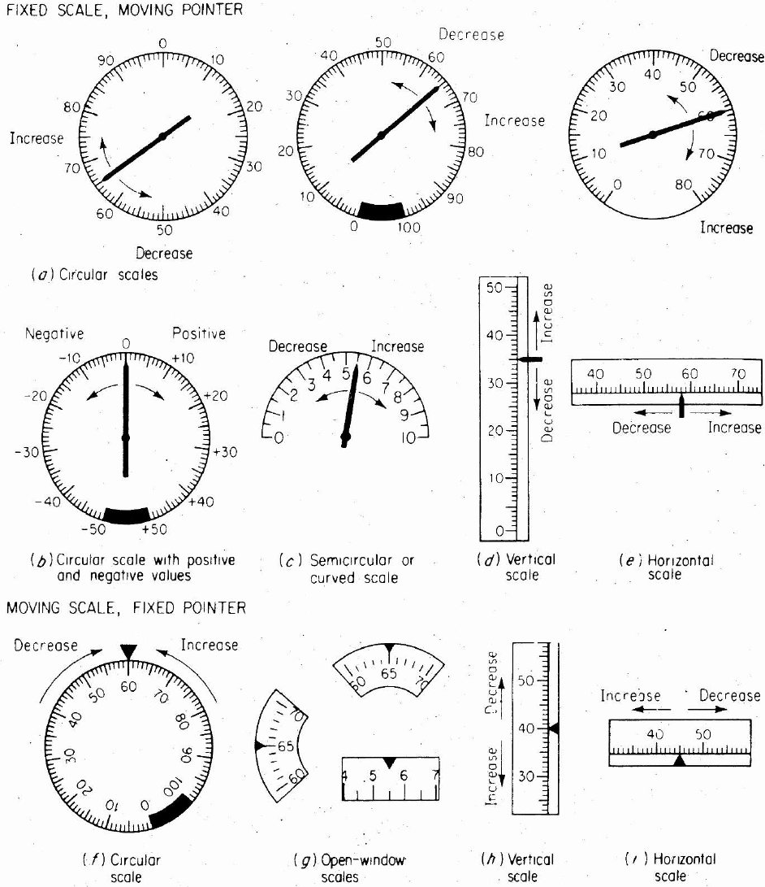
Mechanical Displays
Analog Displays
2. Digital Display

Slide 6
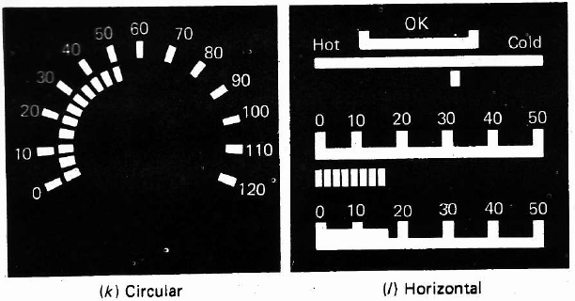
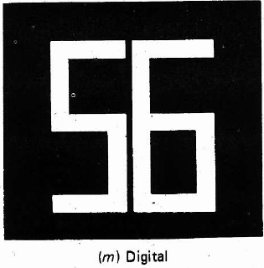
Electronic Displays
Analog Displays
2. Digital Display

Slide 7
Cont. Quantitative Visual Displays
Comparison of Different Designs (Studies)
Digital displays preferred vs. analog when:
a precise numeric (quantitative) value is required
values shown remain visible long enough to be read (i.e. not continuously changing)
Analog displays preferred vs. digital when:
fixed-scale moving-pointer displays: useful when the values change frequently /continuously ⇒ limited time in reading values if digital displays were used
when important to know direction or rate of value change (qualitative reading)

Slide 8
Cont. Quantitative Visual Displays
Cont. Comparison of Different Designs
Fixed scale w/ moving pointer vs. moving scale w/ fixed pointer
Generally: fixed scale is preferred vs. moving scale
If numerical increase is related to another natural interpretation (e.g. more or less, up and down):
easier to interpret straight line (horizontal or vertical scales) or thermometer scale with a moving pointer
pointer position relative to zero/null adds value
Don’t mix different types of pointer-scale indicators when used for related functions
this avoids reversal errors in reading
Direction of motion of moving element is clearer if manual control moves pointer (rather than scale)
For slight variable movements/changes in quantity ⇒ more clear if a moving pointer is used

Slide 9
Cont. Quantitative Visual Displays
Cont. Comparison of Different Designs
Moving scale w/ fixed pointer vs. fixed scale w/ moving pointer
Moving scale preferred (due to small panel space) when range of values: too great to show on small scale; e.g.:
moving rectangular open-window scales
moving horizontal and vertical scales
Also when a numerical value is needed to be readily available, a moving scale appearing in an open window can be read more quickly (which ?)
Circular/Semicirc. scales vs. vertical/horizontal
Circular/Semicirc. Scales generally preferred (a,b,c)
Vertical/horizontal preferred (d,e) when relating to null or viewing more/less, up/down (see slide 8)

Slide 10
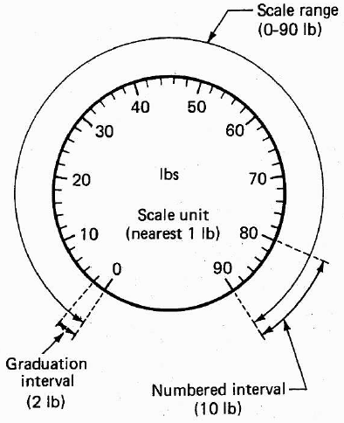
Cont. Quantitative Visual Displays:
Basic Features of Quantitative Displays
Scale range:
Numerical difference bet. highest & lowest values on scale
Numbered interval:
Numerical difference bet. adjacent #’s on scale
Graduation interval:
Numerical difference bet. smallest scale markers
Scale unit
Smallest unit to which scale is to be read (note, not necessarily = graduation interval)

Slide 11
Cont. Quantitative Visual Displays
Specific Features of Conventional Quant. Displays
Ability of people to make visual discriminations in QVD’s is influenced by the following specific features:
Numeric Progressions of Scales
Length of Scale Unit
Design of Scale Markers
Scale Markers and Interpolation
Design of Pointers
Combining Scale Features
Scale Size and Viewing Distance
Note, above features discussed here for mechanical scales, yet much of this applies also to electronic displays

Slide 12
Cont. Quantitative Visual Displays
Specific Features of Conventional Quant. Displays
Numeric Progressions of Scales
Every quantitative scale has numeric progression system, including
Graduation interval: bet. adjacent markers
Numbered interval: major scale markers
Number progressions:
Progression by 1s (0,1,2,3,…) is easiest to use:
Major markers: 0,10,20,30,….,
with intermediate markers: 5,15,25,35,….,
with minor markers at individual numbers
Progression by 5 is also satisfactory
Progression by 25 is moderate.
Decimals make scales more difficult to use:
If used, zero before decimal should be omitted
Unusual progressions (3s, 8s etc): avoid

Slide 13
Cont. Quantitative Visual Displays
Specific Features of Conventional Quant. Displays
Length of Scale Unit
Def^{n}: length on scale representing smallest numeric value to which the scale is to be read
e.g. force is to be measured to nearest 10 Newtons,
On scale: 10 N is to correspond to 1.3 mm
⇒ length of scale unit = 1.3 mm
length of scale unit should allow distinctions between values with optimum reliability in terms of human sensory & perceptual skills:
research suggests values between: 1.3 - 1.8 mm
Larger values are needed when instruments are used in non-ideal conditions
e.g. low vision, poor illumination, limited time, etc)

Slide 14
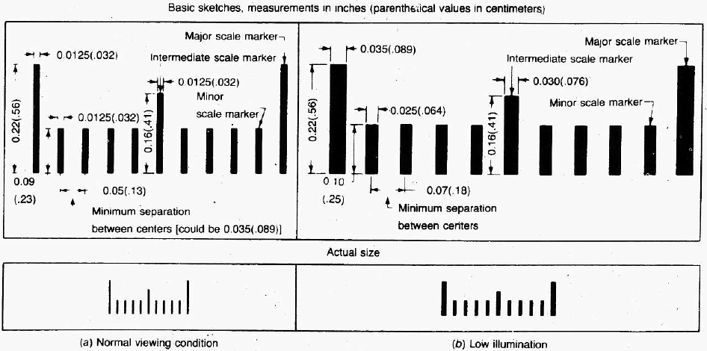
Cont. Quantitative Visual Displays
Specific Features of Conventional Quant. Displays
Cont. Length of Scale Unit
recom. format for quantitative scale given length of scale unit (?), graduation markers

Slide 15
Cont. Quantitative Visual Displays
Specific Features of Conventional Quant. Displays
Design of Scale Markers
recommended to include a scale marker for each scale unit to be read
Conventional progression scheme (last slide), based on:
Major markers: 1, 10, 100, etc.
minor markers: 0.1, 1, 10, etc. (example?)
Scale Markers and Interpolation
If scales: much compressed (>last slide) ⇒ scale markers: crowded ⇒ reading accuracy ↓
Such case: use a scale requiring interpolation
Interpolation: estimation of values between markers
For high accuracy reading of scale:
marker should be placed at every scale unit
Requires: a larger scale or a closer viewing distance

Slide 16
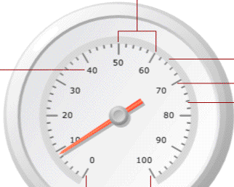
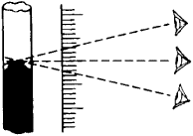
Cont. Quantitative Visual Displays
Specific Features of Conventional Quant. Displays
Design of Pointers
Recommendations for pointer design:
pointed pointers (tip angle of about 20°)
have the pointer tip meet, but not overlap, the smallest scale markers
have the color of the pointer extend from the tip to the center of the scale
have the pointer close to the surface of the scale to avoid parallax (see below)

Slide 17
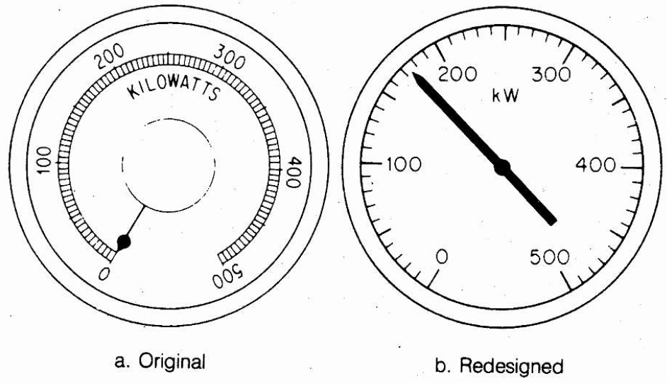
Cont. Quantitative Visual Displays
Specific Features of Conventional Quant. Displays
Combining Scale Features
mentioned features of quantitative scales: are integrated into relatively standard formats
e.g. slide 14: used for circular, semi-circular scales
Note, above features: only general (non-rigid) guidelines
e.g.’s of poor scale designs:
Ampere scale:
Shortness of scale units
Inadequate inter- mediate markers
Kilowatt scale (left):
Name 5 corrections?

Slide 18
Cont. Quantitative Visual Displays
Specific Features of Conventional Quant. Displays
Scale Size and Viewing Distance
previous guidelines: for normal viewing distance: 28 in. (71cm)
If display viewed from farther distances ⇒
features have to be enlarged to maintain the same visual angle (VA) at the eye
To maintain same VA for any viewing distance x: use this formula to find proper dimension :
Dimension at x [in] = Dimension @ 28 in * (x [in] / 28)
Example: find @ 100 cm from scale (viewed in normal viewing conditions):
Minimum length of scale unit
VA
Minimum Snellen acuity required to read scale

Slide 19
Qualitative Visual Displays
Objective of displays used for qualitative info:
Approx. value of continuously changing variable
e.g. pressure, temperature, speed, etc.
Rate of change/change in direction of variable
Quantitative basis of Qualitative Reading
Determining status/condition of variable in terms of specific predetermined range(s)
e.g. gauge of engine: cold, normal, or hot
Maintain a desirable range of approximate values
e.g. speed range between 50-55 mph (80-88 kmh)
Observing trends/rates of change
e.g. airplane ascending or descending; or N, S, E, W

Slide 20
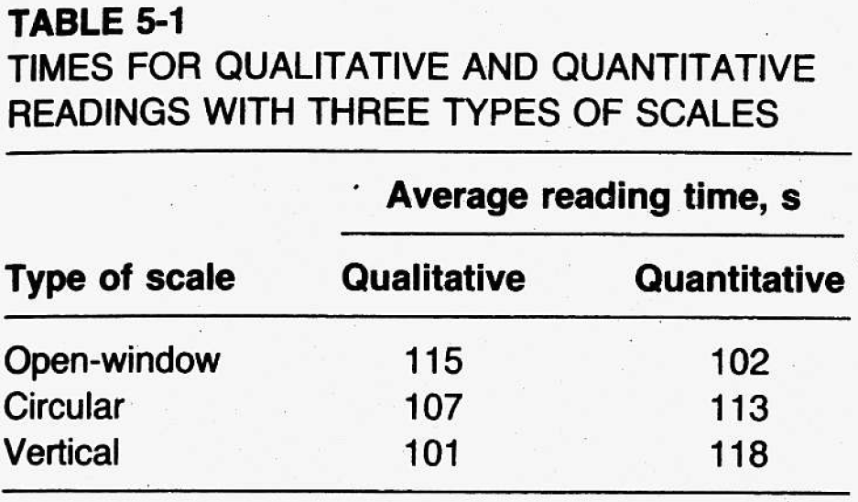
Cont. Qualitative Visual Displays
Cont. Quant. Basis of Qualitative Reading
Note, scales best applicable for quant. task not necessarily best applicable for qualit. task (below)
Can you analyze table below?

Slide 21
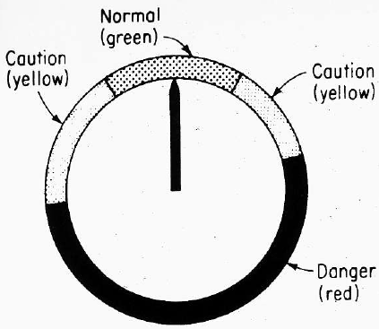
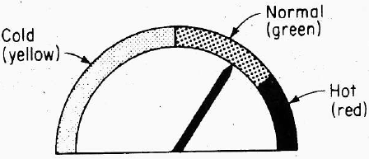
Cont. Qualitative Visual Displays
Design of Qualitative Scales
Values: sliced into limited number of ranges
Coding for ranges/readings on qualit. scales:
Color codes for ranges (right)
Shape coding for specific ranges of values
advise: take advantage of natural compatible associations people have bet. coding features and intended meanings

Slide 22
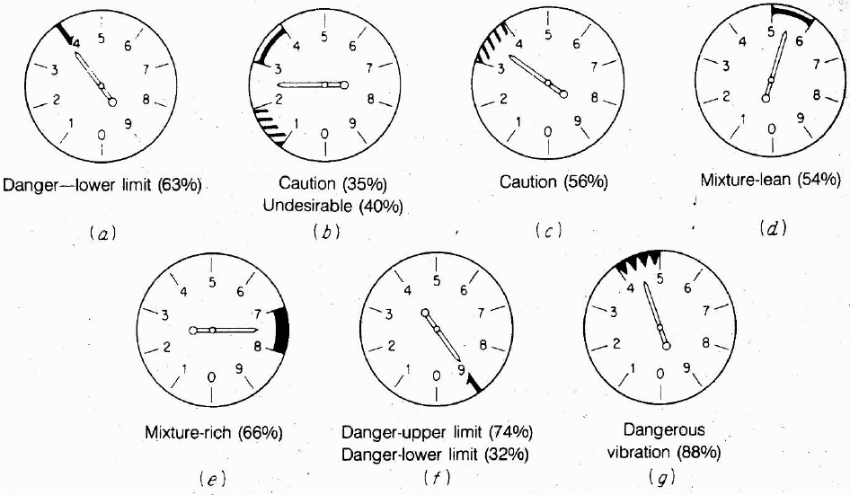
Cont. Qualitative Visual Displays
Cont. Design of Qualitative Scales
Cont. Shape coding
Experiment conducted:
Purpose: determine best association between shapes and meaning of different military plane readings
140 subjects
7 shapes vs. 7 meanings
%ge correct responses shown in ( )

Slide 23
Cont. Qualitative Visual Displays
Cont. Design of Qualitative Scales
Use of strictly Quantitative displays:
involves identifying quantitative value, and
involves assigning value read to one of possible ranges of values that represent the categories
Use of strictly Qualitative displays
directly conveys meaning of display indicator
Use of Quantitative + Qualitative displays:
Indicate trend, direction, rate of change (qualit.)
Indicate also: quant. reading (if values included)
Examples:
Last slide
Car speed gauge (numbers + indication at 120 kmh)
Other examples?

Slide 24
Cont. Qualitative Visual Displays
Check Reading
instrument that checks if reading is normal
this is achieved using quant. scale
normal condition is represented by an exact or very narrow values (not range)
e.g. to determine if voltage is ~110V or ~220V
requires caution to display normal reading clearly
research suggests normal reading should be aligned (for circular scales) at:
9 o’clock position (next slide)
12 o’clock position (also acceptable)

Slide 25
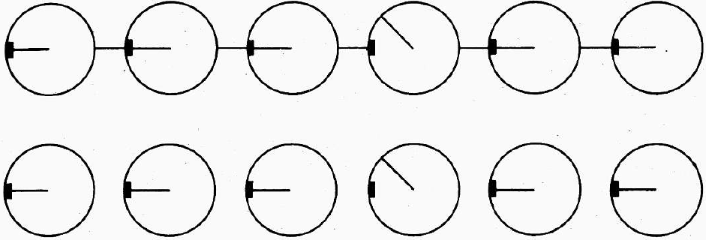
Cont. Qualitative Visual Displays
Cont. Check Reading
when several check reading devices used ⇒ deviant device should stand out (see below)
“gestalt”: human tendency to perceive complex configuration as complete entity
⇒ odd entity becomes immediately clear
e.g. below: lines between dials adds to “gestalt”
lower configuration also acceptable (less clear)

Slide 26
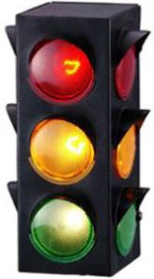
Cont. Qualitative Visual Displays
Status Indicators
Qualitative info. can indicate status of system
e.g. check reading: normal or abnormal
e.g. automobile thermometer: cold/normal/hot
status indicators: show –only- separate, discrete conditions (comp. to check reading)
e.g. on/off
e.g. traffic lights: stop/caution/go
Note, scales that show only check reading can be converted to status indicators
Common uses:
light indicators (varying color, position)
e.g. traffic lights: red (top), yellow (middle), green (bot.)
also used with stove controls (on/off)

Slide 27
Cont. Qualitative Visual Displays
Signal and Warning Lights
Flashing/steady state lights used for:
Warning (e.g. highways)
Identification (e.g. aircrafts at night)
Navigation aids, beacons
Attracting attention (e.g. on instrument panel)
Factors affecting detectability of lights
Size, Luminance, and Exposure time
Color of Lights
Flash Rate of Lights

Slide 28
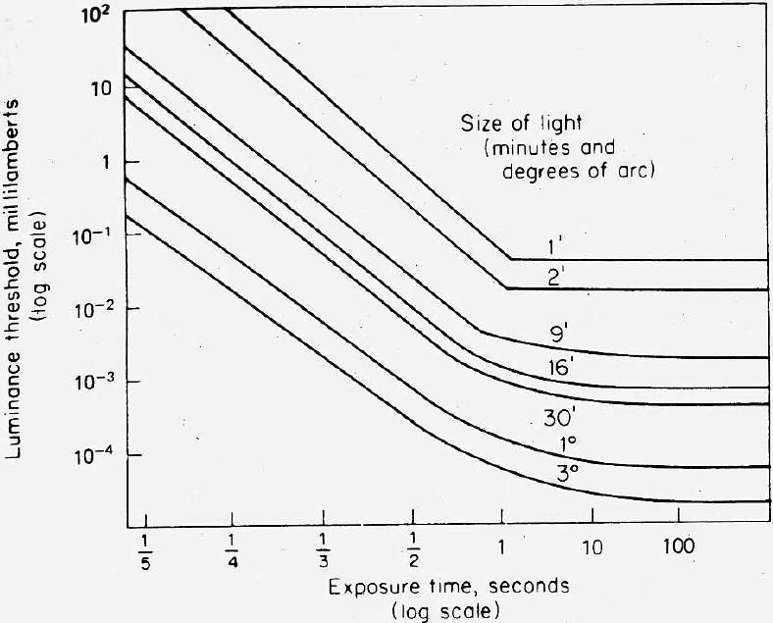
Cont. Qualitative Visual Displays
Cont. Signal and Warning Lights
Size, Luminance, and Exposure Time
Detecting flashing light depends on combin^{on}: size, luminance, exposure time
as size of light ↑ and/or as exposure time ↑ ⇒ luminance required to just detect light ↓
“just detect”: can be detected 50% of the time (i.e. luminance threshold)
for operational use:
luminance should be at least double these to be detected 99% of the time

Slide 29
Cont. Qualitative Visual Displays
Cont. Signal and Warning Lights
Color of Lights
background color + ambient illumination ⇒
influence ability of people to detect and respond to lights of different colors
With good signal brightness contrast + dark background
color has minimal importance in attracting attention
With low signal-to-background brightness contrast:
red signal is recommended,
followed by green, yellow, and white

Slide 30
Cont. Qualitative Visual Displays
Cont. Signal and Warning Lights
Flash Rate of Lights
flash rate should be « 30 times/sec
≥30 ⇒ light appears steady ⇒ “flicker-fusion”
Recommended to attract attention, use:
flash rates of about 3-10 per second
duration of at least 0.05 s
Recommended for highways and flyways, use:
60-120 flashes per minute (1-2 per second)
Varying flashing lights
mostly: single/fixed flashing light used
some applications: lights with different flash rates
e.g. tail lights showing rate of deceleration: car brakes
Keep in mind: humans can differentiate -maximum of- three different flash rates clearly (remember: JND ?)

Slide 31
References
Human Factors in Engineering and Design. Mark S. Sanders, Ernest J. McCormick. 7th Ed. McGraw: New York, 1993. ISBN: 0-07-112826-3.
Slides by: Dr. Khaled Al-Saleh; online at: http://faculty.ksu.edu.sa/alsaleh/default.aspx

