Slide 1
Manufacturing Engineering Technology in SI Units, 6th Edition
Chapter 23:
Machining Processes: Hole Making – Part B (Drilling)
Manufacturing Processes (2), IE-352
Ahmed M El-Sherbeeny, PhD
Spring 2017

Slide 2
Drilling, Drills, and Drilling Machines
Most products have many holes in them
  e.g. for rivets on plane wings
  e.g. for bolts in engine blocks
Holes used for:
  assembly with fasteners (e.g. screws, bolts, rivets)
  design purposes (e.g. weight reduction, ventilation)
  appearance
Hole making:
  Among most important operations in manufacturing
  Drilling is major, common hole-making process
  Cost is among highest machining costs in car engine prod^{on}
Notes:
Rivets: threadless nails; Bolts: threaded nails; screws: small threaded nails

Slide 3
Drilling, Drills, and Drilling Machines: Drills
Drill properties:
  Have high length-to-diameter ratios (see next slide)
  Thus, capable of producing deep holes
  Caution: drills are flexible ⇒ should be used with care
    to drill holes accurately
    and to prevent breakage
Drilling Marks:
  Drills leave burr* on bottom surface upon breakthrough
    ⇒ requires deburring operations
  Rotary motion of drilling
    ⇒ holes with “circumferential marks” on walls
Notes:
* Burr: a rough area on a piece of metal that is left after the metal is cut

Slide 4
Drilling, Drills, and Drilling Machines: Drills
(AKA: standard-point twist drill)
2 common
types of
drills
a) margins: provide bearing surface for drill against walls of hole as it penetrates workpiece
b) have good centering ability, chips break easily ⇒ suitable for deep holes
Notes:
Bearing surface: i.e. support surface

Slide 5
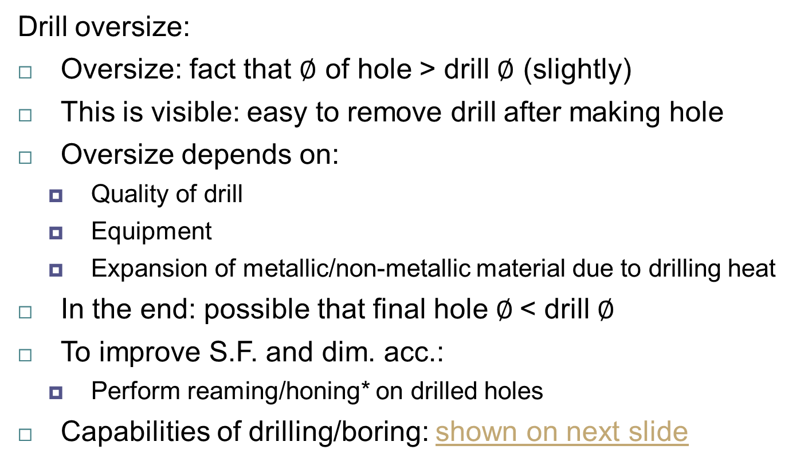
Drilling, Drills, and Drilling Machines: Drills
Drill oversize:
Oversize: fact that $∅$ of hole > drill $∅$ (slightly)
This is visible: easy to remove drill after making hole
Oversize depends on:
  Quality of drill
  Equipment
  Expansion of metallic/non-metallic material due to drilling heat
In the end: possible that final hole $∅$< drill $∅$
To improve S.F. and dim. acc.:
  Perform reaming/honing* on drilled holes
Capabilities of drilling/boring: shown on next slide
Notes:
* Honing: abrasive machining process that produces a precision surface on a metal workpiece by scrubbing an abrasive stone against it

Slide 6

Drilling, Drills, and Drilling Machines: Drills
Note, depth/diameter is a ratio (i.e. unitless)
  e.g. for twist drill:
  typical depth @ $100 mm ∅ = 8 ∗ 100 mm = 800 mm$

Slide 7
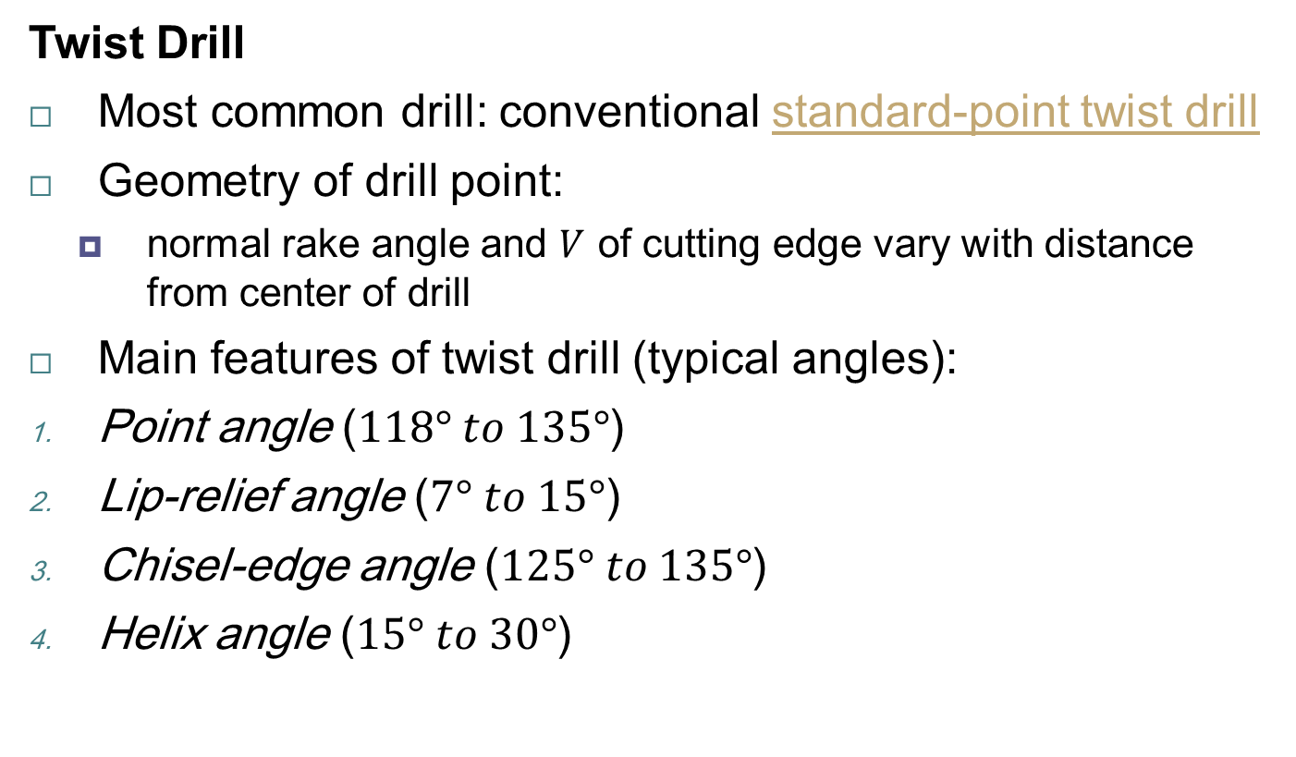
Drilling, Drills, and Drilling Machines: Drills
Twist Drill
Most common drill: conventional standard-point twist drill
Geometry of drill point:
  normal rake angle and $V$ of cutting edge vary with distance from center of drill
Main features of twist drill (typical angles):
Point angle ($118° to 135°$)
Lip-relief angle ($7° to 15°$)
Chisel-edge angle ($125° to 135°$)
Helix angle ($15° to 30°$)

Slide 8
Drilling, Drills, and Drilling Machines: Drills
Cont. Twist Drill
Grooves in drills:
  Spiral grooves run along length of drill
  Chips: guided through grooves, upward
  Grooves: also allow cutting fluid to reach cutting edges
  Some drills have internal longitudinal holes for cutting fluids (a) ⇒ lubrication, cooling, flushing chips
  Drills have chip-breaker feature ground along cutting edges
Drill angles (chosen carefully):
  Produce accurate holes
  Minimize drilling forces and torque
  Increase drill life
  Small change in angles ⇒ great change in performance*
Notes:
* e.g. too small lip relief angle ⇒ increased thrust force ⇒ increased heat ⇒ increased wear, while too large angle ⇒ chipping/breaking of cutting edge

Slide 9

Drilling, Drills, and Drilling Machines: Drills
Other Types of Drills
Step drill:
  Holes with $≥$ 2 $∅$’s
Core drill:
  Enlarge existing hole
Counter boring/countersinking:
  Make depressions on surfaces to accommodate heads of screws, bolts below workpiece surface
Center drill:
  Short; produce hole at end of piece of stock
Spot drill:
  Spots (i.e. starts) hole at desired location on a surface

Slide 10

Drilling, Drills, and Drilling Machines: Drills
Other Types of Drills
Spade drills (a):
  Removable bits
  Large $∅$ holes
  Deep holes
(indexable)
  Advantages: high stiffness, ease of grinding edges, low cost
Straight-flute drill (b):
  Similar to spade drill
Solid carbide (c), carbide-tipped drills* (d) for drilling:
  Hard materials (e.g. cast irons)
  High-temp. metals
  Abrasive (e.g. concrete) and composite materials (e.g. glass)
Notes:
* Note that, unlike in c), the body of the carbide-tipped drills (d) are made of steel (low-alloy) and carbide tip is brazed

Slide 11
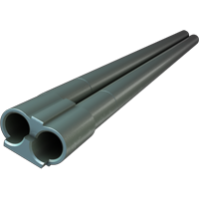

Drilling, Drills, and Drilling Machines: Drills
Gun Drilling
Name origin “gun”
  Drilling gun barrels
Features:
  Drilling deep holes
  Requires a special drill
  Hole depth-to-$∅$ ratio: $≥$ $300:1$
  $F_{t}$ balanced by bearing pads on inside surface
  ⇒ gun drill: self-centering (important for drilling deep holes)
Gun trepanning:
  Uses cutting tool similar to gun drill
  Tool has a central hole
Gun drill
Gun drilling operation
Notes:
$F_{t}$: thrust force (radial force that tends to push drill sideways)

Slide 12
Drilling, Drills, and Drilling Machines: Drills
Cont. Gun Drilling
Cutting fluid
  Forced under high pressure through passage in drill body (fig a)
  Cooling and lubrication effect
  Also: flushes out chips that could be trapped in deep holes
  ⇒ chips don’t interfere with drilling operation
  ⇒ no need to retract tool to clear chips (i.e. unlike twist drills)

Slide 13
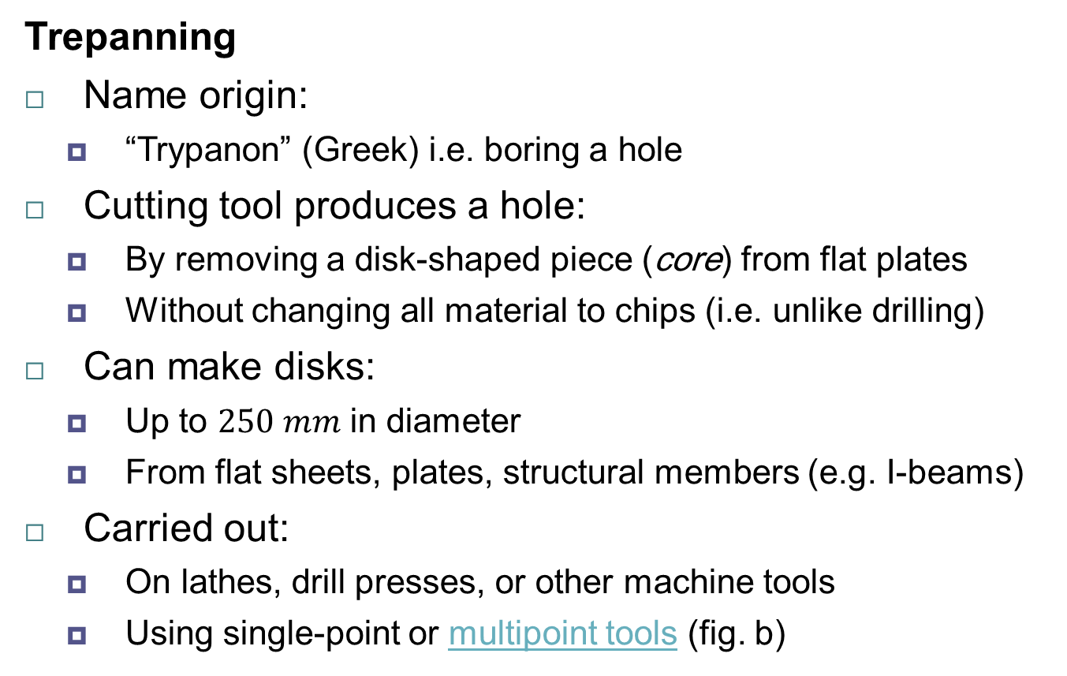
Drilling, Drills, and Drilling Machines: Drills
Trepanning
Name origin:
  “Trypanon” (Greek) i.e. boring a hole
Cutting tool produces a hole:
  By removing a disk-shaped piece (core) from flat plates
  Without changing all material to chips (i.e. unlike drilling)
Can make disks:
  Up to $250 mm$ in diameter
  From flat sheets, plates, structural members (e.g. I-beams)
Carried out:
  On lathes, drill presses, or other machine tools
  Using single-point or multipoint tools (fig. b)

Slide 14
Drilling, Drills, and Drilling Machines: Drills
Cont. Trepanning
a) Trepanning tool
b) Trepanning with drill-mounted single cutter

Slide 15
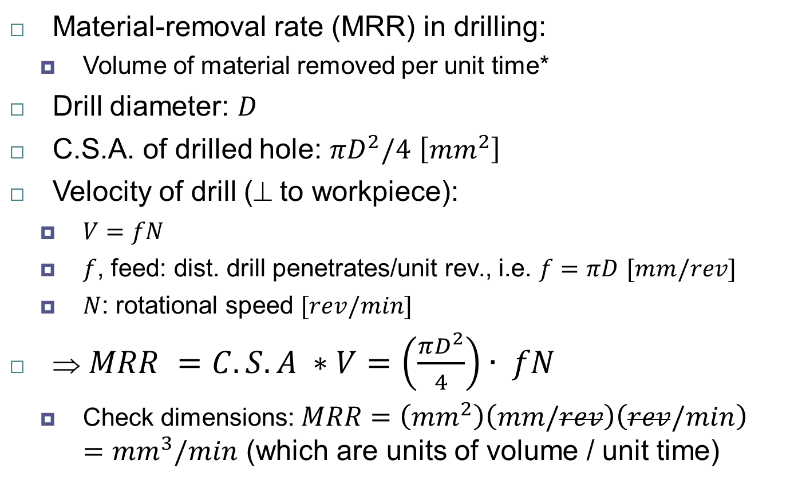
Drilling, Drills, and Drilling Machines:
Material-removal Rate in Drilling
Material-removal rate (MRR) in drilling:
  Volume of material removed per unit time*
Drill diameter: $D$
C.S.A. of drilled hole: $πD^{2}/4$ $\left[{mm}^{2}\right]$
Velocity of drill ($$ to workpiece):
  $V=fN$
  $f$, feed: dist. drill penetrates/unit rev., i.e. $f=πD$ $[mm/rev]$
  $N$: rotational speed $[rev/min]$
⇒ $MRR =C.S.A ∗V=\left(\frac{πD^{2}}{4}\right)∙ fN$
  Check dimensions: $MRR=\left({mm}^{2}\right)\left(mm/rev\right)\left(rev/min\right)={mm}^{3}/min$ (which are units of volume / unit time)
Notes:
* note, MRR means the same in all machining operations (i.e. vol. of material removed per unit time)

Slide 16
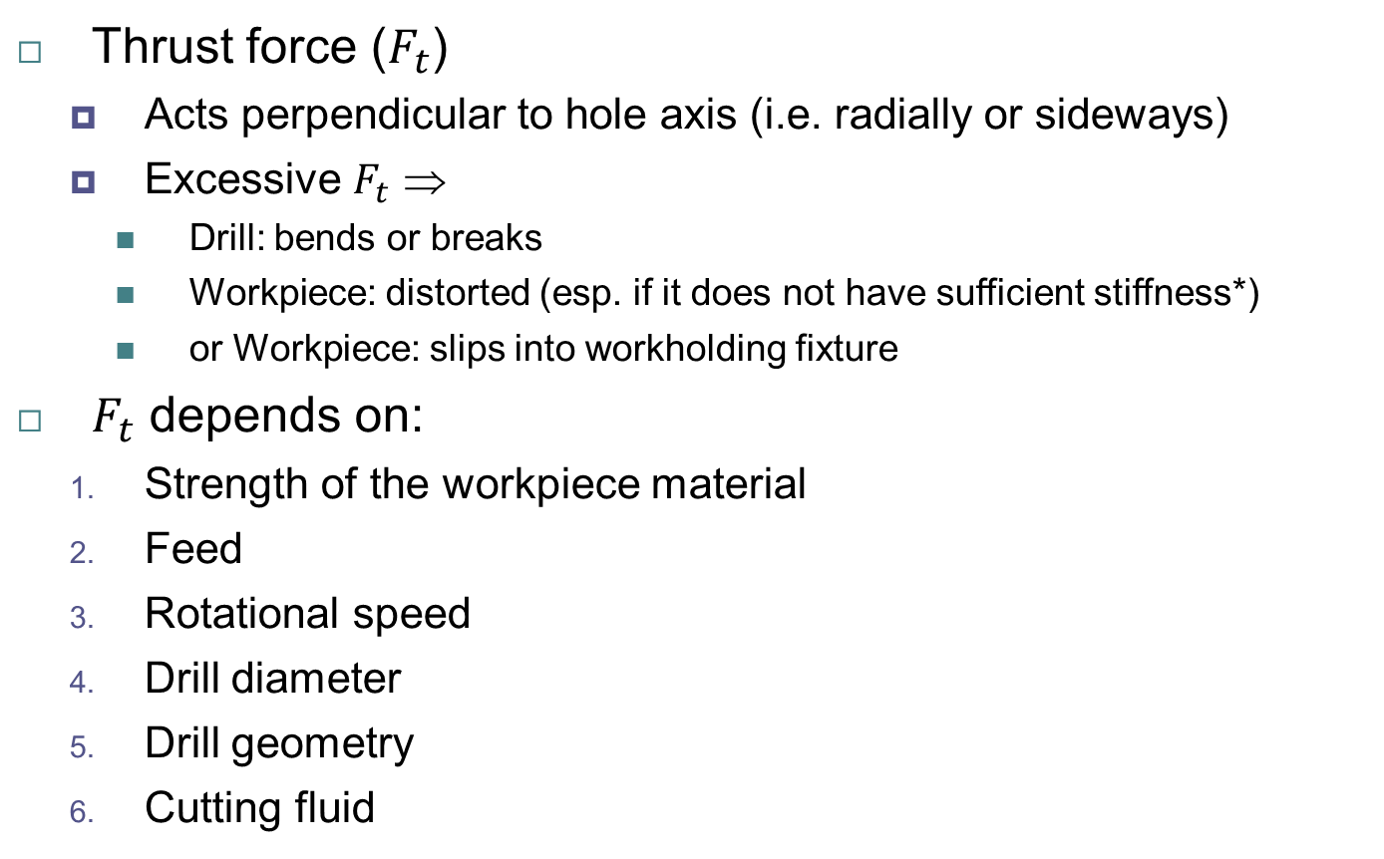
Drilling, Drills, and Drilling Machines:
Thrust Force and Torque
Thrust force ($F_{t}$)
  Acts perpendicular to hole axis (i.e. radially or sideways)
  Excessive $F_{t}$ ⇒
    Drill: bends or breaks
    Workpiece: distorted (esp. if it does not have sufficient stiffness*)
    or Workpiece: slips into workholding fixture
$F_{t}$ depends on:
  Strength of the workpiece material
  Feed
  Rotational speed
  Drill diameter
  Drill geometry
  Cutting fluid
Notes:
* e.g. this may happen with thin sheet-metal structures

Slide 17

Drilling, Drills, and Drilling Machines:
Thrust Force and Torque
Finding $F_{t}$:
  Accurate calculation is difficult
  Range:
    few $N$ for small drills
    to $100 kN$ for high-strength materials with large drills
  Experimental data: helps in using drills

Slide 18
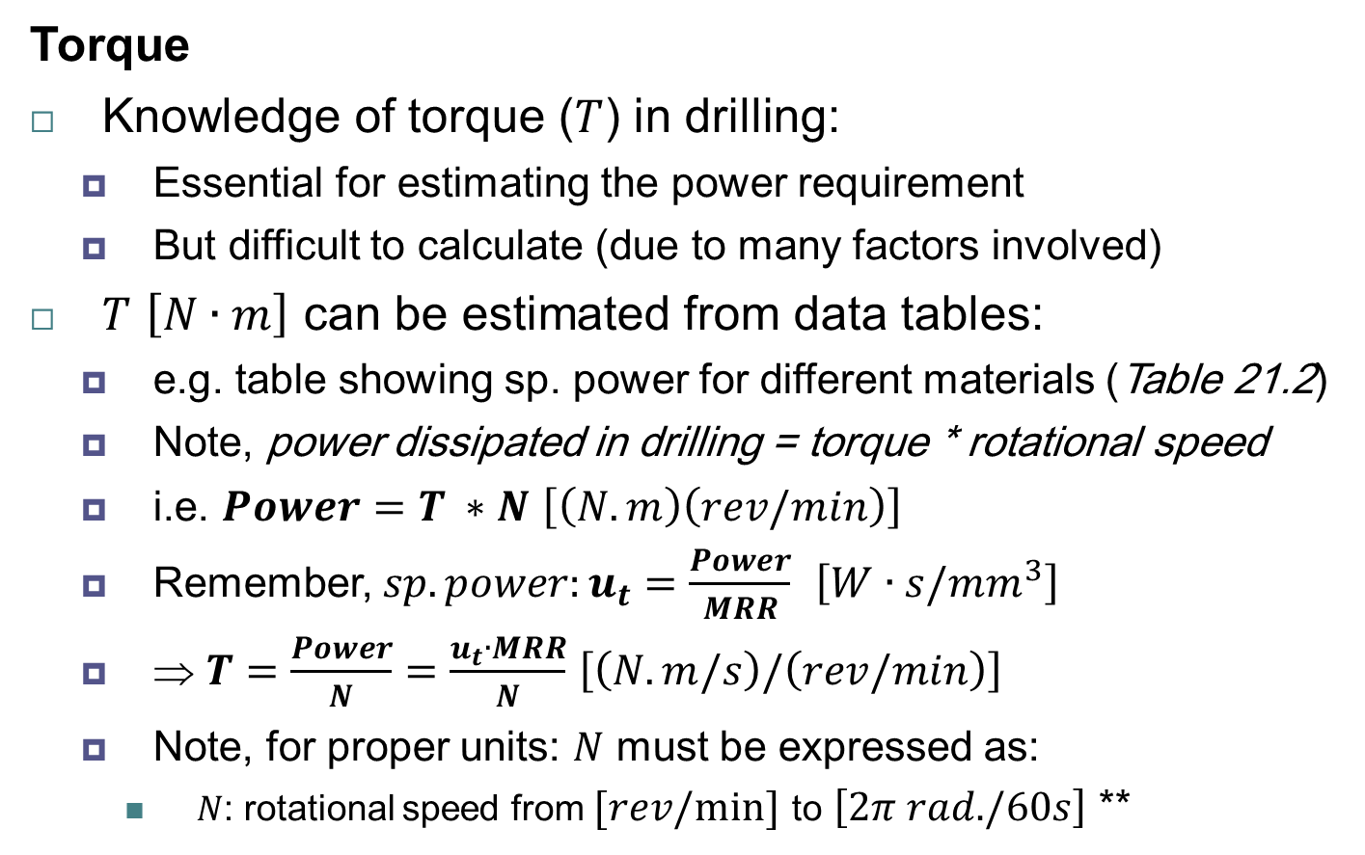
Drilling, Drills, and Drilling Machines:
Thrust Force and Torque
Torque
Knowledge of torque ($T$) in drilling:
  Essential for estimating the power requirement
  But difficult to calculate (due to many factors involved)
$T$ $\left[N∙m\right]$ can be estimated from data tables:
  e.g. table showing sp. power for different materials (Table 21.2)
  Note, power dissipated in drilling = torque * rotational speed
  i.e. $Power=T ∗N$ $\left[\left(N.m\right)\left(rev/min\right)\right]$
  Remember, $sp. power:u_{t}=\frac{Power}{MRR}$ $\left[{W∙s/mm}^{3}\right]$
  ⇒ $T=\frac{Power}{N}=\frac{u_{t}∙MRR}{N}$ $\left[\left(N.m/s\right)/\left(rev/min\right)\right]$
  Note, for proper units: $N$ must be expressed as:
    $N$: rotational speed from $[rev/min]$ to $\left[2π rad./60s\right]$ **
Notes:
* note, T can be as high as 4,000 N$∙$m ** note; 1 rev. = $2π rad$, and 1 min. = 60 s

Slide 19

Drilling, Drills, and Drilling Machines:
Thrust Force and Torque
EXAMPLE 23.4
Material-removal Rate and Torque in Drilling
A hole is being drilled in a block of magnesium alloy with a $10−mm$ drill bit at a feed of $0.2 mm/rev$ and with the spindle running at $N = 800 rpm$. Calculate the material-removal rate and the torque on the drill.

Slide 20
Drilling, Drills, and Drilling Machines:
Thrust Force and Torque
Solution
Material-removal Rate and Torque in Drilling
The material-removal rate is
The power required is
The torque is
Copyright © 2010 Pearson Education South Asia Pte Ltd

Slide 21
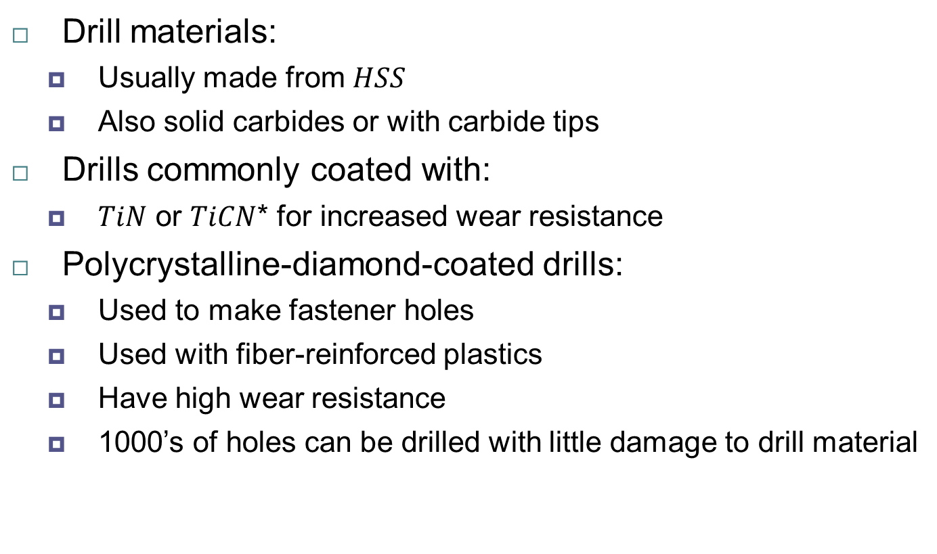
Drilling, Drills, and Drilling Machines:
Drill Materials and Sizes
Drill materials:
  Usually made from $HSS$
  Also solid carbides or with carbide tips
Drills commonly coated with:
  $TiN$ or $TiCN$* for increased wear resistance
Polycrystalline-diamond-coated drills:
  Used to make fastener holes
  Used with fiber-reinforced plastics
  Have high wear resistance
  1000’s of holes can be drilled with little damage to drill material
Notes:
* remember: TiN and TiCN: titanium nitride and titanium carbonitride (which are commonly used as coating materials)

Slide 22
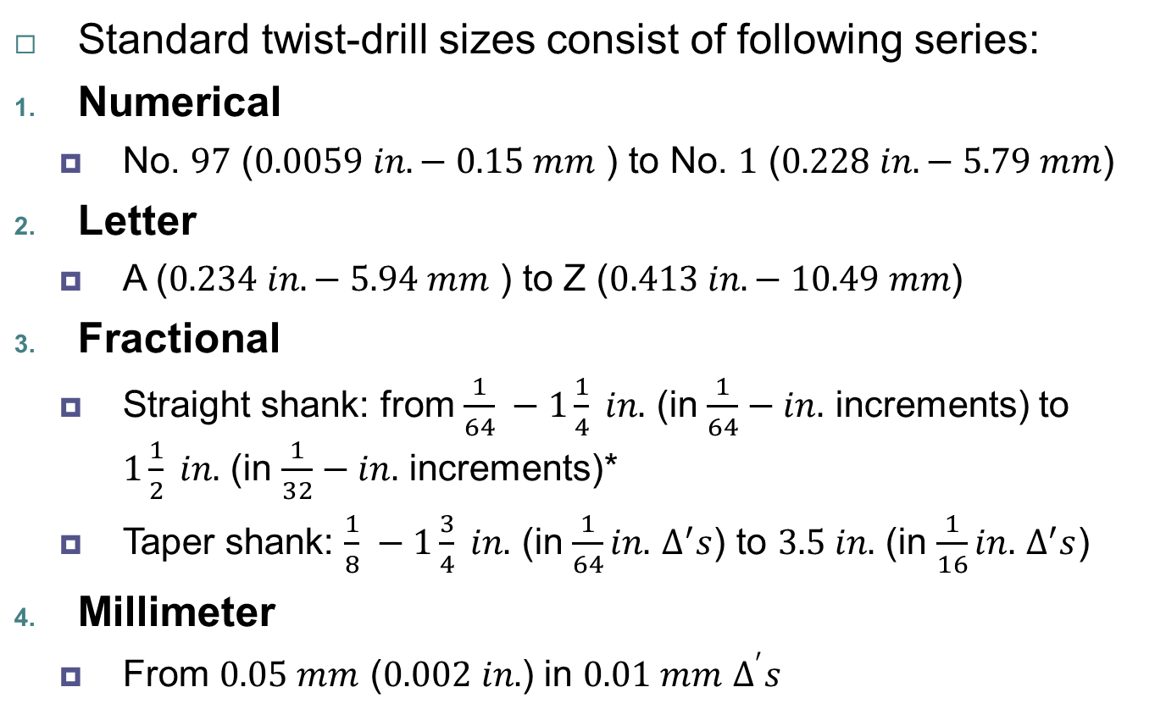
Drilling, Drills, and Drilling Machines:
Drill Materials and Sizes
Standard twist-drill sizes consist of following series:
Numerical
  No. $97$ ($0.0059 in. − 0.15 mm$ ) to No. $1$ ($0.228 in. − 5.79 mm$)
Letter
  A ($0.234 in. − 5.94 mm$ ) to Z ($0.413 in. − 10.49 mm$)
Fractional
  Straight shank: from $\frac{1}{64} −1\frac{1}{4} in.$ (in $\frac{1}{64}−in.$ increments) to $1\frac{1}{2} in.$ (in $\frac{1}{32}−in.$ increments)*
  Taper shank: $\frac{1}{8} −1\frac{3}{4} in.$ (in $\frac{1}{64}in.$ $∆^{′}s$) to $3.5 in.$ (in $\frac{1}{16}in.$ $∆^{′}s$)
Millimeter
  From $0.05 mm$ ($0.002 in.$) in $0.01 mm$ $∆^{′}s$
Notes:
* For larger drills, larger increments are used; note: $1 in. = 25.4 mm$

Slide 23
Drilling, Drills, and Drilling Machines:
Drilling Practice
Drill chucks:
  Used to hold drills (and similar hole-making tools)
  Tightened with/without keys
  Special chucks
    Have quick change features
    Do not require stopping the spindle
    Available for use in production machinery
Lateral deflection of drill:
  Drills do not have a centering action
  ⇒ tend to “walk” on workpiece surface at start of operation
  Problem severe with small-D long drills, may lead to failure

Slide 24
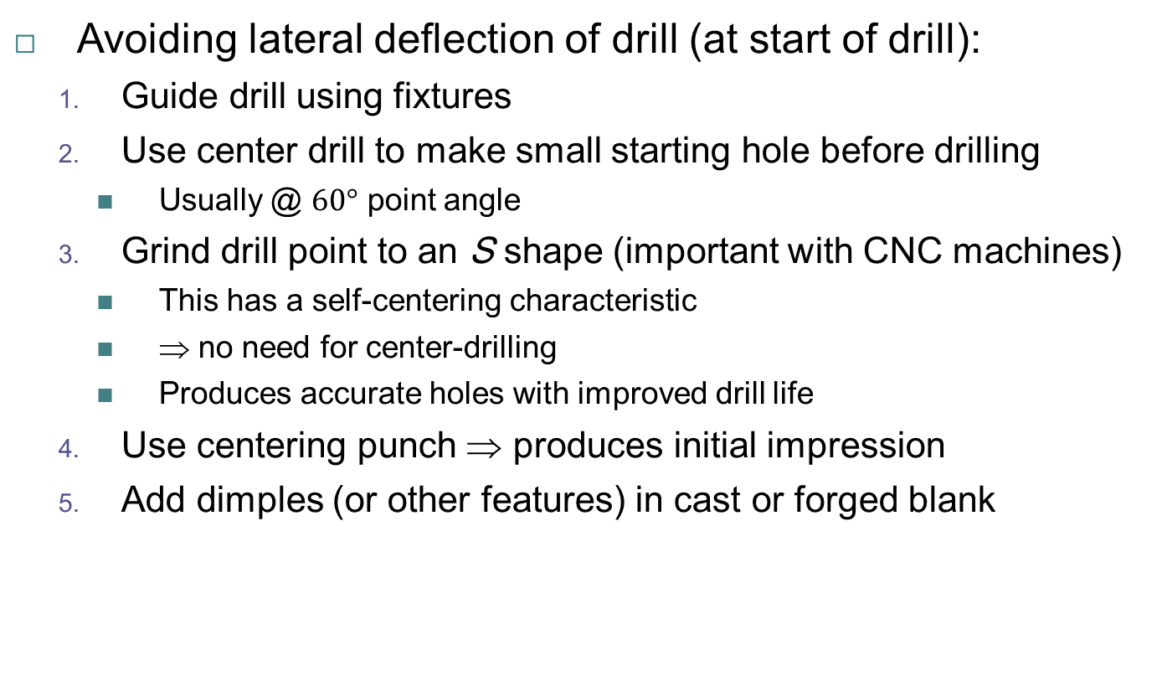
Drilling, Drills, and Drilling Machines:
Drilling Practice
Avoiding lateral deflection of drill (at start of drill):
  Guide drill using fixtures
  Use center drill to make small starting hole before drilling
    Usually @ $60°$ point angle
  Grind drill point to an S shape (important with CNC machines)
    This has a self-centering characteristic
    ⇒ no need for center-drilling
    Produces accurate holes with improved drill life
  Use centering punch ⇒ produces initial impression
  Add dimples (or other features) in cast or forged blank
Copyright © 2010 Pearson Education South Asia Pte Ltd

Slide 25
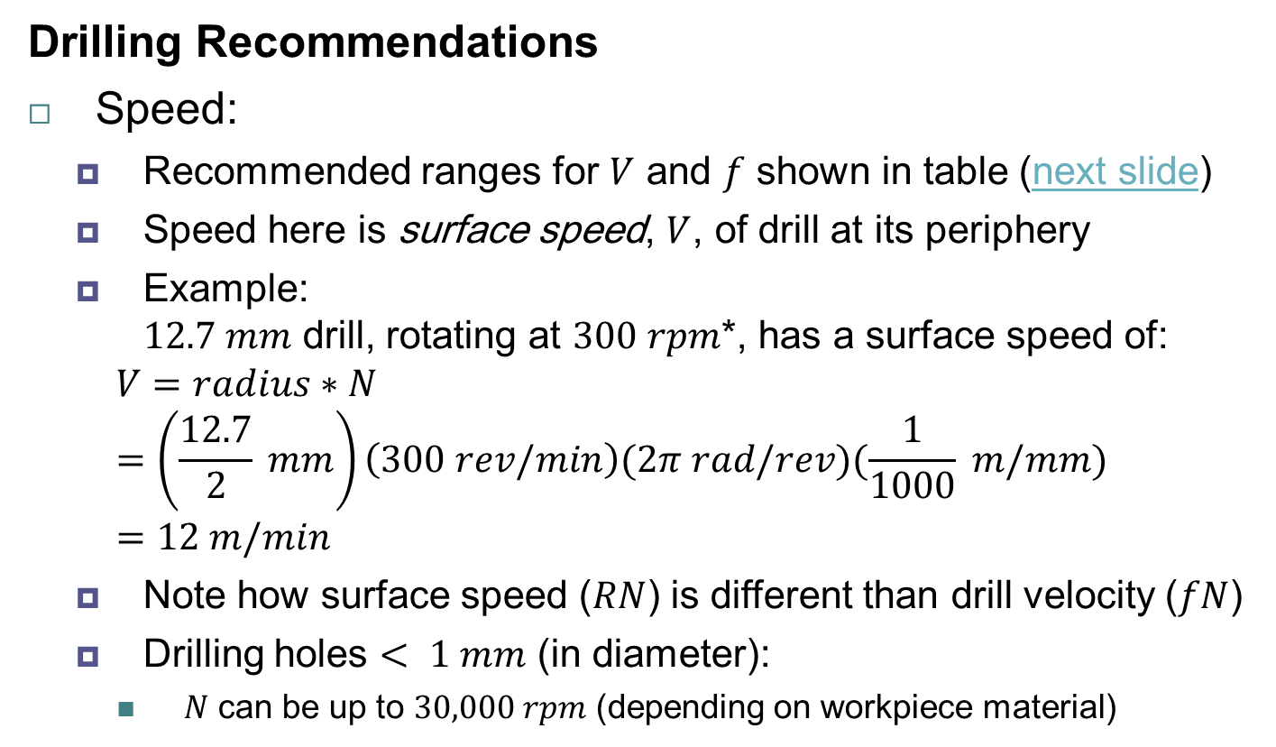
Drilling, Drills, and Drilling Machines:
Drilling Practice
Drilling Recommendations
Speed:
  Recommended ranges for $V$ and $f$ shown in table (next slide)
  Speed here is surface speed, $V$, of drill at its periphery
  Example:
  $12.7 mm$ drill, rotating at $300 rpm$*, has a surface speed of:
    $$V=radius∗N$$
    $$=\left(\frac{12.7}{2} mm\right)\left(300 rev/min\right)(2π rad/rev)(\frac{1}{1000} m/mm) \\ =12 m/min$$
  Note how surface speed ($RN$) is different than drill velocity ($fN$)
  Drilling holes $< 1 mm$ (in diameter):
    $N$ can be up to $30,000 rpm$ (depending on workpiece material)
Notes:
* Q: Can you guess what material(s) this example can be applicable to; A: titanium alloys or stainless steels

Slide 26
Drilling, Drills, and Drilling Machines:
Drilling Practice
Drilling Recommendations

Slide 27
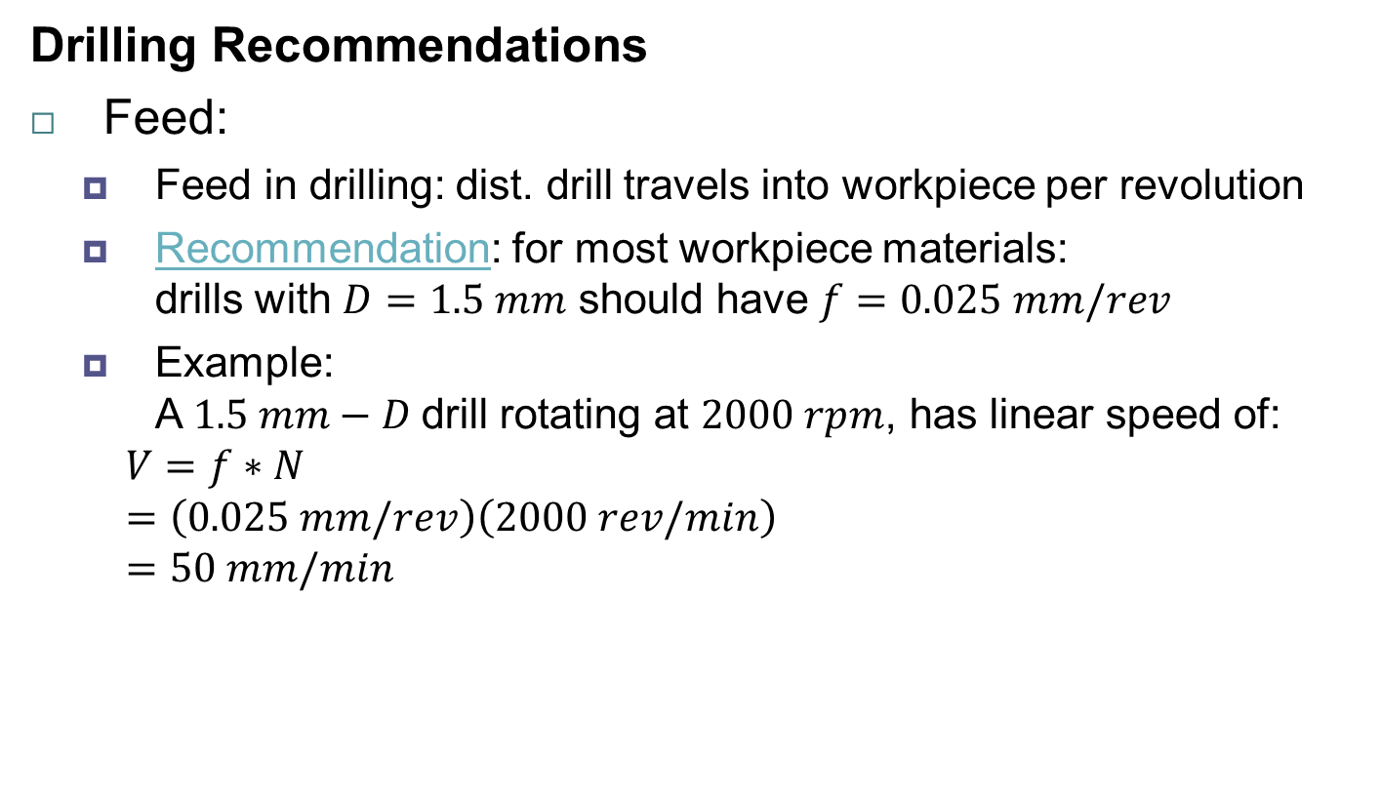
Drilling, Drills, and Drilling Machines:
Drilling Practice
Drilling Recommendations
Feed:
  Feed in drilling: dist. drill travels into workpiece per revolution
  Recommendation: for most workpiece materials:
  drills with $D=1.5 mm$ should have $f=0.025 mm/rev$
  Example:
  A $1.5 mm−D$drill rotating at $2000 rpm$, has linear speed of:
    $$V=f∗N$$
    $$=\left(0.025 mm/rev\right)\left(2000 rev/min\right)$$
    $$=50 mm/min$$

Slide 28
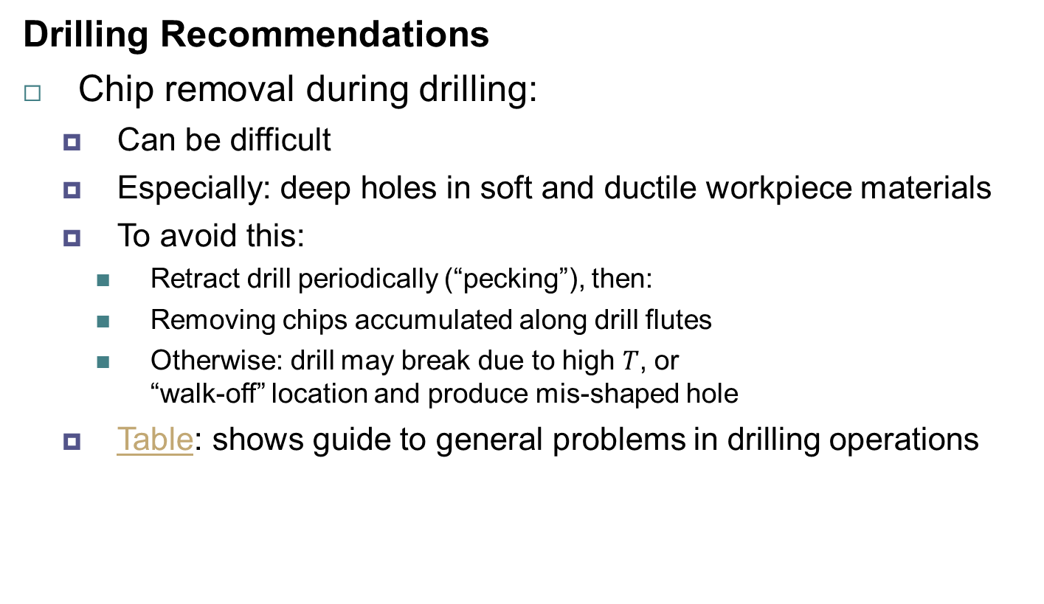
Drilling, Drills, and Drilling Machines:
Drilling Practice
Drilling Recommendations
Chip removal during drilling:
  Can be difficult
  Especially: deep holes in soft and ductile workpiece materials
  To avoid this:
    Retract drill periodically (“pecking”), then:
    Removing chips accumulated along drill flutes
    Otherwise: drill may break due to high $T$, or
    “walk-off” location and produce mis-shaped hole
  Table: shows guide to general problems in drilling operations

Slide 29
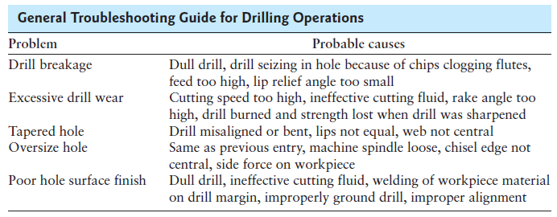
Drilling, Drills, and Drilling Machines:
Drilling Practice
Drilling Recommendations

Slide 30
Drilling, Drills, and Drilling Machines:
Drilling Practice
Drill Reconditioning
Drills reconditioned by grinding, either:
  Manually (i.e. by hand), or
  With special fixtures
Reconditioning: especially important with CNC machines
Hand grinding:
  Difficult
  Requires considerable skill to produce symmetric cutting edges
Grinding on fixtures:
  Accurate
  Done on special computer controlled grinders
Coated drills can be recoated

Slide 31
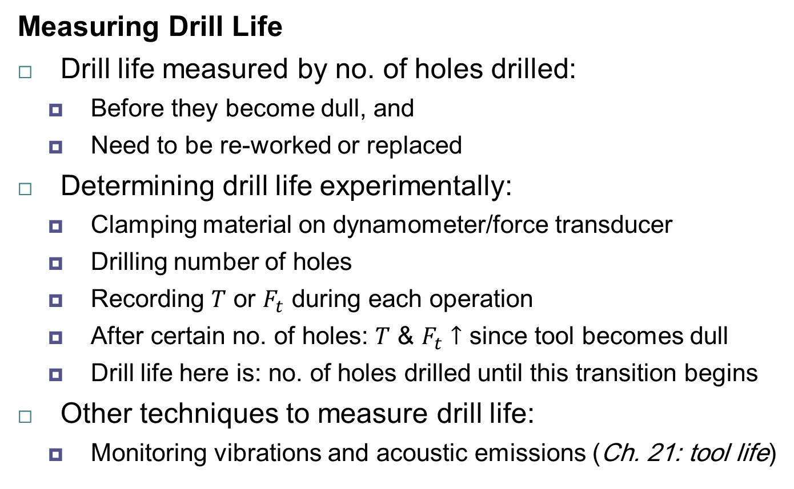
Drilling, Drills, and Drilling Machines:
Drilling Practice
Measuring Drill Life
Drill life measured by no. of holes drilled:
  Before they become dull, and
  Need to be re-worked or replaced
Determining drill life experimentally:
  Clamping material on dynamometer/force transducer
  Drilling number of holes
  Recording $T$ or $F_{t}$ during each operation
  After certain no. of holes: $T$ & $F_{t}$ $↑$ since tool becomes dull
  Drill life here is: no. of holes drilled until this transition begins
Other techniques to measure drill life:
  Monitoring vibrations and acoustic emissions (Ch. 21: tool life)

Slide 32
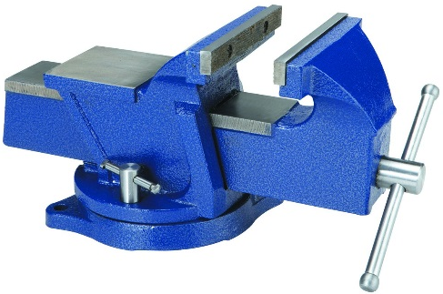
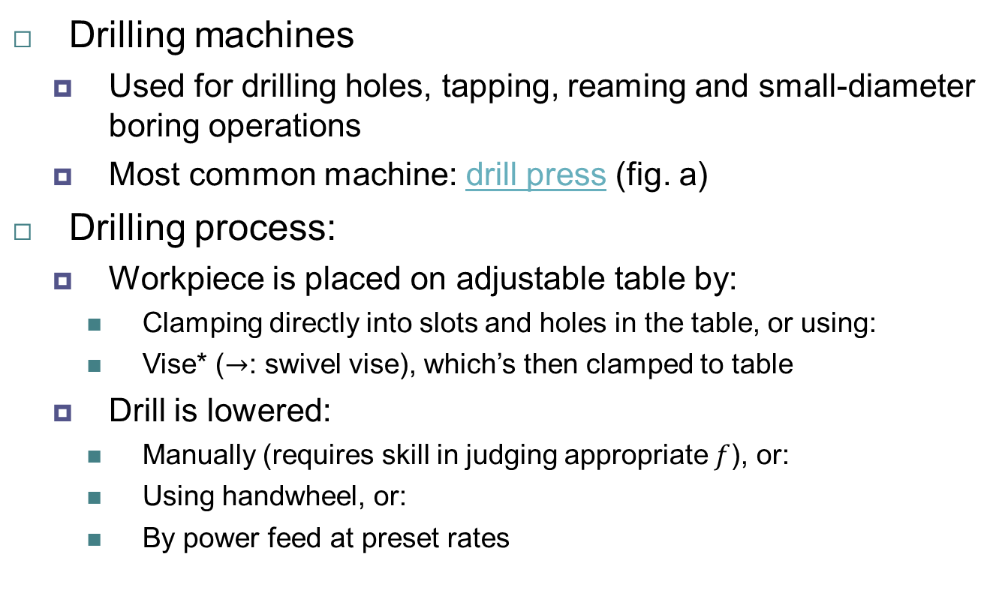
Drilling, Drills, and Drilling Machines:
Drilling Machines
Drilling machines
  Used for drilling holes, tapping, reaming and small-diameter boring operations
  Most common machine: drill press (fig. a)
Drilling process:
  Workpiece is placed on adjustable table by:
    Clamping directly into slots and holes in the table, or using:
    Vise* ($→$: swivel vise), which’s then clamped to table
  Drill is lowered:
    Manually (requires skill in judging appropriate $f$), or:
    Using handwheel, or:
    By power feed at preset rates
Notes:
* vise: tool for holding a workpiece with two jaws usually with screws

Slide 33
Drilling, Drills, and Drilling Machines:
Drilling Machines
Schematic: components of vertical drill
Radial drilling machine

Slide 34
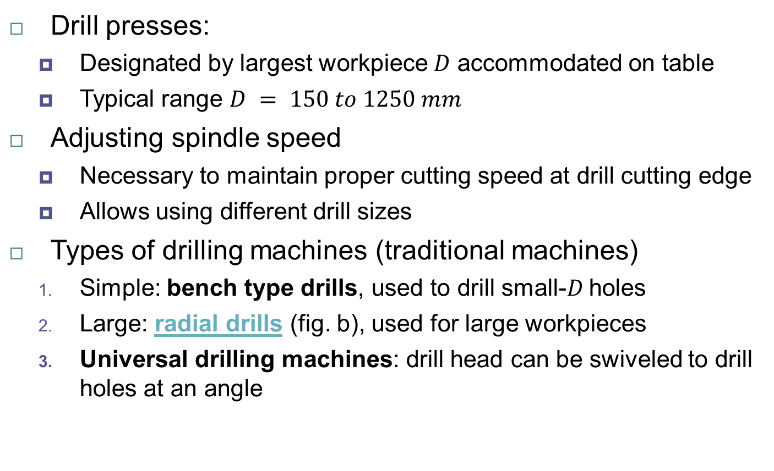
Drilling, Drills, and Drilling Machines:
Drilling Machines
Drill presses:
  Designated by largest workpiece $D$ accommodated on table
  Typical range $D = 150 to 1250 mm$
Adjusting spindle speed
  Necessary to maintain proper cutting speed at drill cutting edge
  Allows using different drill sizes
Types of drilling machines (traditional machines)
  Simple: bench type drills, used to drill small-$D$ holes
  Large: radial drills (fig. b), used for large workpieces
  Universal drilling machines: drill head can be swiveled to drill holes at an angle

Slide 35
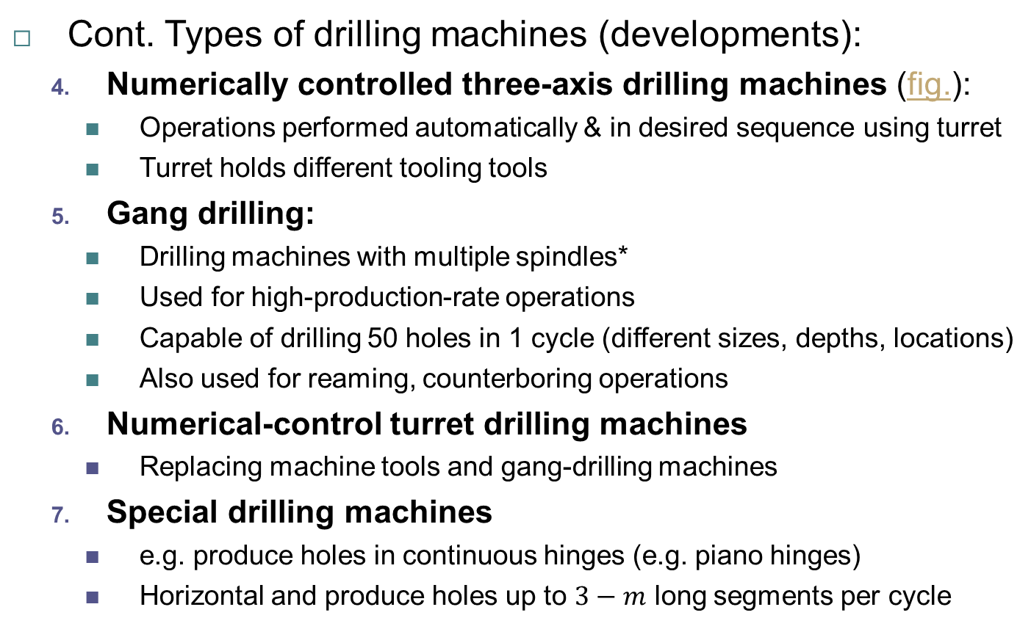
Drilling, Drills, and Drilling Machines:
Drilling Machines
Cont. Types of drilling machines (developments):
  Numerically controlled three-axis drilling machines (fig.):
    Operations performed automatically & in desired sequence using turret
    Turret holds different tooling tools
  Gang drilling:
    Drilling machines with multiple spindles*
    Used for high-production-rate operations
    Capable of drilling 50 holes in 1 cycle (different sizes, depths, locations)
    Also used for reaming, counterboring operations
  Numerical-control turret drilling machines
    Replacing machine tools and gang-drilling machines
  Special drilling machines
    e.g. produce holes in continuous hinges (e.g. piano hinges)
    Horizontal and produce holes up to $3−m$ long segments per cycle
Notes:
* note, all previously mentioned involve only 1 spindle

Slide 36
Drilling, Drills, and Drilling Machines:
Drilling Machines
3-axis NC drilling machine;
turret holds as many as 8 different tools (e.g. drills, taps, reamers)
Notes:
* Q: why is it called a 3-axis drilling machine? A: look at the 3, 2-sided arrows and you will know

Slide 37
Drilling, Drills, and Drilling Machines:
Drilling Machines
Workholding devices:
  Ensure workpiece is located properly
  Keep workpiece from slipping or rotating during drilling
  Available in various designs
  Important features:
    3-point locating (for accuracy)
    3-D workholding for secure fixtures
Notes:
* note, all previously mentioned involve only 1 spindle

Slide 38
Drilling, Drills, and Drilling Machines:
Design Considerations for Drilling
Basic design guidelines for drilling:
  Designs should allow holes to be drilled
    On flat surfaces and ⊥ to drill motion
    Otherwise: drills deflect and hole will not be located properly
  Interrupted hole surfaces should be avoided
    This ensures: dim. acc., longer drill life, avoids vibrations
  Hole bottoms should match standard drill-point angles
  Through holes are preferred over blind holes
  Dimples should be provided:
    When pre-existing holes not possible, to reduce drill “walk-off”
  Parts should be designed to drill with minimum of fixturing
  Blind holes: drill deeper than subsequent reaming/tapping

