Slide 1
Titration curve of amino acids
BCH 312 [PRACTICAL]

Slide 2
- Objective:
-To study titration curves of amino acid,
-Determine the pKa values,
-Determine pI.
-Determine buffering regions

Slide 3
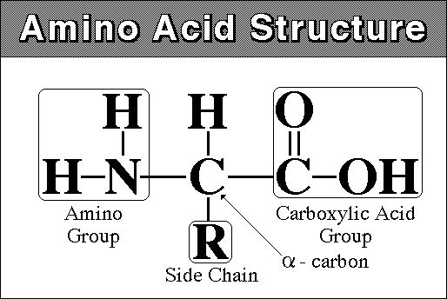
- Titration Curves:
- Titration Curves are produced by monitoring the pH of a given volume of a sample solution after successive addition of acid or alkali. The curves are usually plots of pH against the volume of titrant added.
- Amino acid general formula:
- Amino acids consist of:
A basic amino group ( —NH 2 )
An acidic carboxyl group ( —COOH)
A hydrogen atom ( —H)
A distinctive side chain ( —R).

Slide 4
- Titration of amino acid:
-When an amino acid is dissolved in water it exists predominantly in the isoelectric form.
-Upon titration with acid, it acts as a base (accept a proton).
-Upon titration with base, it acts as an acid (donate a proton)
-( a compound that can act as either an acid or a base is known as an amphoteric compound).
- Amino acids are example of weak acid which contain more than one dissociate group.

Slide 5
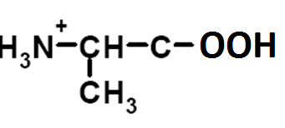
- Example :
(1) Alanine contain COOH (PKa1= 2.34)and NH3+ (PKa2= 9.69) groups (it has one PI value=6.010) [ diprotenation]
The COOH will dissociate first then NH3+ dissociate later .
(Because PKa1<PKa2)
R-group = methyl-group
Full protonated alanine
Notes:
The isoelectric point (pI, pH(I), IEP), is the pH at which a particular molecule carries no net electrical charge

Slide 6
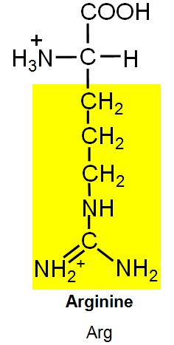
2) Arginine contain COOH (PKa1= 2.34) , NH3 (PKa2= 9.69) groups and basic group(pKa3=12.5) (It has one pI value=11) [Triprotenation]

Slide 7
9X
7X
8X
6X
5X
4X
3X
2X
1X

Slide 8
- Titration curve of alanine (or glycine) [diprotenation]:
[1] alanine in starting point is full protonation [NH3+-CH-CH3-COOH].
[2] COOH will dissociate first ,
[NH3+-CH-CH3-COOH] > [NH3+-CH-CH3-COO-]
PH<PKa1.
[3] [NH3+-CH-CH3-COOH]=[NH3+-CH-CH3-COO-] , PH=PKa1,
We already define Pka in the last experiment , in this point the component of alanine act as buffer.
[4] [NH3+-CH-CH3-COOH]<[NH3+-CH-CH3-COO-] , PH > PKa1

Slide 9
[5] The COOH full dissociate to COO- , [NH3+-CH-CH3-COO-] .
At this point the conc. Of negative charge = conc. Of positive charge .the amino acid present as Zwetter ion (neutral form) .
PI (isoelectric point) : PH value at which the net charge of amino acid equal to zero.
PI = (PKa1 + PKa2) /2 = (2.32+9.96)/2= 6.01
[6] The NH3+ start dissociate ,
[NH3+-CH-CH3-COO-] >[NH2-CH-CH3-COO-]
PH <PKa2.
[7] [NH3+-CH-CH3-COO-] = [NH2-CH-CH3-COO-] . PH=PKa2 , the component of alanine act as buffer.
[8] [NH3+-CH-CH3-COO-] < [NH2-CH-CH3-COO-] , PH >PKa2

Slide 10
[9] The NH3 group will dissociate and at the same time the alanine full
dissociate in end point , [NH2-CH-CH3-COO]
POH= (Pkb+P[A-])/2
PKb = PKw – PKa2

Slide 11
- Note in calculation method:
The PH calculated by different way :
[1] at starting point PH= (Pka+P[HA])/2
[2] At any point within the curve (befor or in or after middle titration) PH=Pka+log([A-]/[HA])
[3] At end point POH=(PKb+P[A-])/2
PH=PKw – POH

Slide 12
Results:
[1] record the titration table and Plot a Curve of pH versus ml of OH- added.
[2]Calculate the pH of the alanine solution after the addition of 0 ml, 5ml, of 0.2M NaOH. And calculate PH after addition of 0.5 ml , 2 ml of HCL
[3] determine the pKa of ionizable groups of amino acids
[4]Compare your calculated pH values with those obtained from Curve.
[5] determine the PI value from your result .

