Slide 1
ABDOMEN

Slide 2
The abdomen is the posterior end of the three body regions of an adult insect. It is composed of 11 segments.
The abdomen bears the external genitalia of the insect. In female insects these consist of an ovipositor.
Each segment of the abdomen consists of a dorsal sclerite, tergum, and a ventral sclerite.

Slide 3
Abdomen in insects is divided into three main areas
pregenital segments: which include the first seven episodes and be free from appendages in the adult phase
Genital segments: Include the ninth Episode in male and carrying genital appendages. In females, paired appendages of the eighth and ninth abdominal segment fit together to form an egg-laying mechanism called the ovipositor
Postgenital segments: Include the tenth and eleventh segment . carrying the two appendages analcerci.

Slide 4
Abdomen appendages
Genital appendages
Analcerci

Slide 5
Ovipositor
The ovipositor is an organ used by insect females for oviposition (laying of eggs).
consists of three pairs of appendages formed to transmit the egg, to prepare a place for it, and to place it properly. In some insects the ovipositor is used merely to attach the egg to some surface. It is used by grasshoppers to force a burrow in the earth to receive the eggs.

Slide 6
The sting of Hymenoptera (bees) is also an ovipositor, in this case highly modified and associated with poison glands that are used to paralyze prey.
This would allow eggs to be laid without the host fighting back, and probably also to suppress the host's immune system so that it can't destroy the eggs or shake off the paralysis.

Slide 7
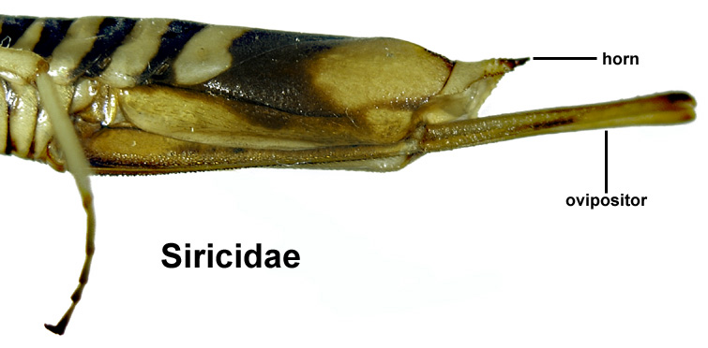

Slide 8
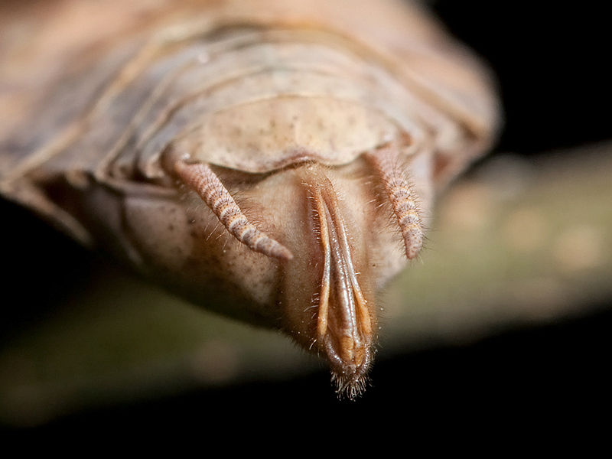
Ovipositor of an adult female Carolina mantis (Stagmomantis Carolina)

Slide 9
Male genitalia
Male genitalia in many insect species have species-specific male genitalia with morphological divergence among closely related species that is often dramatic and complex.
The two main organs in male external genitalia are the aedeagus which is used to transfer sperms from male to female genital duct, and a pair of claspers which are used for holding the female during coupulaion.

Slide 10
Seconded: Non Reproductive appendages
Include appendages that do not have relation to reproduction and which are on pregenital and Postgenital segments. Divided to:

Slide 11
Analcerci
Commonly found in both male and female may be long with many segment such as silver fish(lepisma).
short and divided as in the cockroach.
short, and stronghold, such as locusts.
Thorley form of tweezers or insect used in defense and attack, as in the Forficula auricularia.
Long and non divided such as Ground dwelling insects.
mutate to the gills to breathe, as in (nymphs) , who lives in the small water

Slide 12
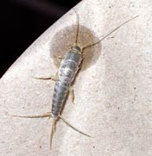

Slide 13
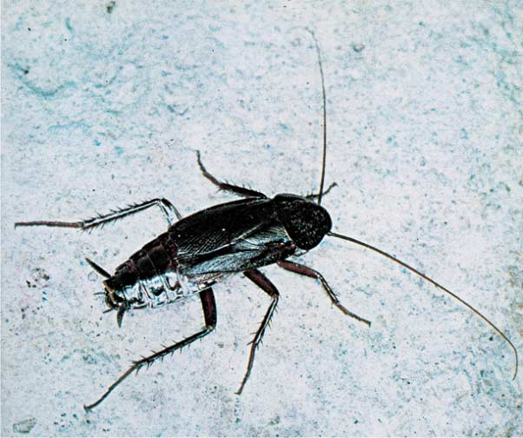
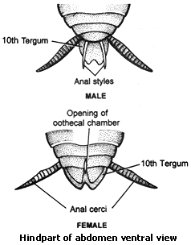

Slide 14
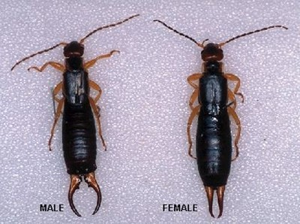
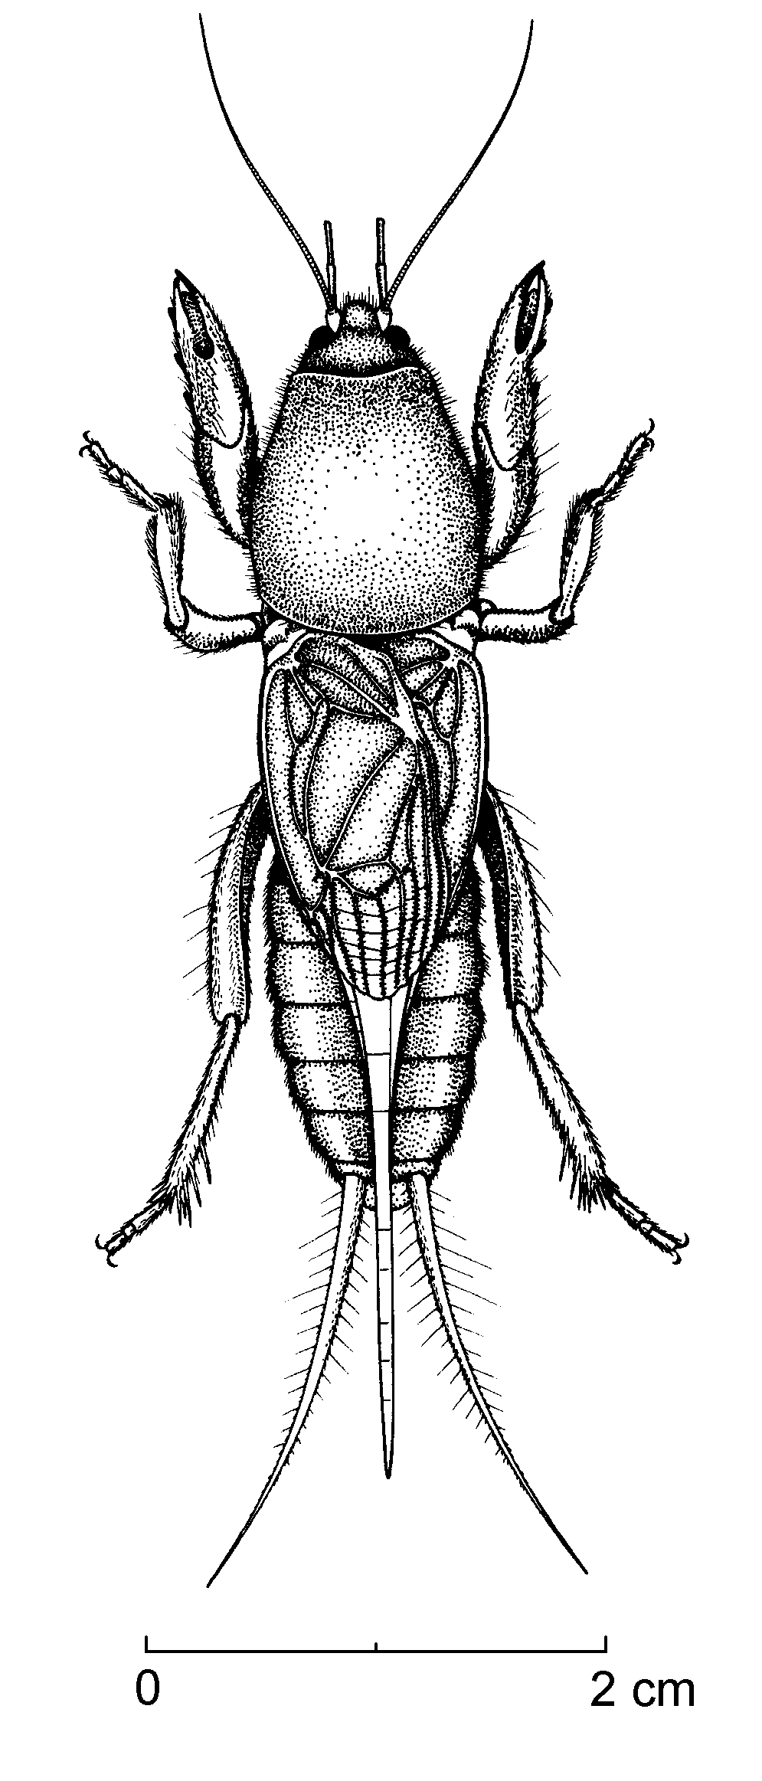

Slide 15
Pro-legs: fleshy, locomotory appendages found only in the larvae of certain orders Hymenoptera).
Abdominal gills: respiratory organs found in the nymphs (naiads) of certain aquatic insects. In Ephemeroptera (mayflies), paired gills are located along the sides of each abdominal segment; in Odonata

Slide 16
Non sexual appendages in primitive insects
Collembola have three pre-genital appendages on three abdominal segments. From the first segment, a median lobe projects forward and down between the last pair of legs, this is known as the ventral lobe and at its tip are a pair of vesicles. This ventral lobe appear to have two main functions:
1- In some circumstances it function as an adhesive organ
2- Absorption of water from substratum
The appendages of third and fourth segment of the abdomen of many Collembola form the retinaculum and furca which are used in locomotion.

Slide 17
