Slide 1
MECHANICS OF METAL CUTTING
(feed force)
Radial force
Tool feed direction
Main Cutting force

Slide 2
Topics to be covered
Tool terminologies and geometry
Orthogonal Vs Oblique cutting
Turning Forces
Velocity diagram
Merchants Circle
Power & Energies

Slide 3
Need for calculating forces, velocities and angles during machining??
We need to determine the cutting forces in turning for Estimation of cutting power consumption, which also enables selection of the power source(s) during design of the machine tools.
Structural design of the machine – fixture – tool system.
Evaluation of role of the various machining parameters (tool material and geometry) on cutting forces to make machining process more efficient and economical.
Condition monitoring of the cutting tools and machine tools.

Slide 4
Heat Generation Zones
30%
(Dependent on μ)
(Dependent on φ)
60%
10%
(Dependent on sharpness
of tool)

Slide 5
Tool Terminology
Side Rake
(SR), +
Back
Rake
End Cutting
(BR),+
edge angle
(ECEA)
Turning
Cutting
Facing
Cutting
edge
edge
Nose
Radius
Side relief
angle
Side cutting
edge angle
(SCEA)
Clearance or end
relief angle

Slide 6
Cutting Geometry

Slide 7
Material Removal Rate

Slide 8
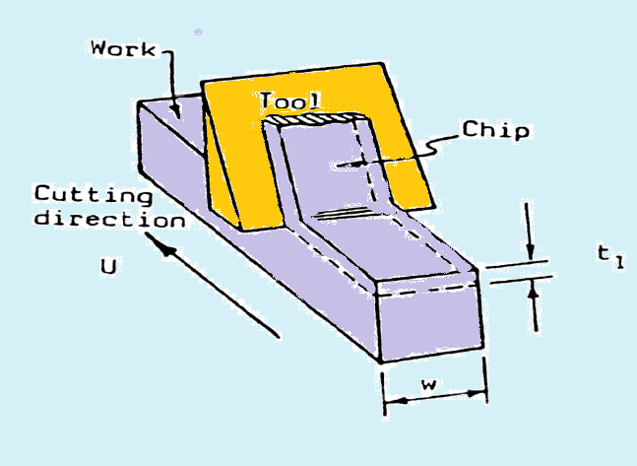
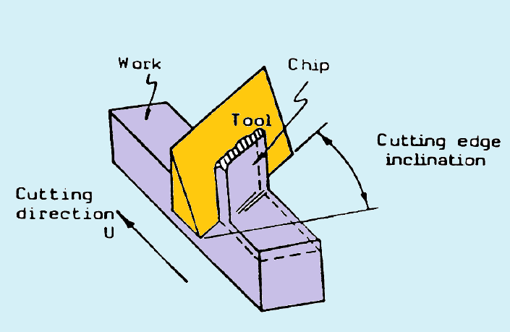
Metal cutting
Metal Cutting is the process of removing unwanted material from the workpiece in the form of chips
Orthogonal cutting
Oblique cutting
Cutting Edge is normal to tool feed.
Here only two force components are considered i.e. cutting force and thrust force. Hence known as two dimensional cutting.
Shear force acts on smaller area.
Cutting Edge is inclined at an acute angle to tool feed.
Here only three force components are considered i.e. cutting force, radial force and thrust force. Hence known as three dimensional cutting.
Shear force acts on larger area.

Slide 9
Assumptions
(Orthogonal Cutting Model)
The cutting edge is a straight line extending perpendicular to the direction of motion, and it generates a plane surface as the work moves past it.
The tool is perfectly sharp (no contact along the clearance face).
The shearing surface is a plane extending upward from the cutting edge.
The chip does not flow to either side
The depth of cut/chip thickness is constant uniform relative velocity between work and tool
Continuous chip, no built-up-edge (BUE)

Slide 10
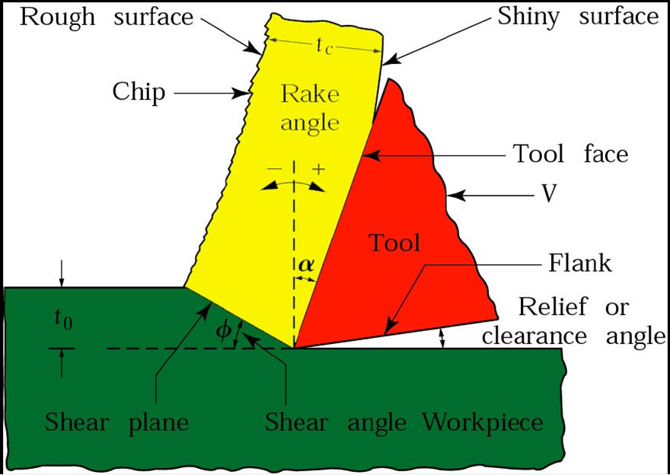
Terminology

Slide 11
Terminology
α : Rack angle
β : Frictional angle
ϕ : Shear angle
F_{t} : Thrust Force
F_{c}: Cutting Force
F_{s}: Shear Force
F_{n}: Normal Shear Force
F: Frictional Force
N: Normal Frictional Force
V: Feed velocity
Vc: Chip velocity
Vs: Shear velocity

Slide 12
Forces For Orthogonal Model
Note: For the 2D Orthogonal Mechanistic
Model we will ignore the Longitudinal
component
End view

Slide 13
Orthogonal Cutting Model
(Simple 2D mechanistic model)
Chip thickness
t
c
Velocity V
Rake
Angle
+
tool
Chip
Tool
α
depth of cut
t
0
Shear Angle
φ
Clearance Angle
Workpiece
Mechanism: Chips produced by the shearing process along the shear plane

Slide 14
Orthogonal Cutting

Slide 15
Cutting Ratio
(or chip thicknes ratio)
Chip
tool
(φ−α)
B
t
t
c
o
φ
A
Workpiece

Slide 16
Experimental Determination of
Cutting Ratio
Shear angle φ may be obtained
either from photo-micrographs
or assume volume continuity
(no chip density change):
L
c
w
t
c
c
t
0
L
w
0
0
i.e. Measure length of chips (easier than thickness)

Slide 17
Shear Plane Length
and Angle φ
Chip
tool
B
(φ−α)
t
t
c
o
φ
A
Workpiece
or make an assumption, such as φ adjusts to minimize
cutting force:
(Merchant)

Slide 18
Velocities
(2D Orthogonal
Model)
V = Chip Velocity
c
Shear Velocity
(Chip relative to tool)
(Chip relative
to workpiece)
V
s
V = Cutting Velocity
Chip
Tool
(Tool relative to
workpiece)
Workpiece
Velocity Diagram
V
c
V
α
s
φ − α
90 − φ
φ
V

Slide 19
Cutting Forces
(2D Orthogonal Cutting)
Chip
Tool
Generally we know:
Tool geometry & type
Workpiece material
and we wish to know:
F = Cutting Force
F = Thrust Force
F = Friction Force
N = Normal Force
F = Shear Force
F = Force Normal to Shear
R
φ
F
F
s
N
F
R
n
c
R
F
t
c
Workpiece
F
R
t
s
n
Dynamometer
Free Body Diagram

Slide 20
Cutting Forces
(2D Orthogonal Cutting)
F_{s} , Resistance to shear of the metal in forming the chip. It acts along the shear plane.
F_{n} , ‘Backing up’ force on the chip provided by the workpiece. Acts normal to the shear plane.
N, It at the tool chip interface normal to the cutting face of the tool and is provided by the tool.
F, It is the frictional resistance of the tool acting on the chip. It acts downward against the motion of the chip as it glides upwards along the tool face.

Slide 21
Construction of merchant’s circle
F_{s}
F_{n}
α
F_{c}
φ
V
λ-α
F_{t}
φ
R
α
λ
F
N
Knowing F_{c} , F_{t} , α and ϕ, all other component forces can be calculated.
Please note λ is same as β in next slide = friction angle

Slide 22
Force Circle Diagram
(Merchants Circle)
α
F
s
Tool
F
φ
c
β − α
F
F
t
n
α
φ
R
β − α
β
F
α
N

Slide 24
Cutting Forces
Forces considered in orthogonal cutting include
  Cutting, friction (tool face), and shear forces
Cutting force,F_{c} acts in the direction of the cutting speed V, and supplies the energy required for cutting
  Ratio of F_{c} to cross-sectional area being cut (i.e. product of width and depth of cut, t₀) is called: specific cutting force
Thrust force,F_{t} acts in a direction normal to the cutting force
These two forces produces the resultant force, R
On tool face, resultant force can be resolved into:
  Friction force, F along the tool-chip interface
  Normal force, N to ⊥ to friction force

Slide 25
Cutting Forces
It can also be shown that (β is friction angle)
Resultant force, R is balanced by an equal and opposite force along the shear plane
It is resolved into shear force, F_{s} and normal force, F_{n}
Thus,
The magnitude of coefficient of friction, μ is

Slide 26
Cutting Forces
The toolholder, work-holding devices, and machine tool must be stiff to support thrust force with minimal deflections
  If F_{t} is too high ⇒ tool will be pushed away from workpiece
  this will reduce depth of cut and dimensional accuracy
The effect of rake angle and friction angle on the direction of thrust force is
Magnitude of the cutting force, F_{c} is always positive as the force that supplies the work is required in cutting
However, F_{t} can be +ve or –ve; i.e. F_{t} can be upward with a) high rake angle, b) low tool-chip friction, or c) both

Slide 27


Forces from Merchant's Circle

Slide 28
Stresses
On the Shear plane:
On the tool rake face:

Slide 29
Power
Power (or energy consumed per unit time) is the product of force and velocity. Power at the cutting spindle:
Power is dissipated mainly in the shear zone and on the rake face:
Actual Motor Power requirements will depend on machine efficiency E (%):

Slide 30
Material Removal Rate (MRR)

Slide 31
Specific Cutting Energy
(or Unit Power)
Energy required to remove a unit volume of material (often quoted as a function of workpiece material, tool and process:

Slide 32
Specific Cutting Energy
Decomposition
1. Shear Energy/unit volume (Us)
(required for deformation in shear zone)
2. Friction Energy/unit volume (Uf)
(expended as chip slides along rake face)
3. Chip curl energy/unit volume (Uc)
(expended in curling the chip)
4. Kinetic Energy/unit volume (Um)
(required to accelerate chip)

Slide 33
Cutting Forces and Power measurement
Measuring Cutting Forces and Power
Cutting forces can be measured using a force transducer, a dynamometer or a load cell mounted on the cutting-tool holder
It is also possible to calculate the cutting force from the power consumption during cutting (provided mechanical efficiency of the tool can be determined)
The specific energy (u) in cutting can be used to calculate cutting forces

Slide 34
Cutting Forces and Power
Power
Prediction of forces is based largely on experimental data (right)
Wide ranges of values is due to differences in material strengths
Sharpness of the tool tip also influences forces and power
Duller tools require higher forces and power

