Slide 1
Chapter 5
Compacting and Finishing
Part 2

Slide 2
Compaction Operations
After selecting appropriate compaction equipment, a compaction plan must be developed.
The major variables to be considered include:
  soil moisture content, lift thickness,
  number of passes used,
  ground contact pressure,
  compactor weight, and
  compactor speed.
For vibratory compactors, it is also necessary to consider the frequency and amplitude of vibration to be employed.

Slide 3
Compaction Operations
the compactive effort delivered by a piece of compaction equipment will seldom be exactly the same as that of either the standard or modified compaction test.
  Thus, the field optimum moisture content for a particular soil/compactor combination will seldom be the same as the laboratory optimum.

Slide 4
Compaction Operations
This is illustrated by Figure 5-11, where only one of the four compactors has a field optimum moisture content close to the laboratory optimum.

Slide 5
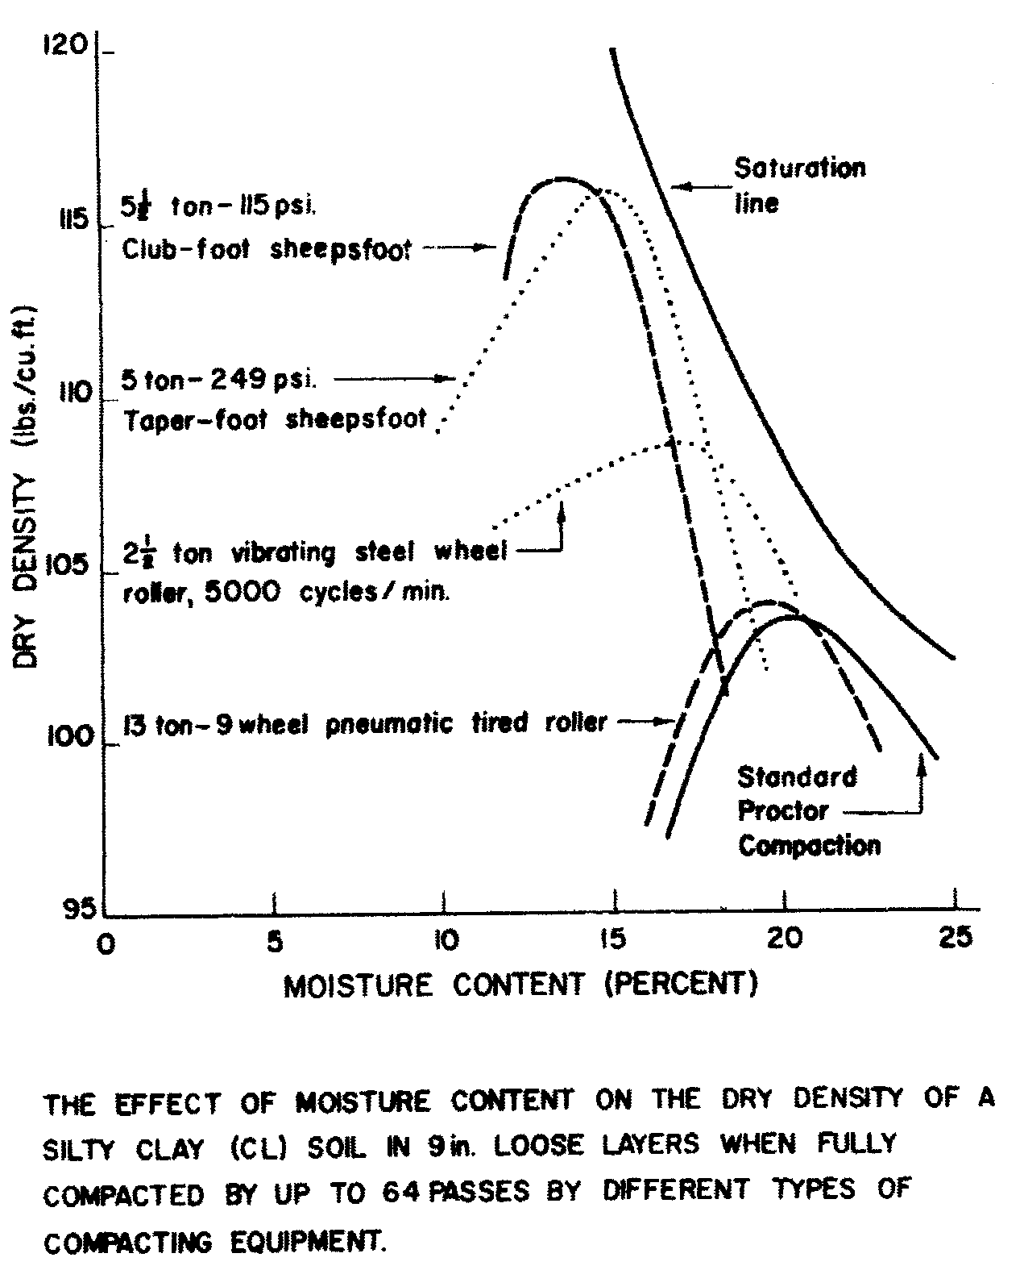
FIGURE 5-11: Variation of optimum moisture content with roller type.
(From reference 6)

Slide 6
Compaction Operations
Lifts thicknesses :
  It should be kept thin for most effective compaction.
  For all rollers, except vibratory rollers and heavy pneumatic rollers, a maximum of 5 to 8 in. (15 to 20 cm).
  The maximum lift thickness depends on the static weight of the compactor.

Slide 7
Compaction Operations
The compaction achieved by repeated passes:
  The compaction achieved by repeated passes of a compactor depends on the soil/compactor combination utilized.
  For some combinations (such as a tamping foot roller compacting a clayey gravel), significant increases in density may continue to occur beyond 50 passes.
  As shown in Figure 5-12, the increase in density is relatively small after about 10 passes for most soil/compactor combinations.

Slide 8
FIGURE 5-12: Typical effect of number of passes.

Slide 9
Compaction Operations
Effect of Ground contact pressure on Compaction:
  for a tamping foot roller, Ground contact pressure may vary from:
    30 lb/sq in. (207 kPa) for a pneumatic roller to
    300 lb/sq in. (2070 kPa) or more.
  Within these ranges it has been found that:
    total roller weight has a much more pronounced effect on the compaction achieved than does contact pressure.
  The use of excessive ground contact pressure will result in shearing and displacement of the soil being compacted.

Slide 10
Compaction Operations
Effect of Travel time on Compaction:
  Except for vibratory compactors, tests have shown little relationship between compactor travel speed and the compaction achieved.
  For vibratory equipment,
    travel speed (at a fixed operating frequency) determines the number of vibrations that each point on the ground surface will receive.
    Therefore, when using vibratory equipment, tests should be performed to determine the compactor speed that results in the highest compactor productivity.
  For conventional equipment the highest possible speed should be utilized that does not result in excessive surface displacement.

Slide 11
Estimating Compactor Production
Equation 5-1 may be used to calculate compactor production based on:
  compactor speed,
  lift thickness, and
  effective width of compaction.
The accuracy of the result obtained will depend on the accuracy in estimating speed and lift thickness.
Trial operations will usually be necessary to obtain accurate estimates of these factors.
Typical compactor operating speeds are given in Table 5-3.

Slide 12
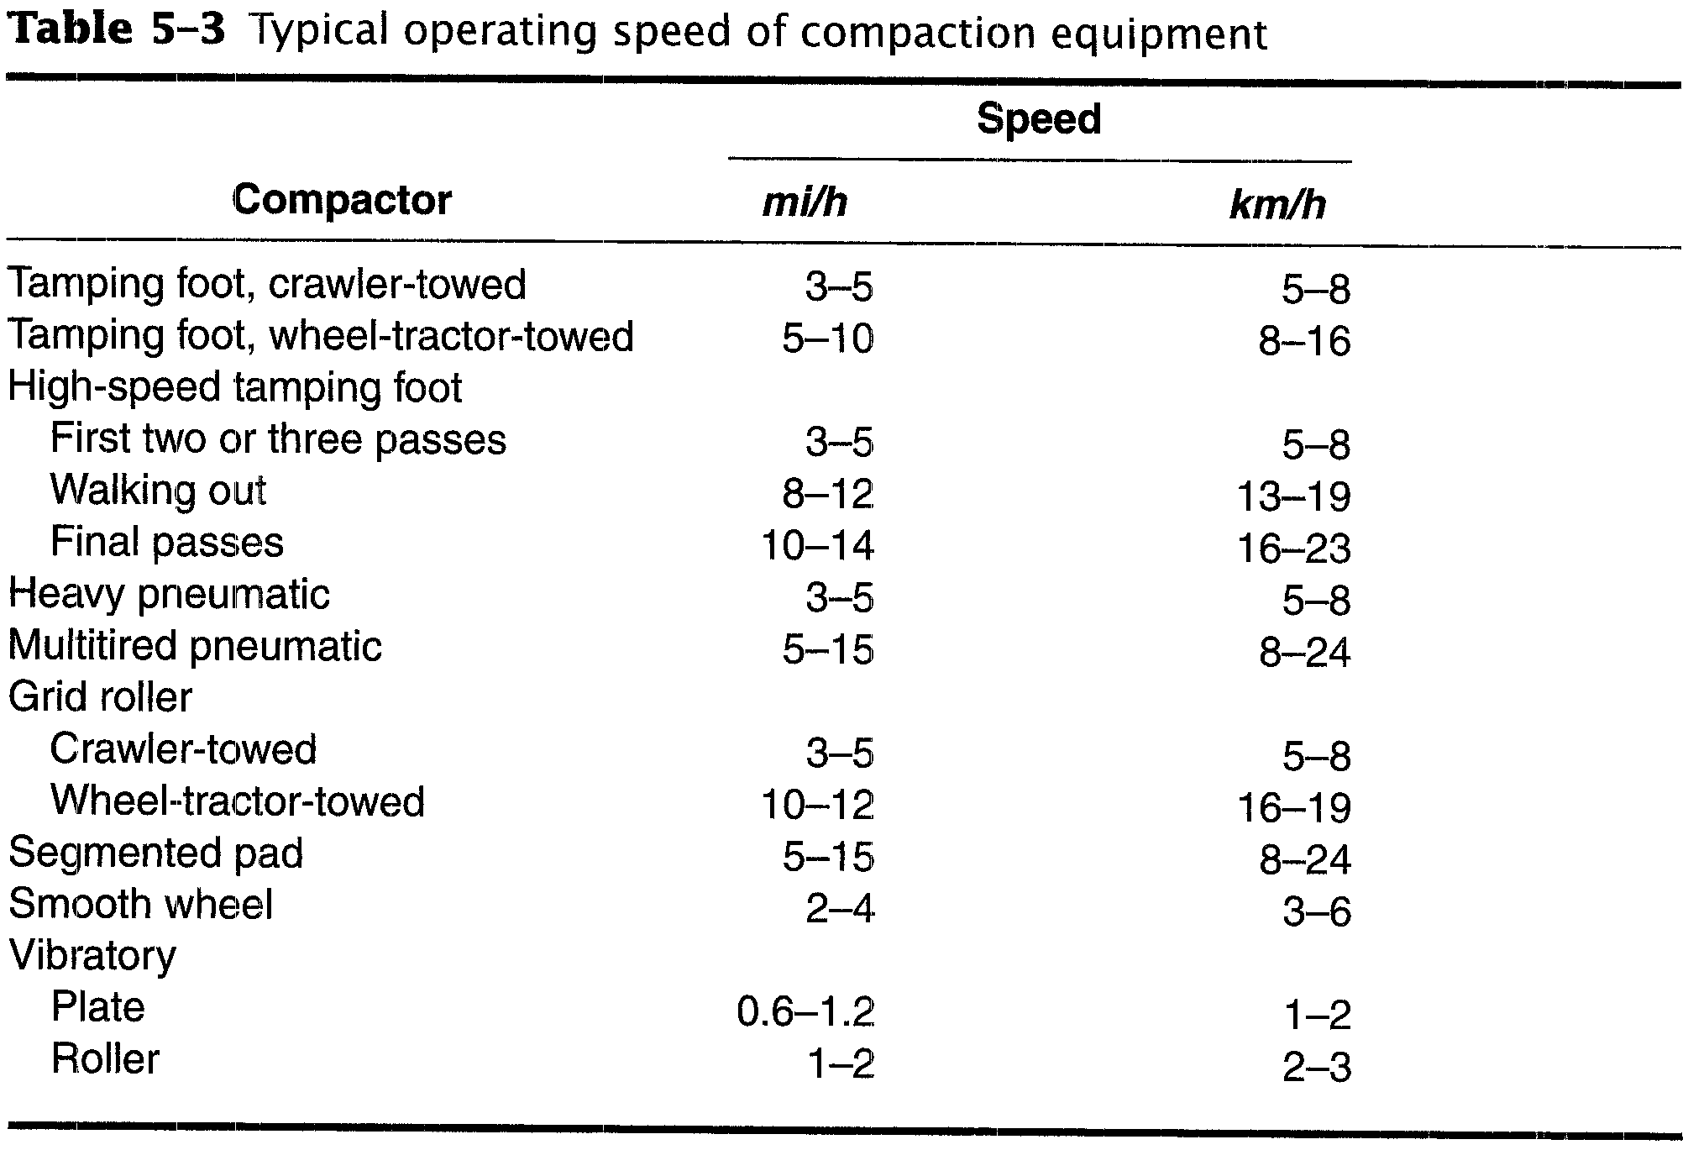
TABLE 5-3: Typical operating speed of compaction equipment

Slide 13
Estimating Compactor Production
Production (CCY/h)= 16.3 × W × S × L × E / P (5-lA)
Production (CCM/h) = 10 × W × S × L × E / P (5-lB)
Where
P = number of passes required
W = width compacted per pass (ft or m)
S = compactor speed (mi/h or km/h)
L = compacted lift thickness (in. or em)
E = job efficiency

Slide 14
Estimating Compactor Production
The power required to tow rollers depends on the roller's total resistance (grade plus rolling resistance).
  The rolling resistance of tamping foot rollers has been found to be approximately 450 to 500 lb/ton (225 to 250 kg/t).
  The rolling resistance of pneumatic rollers and the maximum vehicle speed may be calculated by the methods of Chapter 4.

Slide 15
Job Management
trial operations are usually required to determine:
  the exact values of soil moisture content,
  lift thickness,
  compactor weight, and
  vibrator frequency and amplitude that yield maximum productivity while achieving the specified soil density.
The use of a nuclear density device to measure the soil density actually being obtained during compaction is strongly recommended.

Slide 16
Job Management
Traffic planning and control is an important factor in compaction operations.
Hauling equipment must be given the right-of-way without excessively interfering with compaction operations.

Slide 17
5-3 SOIL STABILIZATION
Soil stabilization has been defined as:
  the process of giving natural soils enough abrasive resistance and shear strength to accommodate traffic or loads.
Soil stabilization methods include:
  mechanical methods (Read from the Textbook),
  hydraulic methods (Read from the Textbook),
  reinforcement methods (Read from the Textbook), and
  physiochemical methods.
Some techniques falling under each of these categories are shown in Table 5-4.

Slide 18
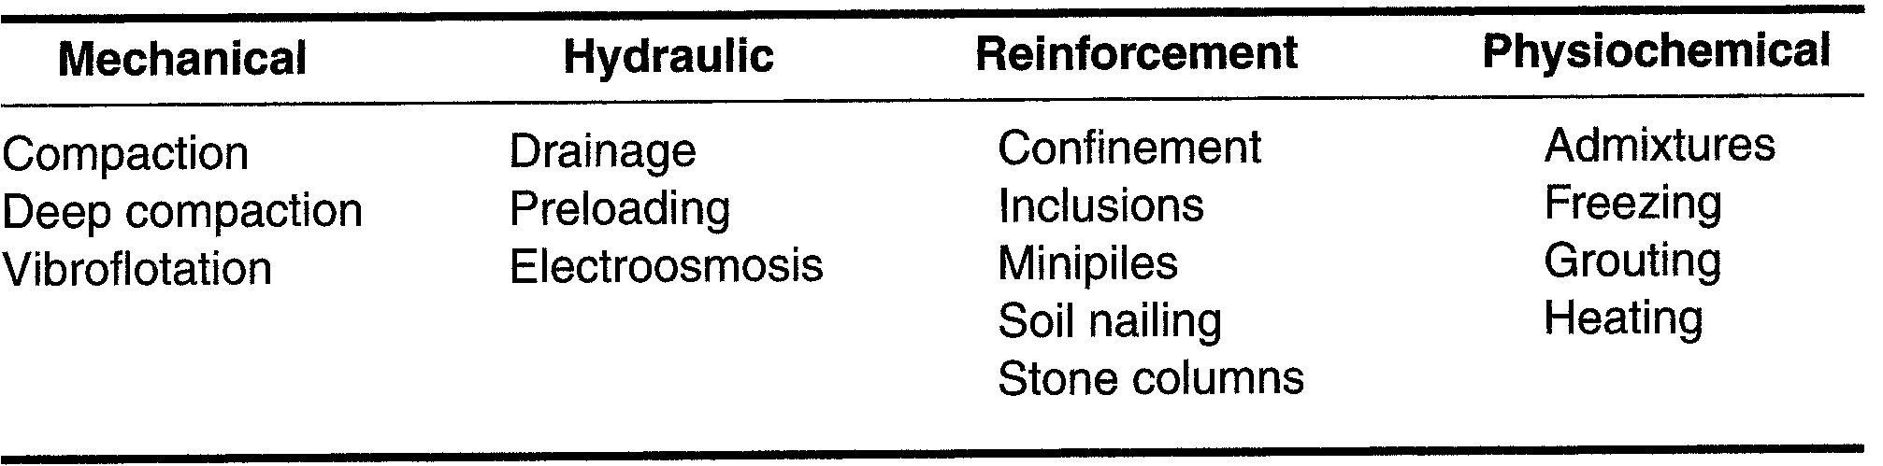
TABLE 5-4: Soil stabilization methods

Slide 19
5-4 GRADING AND FINISHING
Grading is the process of bringing earthwork to the desired shape and elevation (or grade).
Finish grading, or simply finishing, involves:
  smoothing slopes,
  shaping ditches, and
  bringing the earthwork to the elevation required by the plans and specification.
Finishing usually follows closely behind excavation, compaction, and grading.
Finishing, in turn, is usually followed closely by seeding or sodding to control soil erosion.

Slide 20
5-4 GRADING AND FINISHING
The piece of equipment most widely used for grading and finishing is the motor grader (Figure 5-13).
Grade trimmers and excavators are frequently used on large highway and airfield projects
  because their operating speed is greater than that of the motor grader.

Slide 21
FIGURE 5-13: Modern motor grader.
(Courtesy of Fiatallis North America, Inc.)

Slide 22
5-4 GRADING AND FINISHING
In highway construction,
  the process of cutting down high spots and filling in low spots of each roadway layer is called balancing.
  Trimming is the process of bringing each roadway layer to its final grade.

Slide 23
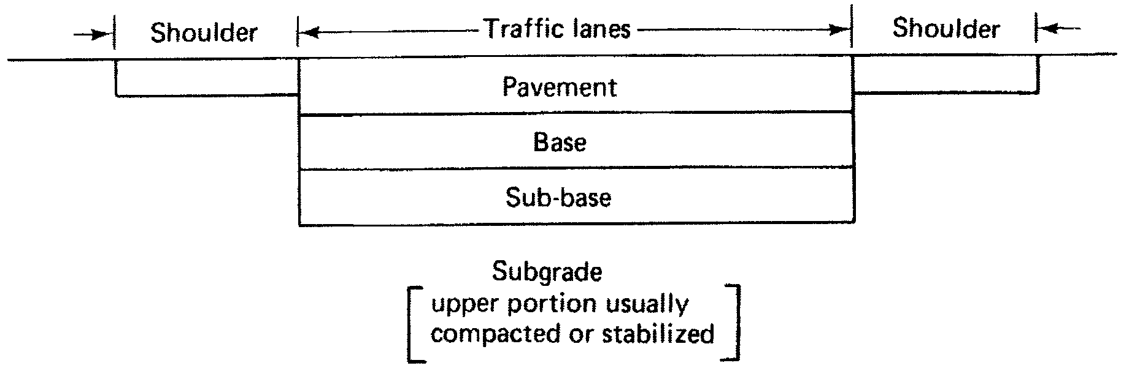
FIGURE 5-14: Typical roadway components.

Slide 24
5-4 GRADING AND FINISHING
Motor Grader
Grade Excavators and Trimmers
Estimating Grader Production
Job Management

Slide 25
Motor Grader
The motor grader is one of the most versatile items of earthmoving equipment.
It can be used for:
  light stripping,
  grading,
  finishing,
  trimming,
  bank sloping,
  ditching,
  backfiling, and
  scarifying.

Slide 26
Motor Grader
It is also :
  capable of mixing and spreading soil and asphaltic mixtures.
  used on building construction projects as well as in heavy and highway construction.
  It is frequently used for the maintenance of highways and haul roads.

Slide 27
Motor Grader
The blade of a motor grader:
  is referred to as a moldboard and is equipped with replaceable cutting edges and end pieces (end bits).
  The wide range of possible blade positions is illustrated in Figure 5-15.

Slide 28
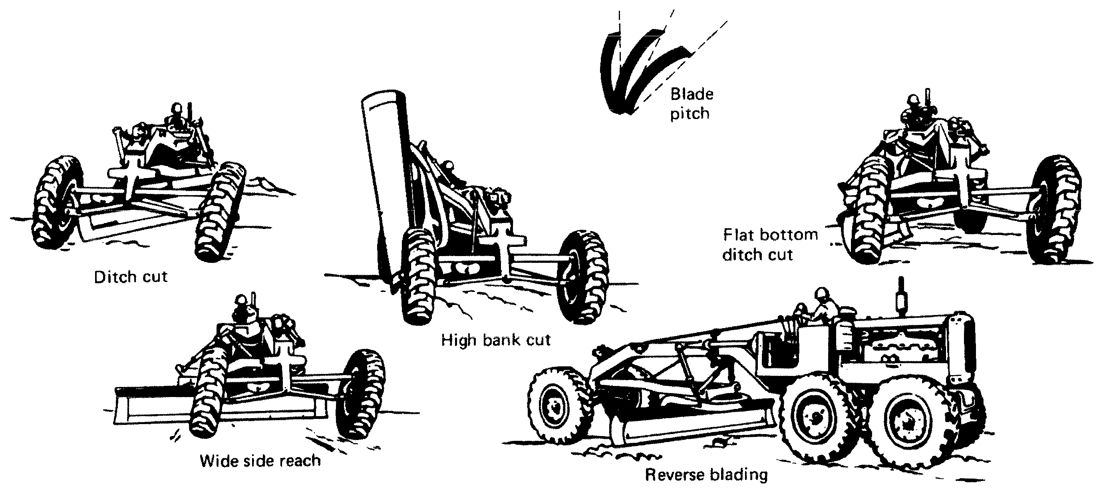
FIGURE 5-15: Blade positions for the motor grader.
(U.S. Department of the Army)

Slide 29
Motor Grader
Motor graders are available with articulated frames that increase grader maneuverability.
The three possible modes of operation for an articulated grader are illustrated in Figure 5-16.

Slide 30
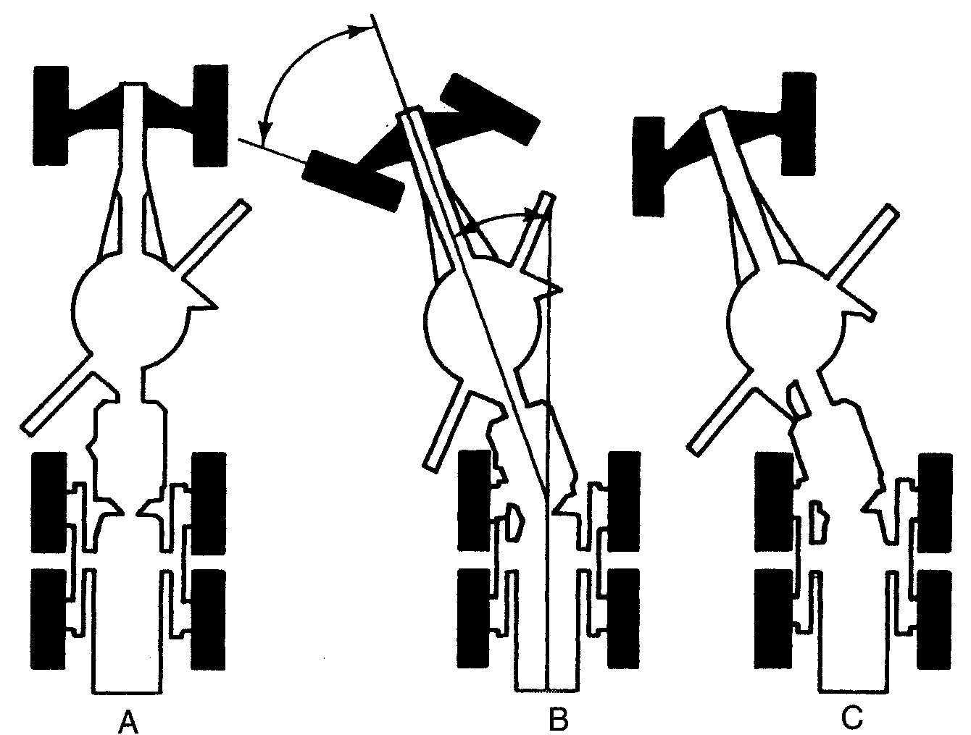
FIGURE 5-16: Articulated grader positions.

Slide 31
Motor Grader
The machine operation modes are:
  Conventional manner when in the straight mode (Figure 5-16A).
  Articulated mode (Figure 5-16B) to allow the machine to turn in a short radius.
  the crab mode (Figure 5-16C) permits the rear driving wheels to be offset so that they remain on firm ground while the machine cuts banks, side slopes, or ditches.

Slide 32
Motor Grader
The front wheels of both conventional and articulated graders may be leaned from side to side.
Wheels are leaned away from the cut to:
  offset the side thrust produced by soil pressure against the angled blade.
  assist in turning the grader.

Slide 33
Motor Grader
Graders are available with automatic blade control systems that:
  permit precise grade control.
  utilize a sensing system that follows an existing surface, string line, or laser beam to automatically raise or lower the blade as required to achieve the desired grade.

Slide 34
Grade Excavators and Trimmers
Grade excavators or trimmers:
  they are machines that are capable of finishing roadway and airfield subgrades and bases faster and more accurately than can motor graders.
  Many of these machines also act as reclaimers.
  they are capable of scarifying and removing soil and old asphalt pavement.

Slide 35
FIGURE 5-17: Large grade trimmer/reclaimer/paver.
(Courtesy of CMI Corp.)

Slide 36
Grade Excavators and Trimmers
Grade trimmers:
  They lack the versatility of motor graders.
  They are very useful on large roadway and airfield projects.
    Because of their accuracy and high speed.
  Their large size often requires that they be partially disassembled and transported between job sites on heavy equipment trailers.

Slide 37
Estimating Grader Production
Grader production is usually calculated:
  on a linear basis (miles or kilometers completed per hour) for roadway projects and
  on an area basis (square yards or square meters per hour) for general construction projects.
The time required to complete a roadway project may be estimated as follows:

Slide 38
Estimating Grader Production
Average speed will depend on:
  operator skill,
  machine characteristics, and
  job conditions.
Typical grader speeds for various types of operations are given in Table 5-6.

Slide 39
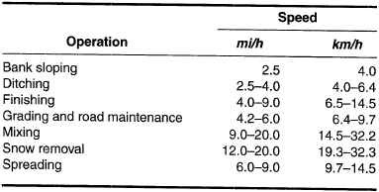
TABLE 5-6: Typical grader operating speed

Slide 40
EXAMPLE 5-1
Fifteen miles (24.1 km) of gravel road require reshaping and leveling. You estimate that six passes of a motor grader will be required. Based on operator skill, machine characteristics, and job conditions, you estimate two passes at 4 mi/h (6.4 km/h), two passes at 5 mi/h (8.0 km/h), and two passes at 6 mi/h (9.7 km/h). If job efficiency is 0.80, how many grader hours will be required for this job?

Slide 41
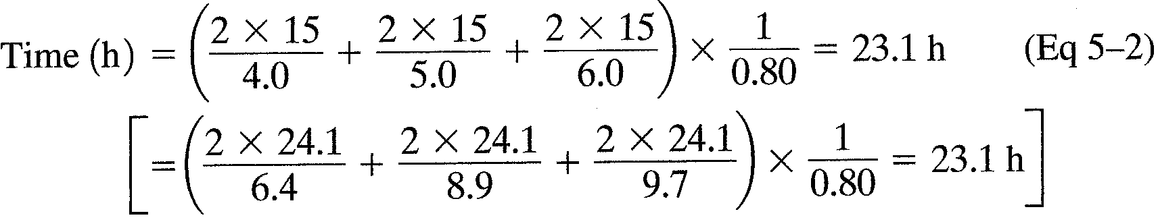
EXAMPLE 5-1
Solution

Slide 42
Job Management
to maximize grader production efficiency, it is required:
  Careful job planning,
  the use of skilled operators, and
  competent supervision.
Use the minimum possible number of grader passes to accomplish the work.
Eliminate as many turns as possible.

