Slide 1
Chapter 5
Compacting and Finishing
Part 1

Slide 2
5-1 PRINCIPLES OF COMPACTION
The Compaction Process
Optimum Moisture Content
Compaction Specifications
Measuring Field Density

Slide 3
The Compaction Process
Compaction:
  is the process of increasing the density of a soil by mechanically forcing the soil particles closer together, thereby expelling air from the void spaces in the soil.
  It should not be confused with consolidation,
Consolidation:
  is an increase in soil density of a cohesive soil resulting from the expulsion of water from the soil's void spaces.
  Consolidation may require months or years to complete, whereas compaction is accomplished in a matter of hours.

Slide 4
The Compaction Process
Compaction has been employed for centuries to improve the engineering properties of soil.
Improvements include:
  increased bearing strength,
  reduced compressibility,
  improved volume-change characteristics, and
  reduced permeability.

Slide 5
The Compaction Process
the equipment and methods employed for compaction in building construction are usually somewhat different from those employed in heavy and highway construction because of:
  the limited differential settlement that can be tolerated by a building foundation,
  the necessity for working in confined areas close to structures, and
  the smaller quantity of earthwork involved.

Slide 6
The Compaction Process
The degree of compaction may be achieved in a particular soil depends on:
  the soil's physical and chemical properties (see Chapter 2),
  the soil's moisture content,
  the compaction method employed,
  the amount of compactive effort, and
  the thickness of the soil layer being compacted (lift thickness).

Slide 7
The Compaction Process
The four basic compaction forces are:
  static weight,
  manipulation (or kneading),
  impact, and
  vibration.

Slide 8
The Compaction Process
Although all compactors utilize static weight to achieve compaction, most compactors combine this with one or more of the other compaction forces.
  For example, a plate vibrator combines static weight with vibration.
Manipulation of soil under pressure to produce compaction is most effective in plastic soils.

Slide 9
The Compaction Process
The forces involved in impact and vibration are similar except for their frequency.
  Impact or tamping involves blows delivered at low frequencies:
    usually about 10 cycles per second (Hz),
    It is most effective in plastic soils.
  Vibration involves higher frequencies:
    may extend to 80 cycles per second (Hz) or more.
    Vibration is particularly effective in compaction of cohesionless soils such as sand and gravel.

Slide 10
The Compaction Process
The selection and employment of compaction equipment is discussed in Section 5-2.

Slide 11
Optimum Moisture Content
Soil moisture content:
  is one of the five factors influencing compaction results
  it is a very important one.
A standard laboratory test
  It is called a Proctor test
  It has been developed to evaluate a soil's moisture density relationship under a specified compaction effort.
  There are two Proctor tests which are:
    Standard Proctor Test (ASTM D 698, AASHTO T-99) and
    Modified Proctor Test (ASTM D 1557, AASHTO T-180).
  Characteristics of these two tests are given in Table 5-1.

Slide 12
TABLE 5-1: Characteristics of Proctor compaction tests

Slide 13
Optimum Moisture Content
The modified test:
  It was developed for use where high design loads are involved (such as airport runways),
  the compactive effort for the modified test is more than four times as great as for the standard test.

Slide 14
Optimum Moisture Content
To determine the maximum density of a soil using Proctor test procedures, compaction tests are performed over a range of soil moisture contents (see Figure 5-1).
The peak of each curve represents the maximum density obtained under the compactive effort supplied by the test.

Slide 15
FIGURE 5-1: Typical compaction test results.

Slide 16
Optimum Moisture Content
Comments on Figure 5-1 are:
  maximum density achieved under the greater compactive effort of the modified test is higher than the density achieved in the standard test.
  the line labeled "zero air voids“ represents the maximum possible soil density for any specified water content.

Slide 17
Optimum Moisture Content
  optimum moisture content of a soil is the moisture content at which maximum dry density is achieved under a specific compaction effort.
    20% for Standard Proctor Test.
    15% for the modified test.
  This relationship is typical for most soils where soil's optimum moisture content decreases as the compactive effort is increased.
    The line of optimum moisture contents demonstrates that.

Slide 18
Optimum Moisture Content
The importance of soil moisture content to field compaction practice can be demonstrated using Figure 5-1.
  Suppose that specifications require a density of 100 lb/cu ft (1.6 g/cm3) for this soil and
  the compactive effort being used is equal to that of the Standard Proctor Test.
  From Figure 5-1 it can be seen that the required density may be achieved at any moisture content between 13 and 24%.
  a density of 105 lb/cu ft (1.68 glcm3) can only be achieved at a moisture content of 20%.

Slide 19
FIGURE 5-2: Modified Proctor Test results for various soils. (Courtesy of Dr. Harvey E. Wahls)

Slide 20
Compaction Specifications
Compaction specifications are intended to ensure that the compacted material provides the required engineering properties and a satisfactory level of uniformity by:
  prescribing the characteristics of the material to be used and
  a minimum dry density to be achieved.
The Proctor test is widely used for expressing the minimum density requirement.
  The specification will state that a certain percentage of Standard Proctor or Modified Proctor density must be obtained.

Slide 21
Compaction Specifications
As in an example, the soil of Figure 5-1,
  100% of Standard Proctor density corresponds to a dry density of 105 lb/cu ft (1.68 glcm3).
  Thus a specification requirement for 95% of Standard Proctor density corresponds to a minimum dry density of 99.8 lb/cu ft (1.60 g/cm3).

Slide 22
Compaction Specifications
Typical density requirements range from 90% of Standard Proctor to 100% of Modified Proctor. For example,
  95% of Standard Proctor is often specified for embankments, dams, and backfills.
  90% of Modified Proctor might be used as requirement for the support of floor slabs.
  95 to 100% of Modified Proctor are commonly used as requirement for the support of structures and for pavement base courses where high wheel loads are expected.

Slide 23
Compaction Specifications
A lack of uniformity in compaction may result in:
  differential settlement of structures or
  may produce a bump or depression in pavements.
it is important that uniform compaction be obtained.
Uniformity is commonly controlled by specifying a maximum variation of density between adjacent areas.

Slide 24
Compaction Specifications
Compaction specifications may range from:
  performance specifications in which only a minimum dry density is prescribed to
  method specifications that prescribe the exact equipment and procedures to be used.
(See Section 18-4 for a discussion of specifications.)

Slide 25
Measuring Field Density
To verify the adequacy of compaction, the soil density actually obtained in the field must be measured and compared with the specified soil density.
The methods available for performing in-place density tests include:
  a number of traditional methods (liquid tests, sand tests, etc.) and
  nuclear density devices.

Slide 26
Measuring Field Density
All the traditional test methods involve:
  removing a soil sample,
  measuring the volume of the hole produced, and
  determining the dry weight of the material removed.
Density is then found as the dry weight of soil removed divided by the volume of the hole.

Slide 27
Measuring Field Density
Nuclear density devices :
  measure the amount of radioactivity from a calibrated source that is reflected back from the soil to determine both soil density and moisture content.
  When properly calibrated and operated, these devices produce accurate results in a fraction of the time required to perform traditional density tests.
  The use of nuclear density devices is becoming widespread because of increased need of rapid soil density determination.

Slide 28
5-2 COMPACTION EQUIPMENT AND PROCEDURES
Types of Compaction Equipment
Compaction in Confined Areas
Selection of Compaction Equipment
Compaction Operations
Estimating Compactor Production
Job Management

Slide 29
Types of Compaction Equipment
Principal types of compaction equipment include:
  tamping foot rollers,
  grid or mesh rollers,
  vibratory compactors,
  smooth steel drum rollers,
  pneumatic rollers,
  segmented pad rollers, and
  tampers or rammers (see Figure 5-3).

Slide 30
Types of Compaction Equipment
Tamping foot rollers:
  They utilize a compaction drum equipped with a number of protruding feet.
  They are available in a variety of foot sizes and shapes, including the sheepsfoot roller.
  How it works?
    During initial compaction, roller feet penetrate the loose material and sink to the lower portion of the lifts.
    As compaction proceeds, the roller rises to the surface or "walks out" of the soil.

Slide 31
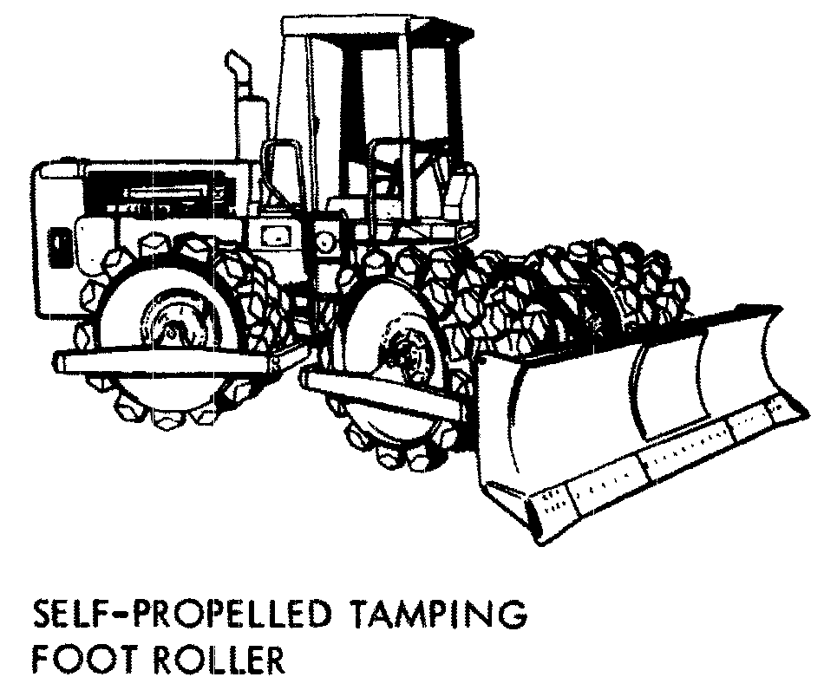
FIGURE 5-3: Major types of compaction equipment.
(Reprinted by permission of Caterpillar Inc., ©1971)

Slide 32
Types of Compaction Equipment
  All tamping foot rollers utilize static weight and manipulation to achieve compaction.
    Therefore, they are most effective on cohesive soils.
  The sheepsfoot roller:
    produces some impact force, and
    tends to displace and tear the soil as the feet enter and leave the soil.

Slide 33
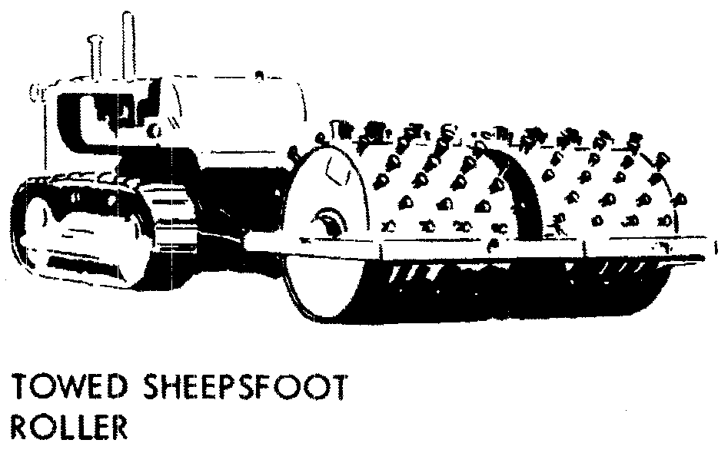
FIGURE 5-3: Major types of compaction equipment.
(Reprinted by permission of Caterpillar Inc., ©1971)

Slide 34
Types of Compaction Equipment
Grid or mesh rollers:
  They utilize a compactor drum made up of a heavy steel mesh.
  Because of their design, they can operate at high speed without scattering the material being compacted.
  Compaction is due to static weight and impact plus limited manipulation.
  Grid rollers are used to:
    compact clean gravels and sands (most effective).
    break up lumps of cohesive soil.
    crush and compact soft rock (rock losing 20% or more in the Los Angeles Abrasion Test).

Slide 35
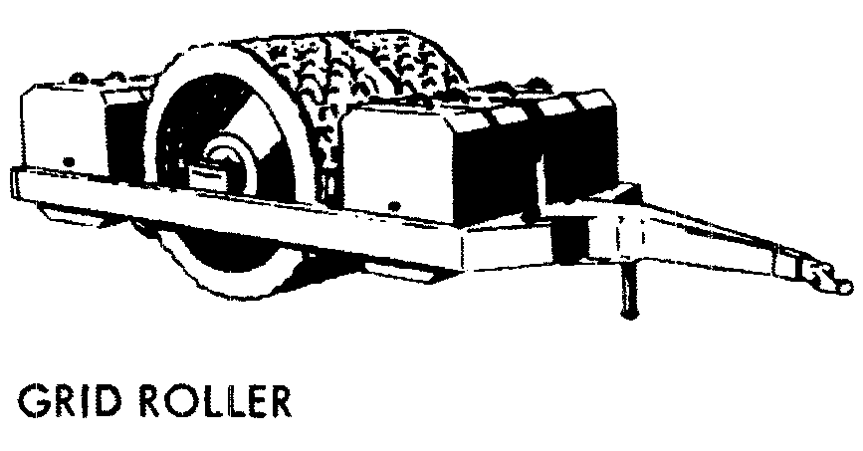
FIGURE 5-3: Major types of compaction equipment.
(Reprinted by permission of Caterpillar Inc., ©1971)

Slide 36
Types of Compaction Equipment
Vibratory compactors:
  They are available in a wide range of sizes and types.
  In size they range from:
    small hand-operated compactors (Figure 5-4) through
    towed rollers to large self-propelled rollers (Figure 5-5).
  By type they include:
    plate compactors,
    smooth drum rollers, and
    tamping foot rollers.
  Small walk behind vibratory plate compactors and vibratory rollers are used primarily for compacting around the structures and in other confined area.

Slide 37
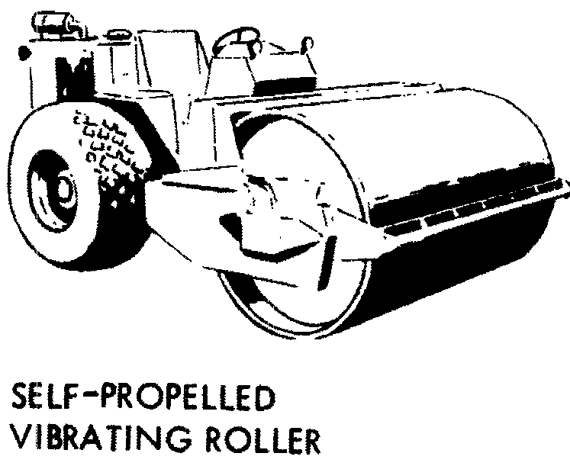
FIGURE 5-3: Major types of compaction equipment.
(Reprinted by permission of Caterpillar Inc., ©1971)

Slide 38
FIGURE 5-4: Walk-behind vibratory plate compactor.
(Courtesy of Wacker Corp.)

Slide 39
FIGURE 5-5: Vibratory tamping foot compactor.
[Courtesy of BOMAG (USA)]

Slide 40
Types of Compaction Equipment
  Vibratory plate compactors are also available as attachments for hydraulic excavators.
  The towed and self-propelled units are utilized in general earthwork.
  Large self propelled smooth drum vibratory rollers are often used for compacting bituminous bases and pavements.

Slide 41
Types of Compaction Equipment
Steel wheel or smooth drum rollers :
  They are used for compacting:
    granular bases,
    asphaltic bases, and
    asphalt pavements.
  The compactive force involved is primarily static weight.

Slide 42
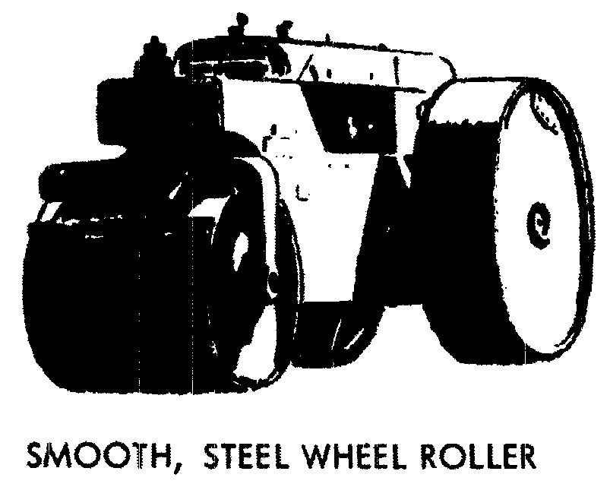
FIGURE 5-3: Major types of compaction equipment.
(Reprinted by permission of Caterpillar Inc., ©1971)

Slide 43
Types of Compaction Equipment
Rubber-tired or pneumatic rollers :
  They are available as:
    light- to medium weight multi tired rollers and
    heavy pneumatic rollers.
  Wobble-wheel rollers are multi tired rollers with wheels mounted at an angle so that they appear to wobble as they travel.
    This imparts a kneading action to the soil.
  Heavy pneumatic rollers weighing up to 200 tons are used for dam construction, compaction of thick lifts, and proof rolling.
  Pneumatic rollers are
    effective on almost all types of soils
    least effective on-clean sands and gravels.

Slide 44
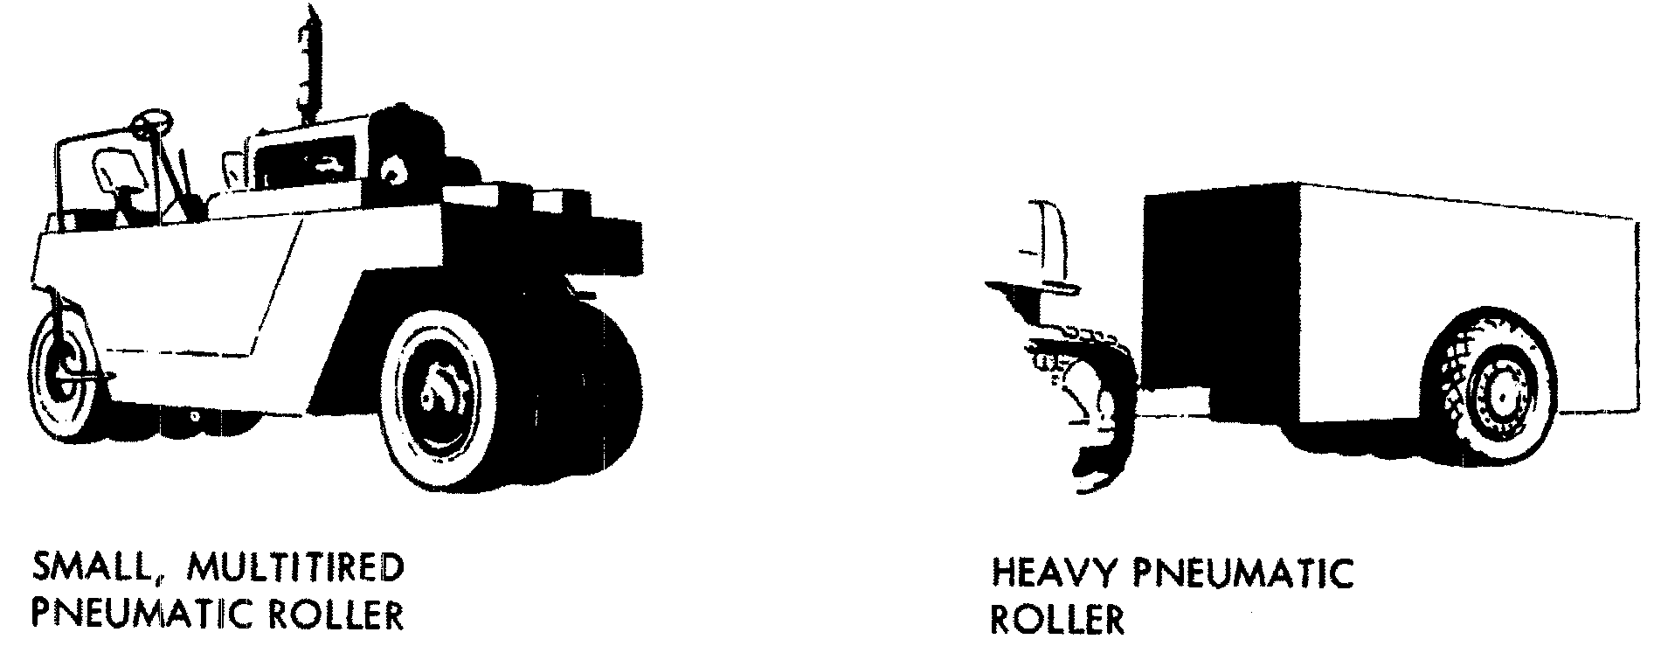
FIGURE 5-3: Major types of compaction equipment.
(Reprinted by permission of Caterpillar Inc., ©1971)

Slide 45
Types of Compaction Equipment
Segmented pad rollers :
  They are somewhat similar to tamping foot rollers except that they utilize pads shaped as segments of a circle instead of feet on the roller drum.
  As a result, they produce less surface disturbance than do tamping foot rollers.
  Segmented pad rollers are effective on a wide range of soil types.

Slide 46
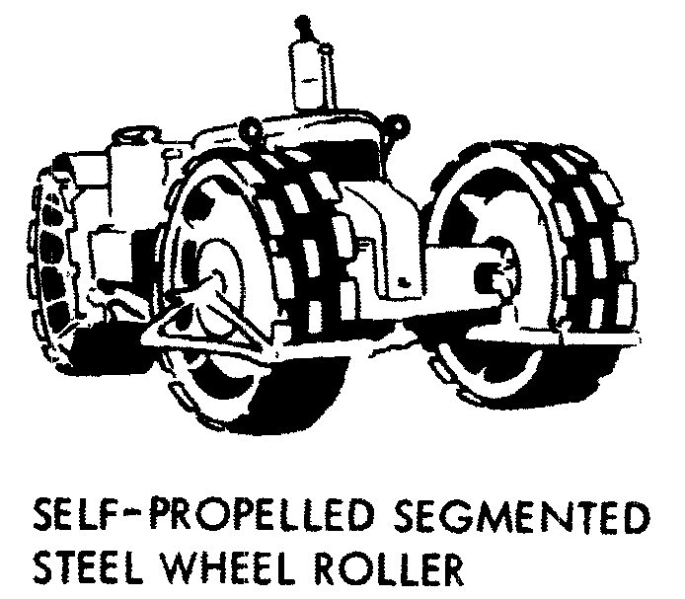
FIGURE 5-3: Major types of compaction equipment.
(Reprinted by permission of Caterpillar Inc., ©1971)

Slide 47
Types of Compaction Equipment
Rammers or tampers :
  They are small impact-type compactors which are primarily used for compaction in confined areas.
  Some rammers, like the one shown in Figure 5-6, are classified as vibratory rammers because of their operating frequency.

Slide 48
FIGURE 5-6: Small vibratory rammer.
(Courtesy of Wacker Corp.)

Slide 49
Compaction in Confined Areas
The equipment available for compaction in confined areas such as:
  trenches and around foundations includes small vibratory plate compactors (Figure 5-4),
  tampers or rammers (Figure 5-6),
  walk-behind static and vibratory rollers (Figure 5-7), and
  attachments for backhoes and hydraulic excavators.
  Compaction Wheels (Figure 5-8)
  Vibratory plate attachments (Figure 5-9)

Slide 50
FIGURE 5-4: Walk-behind vibratory plate compactor.
(Courtesy of Wacker Corp.)

Slide 51
FIGURE 5-6: Small vibratory rammer.
(Courtesy of Wacker Corp.)

Slide 52
FIGURE 5-7: Walk-behind vibratory roller with remote control.
(Courtesy of Wacker Corporation)

Slide 53
FIGURE 5-8: Compaction wheel mounted on hydraulic excavator.
(Courtesy of American Compaction Equipment, Inc.)

Slide 54
FIGURE 5-9: Vibratory plate compactor for excavator

Slide 55
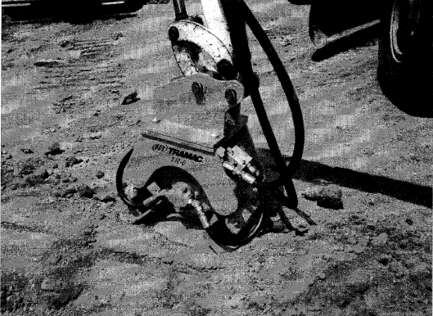
FIGURE 5-9: Vibratory plate compactor attachment for excavator
(Courtesy of Ingersoll-Rand Tramac)

Slide 56
Selection of Compaction Equipment
The proper selection of compaction equipment is an important factor in obtaining the required soil density with a minimum expenditure of time and effort.
The chart in Figure 5-10 provides a rough guide to the selection of compaction equipment based on soil type.

Slide 57
FIGURE 5-10: Compaction equipment selection guide.

