Slide 1
Buffer Capacity
BCH 312 [PRACTICAL]

Slide 2
Objective:
1. To understand the concept of buffer capacity.
2.To determine the maximum buffer capacity of a number of buffer solutions.
3.To establish the relationship between buffer capacity and buffer concentration.

Slide 3
Introduction:
- Buffer solutions, are solutions that can resist changes in pH upon addition of small amounts of acid/base.
- Common buffer mixtures contain two substances, a conjugate acid and a conjugate base.
- Together the two species (conjugate acid and conjugate base) resist large changes in pH by absorbing the H+ ions or OH- ions added to the system. When H+ ions are added to the system they will react with the conjugate base in the buffer. When OH- ions are added they will react with the conjugate acid in the buffer.

Slide 4
- When H⁺ ions are added to the system they will react with the conjugate base in the buffer as follows,
H⁺ + A⁻ HA
-When OH⁻ ions are added they will react with the conjugate acid in the buffer as follows,
OH⁻ + HA A⁻ + H₂O
Thus the buffer is effective as long as it does not run out of one of its components.

Slide 5
-Quantitative measure of this resistance to pH changes is called buffer capacity.
-Buffer capacity can be defined in many ways, it can be defined as the number of moles of H+/OH- ions that must be added to one liter of the buffer in order to decrease /increase the pH by one unit respectively.
-The buffer capacity is expressed as β and can be derived from
Henderson Hasselbalch equation;
-Where β is the buffer capacity , [H⁺] = the hydrogen ion concentration of the buffer , [C] is concentration of the buffer.
-From the equation that the buffer capacity is directly proportional to the buffer concentration.

Slide 6
How to calculate the buffer capacity practically?

Slide 7
Method :
You are provided with two acetate buffer (pH=5) ; 0.1 M acetate buffer and 0.2 M acetate buffer .
-Calculate the buffer capacity by titration for both buffers (using 8 ml), by 2 M HCl (0.5 ml) then compare between them (which one has higher buffer capacity and why?)
Question:
What do you conclude finally about the relationship between, Buffer concentration and buffer capacity ?

Slide 8
Method :
- You are provided with two acetate buffer (pH=5) ; 0.1 M acetate buffer and 0.2 M acetate buffer .
- In one beaker add 8ml of the 0.1 M acetate buffer, and in another beaker add 8ml of 0.2 M acetate buffer.
- Start the titration by adding 0.5 ml of 0.1 M HCl from the burette and determine the pH of the solution after each addition.
- Continue adding acid in until pH falls to about 2 pH units from your starting pH .
- Plot a Curve of pH against ml of HCl added.
- Calculate the buffer capacity (which one has higher buffer capacity. why?)

Slide 9
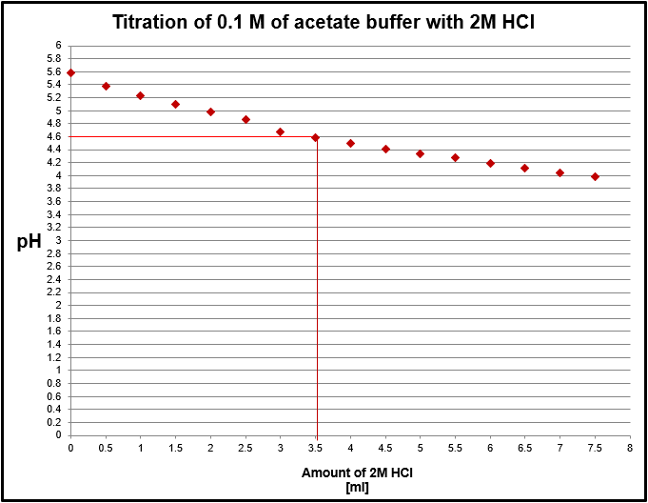

Slide 10
