Slide 1
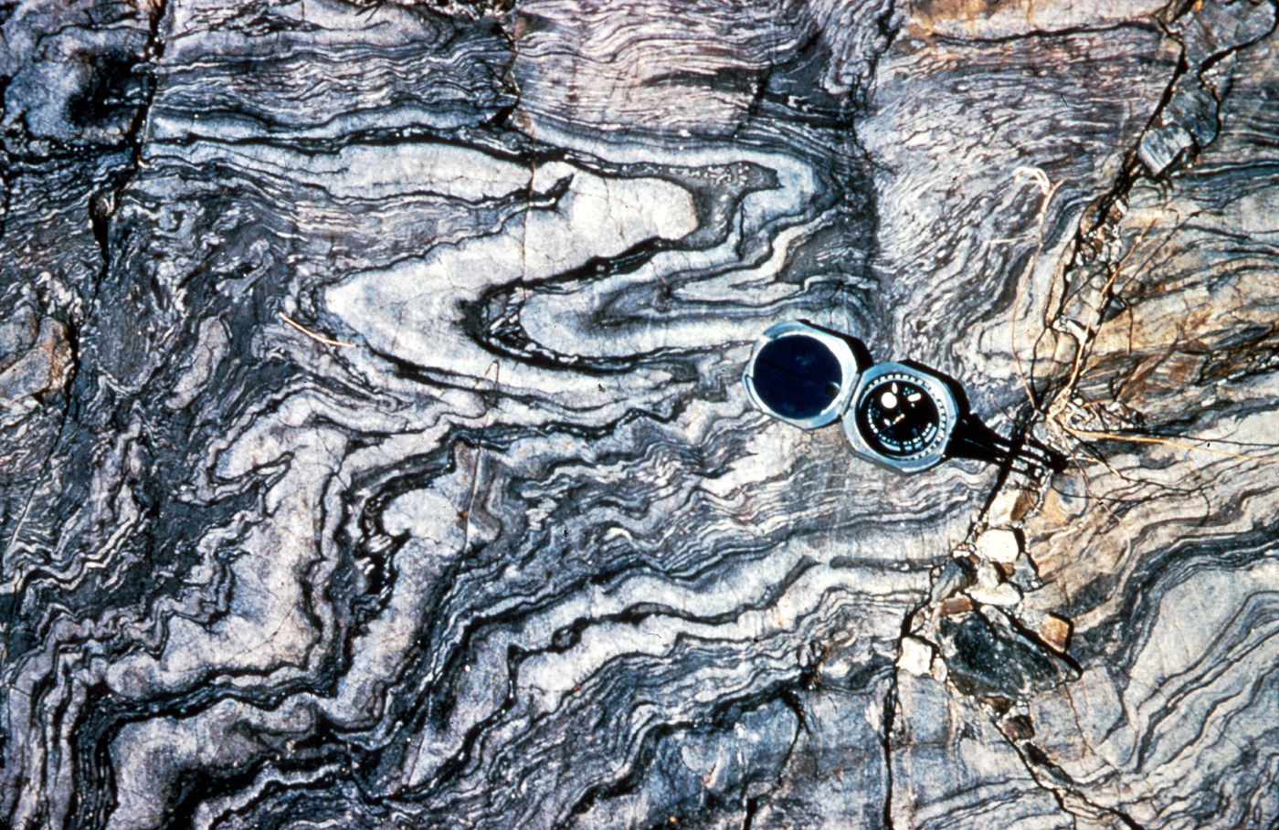
METAMORPHIC ROCKS
UNIT - 5

Slide 2
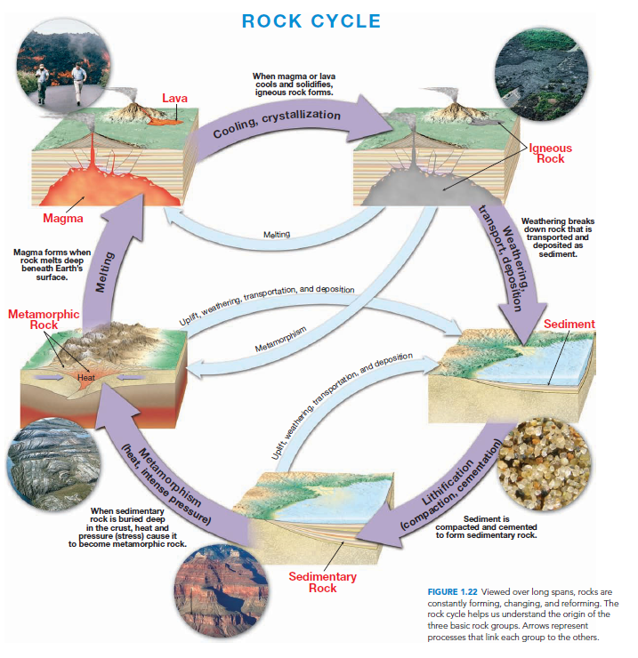

Slide 3
What is Metamorphism
Metamorphism (from the Greek words for “changing form”) is the process by which rising temperature and changes in other environmental conditions transform rocks and minerals.
In other word metamorphism is the transformation of one rock type into another.
Metamorphism takes place where the pre-existing rocks are subjected to temperature and pressure unlike those in which they were formed.
In response to these new conditions the rock gradually changes until it reaches a state of equilibrium with the new environment.
Metamorphism is always gradual and it ranges from low grade metamorphism to high grade metamorphism.
However rock should always be in the solid state during metamorphism.
If the rocks melts at a certain point, then we enter the zone of igneous activity.

Slide 4
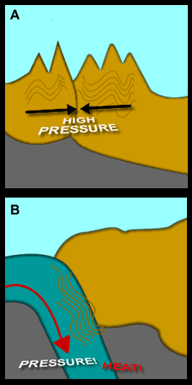
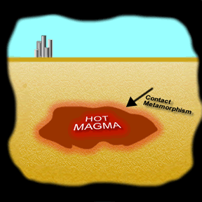
Environment of metamorphism
Most metamorphism occurs in one of the three settings:
Contact or thermal metamorphism occurs where hot magma intrudes cooler country rock. The country rock may be of any type—sedimentary, metamorphic, or igneous.
The highest-grade metamorphic rocks form at the contact, closest to the magma. Lower-grade rocks develop farther out.
The change is driven by the rise in temperature within the host rock surrounding an igneous intrusion.
Most contact metamorphic rocks are fine-grained, dense,tough rocks of various chemical compositions.
Because directional pressure is not a major factor, these rocks are not generally foliated.
Hydrothermal metamorphism (also called hydrothermal alteration and metasomatism) occurs when hot water and ions dissolved in the hot water react with a rock to change its chemical composition and minerals.
Regional metamorphism occurs during the process of mountain building, great quantities of rocks are subjected to directed pressure and high temperatures associated with large scale deformation.

Slide 5
Agents of metamorphism
Heat contributes to the process in two ways. First, atoms may combine differently at different temperatures.
This means that a mineral stable at one temperature might become unstable at a higher (or lower) temperature and be converted to a different mineral with a more stable atomic structure.
This may or may not involve changing the exact elemental composition.
Second, heat makes practically all chemical reactions go faster, meaning that mineral transformations are much easier at higher temperature.

Slide 6
Agents of metamorphism
Pressure also has two effects. As with heat, it can also control which minerals or forms of minerals are stable.
Some minerals may be converted to minerals with similar composition but different atomic packing simply because pressure is increased.
The exact nature of the pressure is not important in this case. Only the amount is important. Thus the confining or lithostatic pressure created by deep burial of rocks under sediment may have this effect as well as the directed pressure during mountain building processes.
The second effect of pressure is to reorient minerals with linear or platy structure or to create a preferred orientation of them as they form.
Thus elongate minerals such as amphiboles, or platy minerals such as clays or micas tend to align themselves parallel to each other when under pressure.
This only happens when there is directed pressure; confining pressure does not accomplish it.

Slide 7
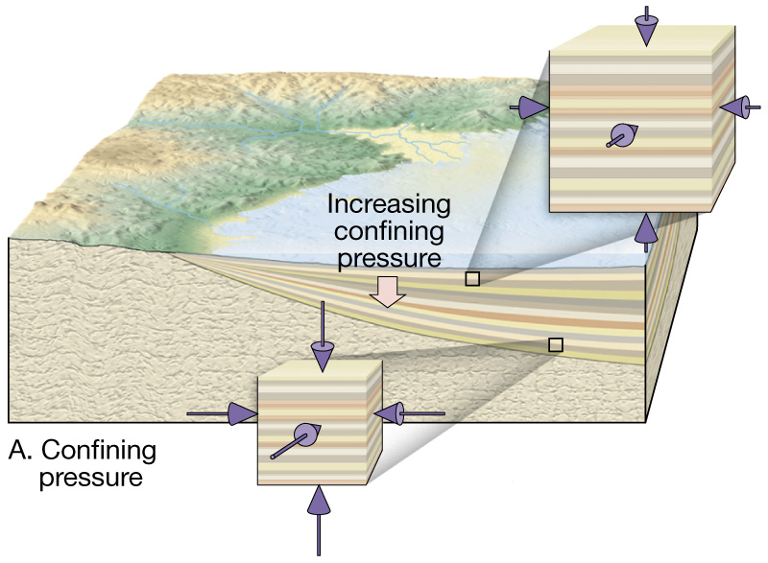
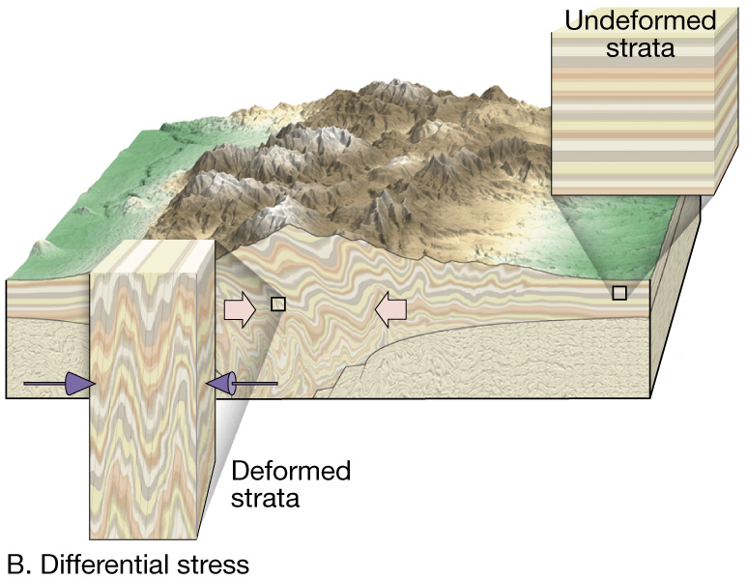
Agents of metamorphism
Confining Pressure and Directed Pressure

Slide 8
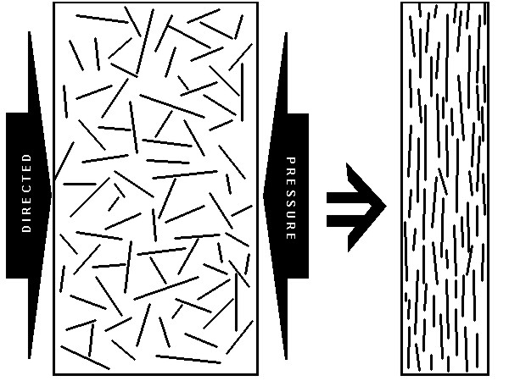
Agents of metamorphism
The diagram illustrates the effect. A texture of this sort in a metamorphic rock is called foliation and the rocks are said to be foliated.

Slide 9
Agents of metamorphism
Fluids serve only to speed up other metamorphic processes, or perhaps even allow them to happen at all.
Chemical reactions require water, and most proceed much faster as the amount of water goes up.
Dissolved ions in the fluid also make those mineral transformations that require chemical changes in the minerals to occur, whether by supplying needed ions or flushing away excess ones.

Slide 10
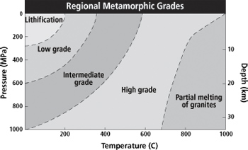
Grade of Metamorphism
Different locations in the crust experience different levels of heat and pressure as result the rocks may experience different grades of metamorphism.
The changes that occur during metamorphism are recorded in the form of texture and mineral assemblages.
High grade metamorphic rocks are greatly altered from its original form and often have a completely different mineralogy than the parent rock.

Slide 11
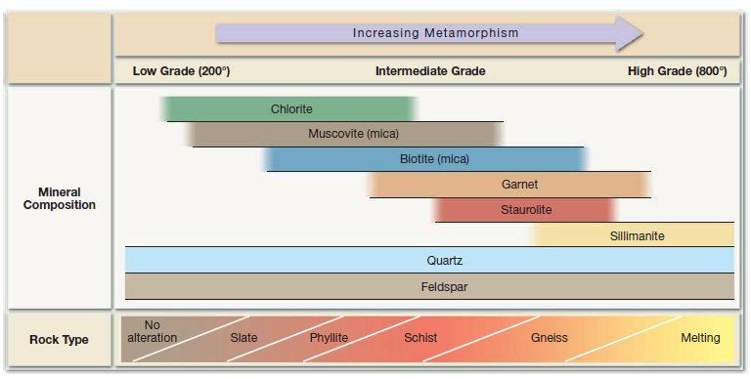
Index minerals
Through the study of metamorphic rocks it has been found that some minerals are good indicators of the metamorphic environment in which they formed. These minerals are known as index minerals.
Using these index minerals, geologists distinguish among different zones of regional metamorphism.
For example, the mineral chlorite begins to form when temperatures are relatively low, less than 200 °C Thus, rocks that contain chlorite are referred to as low-grade.
By contrast, the mineral sillimanite only forms in extreme environments where temperatures exceed 500 °C, and rocks containing it are considered high-grade.
Quartz and Feldspar also appear in metamorphic products but since they are found in both low and high grade metamorphic rocks, they are not considered as index minerals.

Slide 12
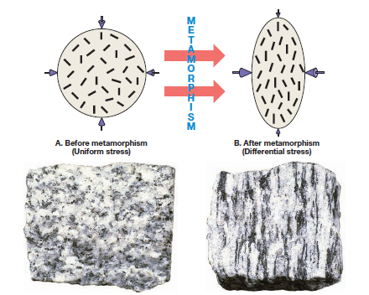
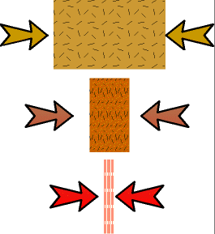
Metamorphic rock textures
Metamorphic rocks exhibit a variety of textures. They can be either foliated or granular.
Foliation refers to any planar arrangement of mineral grains or structural features within a rock.
Most metamorphic rocks form in the influence of a directed stress field. Because of this they develop conspicuous directional textures.
As metamorphism proceeds, the sheet structure silicates (flat minerals with basal cleavage) such as mica (biotite and muscovite) and chlorite start to grow.
The sheets orient themselves perpendicular to the direction of maximum stress.
The new parallel mineral flakes produce a planar texture called foliation. (from the Latin folium - leaf).
Foliation can be subtle or pronounced depending on the degree of metamorphism.

Slide 13
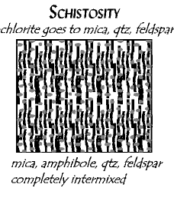
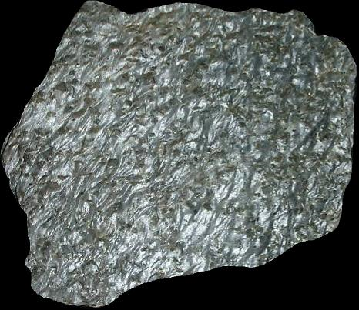
Metamorphic rock textures
The foliated textures develop in the sequence listed below as temperature and pressure increases. Here we just define the textures. Below are descriptions and illustrations of how each texture develops.
Slaty cleavage is formed as a result of parallel foliation (layering) of fine-grained platy minerals (chlorite) in a direction perpendicular to the direction of maximum stress. Exmaples of such rocks are Slate and Phyllite.
Schistosity is formed as a result of the layering in a coarse grained, crystalline rock due to the parallel arrangement of platy mineral grains such as muscovite and biotite.
Other minerals present are typically quartz and feldspar, plus a variety of other minerals such as garnet, staurolite, kyanite, sillimanite.

Slide 14
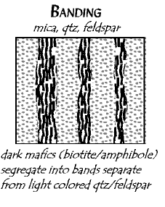
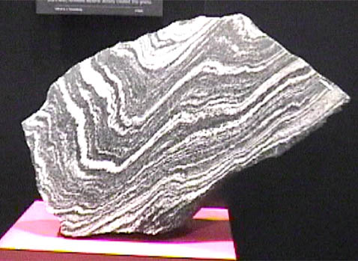
Metamorphic rock textures
Mineral Banding (Gneiss) is the layering in a rock in which bands or lenses of granular minerals (quartz and feldspar) alternate with bands or lenses in which platy (mica) or elongate (amphibole) minerals predominate.

Slide 15
Metamorphic rock textures
Non foliated textures are formed around igneous intrusions where the temperatures are high but the pressures are relatively low and equal in all directions (confining pressure).
The original minerals within the rock recrystallize into larger sizes and the atoms become more tightly packed together, increasing the density of the rock.
Examples of such rock types are Quartzite and Marble.

Slide 16
Metamorphic rock textures
When the parent rock is composed only of a single mineral, metamorphism changes the rocks into one composed of the same mineral but with a coarser texture.
Example Limestone changes to Marble and Quartz Sandstone changes to Quartzite

Slide 17
Metamorphic rock textures
In contrast, metamorphism of a parent rock containing several minerals usually forms a rock with new and different minerals and a new texture.
For example, a typical shale contains large amounts of clay, as well as quartz and feldspar.
When heated, some of those minerals decompose, and their atoms recombine to form new minerals such as mica, garnet, and a different kind of feldspar to form a rock called hornfels which has a different texture and as well as minerals than shale.

Slide 18
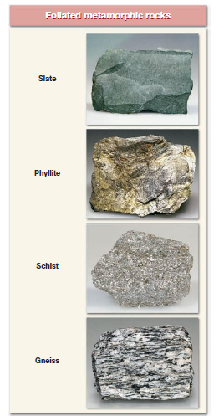
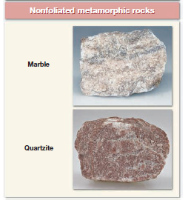
Common Metamorphic Rocks
Metamorphic Rocks are divided into two basic divisions
1. Foliated/Banded
2.Non-Foliated (also, granular or equidimensional)

Slide 19
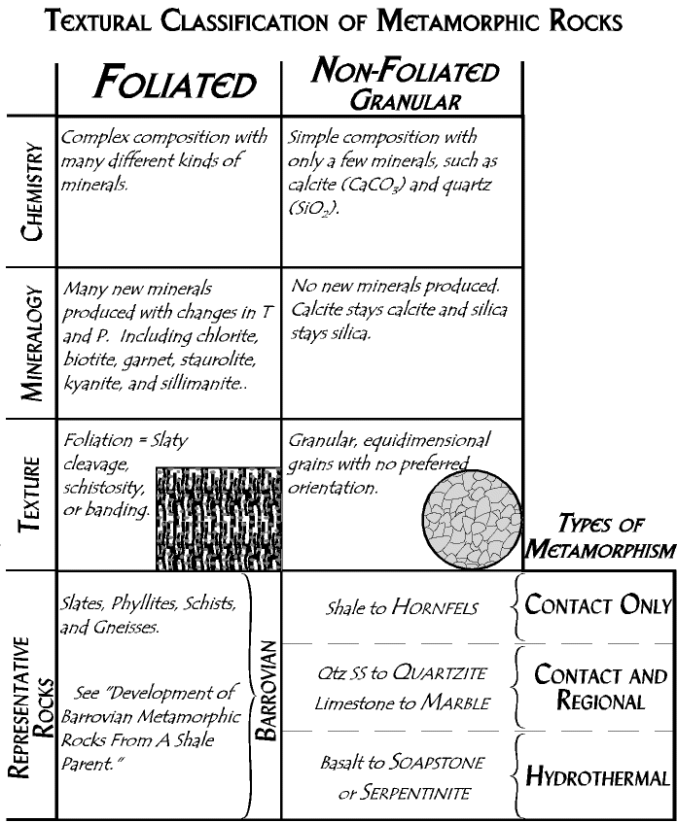

Slide 20
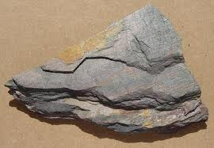
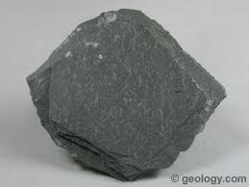
Foliated metamorphic rocks
Slate is a fine grained (less than 0.5 mm) foliated rock composed of mica flakes.
Slate is dull colored and closely resembles shale.
The most important characteristic of shale is its tendency to break into flat slabs.
Slate is generally formed by low grade metamorphism of shale, mudstone or siltstone.
Color of slate depends upon its mineral composition.
Black slate contains organic material. Red slate contains Iron Oxide.
Green slate contains chlorite.

Slide 21
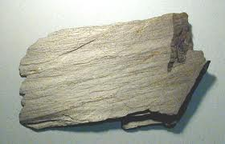
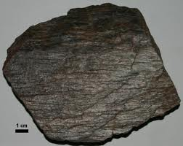
Foliated metamorphic rocks
Phyllite: It represents a degree of metamorphism in between slate and schist.
Its constituent platy minerals are larger than those in slate but still not large enough to be identified with the naked eye.
Phyllite appears similar to slate but can be distinguished from slate by its glossy sheen and wavy surface.
Phyllite also breaks as a flat surface and is composed of fine crystals of muscovite or chlorite or both.

Slide 22
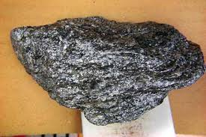
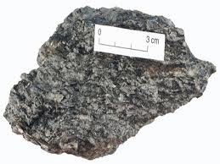
Foliated metamorphic rocks
Schists are medium to coarse grained metamorphic rocks in which platy minerals predominate.
These minerals include muscovite and biotite.
These platy minerals are arranged in a planar fashion that gives the rock its foliated texture.
In addition to mica, schist also contains other minerals such as quartz and feldspars.
Like slate, the parent rock for many schists are also shale which has undergone medium to high grade metamorphism during the process of mountain building.
Schist is the name given to the texture of the metamorphic rock.
To indicate the composition minerals names are used such as mica scist, talc schist, chlorite schist.

Slide 23
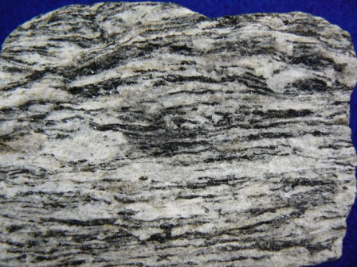
Foliated metamorphic rocks
Gneiss is the term applied to medium or coarse grained banded metamorphic rocks in which granular and elongated minerals predominate.
The most common minerals in gneiss are Quartz. Potassium feldspar, Na feldspar.
Gneiss also contains smaller amounts of biotite, muscovite and amphibole that develop a preferred orientation.
During the high grade metamorphism the dark and light colored minerals segregate giving the gneisses their typical banded or layered appearance.
Most gneisses have a felsic composition, however some of them are also formed by the high grade metamorphism of shale.

Slide 24
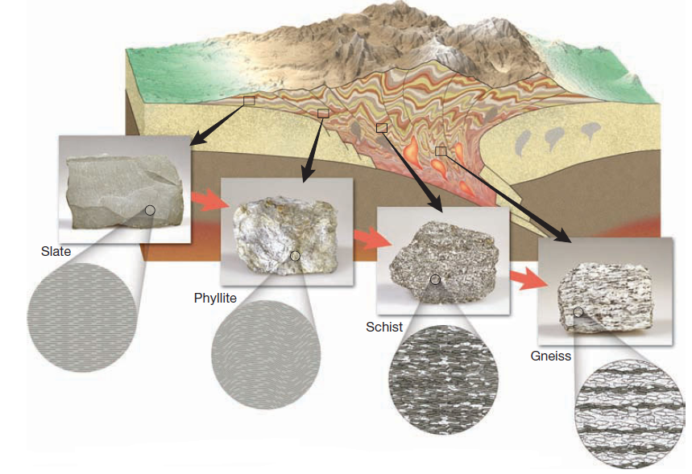
Foliated metamorphic rocks

Slide 25
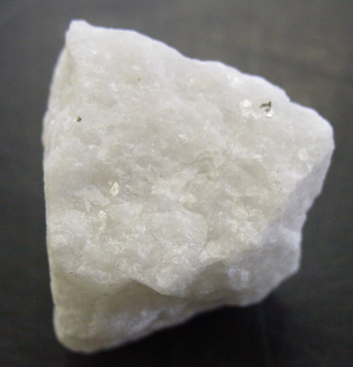
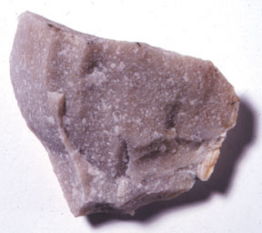
Non-foliated metamorphic rocks
Marble: It is a coarse grained crystalline rock whose parent rock was limestone or dolostone.
Pure marble is white and is composed entirely of the mineral calcite.
The parent rocks from which marbles are formed often contain some impurities and this imparts color to marble.
Marble can be pink, gray or even black in color.
Quartzite: It is a very hard metamorphic rock formed from quartz sandstone.
They are formed under moderate to high grade metamorphism.
The crystals of quartz fuse together when they undergo metamorphism and as result the crystal size for quartzite is much bigger than its parent rock.

