Slide 1
Differential staining
Spore stain
Capsule stain

Slide 2
Spore stain
Members of the anaerobic genera Clostridium species, aerobic Bacillus species are examples of organisms that have the capacity to exist either as metabolically active Vegetative cells or resistant metabolically inactive cells Spores .
Non active, resistant to heating and chemicals. because of the composition of spore layers.
Remain dormant until favorable conditions return.

Slide 3
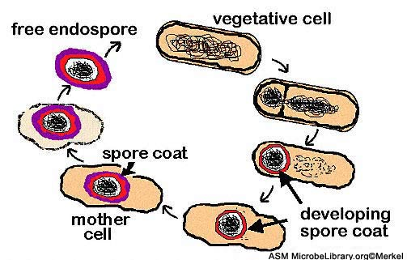
life cycle of a spore forming bacteria

Slide 4
Not easily stained:
Mild heating.
Use of strong stain.
Timing of the stain is extended.

Slide 5
Spore stain reagents
1-Primary stain:
Malachite green, both vegetative cell and spores will appear green.
2-Decolorizing Agent:
Water, it will remove the color from the cell, spores will remain green.
3-Counter stain:
Safranin which will be absorbed by the vegetative cell.

Slide 6
Spore stain steps
Apply malachite green for 5 min application of heat is required.
Rinse with D. water.
Stain with safranin for 1 min.
Observation:
Spores appear green While vegetative bacteria or non spore forming bacteria appear red/pink

Slide 7
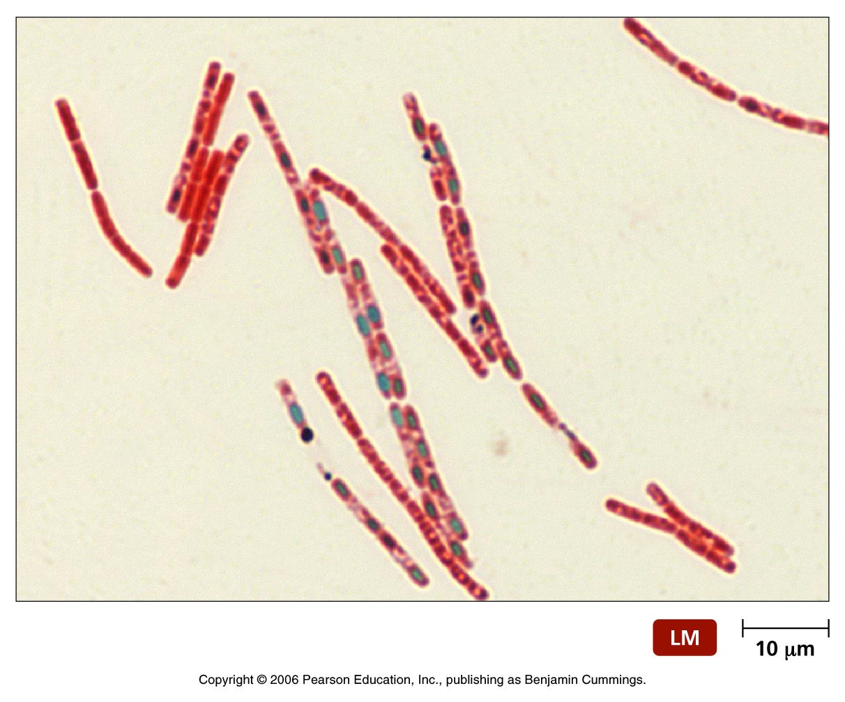
Spore stain

Slide 8
Capsule stain
A Capsule is gelatinous outer layer that is secreted by the cell and that surrounds and adheres to the cell wall. Capsules are virulent and capable of producing disease, since the structure protects bacteria against phagocytes of the host cell.
Capsules are non ionic, uncharged because they are composed of polysaccharides.

Slide 9
Capsule stain
Capsule staining is more difficult than other types of differential staining procedures because the capsular material are water-soluble and maybe removed by washing. Smear shouldn’t be heated because the resultant cell shrinkage may create a clear zone around the organism that can be mistaken for the capsule.

Slide 10
This method use Nigrosin and Safranin to stain the bacteria and the background leaving capsule unstained as a clear halo surrounding bacteria.

Slide 11
Capsule stain steps
Deliver 1 drop of Nigrosin by the loop and 1 drop of safranin at the end of clean slide.
Mix a loopful of culture ( Kelbsiella sp.) with the stain.
Spread the mixture on the slide as a blood film.
Air dry the film.

Slide 12
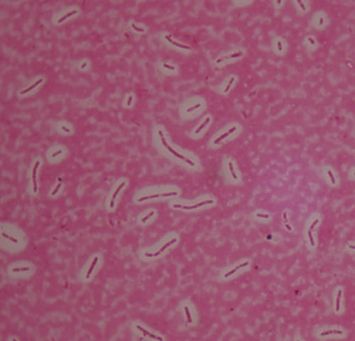
Capsule stain

