Slide 1
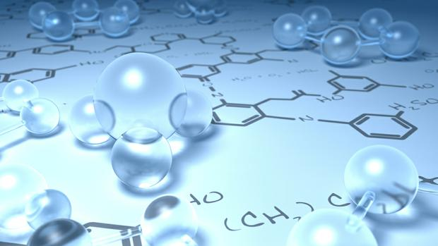

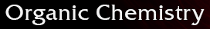
By
Dr. Mohamed El-Newehy
Chemistry Department, College of Science, King Saud University
http://fac.ksu.edu.sa/melnewehy

Slide 2
Aromatic Compounds

Slide 3
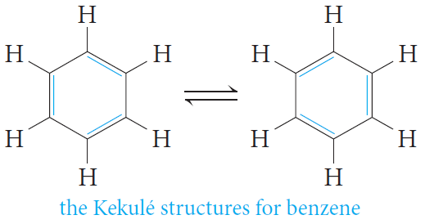
The Structure of Benzene Ring
- Benzene is the parent hydrocarbon of aromatic compounds, because of their special chemical properties.
- Today a compound is said to be aromatic if it is benzene-like in its properties.
Structure of Benzene
- Molecular formula = C₆H₆
The carbon-to-hydrogen ratio in benzene, suggests a highly unsaturated structure.
- Benzene reacts mainly by substitution.
It does not undergo the typical addition reactions of alkenes or alkynes.
- Kekulé structure for benzene.
He suggested that six carbon atoms are located at the corners of a regular hexagon, with one hydrogen atom attached to each carbon atom.
He suggested that single and double bonds alternate around the ring (conjugated system of double bonds).
Kekulé suggested that the single and double bonds exchange positions around the ring so rapidly that the typical reactions of alkenes cannot take place.

Slide 4
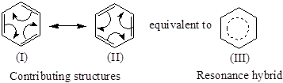
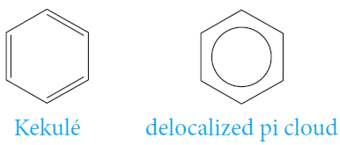
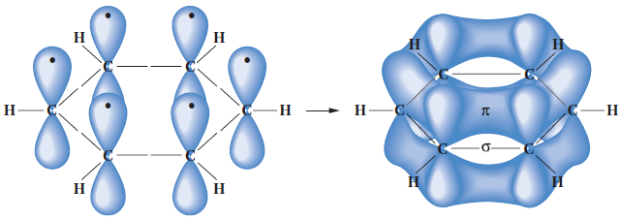
The Structure of Benzene Ring
Structure of Benzene
- Resonance Model for Benzene.
- Benzene is planar.
- All of the carbon–carbon bond lengths are identical: 1.39 Aº , intermediate between typical single (1.54Aº) and double (1.34 Aº) carbon–carbon bond lengths.
- Each carbon is therefore sp2-hybridized.
- Bond angles of 120°.

Slide 5
Aromatic Character (Armaticity)
- Aromatic character (Aromaticity) is associated with several structural requirements.
◆
Cyclic structure.
❖
Cyclic structure contains what looks like a continuous system of alternating double and single bonds.
⬥
Aromatic compounds must be planar.

Aromaticity is possible only if it obeys Hückel’s rule
the number of ∏ electrons in the compound = (4n + 2)
Where (n = 0,1, 2, 3, and so on).

Slide 6
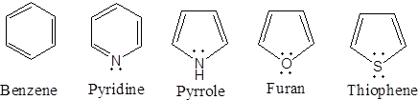
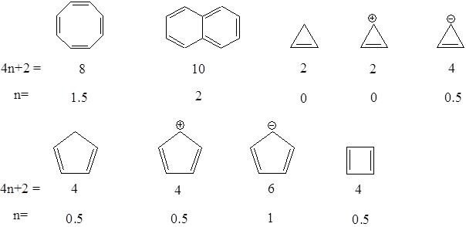
Aromatic Character (Armaticity)
Structure and name of aromatic compound | 4n + 2 | n
6 | 1
Examples

Slide 7
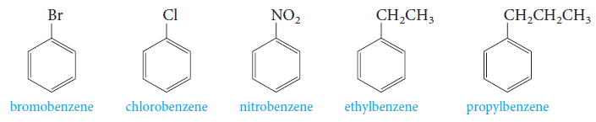
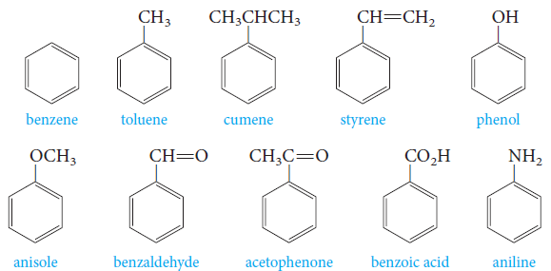
Nomenclature of Aromatic Compounds
- Monosubstituted benzenes that do not have common names accepted by IUPAC are named as derivatives of benzene.
- Common names are accepted by IUPAC (parent compounds).

Slide 8
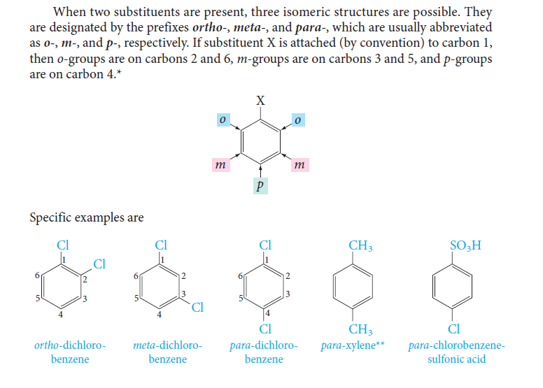
Nomenclature of Aromatic Compounds
- When two substituents are present, three isomeric structures are possible.
- They are designated by the prefixes; ortho- (o-), meta- (m-) and para- (p-).
- If substituent X is attached to carbon 1; 0- groups are on carbons 2 and 6, m- groups are on carbons 3 and 5, and p- groups are on carbon 4.
- Examples;

Slide 9
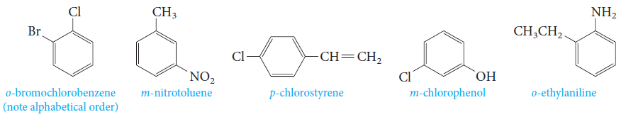
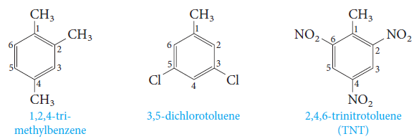
Nomenclature of Aromatic Compounds
- The prefixes; ortho- (o-), meta- (m-) and para- (p-) are used when the two substituents are not identical.
- When more than two substituents are present, their positions are designated by numbering the ring.

Slide 10
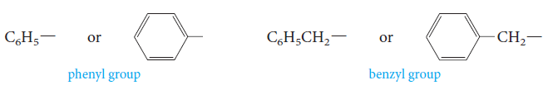
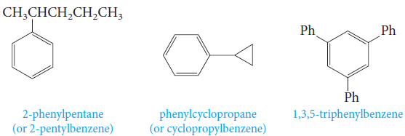
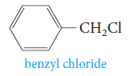
Nomenclature of Aromatic Compounds
- Two groups with special names occur frequently in aromatic compounds; the phenyl group and the benzyl group.
- Examples;

Slide 11
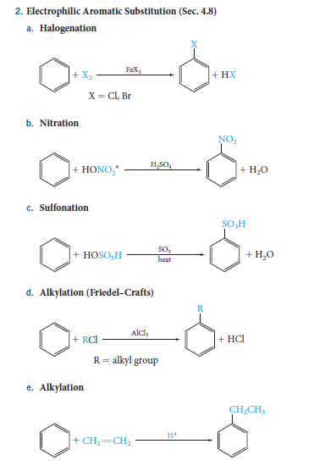
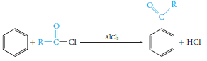
Reactions of Benzene
Electrophilic Aromatic Substitution Reactions
1) Halogenation
2) Nitration
3) Sulfonation
4) Alkylation (Friedel-Crafts)
5) Acylation (Friedel-Crafts)

Slide 12
Reactions of Benzene
Electrophilic Aromatic Substitution Reactions
The Mechanism of Electrophilic Aromatic Substitution
- We can generalize this two-step mechanism for all the electrophilic aromatic substitutions.
Halogenation

Slide 13
Reactions of Benzene
Electrophilic Aromatic Substitution Reactions
The Mechanism of Electrophilic Aromatic Substitution
Nitration
In aromatic nitration reactions, the sulfuric acid catalyst protonates the nitric acid, which then loses water to generate the nitronium ion (NO₂⁺), which contains a positively charged nitrogen atom.
Sulfonation
We use either concentrated or fuming sulfuric acid, and the electrophile may be sulfur trioxide, SO₃, or protonated sulfur trioxide, ⁺SO₃H.

Slide 14
Reactions of Benzene
Electrophilic Aromatic Substitution Reactions
The Mechanism of Electrophilic Aromatic Substitution
Friedel–Crafts Alkylation
The electrophile is a carbocation, which can be formed either by removing a halide ion from an alkyl halide with a Lewis acid catalyst (for example, AlCl₃) .
Friedel–Crafts Acylation
The electrophile is an acyl cation generated from an acid derivative, usually an acyl halide. The reaction provides a useful general route to aromatic ketones.

Slide 15
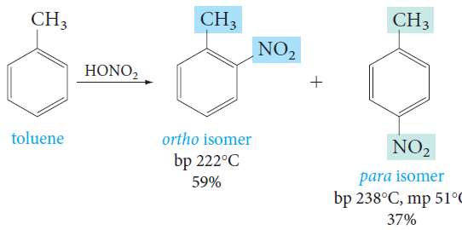
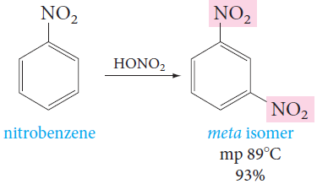
Reactions of Benzene
Disubstituted Benzenes: Orientation
- Substituents already present on an aromatic ring determine the position taken by a new substituent. For example, nitration of toluene gives mainly a mixture of o- and p-nitrotoluene.
- On the other hand, nitration of nitrobenzene under similar conditions gives mainly the meta isomer.

Slide 16
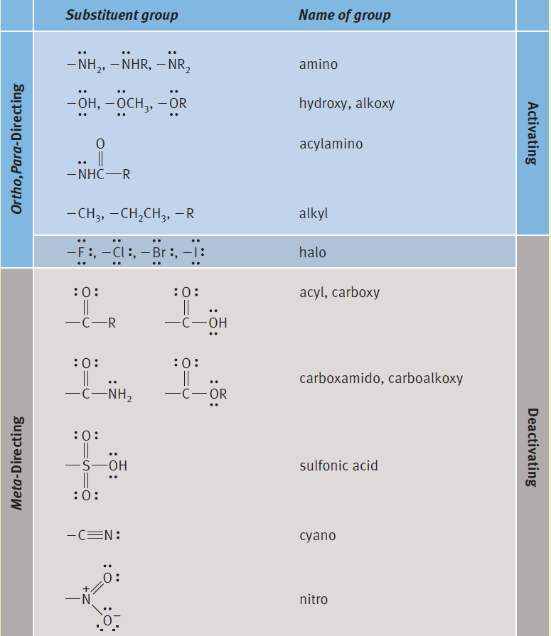
Reactions of Benzene
Disubstituted Benzenes: Orientation & Reactivity
Directing and Activating Effects of Common Functional Groups
Substituents that release electrons to the ring will activate the ring toward electrophilic substitution.
Substituents that withdraw electrons from the ring will deactivate the ring toward electrophilic substitution.

Slide 17
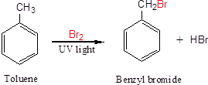
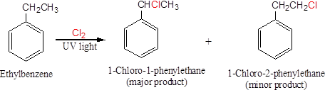
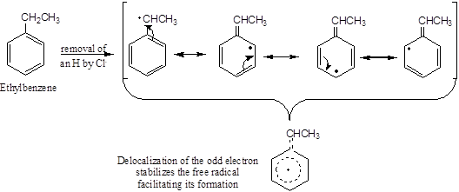
Reactions of Benzene
Side-Chain Reactions of Benzene-Derivatives
1. Halogenation of an Alkyl Side Chain

Slide 18
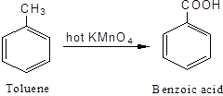
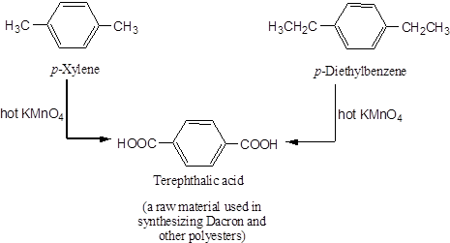
Reactions of Benzene
Side-Chain Reactions of Benzene-Derivatives
2. Oxidation of an Alkyl Side Chain
- Conversion into a carboxyl group, -COOH, by treatment with hot potassium permanganate.
- Regardless the length of the alkyl chain, the product is always the same.

