Slide 1
THROXA
521zoo
presented by: hessa alobaid

Slide 2
Why Study the Insect Thorax?
Structure determines how an insect moves through its habitat.
Wings determine flight capability
Legs determine how it moves and digs on land

Slide 3
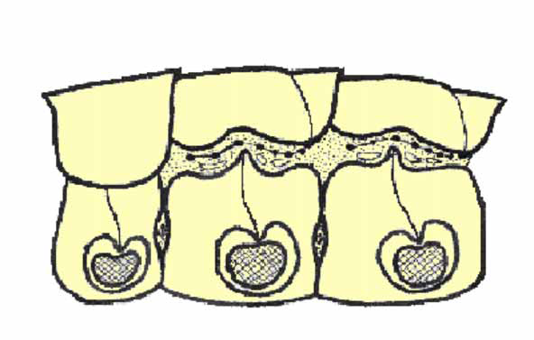
Prothorax Mesothorax Metathorax
Tergum
Pleuron
Sternum

Slide 4
Insect wings
Insects are the only invertebrates that can fly. Their wings develop as evaginations of the exoskeleton during morphogenesis but they become fully functional only during the adult stage of an insect's life cycle.
Forewing attached to mesothorax, hindwing to metathorax. Meso and metathoracic segments are reinforced, to help support wing muscles during flight.

Slide 5
Wings serve not only as organs of flight, but also may be adapted variously as
Protective covers (Coleoptera and Dermaptera)
Thermal collectors (Lepidoptera)
Gyroscopic stabilizers (Diptera)
Sound producers (Orthoptera)
Visual cues for species recognition and sexual contact (Lepidoptera).

Slide 6
Wing adaptations and modifications

Slide 7
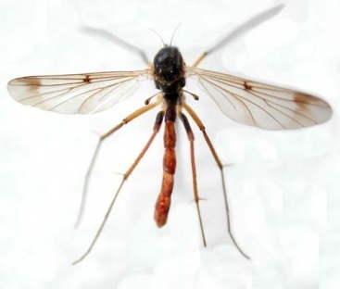
membranous wings
membranous wings: are characterized by having thin, unscleritized (meaning not leathery or hard) membranes between the veins of the wings, ex. Butterflies

Slide 8
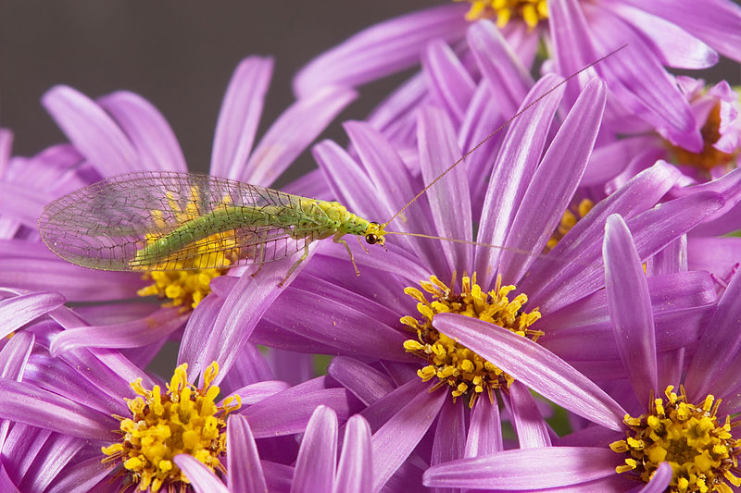
Lancewings
Lancewings: They are characterized by a wide coastal field in their wing venation, which includes the cross-veins. Chrysopidae

Slide 9
Elytr
Elytr: hard, sclerotized front wings that serve as protective covers for membranous hind wings, ex. Coleoptera and Dermaptera

Slide 10

Hemelytra
Hemelytra: half membranous forewing of true bugs, ex. Heteroptera

Slide 11

Tegmina
Tegmina: front wings that are completely leathery or parchment-like in texture, using to protect back wing. Orthoptera

Slide 12
Halteres
Halteres: small, club-like hind wings that serve as gyroscopic stabilizers during flight. Diptera

Slide 13

Fringed wings
Fringed wings: slender front and hind wings with long fringes of hair, Thysanoptera

Slide 14

Hairy wings
Hairy wings: front and hind wings clothed with setae, Trichoptera

Slide 15
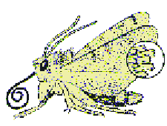
Scaly wings
Scaly wings : front and hind wings covered with flattened setae (scales). Lepidoptera

Slide 16
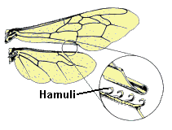
Coupling mechanism
Hamuli: tiny hooks on hind wing that hold front and hind wings together, Hymenoptera
Frenulum : Bristle near base of hind wing that holds front and hind wings together, Lepidoptera

