Slide 1
Chapter 4
Product, Services, and Brands: Building Customer Value

Slide 2
Product, Services, and Branding Strategy
Topic Outline
What Is a Product?
Product and Services Decisions
Services Marketing
Branding Strategy: Building Strong Brands

Slide 3
What Is a Product?
Products, Services, and Experiences
Product is anything that can be offered in a market for attention, acquisition, use, or consumption that might satisfy a need or want
Service is a product that consists of activities, benefits or satisfaction that is essentially intangible and does not result in the ownership of anything
Notes:
Note to Instructor
This Web link is a great example of a store that creates experiences: Jordan’s Furniture in the Boston. These furniture stores include an Imax theater, an amusement park quality motion ride, a trapeze school, and Mardi Gras parades. You can visit their stores through their Web sites.

Slide 4
What Is a Product?
Products, Services, and Experiences
Experiences represent what buying the product or service will do for the customer
Notes:
Note to Instructor
This Web link is a great example of a store that creates experiences: Jordan’s Furniture in the Boston. These furniture stores include an Imax theater, an amusement park quality motion ride, a trapeze school, and Mardi Gras parades. You can visit their stores through their Web sites.

Slide 5
What Is a Product?
Product and Service Classifications
Consumer products
Industrial products

Slide 6
What Is a Product?
Product and Service Classifications
Convenience products
consumer products and services that the customer usually buys frequently, immediately, and with a minimum comparison and buying effort
Newspapers
Candy
Fast food

Slide 7
What Is a Product?
Product and Service Classifications
Shopping products
consumer products and services that the customer compares carefully on suitability, quality, price, and style
Furniture
Cars
Appliances

Slide 8
What Is a Product?
Product and Service Classifications
Specialty products
consumer products and services with unique characteristics or brand identification for which a significant group of buyers is willing to make a special purchase effort
Medical services
Designer clothes
High-end electronics

Slide 9
What Is a Product?
Product and Service Classifications
Unsought products
consumer products that the consumer does not know about or knows about but does not normally think of buying
Life insurance
Funeral services
Blood donations
Notes:
Note to Instructor
Discussion Question
What is a product that could be convenience, shopping, and specialty?
This is a bit of a puzzle. They might realize that a camera could fall into several categories depending on the buyer and the situation. Certainly, if you are on vacation and you forgot your camera, you would pick one up at a convenience store, pharmacy, or maybe the hotel store. If you were a professional photographer, a camera purchase could easily be specialty if you were buying a $5,000 camera. Other examples might include mats for the floor of a automobile, tires, or a fan.

Slide 10
What Is a Product?
Product and Service Classifications
Industrial products
products purchased for further processing or for use in conducting a business
Classified by the purpose for which the product is purchased
Materials and parts
Capital
Raw materials

Slide 11
Product and Service Decisions
Individual Product and Service Decisions
Notes:
Now we dig into the specific
decisions that companies must make
when designing and marketing
products and services.

Slide 12
Product and Service Decisions
Individual Product and Service Decisions
Product or service attributes
communicate and deliver the benefits
Quality
Features
Style and design

Slide 13
Product and Service Decisions
Individual Product and Service Decisions
Style describes the appearance of the product
Design contributes to a product’s usefulness as well as to its looks
Notes:
Note to Instructor
The text highlights OXO’s unique design for their product. This link takes you to the OXO Web site to explore some of there products.

Slide 14
Product and Service Decisions
Individual Product and Service Decisions
Brand is the name, term, sign, or design—or a combination of these—that identifies the maker or seller of a product or service
Notes:
Note to Instructor
Discussion Questions
What brands do you tend to purchase consistently? Why?
This discussion should lead to the consumer benefits of brands including quality and consistency. It is interesting to now ask students what the benefits might be for the seller of having a strong brand. This will include segmentation, positioning, and the ability to communicate product features

Slide 15
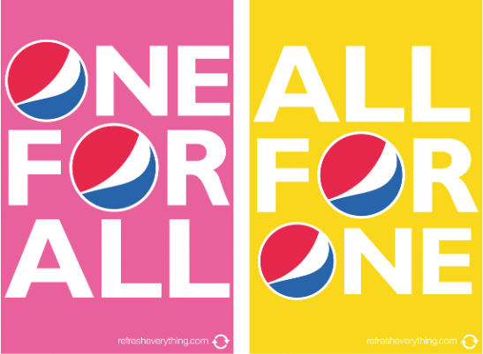
Product and Service Decisions
Individual Product and Service Decisions
Packaging involves designing and producing the container or wrapper for a product
Labels identify the product or brand, describe attributes, and provide promotion
Notes:
Note to Instructor

Slide 16
Services Marketing
Types of Service Industries
Government
Private not-for-profit organizations
Business services

Slide 17
Services Marketing
Marketing Strategies for Service Firms
Managing service quality provides a competitive advantage by delivering consistently higher quality than its competitors
Service quality always varies depending on interactions between employees and customers

Slide 18
Branding Strategy: Building Strong Brands
Brand equity
The differential effect that knowing the
brand name has on customer response to
the product or its marketing.

Slide 19
Branding Strategy: Building Strong Brands

Slide 20
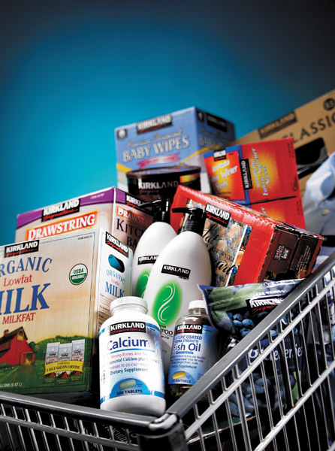
Branding Strategy: Building Strong Brands
Brand Sponsorship
Manufacturer’s brand
Private brand
Licensed brand
Co-brand

Slide 21
All rights reserved. No part of this publication may be reproduced, stored in a retrieval system, or transmitted, in any form or by any means, electronic, mechanical, photocopying, recording, or otherwise, without the prior written permission of the publisher. Printed in the United States of America.
Copyright © 2012 Pearson Education, Inc.
Publishing as Prentice Hall

