Slide 1
King Saud University College of Engineering IE – 341: “Human Factors Engineering” Fall – 2017 (1st Sem. 1438-9H)
Human Capabilities
Part – A. Vision (Chapter 4)
Part 2: Displays – Symbols – Codes
Prepared by: Ahmed M. El-Sherbeeny, PhD

Slide 2
Lesson Overview: Vision
Part 1:
Process of Seeing (Vision)
Visual Capabilities
Accommodation
Visual Acuity
Convergence
Color Discrimination
Dark Adaptation
Perception
Factors Affecting Visual Discrimination
Luminance Level
Contrast
Exposure Time
Target Motion
Age
Training

Slide 3
Cont. Lesson Overview: Vision
Part 2 (this part):
Alphanumeric Displays
Characteristics
Typography
Typography Features
Hardcopy
Visual Display Terminals (VDT)
Graphic Representations
Symbols
Codes

Slide 4
Alphanumeric Displays

Slide 5
Alphanumeric Displays
Most important characteristics:
Visibility:
quality of the character that makes it separately visible from its surroundings (i.e. detectability)
Legibility:
attribute that makes a character identifiable from others (i.e. discriminability)
depends on stroke width, form of characters, contrast, and illumination
Readability:
ability to recognize information content of material when represented by alphanumeric characters, words, sentences (i.e. meaningfulness)
depends more on spacing between lines and letters, etc. than on specific features of characters
Watch this video about legibility and readability: https://youtu.be/74sZJ4b0_Lc

Slide 6
Alphanumeric Displays: Typography
Typography:
various features of alphanumeric displays
Circumstances when it is important to use preferred forms of typography:
Viewing conditions are unfavorable (e.g. low illumination, limited viewing time)
Information is important/critical (e.g. emergency labels, important instructions)
Viewing occurs at a distance
Displays for low vision people
Note, above forms must still satisfy all conditions mentioned in last slide
When faced with ≥ 1 of these conditions, typography features must be considered:

Slide 7
A-N Displays: Typography Features
Hardcopy
Stroke Width
Width-height Ratio
Styles of Type
Size of Characters
at Reading Distance
at a Distance
Layout of Characters
VDT Screens
Illuminated Alphanumeric Characters
Character Distance and Size

Slide 8
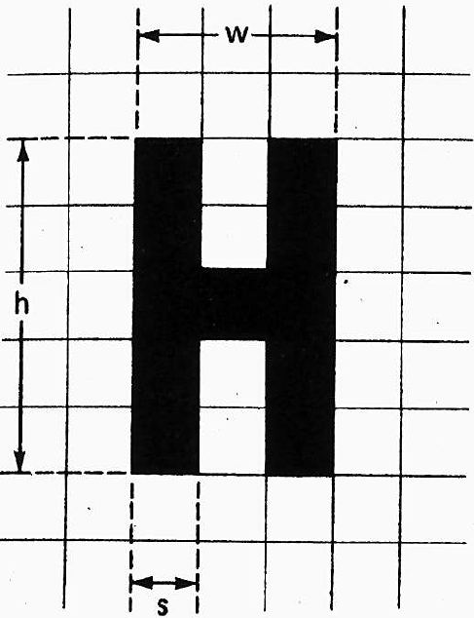
A-N Displays: 1. Stroke Width
Stroke-Width-to-height-ratio ≡ ratio of the thickness of the stroke (s) to the height (h) of the letter/number (stroke ratio for short)
Example (right):
Stroke width-to-height:1:5 = 0.2
Note, width-to-height: 3:5 = 0.6
Stroke Width is affected by:
Background
black on white or
white on black
Illumination

Slide 9
A-N Displays: 1. Stroke Width (Cont.)
Irradiation:
causes white features on a black background to appear to ‘spread’ into adjacent dark areas
But reverse (black on white) isn’t true (no spread)
Thus, black-on-white letters should be thicker i.e. lower ratios than white-on-black letters
With good illumination, stroke width ratios:
Black on white: 1:6 to 1:8
White on black: 1:8 to 1:10
With reduced illumination:
Thick letters become more readable (both types above)
Letters should be: boldface with low stroke ratios (e.g. 1:5)
For highly luminous letters, ratios: 1:12 to 1:20.
For black letters on a very highly luminous background, very thick strokes are needed

Slide 10
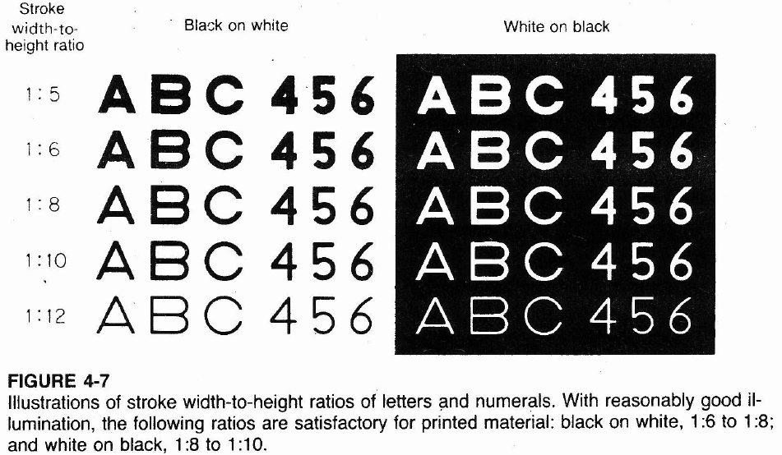
A-N Displays: 1. Stroke Width (Cont.)

Slide 11
A-N Displays: 2. Width-height ratio
Width-to-height (AKA width-height ratio):
Relationship between width and height of alphanumeric character
Expressed as ratio (e.g. 3:5 = 0.6; back 3 slides)
e.g. B: width-height ratio = 3:5
3 vertical strokes (or layers)
5 horizontal strokes
Most letters can be expressed with ratio 3:5
Heglin:
Disagrees with fixed ratios for letters:
For O: perfect circle
For A and V: equilateral triangles

Slide 12
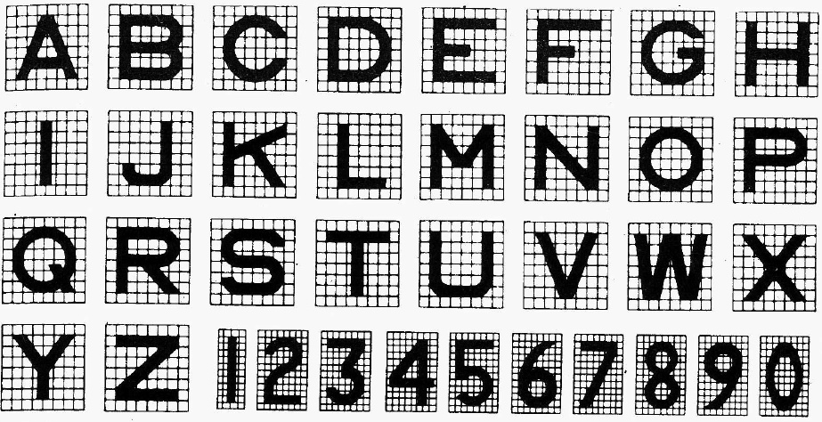
A-N Displays: 2. Width-height Cont.
Cont. width-height ratio
3:5 satisfactory for most purposes
wider letters: appropriate certain circumstances:
e.g. engraved legends
such cases 1:1 ratios are more appropriate
Below: letters: 1:1 (except?); numbers: 3:5 (except?)

Slide 13
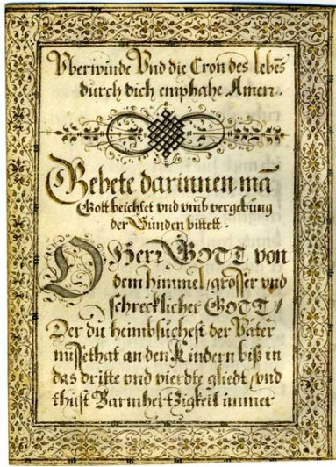
A-N Displays: 3. Styles of Type
Styles of type (AKA typefaces, fonts)
> 30,000 exist!
4 major classes (each including many types)
Roman: most common class; letters have serifs (little flourishes, embellishments)
Sans serif (AKA Gothic): uniform stroke width;
Script: simulate modern handwriting. (eg wedding cards)
Block Letter: resembles German manuscript handwriting used in the fifteenth century (above)
Roman: most used styles for conventional text
Italics: emphasis, titles, names, special words, etc
Boldface: headings, labels, special emphasis, legibility in poor reading conditions
Last slide: style used for military (non-standard)
Notes:
Watch this great video on the font, “comic sans”: http://youtu.be/GUCcObwIsOs

Slide 14
A-N Displays: 4. Character Size
Size
used to measure size of type in printing business
1 point (pt) = 1/72 in. (0.35 mm)
this is the height of the slug on which the type is set, e.g.
tail of the letter “q” (called descender)
top of letter “h” (called ascender)
space between lines of text
Capital letters
Better approximation to letter size:
1 pt = 1/100 in. (0.25 mm)
e.g. letter size, with slug size, heights of cap. letters (in.):
This line is set in 4-pt type (slug = 0.055; letters = 0.04).
This line is set in 6-pt type (slug = 0.084; letters = 0.06).
This line is set in 8-pt type (slug = 0.111; letters = 0.08).
This line is set in 9-pt type (slug = 0.125; letters = 0.09).
This line is set in 10-pt type (slug = 0.139; letters = 0.10).
This line is set in 11-pt type (slug = 0.153; letters = 0.11).
This line is set in 12-pt type (slug = 0.167; letters = 0.12).

Slide 15
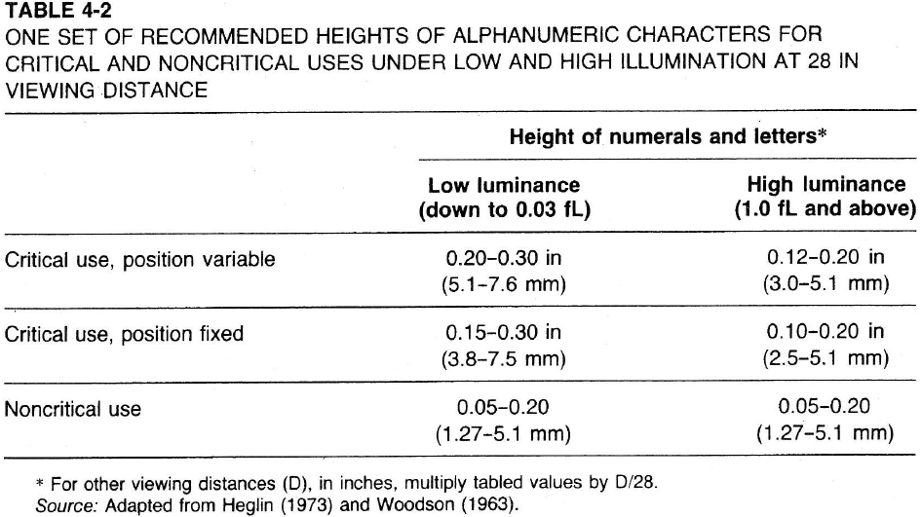
A-N Displays: 4. Size (Cont.)
For Close-Up Reading:
Normal reading distance (e.g. book)
12-16 in.
14 in. (35.5 cm): nominal reading distance
Type size in most printed material
from 7 to 14 pt
most common about 9 to 11 pt
i.e. letters = 0.09 – 0.11 in. (2.3-2.8 mm; VA = 22-27 min??)
Character heights should be increased:
poor illumination (see table)

Slide 16
A-N Displays: 4. Size (Cont.)
For Distance Reading:
Readability and legibility of alphanumeric characters are equal at various distances, provided that:
As viewing distance ↑ ⇒
Characters size ↑ (and vice versa) ⇒
VA (visual angle) subtended at the eye stays the same
Formula: letter height as function of distance and Snellen visual acuity:
W_{s}= 1.45 * 10⁻⁵ * S * d
H_{L} = W_{s}/R
W_{s}, d, H_{L} must be in same units (mm, in.)
W_{s}: stroke width
S: denom. of Snellen visual acuity (e.g. acuity = 20/40 ⇒ S = 40)
d: reading distance
H_{L}: letter height
R: stroke width-to-height ratio of font (e.g. R = 0.20 for ratio: 1:5)
For low illumination, low contrast ⇒ use large letters
Design signs for people with at best: Snellen acuity:20/40

Slide 17
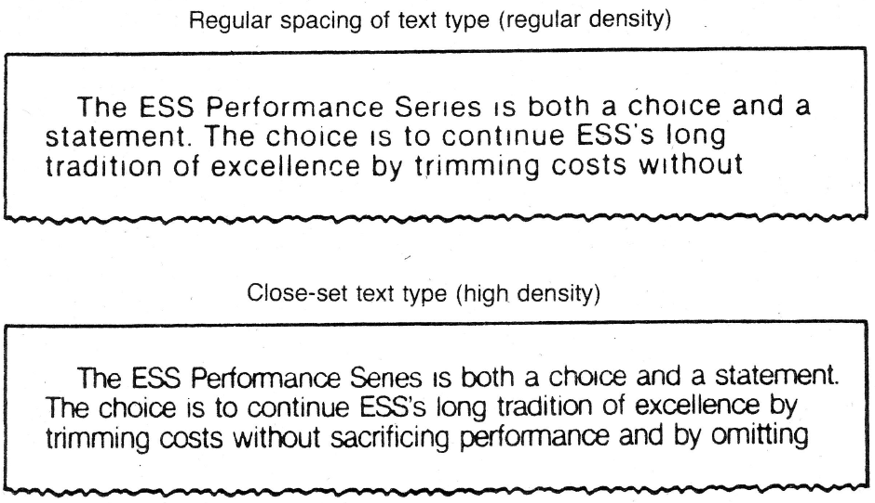
A-N Displays: 5. Layout of Characters
Previous discussion: design of characters
Layout of characters can influence reading:
Interletter Spacing:
i.e. how “tight” are letters packed (i.e. density)
High-density letters: read faster than low density
Reason: more characters viewable in quality visual field (i.e. fovea) at each fixation (see figure below)
Interline Spacing:
More spacing ⇒ ↑ text clarity
Less spacing ⇒ eye strain, headache

Slide 18
A-N Displays: 6. Illuminated AN Characters
Characters also presented on
VDT (visual display terminal), AKA:
VDU (visual display unit, i.e. computer screen)
Characters on VDT
readable: 20-30% slower than on hardcopy
reason:
Dot-matrix VDT: composed of pixels “picture elements”
Horiz. line of pixels form “raster scan” or scan lines
Pixels are lit (turned “on” and “off” to form images)
e.g. 640 * 480 VDT screen: 480 lines by 640 pixels
Higher “resolution” ⇒ more pixels per image ⇒ less difference between reading from VDT vs. hardcopy
Lower resolution (or old VDT): poor accommodation

Slide 19
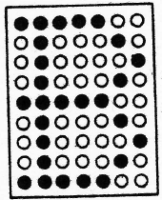
A-N Displays: 6. Illuminated Characters (Cont.)
Dot-Matrix displays:
Characters made up of a matrix of pixels
Individual character: matrix 5 * 7 to 15 * 24
See e.g. below: 7 * 9 dot matrix letter ‘B’
Note, ALL letters/numbers can be created on this formation of dots
7 * 9: minimum size for reading continuous text
Small matrices (e.g. 5 * 7):
individual matrix pixels: visible
⇒ reading is affected
Large matrices:
Individual pixels: not distinct
⇒ performance improves

Slide 20
A-N Displays: 7. Distance & Size (VDT)
Distance
VDT Viewed normally farther than hardcopy text
Eye-to-screen distances:
24-36 in. (61-93 cm)
Mean: 30 in. (76 cm)
ANSI standard: viewing monitor: upright position
18-20 in.
Take 20 in. (50 cm): nominal VDT reading distance
Size
At 20 in. reading distance
Recommended subtended VA = 11-12 min. of arc
⇒ character height = 0.06–0.07 in. (1.5-1.8 mm) (?)
This is smaller than for hardcopy (0.09-0.11 in.)

Slide 21
A-N Displays: 7. Distance & Size (cont.)
Size (Cont.)
ANSI: size for high legibility reading (@ 20 in.)
Minimum: 16 min. ⇒ Height = 0.09 in. (2.3 mm)
Preferred: 20-22 min. ⇒ 0.116-0.128 in. (2.9 – 3.3 mm) Note, these are closer to hardcopy reading heights
Maximum: 24 min. ⇒ 0.14 in. (3.6 mm)
This is threshold height for comfortable reading
When character size ↑ ⇒ more foveal fixation required

Slide 22
Graphic Representations

Slide 23
GRAPHIC REPRESENTATIONS
Graphic Representations of Text
Pictorial information: important for speed
Text information: important for accuracy
Instructional material: should combine:
Pictures + Text ⇒ speed + accuracy + retention
Graphic Representations of Data
Data graphs:
e.g. Pie charts, bar charts, line graphs
2-D graphs, 3-D graphs (next slide)
graph should be
consistent with numerical data
Properly, clearly labelled (all variables, units, etc.)
Some representations: distort data perception
e.g. May change differences between 2 variables
e.g. May give impression of false increases

Slide 24
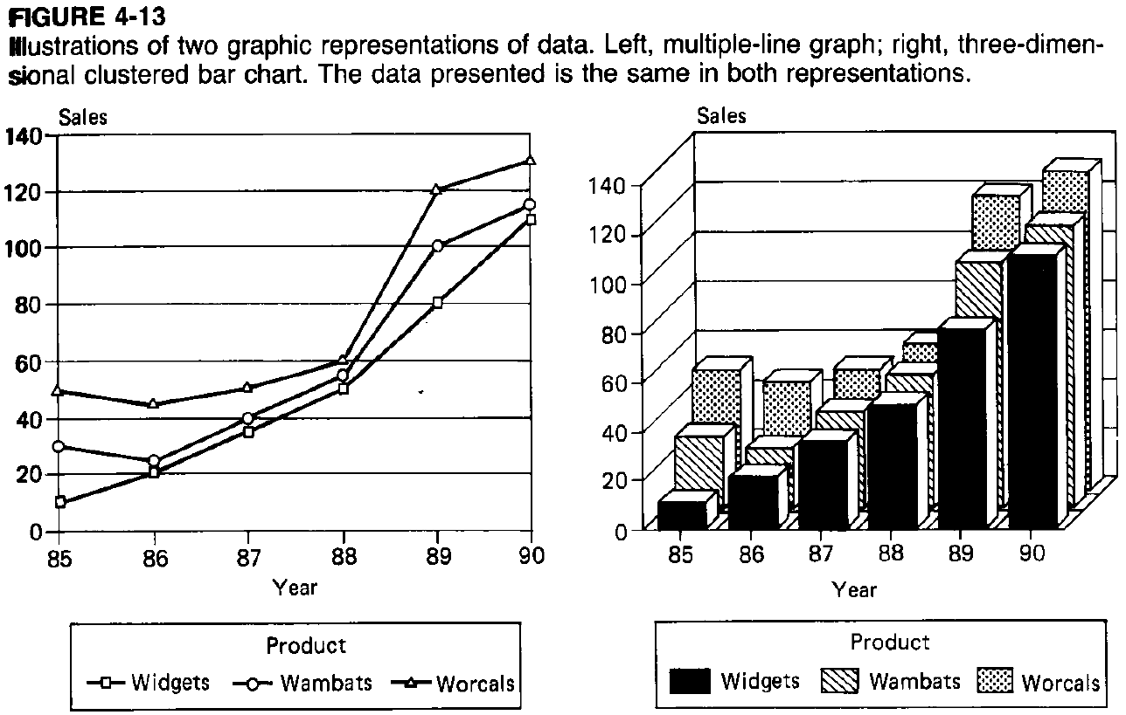
GRAPHIC REPRESENTATIONS (cont.)

Slide 25
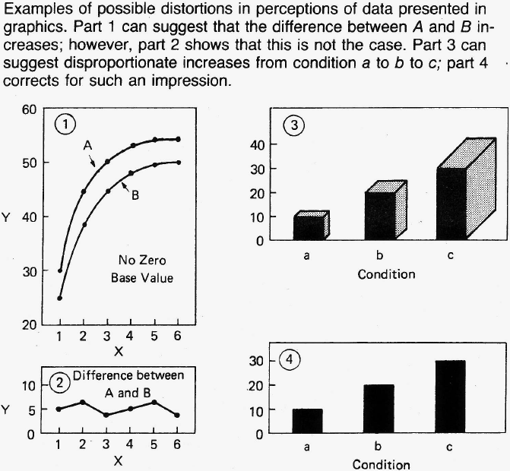
GRAPHIC REPRESENTATIONS (cont.)

Slide 26
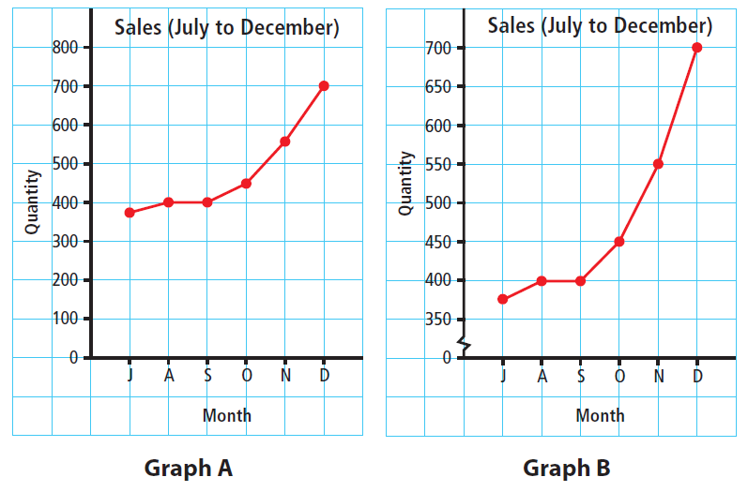
GRAPHIC REPRESENTATIONS (cont.)

Slide 27
Symbols

Slide 28
SYMBOLS
Visual symbols should be very clear
e.g. men vs. women restroom sign
Comparison of Symbolic & Verbal Signs
Verbal sign may require “recoding” (i.e. interpretation)
E.g. sign saying “beware of camels”
Symbols mostly do not require “recoding”
E.g. Road sign showing camels crossing
⇒ no recoding (i.e. immediate meaning)
Note, some symbols require learning & recoding
Ells and Dewar (1979):
Conducted study on traffic signs and symbols
Mean reaction time for correct response was less for symbols (next slide)

Slide 29
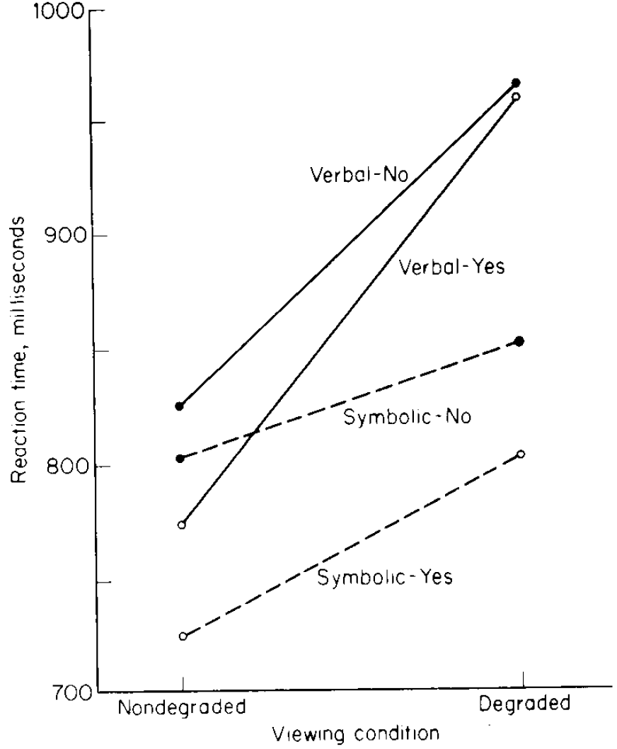
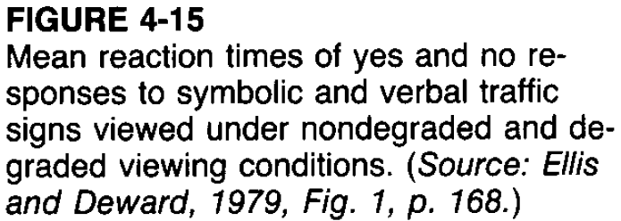
SYMBOLS
Comparison of Symbolic & Verbal Signs
Cont. Ells and Dewar (1979): see results below
Notes:
Q: what is meant by degraded viewing condition?

Slide 30
SYMBOLS (cont.)
Objectives of Symbolic Coding Systems
Symbolic coding system consists of:
symbols: that best represent their referents
referents: concept that symbol represents
Objective: strong association: symbol-referent
Association depends on:
any established association, “recognizability”
ease of learning such an association
Guidelines for using coding systems (discussed earlier)
Detectability
Discriminability
Compatibility
Meaningfulness
Standardization

Slide 31
SYMBOLS (cont.)
Symbols:
Either are used confidently
Tested experimentally for suitability
Criteria for Selecting Coding symbols
Recognition: Subjects presented with symbols and asked:
to write down
or say what each represents
Matching:
symbols are presented to subjects along with a list of all referents represented
Subjects match each symbol with its referent
⇒ confusion matrix : indicating number of times each symbol is confused with every other one
Also reaction time may be measured

Slide 32
SYMBOLS (cont.)
Criteria for Selecting Coding symbols (cont)
Preferences and Opinions: subjects are asked to express their preferences or opinions about design of symbols
Examples of Code Symbol Studies
Mandatory-Action Symbols
E.g.: “recognition” testing of symbols + training

Slide 33
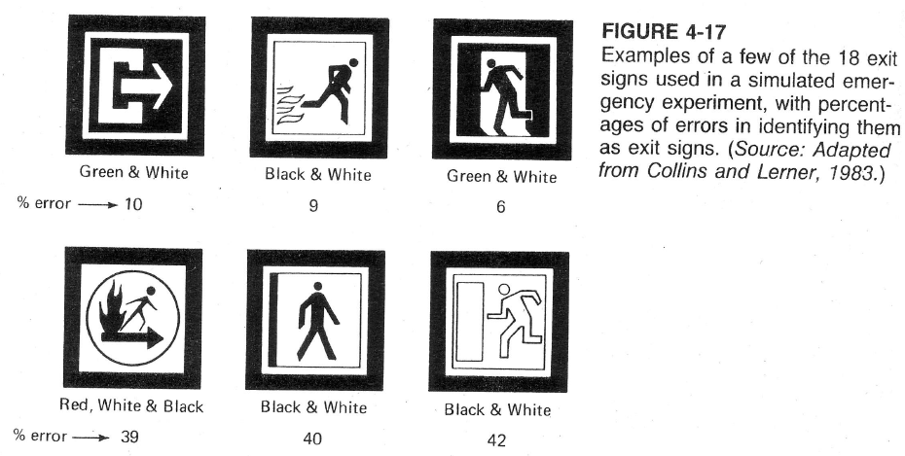
SYMBOLS (cont.)
Examples of Code Symbol Studies (cont.)
Comparison of Exit Symbols for Visibility:
Example of symbol recognition/matching
Note, Some “no-exit” symbols: perceived as “exit”!

Slide 34
SYMBOLS (cont.)
Examples of Code Symbol Studies (cont.)
Generalizations about features of signs
Filled figures superior to outline figures
Square or rectangular backgrounds: better identified than circular figures
Simplified figures (i.e. reduced number of symbol elements) are better than complex figures

Slide 35
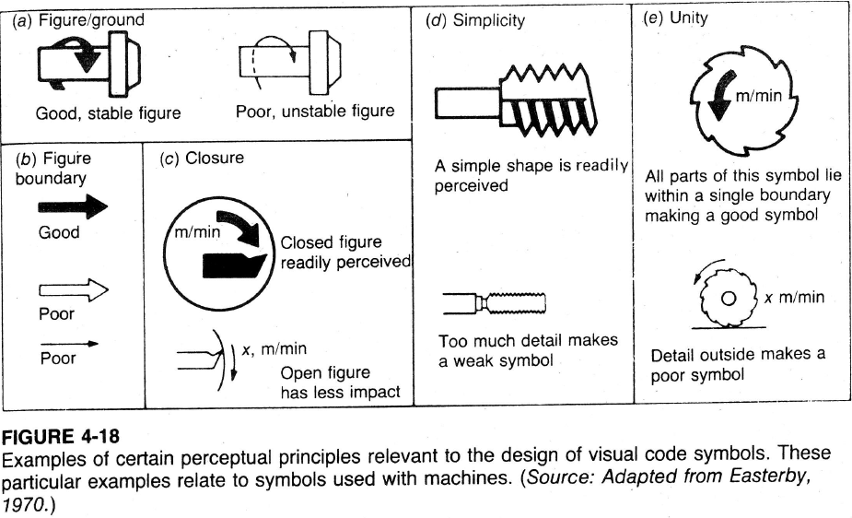
SYMBOLS (cont.)
Perceptual Principles of Symbolic Design
Figure to Ground: e.g. Direction must be clear
Figure Boundaries:
solid boundary better than outline boundary
Closure: figure should be closed (ie continuous)
Simplicity: include only necessary features
Unity:
Include text and other detail close to symbol

Slide 36
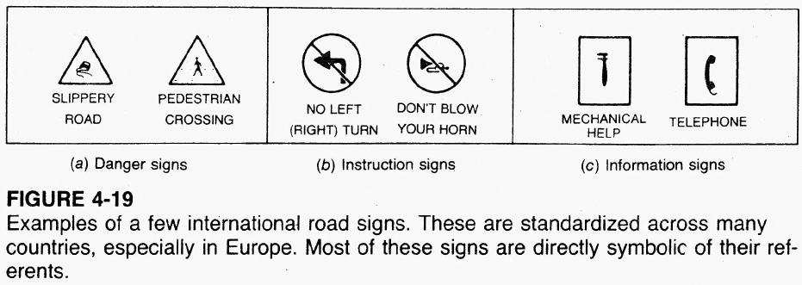
SYMBOLS (cont.)
Standardization of Symbolic Displays
Symbols should be standardized if:
Used for same referent
Used by the same people
E.g. international road signs (below)

Slide 37
Codes

Slide 38
CODES
Coding elements:
Referents: items to be coded
Code: sign/symbol used to indicate referent
coding dimensions: visual stimuli used (e.g. colors, shapes, sizes, numbers, letters)
codes could have
single dimension
or more than one dimension (multidimensional)

Slide 39
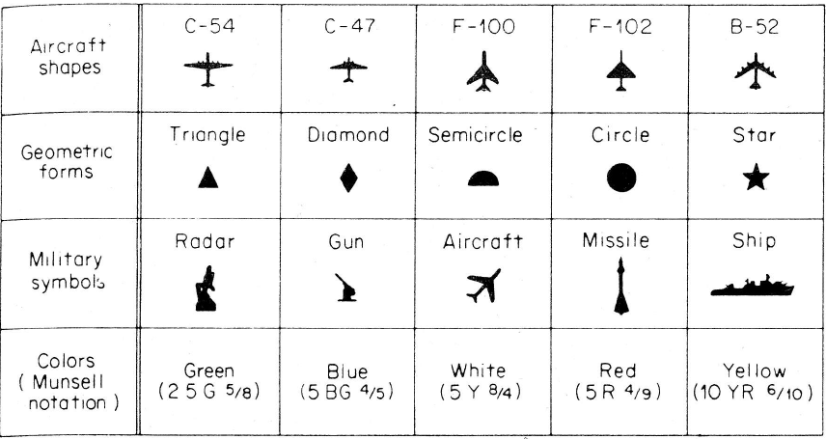
CODES (cont.)
Single Coding Dimensions
Experiments done to see best dimension
Experiment: Smith and Thomas: varied
Shapes, geometric form, symbols, colors (below)
Mean time to count target class was measured
Color showed greatest superiority (see next slide)

Slide 40
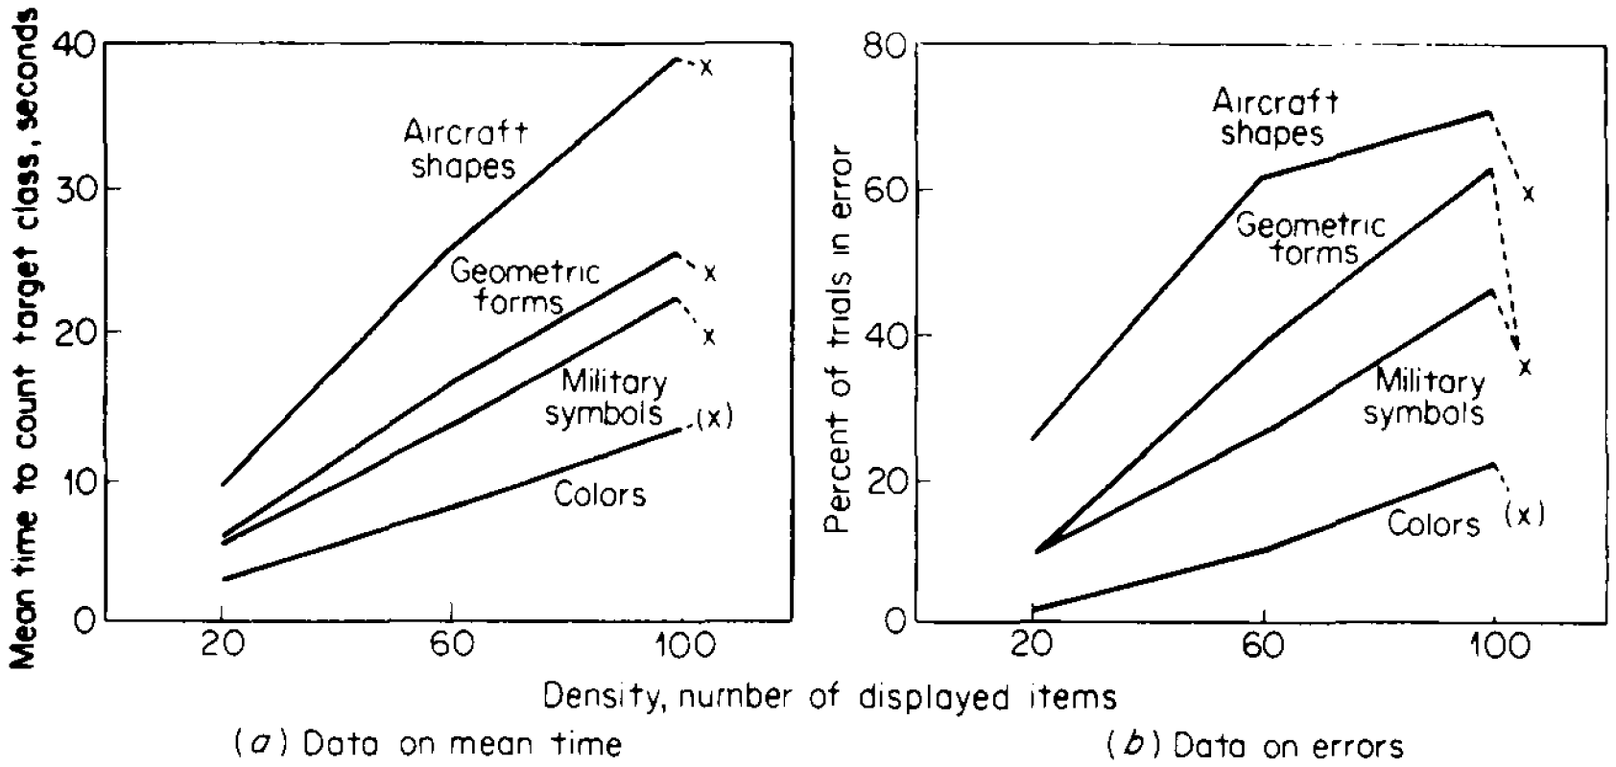
CODES (cont.)
Single Coding Dimensions
cont. Experiment by Smith and Thomas
Results shown below: why is color the best code?

Slide 41
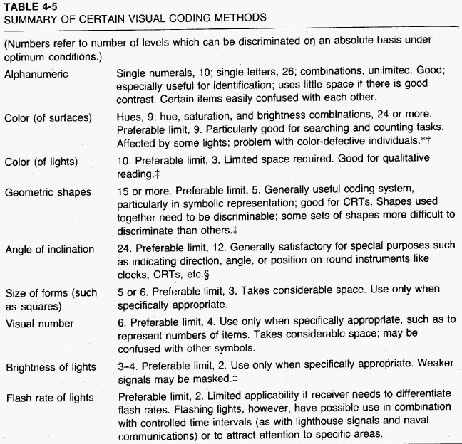
CODES (cont.)
Single Coding Dimensions (cont.)
Different coding dimensions differ in relevance for various tasks and situation
Table (right): guide to selecting appropriate visual code

Slide 42
CODES (cont.)
Color coding
Color is a very useful visual code
Q: What is # of distinct colors that normal color vision person can differentiate (absolute basis)?
Jones (1962) found that the normal observer could identify 9 surface colors
With training, people are able to identify around 24 colors
But when dealing with untrained people, it is wise to use a smaller number of colors
Color coding is very useful in “searching”/ “spotting” (as compared to other dimensions)
e.g. searching maps, items in a file, identifying color-coded wires
Note, color not universal “identification” code

Slide 43
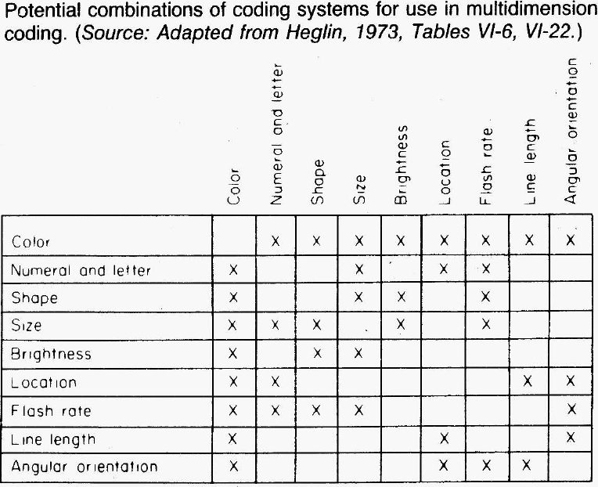
CODES (cont.)
Multidimensional codes
Recommended: no more than 2 dimensions be used together for rapid interpretation
Certain combinations do not ‘go well’ together (see figure)
⇒ not always more effective than single- dimension codes

Slide 44
References
Human Capabilities - Vision
Human Factors in Engineering and Design. Mark S. Sanders, Ernest J. McCormick. 7th Ed. McGraw: New York, 1993. ISBN: 0-07-112826-3.

