Slide 1
King Saud University College of Engineering IE – 341: “Human Factors Engineering” Fall – 2017 (1st Sem. 1438-9H)
Human Capabilities
Part – A. Vision (Chapter 4)
Part 1: Visual Capabilities - Discrimination
Prepared by: Ahmed M. El-Sherbeeny, PhD

Slide 2
Lesson Overview: Vision
Part 1 (this part):
Process of Seeing (Vision)
Visual Capabilities
Accommodation
Visual Acuity
Convergence
Color Discrimination
Dark Adaptation
Perception
Factors Affecting Visual Discrimination
Luminance Level
Contrast
Exposure Time
Target Motion
Age
Training

Slide 3
Cont. Lesson Overview: Vision
Part 2:
Alphanumeric Displays
Characteristics
Typography
Typography Features
Hardcopy
Visual Display Terminals (VDT)
Graphic Representations
Symbols
Codes

Slide 4
Vision and Visual Capabilities

Slide 5
Process of Seeing (Vision)

Slide 6
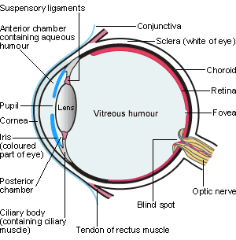

Slide 7
Process of Seeing (Vision)
The human eye works like a camera.
Light rays reflected from object
enter the transparent cornea
pass through
clear fluid (aqueous humor) that fills the space between the cornea
and the pupil (a circular variable aperture)
and adjustable lens behind the cornea (light rays are transmitted and focused)
Close objects: lens bulges
Distant objects: lens relaxes (flattens)
Muscles of the iris change size of pupil:
larger in the dark (about 8 mm diameter; dilation),
smaller in bright conditions (2 mm; constriction)

Slide 8
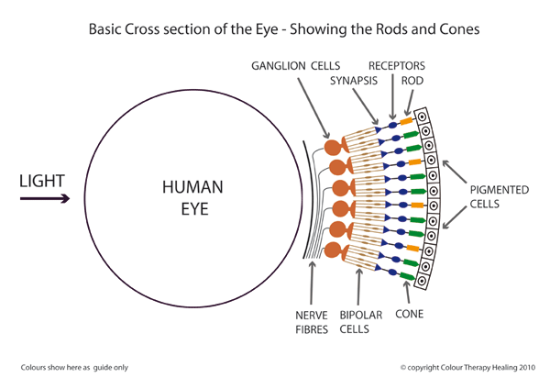
Cont. Process of Seeing (Vision)
Light rays transmitted through pupil to lens
refracted by adjustable lens
then transverse the vitreous humor (a clear jellylike fluid filling the eyeball, behind the lens).
In normal or corrected vision persons
light rays are focused exactly on the sensitive retina
The retina consists of
about 6 to 7 million cones
receive daytime, color vision
concentrated near center of retina (fovea)
and about 130 million rods
rods important in dim light, night.
distributed in the outer retina, around the sides of the eyeball.

Slide 9
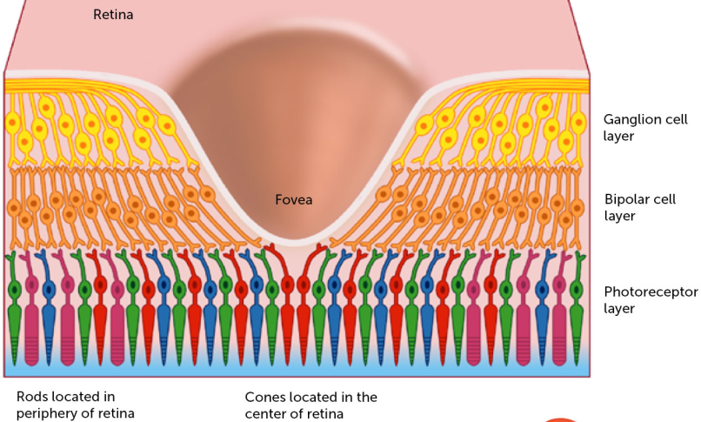
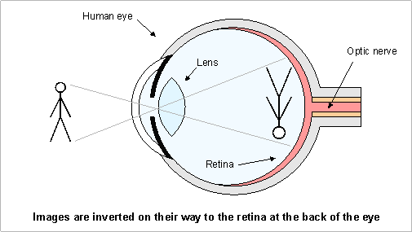
Cont. Process of Seeing (Vision)
Greatest sensitivity is in the fovea
The “dead center” of the retina
For clear vision, the eye must be directed so that the image of the object is focused on the fovea.
The image on the retina is inverted.
Cones and rods connected to optic nerve
Transmits neural impulses to the brain which integrates impulses, giving visual impression of object
process also corrects inverted image on the retina.
More information about vision and human eye:
https://youtu.be/nbwPPcwknPU

Slide 10
Visual Capabilities: 1. Accommodation
Accommodation: ability of the lens to focus light rays on the retina
Near point: closest distance possible for focus (i.e. any closer will be blurry)
Far point: farthest dist. for focus (usu. = ∞)
Diopter: measure of focus (for eye, camera)
Diopter [D] = 1 / target distance
e.g. 1 D = 1 m; 2 D = 0.5 m; 3 D = 0.33 m; 0 D =∞
More powerful lens ⇒ higher diopters
Dark focus: eye accommodation in dark (=1D)
Nearsightedness (myopia): far point: too close; i.e. lens remains bulged with far objects
Farsightedness (hyperopia): near point: too far (i.e. can’t see close objects); lens: flat for close objects

Slide 11
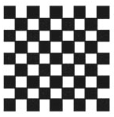
Visual Capabilities: 2. Visual Acuity
Visual Acuity:
ability of eye to discriminate fine details
depends largely on accommodation
Minimum separable acuity:
most common measure of VA (see figure 4-2)
Def^{n}: smallest feature or space between the parts of a target (e.g. letter ‘E’ below) that eye can detect
Visual angle: (<10º):
H = stimulus height
D = dist. from eye
H,D: same units
Normal VA = 1 min.
Note, 1º = 60 min.

Slide 12
Visual Capabilities: 2. Visual Acuity
Notes:
Which of these have you seen the most in vision tests? (optometrist tests)

Slide 13
Visual Capabilities: 2. Visual Acuity
Cont. Visual angle (VA):
reciprocal of VA (for smallest detail that eye can see) is used as measure for visual acuity
i.e. Visual Acuity = [1 / VA]
e.g. VA = 1.5 min. ⇒ Acuity = 0.67
e.g. VA = 0.8 min. ⇒ Acuity = 1.25
Note, as acuity ↑ ⇒ detail that can be resolved is ↓
Clinical testing: D = 20 ft (i.e. 6 m) from chart
e.g. Snellen acuity: 20/30 (6/9) ⇒ person barely reads @ 20 ft what normal (20/20, 6/6) person reads @ 30 ft
e.g. 20/10 ⇒ person reads @ 20 ft what normal person must bring to 10 ft to read (far- or near-sightedness?*)
e.g. 20/20 ⇒ resolving 1 min. arc of detail @ 20 ft (normal vision)
e.g. Given VA = 1.75 min. ⇒ Snellen Acuity = 20 / x i.e. x = (20) (1.75) = 35 ⇒ Snellen Acuity = 20 / 35
Watch nice, short video about acuity: https://youtu.be/ovuyPrffiqg
Notes:
* It is neither; this is called “super” vision (only few people have this, and usually is necessary for jobs where such vision is necessary, e.g. pilots)

Slide 14
Visual Capabilities: 2. Visual Acuity
Other types of visual acuity measures:
Vernier acuity: ability to differentiate the lateral displacement of one line from another
Minimum perceptible acuity: ability to detect a spot from its background
Stereoscopic acuity: ability to differentiate different images received by the retinas of the two eyes of a single object with depth (i.e. converting 2D → 3D).
Most difference is when the object is near the eyes.
Try the following game to see if you have Stereo vision
Center your nose over the brown eye and focus on the eye
Put a free thumb in front of your nose
Continue to focus on the eye
If both eyes are on, you see two thumbs framing one eye.
Now, switch your focus to your thumb
You should see two eyes framing one thumb
Source: http://www.vision3d.com/frame.html

Slide 15
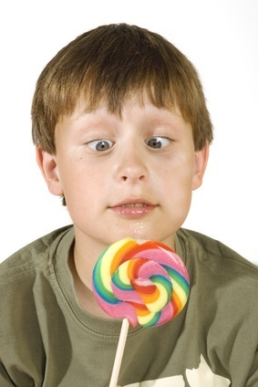
Visual Capabilities: 3. Convergence
Two eyes must converge on an object ⇒
images of the object on the two retinas are in corresponding positions to get the impression of a single object (the images are fused).
Convergence is controlled by muscles surrounding the eyeball.
Some individuals converge too much
others tend not to converge enough
These two conditions are called phorias
This cause double images which are visually uncomfortable and may cause muscular stresses and strains
Orthoptics:
aims to strengthen eye muscles to correct common eye problems (e.g. convergence insufficiency)

Slide 16
Visual Capabilities: 4. Color Discrimination
Cones
Located in fovea (center of retina)
basis for color discrimination
3 types of cones, each sensitive to light wavelengths corresponding to primary colors: Red, Green, Blue
In dark: cones not activated ⇒ no color is visible
Color vision:
Trichromats: people distinguishing different colors
Color deficiency (color blind):
Monochromats (v. v. rare): non-color vision
Dichromats: deficiency in red or green cones
Inherted or acquired (e.g. accident or disease)
Existent in ~ 8% males and 0.5% females
Poorer performance in practical tasks vs. trichromats (e.g. traffic signals)
See more about color vision deficiency: https://youtu.be/tU1krrUM26Q*
Notes:
*Test your color vision strength here: https://youtu.be/xHIykZgE7HY

Slide 17
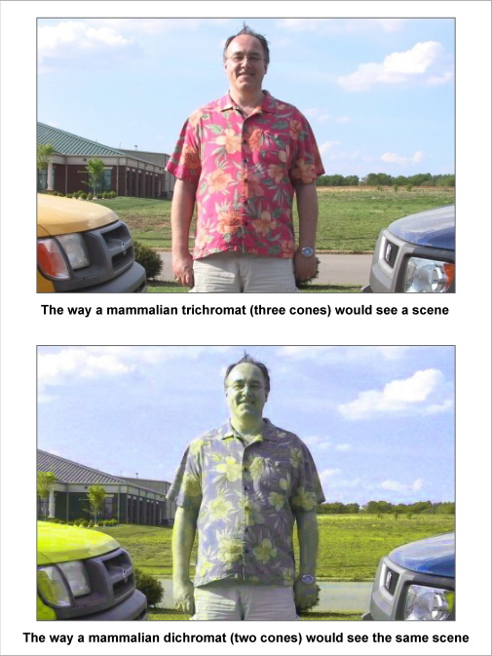
Visual Capabilities: 4. Color Discrimination
Color Images:
This slide: trichromat vs. dichromat
Optical Illusions
Next slide: “rotating turtles”
Slide 17: “doughnut of rotating snakes”
Note slides 16, 17: static -not dynamic- images! (how?????)
Source (much more fun): www.diycalculator.com/ sp-cvision.shtml

Slide 18
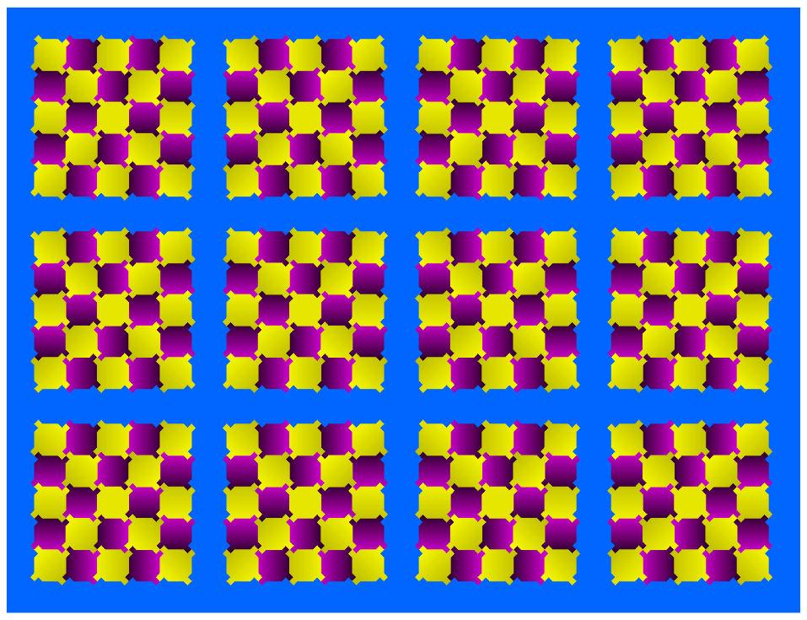
Visual Capabilities: 4. Color Discrimination
Notes:
rotating turtles

Slide 19
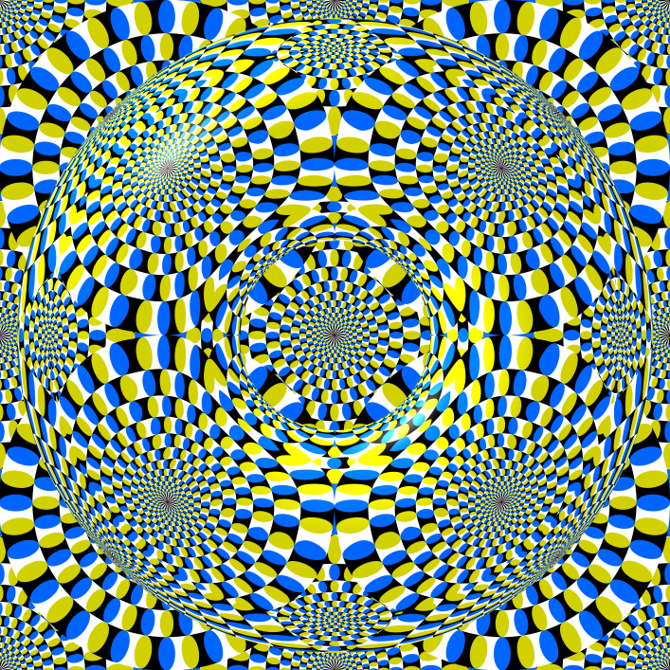
Notes:
doughnut of rotating snakes
Watch the following video on optical illusions: https://youtu.be/VYIr40D7wNw

Slide 20
Visual Capabilities: 5. Adaptation
Adaptation: changes in sensitivity to light
Entering dark room:
This is dark adaptation
Pupil increases in size (aka dilation) ⇒ more light enter eyes
Sensitivity of eye ↑ gradually (up to 30-35 mins.)
Cones lose most sensitivity in dark (mostly rods)
Exiting dark room to light
This is light adaptation
Pupil contracts (aka constriction) to limit light entering eyes
Adaptation requires about 1 min. (why faster?)
More light ⇒ cones are activated

Slide 21
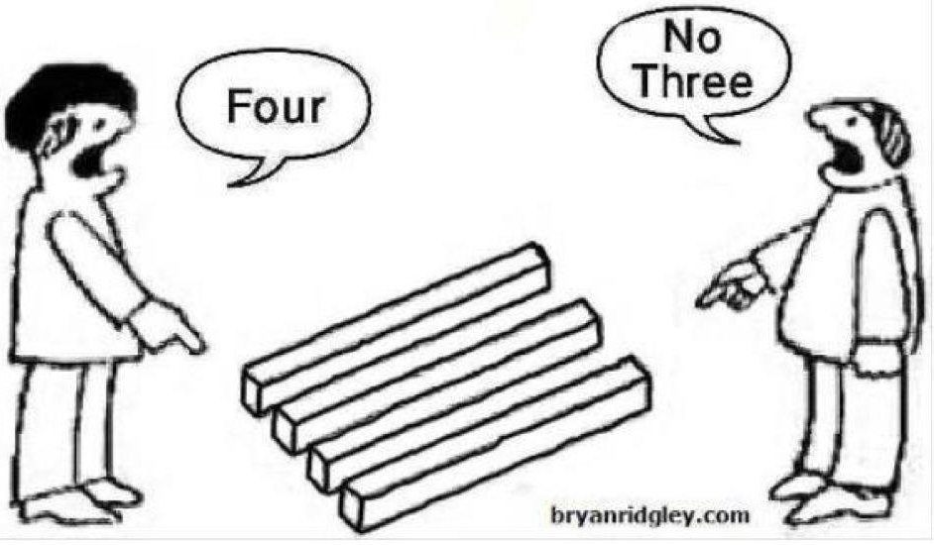
Visual Capabilities: 6. Perception
When viewing visual displays
Displayed features and information may not be enough to make appropriate decisions
Meaning of displayed information must also be understood
Perception*: interpreting sensed information
The interpretation process
sometimes straightforward
most displays: depends on previous learning (experience or training)
Visual displays design must meet 2 objectives
display must be seen clearly
design must help viewer to correctly perceive/understand meaning of display
Notes:
* Remember the human information processing model (chapter 3)?

Slide 22
Factors Affecting Visual Discrimination

Slide 23
Factors Affecting Visual Discrimination
Visual discrimination depends mostly on visual acuity.
Some factors external to the individual affect visual discrimination:
Luminance Level:
As light or background light levels ↑
⇒ cones are activated ⇒ visual acuity ↑
This is required for complex, intricate tasks
Contrast (AKA brightness contrast):
Refers to difference in luminance of viewed objects
Most important consideration: difference in luminance between: object (target) and background
When contrast is low, target must be larger to be equally discriminable to target with greater contrast

Slide 24
Cont. Factors Affecting Vis. Discrimin.
Cont. Contrast:
Measure # 1: Michelson Contrast: measures deviation above and below a mean luminance
L_{MAX}: max. luminance in pattern
L_{min}: min. luminance in pattern
Note, MC varies bet. 0 and 1
Measure # 2: Luminous Contrast :
Measure # 3: Contrast Ratio:
it’s recommended to have CR:
3:1 for target: adjacent surrounding
10:1 for target: remote darker area
1:10 for target: remote lighter area
Note, Can you show the mathematical relation between each of these 3 formulae?

Slide 25
Cont. Factors Affecting Vis. Discrimin.
Exposure Time:
Under high illumination
As exposure time ↑ ⇒ Acuity ↑ for first 100-200 ms.
After that acuity levels off
Target Motion:
Acuity ↓ with motion of:
Target
Observer
or Both
Dynamic visual acuity:
Ability to make visual discriminations under such conditions (e.g. driver looking at objects on sidewalk)
This acuity rapidly ↓ as rate of motion ↑

Slide 26
Cont. Factors Affecting Vis. Discrimin.
Age:
Visual acuity, contrast sensitivity (ability to see details at low contrast levels) ↓ with age
Decline starts at age 40
At age 75: acuity = 20/30
⇒ visual displays for old people must provide:
Large targets
Adequate illumination
Training:
Besides contacts, glasses, eye surgery, vision can be improved by:
Training to improve focus
Improves Snellen acuity by 14%
Improves contrast sensitivity by 32%
Dynamic visual acuity can be improved with practice

Slide 27
References
Human Capabilities - Vision
Human Factors in Engineering and Design. Mark S. Sanders, Ernest J. McCormick. 7th Ed. McGraw: New York, 1993. ISBN: 0-07-112826-3.
More Optical Illusions Sites
http://upload.wikimedia.org/wikipedia/commons/6/60/Grey_square_optical_illusion.PNG
http://www.illusion-optical.com/Optical-Illusions/Circles.php

