Slide 1
King Saud University College of Engineering IE – 462: “Industrial Information Systems” Fall – 2018 (1st Sem. 1439-40H)
Chapter 3
Data Modeling and Design – p3 – Case Study
Prepared by: Ahmed M. El-Sherbeeny, PhD

Slide 2
Lesson Overview
Introduction – (p1)
E-R Diagram – (p2)
Case Study – (p3)

Slide 3
Case Study – Electronic Commerce Application – Conceptual Data Modeling for
“Pine Valley Furniture” WebStore

Slide 4
E-R Diagram: PVF Furniture Webstore
Background:
Remember, senior systems analyst (Jim Woo):
First, completed JAD (Joint Application Design) session
Then created DFD for webstore system
He was then asked to develop a conceptual data model for the WebStore

Slide 5
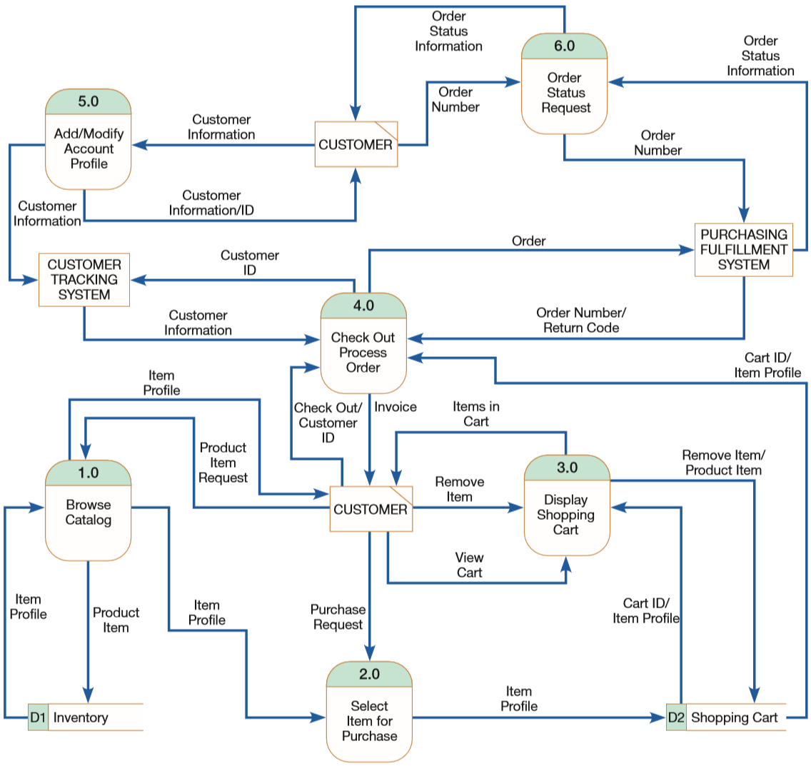

Slide 6
E-R Diagram: PVF Furniture Webstore
Conceptual Data Modeling Plan:
He developed conceptual data model for WebStore using following steps:
Identify general categories of information using:
Information from JAD session
Additional information from DFD (data stores, data flows)
Carefully examine each data category using the DFD:
Determine unique data flows within each data category
Record source and destination of all data flows
Construct E-R diagram for WebStore:
Determine system unique entities
Identify interrelationships among entities
Draw E-R diagram (with entities)

Slide 7
E-R Diagram: PVF Furniture Webstore
Identify general categories of information:
Information from JAD session
Table 8-2 shows a summary of customer and inventory information identified during the JAD session
Identify information the WebStore needs to capture, store, and process
Additional info from DFD (data stores, data flows)
data stores (strong candidates to become entities in ERD):
Inventory (D1)
Shopping Cart (D2)
examine data flows from DFD for other possible sources for entities:
Order
Temporary User/System Messages

Slide 8
E-R Diagram: PVF Furniture Webstore
Notes:
SKU: stock keeping unit

Slide 9
E-R Diagram: PVF Furniture Webstore
Identify general categories of info. (cont.):
Analysis resulted in the identification of 5 general categories of information:
Customer
Inventory
Order
Shopping Cart
Temporary User/System Messages

Slide 10
E-R Diagram: PVF Furniture Webstore
Examine each category using the DFD:
List for each data category (Table 8-3):
each of its data flows, and
corresponding description
List for each data category (Table 8-4):
source and destinations for each unique data flow
Purpose of these two tables:
document WebStore’s requirements
what information is needed to move from point to point
Notes:
Practice the first step (table 8-3) for the customer category

Slide 11
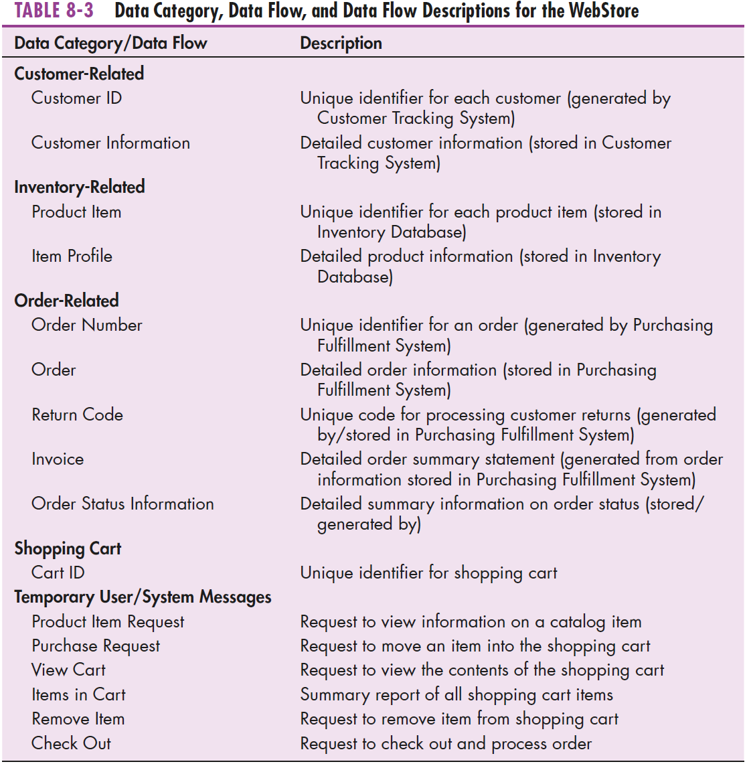

Slide 12
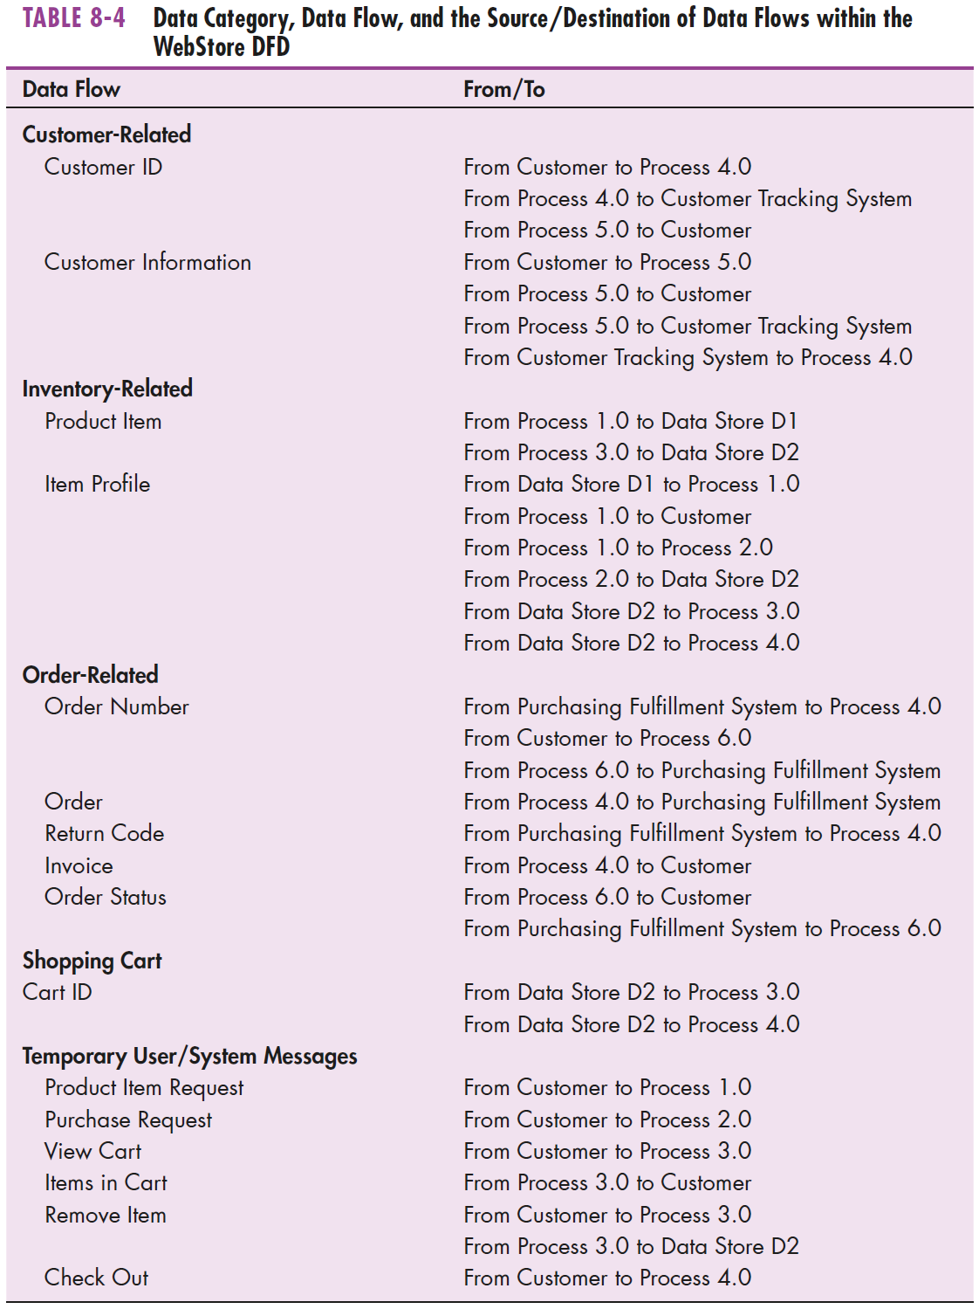

Slide 13
E-R Diagram: PVF Furniture Webstore
Construct E-R diagram for WebStore:
Jim decided that unique entities for E-R diagram:
Customer
Inventory
Order
Note, all 3 meet entity criteria: person, event, or object (which is which?)

Slide 14
E-R Diagram: PVF Furniture Webstore
Construct E-R diagram for WebStore (cont.):
Remaining two categories:
Temporary User/System Messages:
not permanently stored items
not person/event/object
⇒ should not be an entity in model

Slide 15
E-R Diagram: PVF Furniture Webstore
Construct E-R diagram for WebStore (cont.):
Remaining two categories (cont.):
Shopping Cart:
temporarily stored item (for at least duration of a customer’s visit to the WebStore), and
can be considered an object
Process 4.0 (Check Out Process Order) moves Shopping Cart contents to the Purchasing Fulfillment System, where order details are stored
⇒ should be an entity in model
Notes:
i.e. Jim determined that Shopping Cart information is important for data storage process

Slide 16
E-R Diagram: PVF Furniture Webstore
Construct E-R diagram for WebStore (cont.):
Summary of required entities for E-R diagram:
Customer
Inventory
Order
Shopping Cart

Slide 17
E-R Diagram: PVF Furniture Webstore
Construct E-R diagram for WebStore (cont.):
Identify interrelationships among 4 four entities:
CUSTOMER – SHOPPING CART relationship
Each Customer owns 0 or 1 Shopping Cart instances
Each Shopping Cart instance is owned by one and only one Customer

Slide 18
E-R Diagram: PVF Furniture Webstore
Construct E-R diagram for WebStore (cont.):
Interrelationships among 4 four entities (cont.):
SHOPPING CART – INVENTORY relationship
Each Shopping Cart instance contains one and only one Inventory item
Each Inventory item is contained in zero or many Shopping Cart instances
Notes:
Note shopping system here is such that you can only place one inventory item for each Shopping Cart instance, but quantity of items can be many, of course

Slide 19
E-R Diagram: PVF Furniture Webstore
Construct E-R diagram for WebStore (cont.):
Interrelationships among 4 four entities (cont.):
CUSTOMER – ORDER relationship
Each Customer places zero to many Orders
Each Order is placed by one and only one Customer

Slide 20
E-R Diagram: PVF Furniture Webstore
Construct E-R diagram for WebStore (cont.):
Interrelationships among 4 four entities (cont.):
ORDER – SHOPPING CART relationship
Each Order contains one to many Shopping Cart instances
Each Shopping Cart instance is contained in one and only one Order

Slide 21
E-R Diagram: PVF Furniture Webstore
Construct E-R diagram for WebStore (cont.):
Draw E-R diagram (with entities):

Slide 22
E-R Diagram: PVF Furniture Webstore
Construct E-R diagram for WebStore (cont.):
Draw E-R diagram (with entities) – cont.:
Jim can then list specific attributes for each entity
then compare these lists with existing inventory, customer, and order database tables
Notes:
Some of these attributes (inventory and customer) are shown in table 8-2

Slide 23
Videos to Watch
Entity Relationship Diagram (ERD) Tutorial - Part 1 https://youtu.be/QpdhBUYk7Kk
Entity Relationship Diagram (ERD) Tutorial - Part 2 https://youtu.be/-CuY5ADwn24
Entity-Relationship Diagrams (another system) https://youtu.be/c0_9Y8QAstg
Entity Relationship Diagram (ERD) Training Video https://youtu.be/-fQ-bRllhXc
Notes:
Last video is a detailed video and contains exercises on ERD’s

Slide 24
Sources
Modern Systems Analysis and Design. Joseph S. Valacich and Joey F. George. Pearson. Eighth Ed. 2017. Chapter 8.

