Slide 1
King Saud University College of Engineering IE – 341: “Human Factors Engineering” Fall – 2016 (1st Sem. 1437-8H)
Chapter 10. Human Control of Systems
– Tracking (Part 1)
Prepared by: Ahmed M. El-Sherbeeny, PhD

Slide 2
Contents
PART I
Inputs and Outputs in Tracking
Pursuit and Compensatory Displays in Tracking
Control Order of Systems
Control Responses with Various Control Orders
Human Limitations in Tracking Tasks
PART II
Factors that Influence Tracking Performance
Procedures for Facilitating Tracking Performance

Slide 3
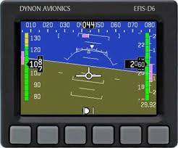
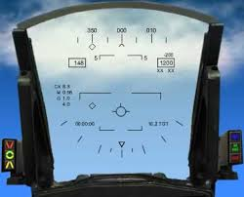

Slide 4
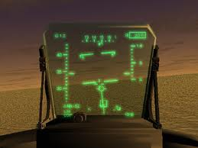
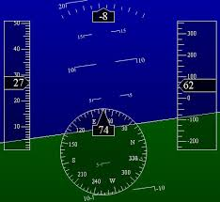
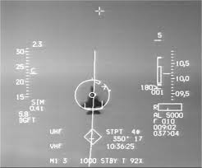

Slide 5
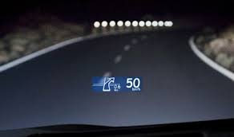

Slide 6
Inputs and Outputs in Tracking
What is tracking?
Involves continuous control of something
Examples: driving a vehicle, piloting a plane, tracing a line on a paper
Requirements of Tracking
Make correct movements at right times
Task is paced by person doing it (e.g. when driving a car)
Task can be externally paced, i.e. person has no control on task rate (e.g. following a racehorse with binoculars)
Topics to be covered here:
Some background on certain concepts in tracking
Some background on many variables involved with tracking performance
Notes:
Source: Sander and McCormick (Ch. 10), 1993

Slide 7
Cont. Inputs and Outputs in Tracking
In tracking:
Input specifies desired output of system
Example: curves in road (input) specify desired path to be followed (output)
Inputs
Types of input:
Constant(e.g. steering a ship to specified heading, flying a plane to an assigned altitude), or
Variable (e.g. following winding road, chasing a maneuvering butterfly with a net)
Received directly from environment
Sensed by:
People
Mechanical sensors (then presented on display as signals)
Other classification of input:
Signal sometimes called: target (or it really is a target)
Movement of signal called: course
Input signal can be described mathematically and shown graphically
These graphs can be used to characterize input

Slide 8
Cont. Inputs and Outputs in Tracking
Input Patterns
Types of elementary patterns (input) that can be distinguished (next slide):
Sine input (characterized by a sine wave)
Step input:
Specifies discrete change in value
e.g. instruction from control tower for plane to change altitude
Ramp input:
Specifies constant rate of change of some variable
e.g. maintaining constant velocity (since $V=dS/dt$)
Output
Frequently called the controlled element
Outputs are brought by:
Physical response with a control mechanism or
Transmission of some form of energy
Output is reflected by:
Indication on display, sometimes called follower or cursor, or:
Observed by outward behavior of system (e.g. movement of car)

Slide 9
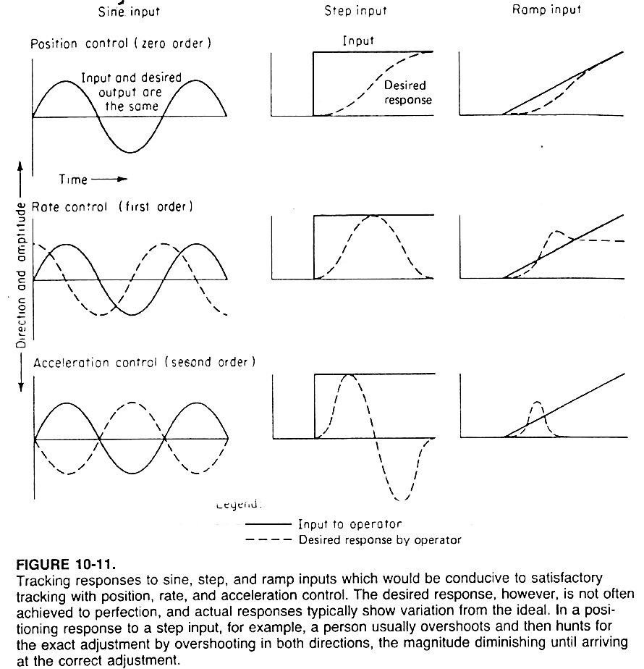

Slide 10
Pursuit & Compensatory Displays in Tracking
Types of tracking displays (see next slide):
Pursuit display
Compensatory display
Displays are shown as:
1-D: relative movement of 2 elements: represented by single value (top fig.)
2-D: relative movement in 2-D (e.g. chasing a moving aircraft) (bottom fig.)
Pursuit display:
Target and cursor (i.e. controlled element) move
Each indicator shows its own location in space
Task of the operator: align moving cursor with moving target
Compensatory display:
One of the two indicators moves (controlled element); other is fixed (target)
Task of the operator: get the moving cursor to align with the target

Slide 11
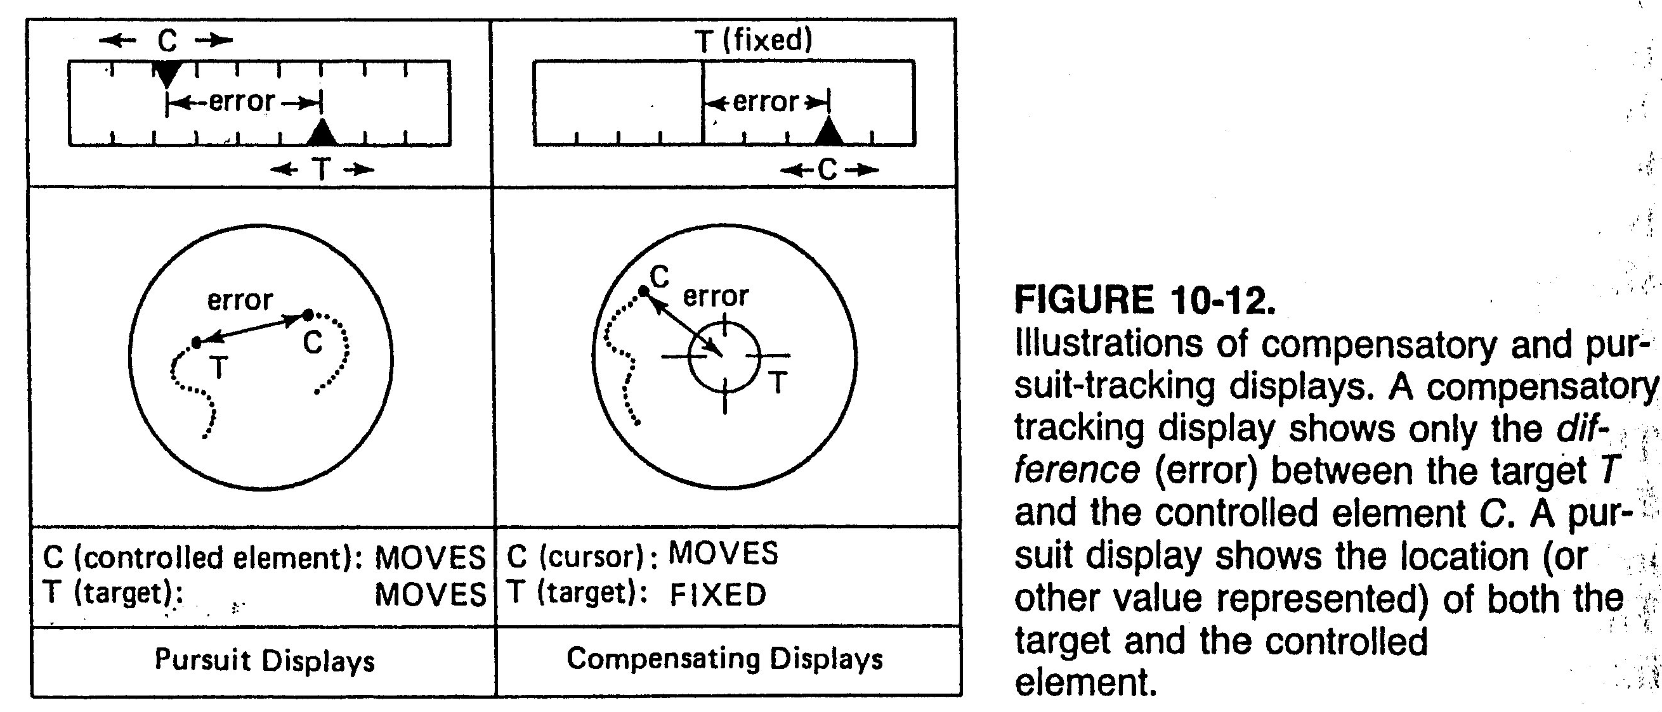
Cont. Pursuit & Compensatory Displays

Slide 12
Pursuit & Compensatory Displays in Tracking
Error control:
When indicators superimposed: controlled element is “on target”
Difference represents: error, which should be minimized/eliminated
Error in pursuit display:
Operator can determine if error is due to target or controlled element
Operator can see target independent of any movement
Error in compensatory display:
Only absolute error/difference between target and controlled element
If error increases, display does not show what has moved (i.e. target, or controlled element, or both)
Advantage of compensatory display: saves space on instrument panel since no need to show entire range of possible values of 2 elements

Slide 13
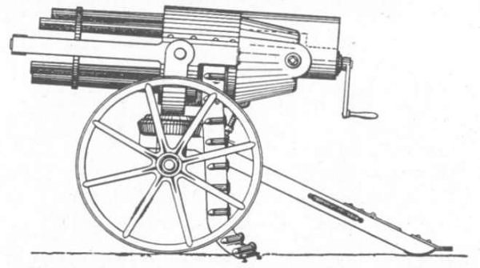
Control Order of Systems
Control order:
It is the hierarchy of control relationships between:
movement of control, and
output it controls
Objective of tracking task:
control system so that output corresponds to input as closely as possible
Position (Zero-Order) tracking tasks:
Movement of control device controls position directly
e.g. moving a spotlight to keep it on an actor on a stage
e.g. following movement of athlete with a camera
Rate (Velocity or First-Order) control tasks:
Operator movement controls rate at which output is being changed
e.g. accelerator (i.e. gas pedal) of car which controls speed ($dS/dt$) ⇒ also $S$
e.g. operation of machine gun that is controlled by hand cranks

Slide 14
Control Order of Systems
Acceleration (second-order) control:
Acceleration: rate of change in rate of movement
e.g. steering wheel of car
angle at which wheel is turned controls angle of front wheels
⇒ this determines rate at which car turns
i.e. rotation of steering wheel accelerates car towards turning direction (i.e. angular acceleration)
Higher order control:
i.e. third- or fourth-order control
e.g. third-order control involves:
direct control of rate of change in acceleration (aka “jerk”)
which then controls rate (i.e. velocity)
which finally controls position of whatever is controlled
e.g. control of a large ship
Considered 3-rd or even 4th order control since involves many variables:
Person steering and actual movement, position, mass of ship
Continuous control can be described as chain-reaction effects:
i.e. change in position ⇒ changes velocity (rate) ⇒ changes acceleration, etc.

Slide 15
Control Responses with Various Control Orders
Operator Control:
Expected to make control responses
This brings about desired operation of system (that is implied by input)
e.g. road to be followed, or flight path of plane
Effect of control order on tracking performance
Absence of help to operator ⇒ makes control harder, esp. with higher-order
e.g. appropriate response for ramp, step, and sine inputs with: position, rate, and acceleration control systems (Figure 10-11)
Dotted line: is response over time needed for satisfactory tracking of input
With higher order of control ⇒ # of controlled movements operator needs to make in response to single change in input ↑
⇒ People do well in 0-order and 1st order control systems
But performance ↓ with 2nd order control system
Tracking error ↑ from $40$ to $100\%$

Slide 16
Control Responses with Various Control Orders
Example of deterioration of control
Consider step input: (middle column in Figure 10-11)
Target: jumps forward, then stops
Responses: made by joystick
0-order control:
Simply move stick forward to proper distance and hold
1-st order (rate) control:
Move stick forward to give certain velocity to controlled element
As controlled element approaches position of target ⇒ return stick to null position before overshooting target position
2nd order control:
More complicated procedure here
Control is first moved forward ⇒ this gives acc. to controlled element
Stick must then be brought to null position (i.e. 0 acc. or const. vel.)
Stick must then be moved in opposite direction (i.e. deceleration or slowing down control) ⇒ this avoids overshooting target
Finally, return stick to null position ⇒ this avoids stopping and going to other direction
Note, this is all to move controlled element forward and stopping it!
Thus, performance here clearly deteriorates

Slide 17
Human Limitations in Tracking Tasks
Humans:
Not very good at tracking tasks
Especially with higher-order control parameters (see last slide)
Wickens (1984): limitations affecting tracking:
Processing time
Bandwidth
Anticipation
Processing time
People don’t process information instantaneously
⇒ there is time delay bet. target change and start of responses to track it
Magnitude of time delay is dependent on order of controlled system:
0 and 1st-order: $150 − 300 ms$
2nd order: $400 −500 ms$
Delays are harmful to tracking performance since:
Operator is always chasing target, and
Operator is always behind (unless help is provided to operator)

Slide 18
Human Limitations in Tracking Tasks
Bandwidth:
This is upper limit of freq. with which corrective decisions can be made
It is the max. freq. of random input that can be successfully tracked
Typical values:
$0.5 – 1.0 Hz$ (normally)
Note, since 2 corrections/cycle required ⇒ $1.0 Hz$ → $2 corrections/s$
People can predict courses as high as $2−3 Hz$
Anticipation:
Often operators track targets using time lagged/sluggish systems
e.g. ships or planes
⇒ operator must:
Anticipate future errors based on present conditions
Then make control responses that may reduce anticipated future error
Problem: people are not good at anticipating future outputs (esp. with slow systems) due to limitations of working memory
Note, this is true even with experienced operators

