Slide 1
Medical Genetics
453 CLS
May Alrashed, PhD

Slide 2
Cytogenetics
Cytogenetics is the study of chromosomes and their role in heredity.
Cytogenetics is all about chromosomes:
  chromosome structure and composition.
  the methods that scientists use to analyse chromosomes (karyotyping).
  chromosome abnormalities associated with disease.
  the roles that chromosomes play in sex determination.
  changes in chromosomes during evolution.

Slide 3
Chromosomes
Chromosomes were first described by Strausberger in 1875.
The term “Chromosome”, however was first used by Waldeyer in 1888.
They were given the name chromosome (Chromo = colour; Soma = body) due to their marked affinity for basic dyes.
Their number can be counted easily only during mitotic metaphase.
Chromosomes are long, thread-like structures that form part of the chromatin network in the nuclei of cells.
They consist of a strand of DNA wound around histones (proteins).

Slide 4
Chromosomes
In somatic (body) cells of diploid organisms:
  The number of chromosomes in each cell is the same.
  Chromosomes are made up of two sets: one from the mother, one from the father. They are called diploid cells, or 2n.
  A maternal chromosome will have a matching paternal chromosome. Together they will form a homologous pair.
  The chromosomes forming a pair will have the same size and shape, but may have different alleles for each trait.

Slide 5
Chromosomes
A set of chromosomes in a cell is called a karyotype. It shows the number, size and shape of the chromosomes during the metaphase of mitosis.
Every species has a specific number of chromosomes in its somatic cells. The DNA of each chromosome replicates to form two identical threads or chromatids joined by a centromere. This takes place in the interphase of a cell cycle, i.e. between cell divisions.
Replication of DNA is very important to ensure that, as a cell divides, each daughter cell receives a full complement of all the genetic material.

Slide 6
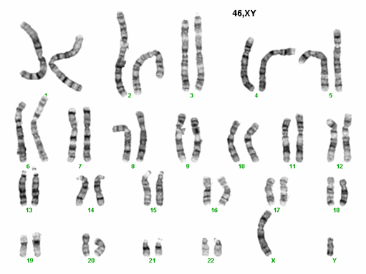
Chromosomes
Gene for cystic fibrosis (chromosome 7)
Chromosomes are made of DNA.
Each contains genes in a linear order.
Human body cells contain 46 chromosomes in 23 pairs – one of each pair inherited from each parent
Chromosome pairs 1 – 22 are called autosomes.
The 23rd pair are called sex chromosomes:
XX is female, XY is male.
Gene for sickle cell disease (chromosome 11)

Slide 7
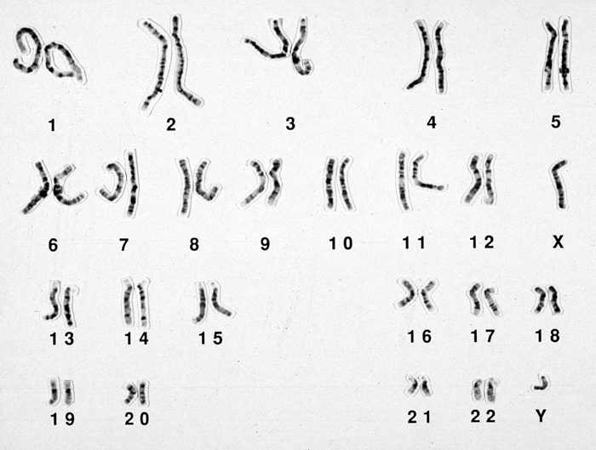
Chromosomes
p
Centromere
q
Chromosome 5

Slide 8
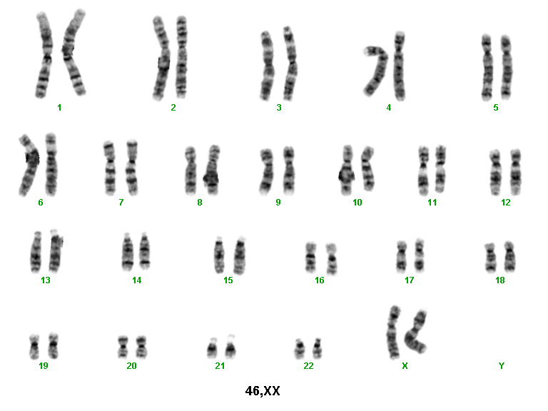
Chromosomes as seen at metaphase during cell division
Telomere
DNA and protein cap
Ensures replication to tip
Tether to nuclear membrane
Light bands
Replicate early in S phase
Less condensed chromatin
Transcriptionally active
Gene and GC rich
Short arm
p (petit)
Centromere
Joins sister chromatids
Essential for chromosome segregation at cell division
100s of kilobases of repetitive DNA: some non-specific, some chromosome specific
Long arm
q
Dark (G) bands
Replicate late
Contain condensed chromatin
AT rich
Telomere

Slide 9
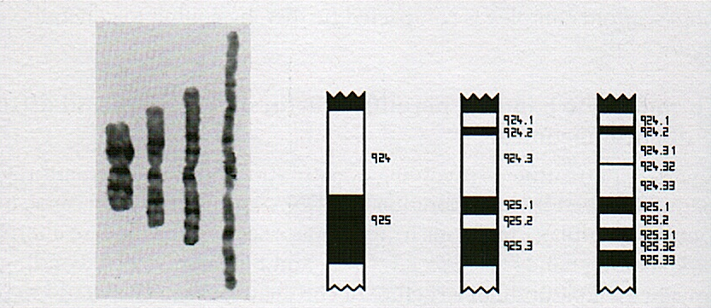
Human chromosome banding patterns seen on light microscopy
Chromosome 1
Different chromosome banding resolutions can resolve bands, sub-bands and sub-sub-bands

Slide 10
A pair of homologous chromosomes (number 1) as seen at metaphase
Locus (position of a gene or DNA marker)
Allele (alternative form of a gene/marker)

Slide 11

Total Genes On Chromosome: 723
373 genes in region marked red, 20 are shown
FZD2
AKAP10
Genes are arranged in linear order on chromosomes
ITGB4
KRTHA8
WD1
SOST
MPP3
MLLT6
STAT3
BRCA1
breast cancer 1, early onset
GFAP
NRXN4
NSF
NGFR
CACNB1
HOXB9
HTLVR
ABCA5
CDC6
ITGB3
Chromosome 17
source: Human Genome Project

Slide 12
Karyotyping
Karyotype is an organized profile of an individual’s chromosomes
Karyotyping is a technique that is use to examine chromosomes in a sample of cells which can help identify genetic problems as the cause of disorder or a disease
Main purpose of the karyotyping is to locate or visualize the changes in the number of chromosomes and abnormality in the structure
Also to locate the evolution

Slide 13
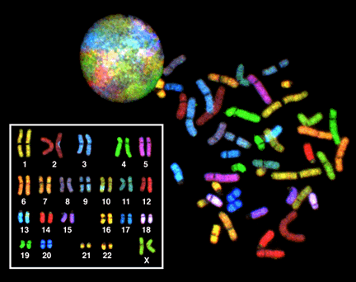
Karyotyping
Karyotyping-process of finding the chromosomal characteristics of a cell
  -chromosomes are stained to show banding and arranged in pairs according to size and structure

Slide 14
The Karyotype
A normal male chromosome pattern would be described as:
46,XY.
46 = total number of chromosomes
XY = sex chromosome constitution
(XY = male, XX = female).
Any further description would refer to any abnormalities or
variants found (see following slide for examples).

Slide 15
The Karyotype: an international description
Total number of chromosomes,
Sex chromosome constitution,
Anomalies/variants.
46,XY
47,XX,+21 Trisomy 21 (Down syndrome)
47,XXX Triple X syndrome
69,XXY Triploidy
45,XX,der(13;14)(p11;q11) Robertsonian translocation
46,XY,t(2;4)(p12;q12) Reciprocal translocation
46,XX,del(5)(p25) Deletion tip of chromosome 5
46,XX,dup(2)(p13p22) Duplication of part of short arm Chr 2
46,XY,inv(11)(p15q14) Pericentric inversion chromosome 11
46,XY,fra(X)(q27.3) Fragile X syndrome
46,XY/47,XXY Mosaicism normal/Klinefelter syndrome

Slide 16
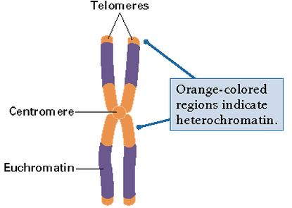
What are the key components of chromosomes?
DNA
  -heterochromatin
  -euchromatin
Proteins
Found in nucleus
You should
understand the relationship between DNA and proteins (chromatin packing and histones)

Slide 17
Key terms
Eukaryotic chromosomes -made of DNA and proteins (histones)
Gene-heritable factor that controls specific characteristics
  -made up of a length of DNA, found on a specific chromosome location (a locus)
Allele-one specific form of a gene (all found at the same locus)
-Example: Everyone has the gene for eye color. The possible alleles are blue, brown, green, etc.

Slide 18
Key terms
Genome-total genetic material of an organism or species (Example: The Human Genome)
Gene pool -total of all genes carried by individuals in a population
Diploid-having two sets of chromosomes
Homologous chromosomes -matching pairs of chromosomes
-have the same genes
-are not identical (one chromosome comes from each parent, thus alleles may be different)
-found in diploid cells

Slide 19
Key terms
Haploid-having only one set of chromosomes
Chromatids -two parts of a chromosome
Centromere -part of a chromosome that connects the chromatids

Slide 20
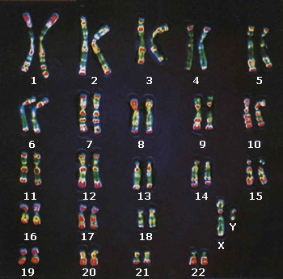
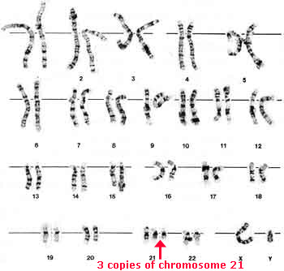
Karyotype of non-disjunction
Abnormal karyotype (aneuploidy)
2n + 1 = 47
Normal karyotype (2n=46)

Slide 21
Theoretical Genetics Key Terms
Dominant allele -the allele that always shows in the heterozygous state (Example: Bb=brown)
Recessive allele -the allele that only shows in the homozygous recessive state (Example: bb=blue)
Codominant alleles -pairs of alleles where two differing alleles are shown in the phenotype in a heterozygote
Homozygous -having two identical alleles of a gene (Example: BB or bb)
Heterozygous -having two different alleles of a gene (Example: Bb)

Slide 22
More Vocabulary
Carrier - a person who has a recessive allele, but does not express it (they are generally heterozygous, Bb)
Genotype -alleles that a person has
(the letters) Ex: Bb
Phenotype - the physical characteristics the a person shows (caused by the genotype) Ex: brown hair or blue eyes
Test cross - crossing two or more genotypes to find the possible genetic outcomes

Slide 23
Chromosome anomalies
Cause their effects by altering the amounts of products of the genes involved.
  Three copies of genes (trisomies)
  = 1.5 times normal amount.
  One copy of genes (deletions)
  = 0.5 times normal amount.
  Altered amounts may cause anomalies directly or may alter the balance of genes acting in a pathway.

Slide 24
Classification of chromosomal anomalies
Numerical (usually due to de novo error in meiosis)
Aneuploidy (The condition in which the chromosomes sets are present in a multiples of “n” )
- monosomy (2n-1)
- trisomy (2n+1)
Polyploidy (When a change in the chromosome number does not involve entire sets of chromosomes, but only a few of the chromosomes )
- triploidy (3n)

Slide 25
Classification of chromosomal anomalies
Structural (may be due to de novo error in meiosis or inherited)
Translocations - reciprocal
- Robertsonian (centric fusion)
Deletions
Duplications
Inversions
Different cell lines (occurs post-zygotically)
Mosaicism

Slide 26
Anomalies of chromosome structure
Translocations
Deletions
Duplications
Ring chromosomes
Robertsonian
Reciprocal

Slide 27
Chromosomal deletions and duplications
(not caused by translocations)
Are usually “one off”/de novo events occurring in meiosis.
Have a very low recurrence risk in future pregnancies.

Slide 28
Most frequent numerical anomalies
in liveborn
Autosomes
Down syndrome (trisomy 21: 47,XX,+21)
Edwards syndrome (trisomy 18: 47,XX,+18)
Patau syndrome (trisomy 13: 47,XX+13)
Sex chromosomes
Turner syndrome 45,X
Klinefelter syndrome 47,XXY
All chromosomes
Triploidy (69 chromosomes)

