Slide 1
Clinical Enzymology
Introduction

Slide 2
Enzyme Characteristics
Catalytic power
  Increase reaction rates by up to 10¹⁴ times
Highly specific for their substrates
  No catalysis for closely related compounds
  Specific active site for substrate binding
  No by-products produced
Regulation – regulated by interactions with
  Inhibitors – reversible or irreversible
  Activators – via presence of an activator or by permanent modification of the enzyme’s structure
Notes:
2

Slide 3
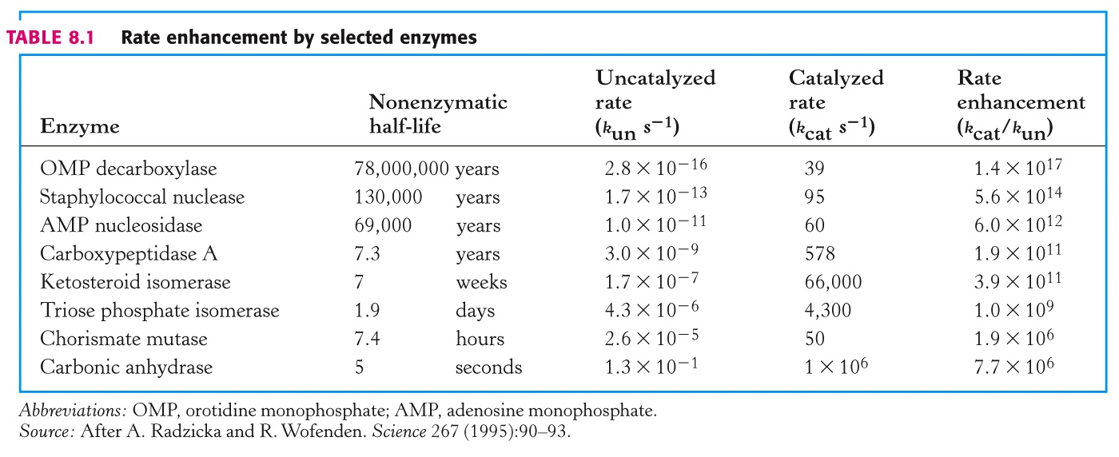
HUDA S.Albakr CLS431, KSU,CAMS,CLS Department
3

Slide 4
Biological Catalysts
Enzymes are protein catalysts (ribozymes are RNA catalysts)
They are required in small amounts
They are not altered permanently by the reaction
They do not change the thermodynamics of a reaction
They can only accelerate the rate at which a favorable reaction proceeds

Slide 5
Biological Catalysts
Example:
A phosphatase enzyme can catalyze a rxn in 10 milliseconds
Without the enzyme the rxn would take…
1 trillion yrs. (1,000,000,000,000)
THE REACTION IS CONSIDERED SPONTANEOUS

Slide 6
Enzyme Nomenclature
Six classes of enzymes in Enzyme Commission (EC)
  Oxidoreductases – redox reactions
  Transferases – transfering functional groups
  Hydrolases – hydrolysis reactions
  Lyases – addition to double bonds
  Isomerases – isomerization reactions
  Ligases – formation of bonds with ATP cleavage
Sub-class, sub-subclass – a code of four numbers is used to identify an enzyme
  Phosphofructokinase – X.X.X.X
  Factor X – X.X.X.X
Notes:
6

Slide 7
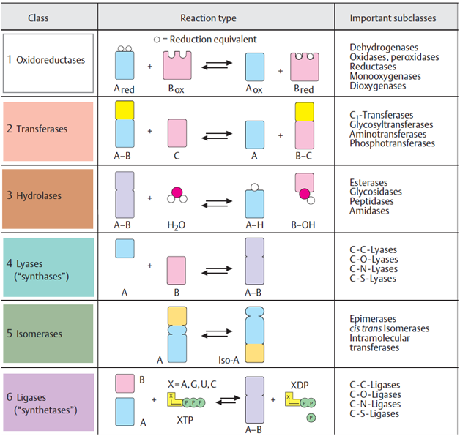

Slide 8
Coenzymes, Cofactors
Many enzymes require other molecules for full enzymatic activity
  Other proteins or small organic molecules
  Covalently bonded or non-covalently bonded
  Small molecules – vitamins, NAD+, NADH
  Other proteins/enzymes – Factor IX requires presence of Factor VIII (and Ca²⁺ and phospholipids) in the blood clotting cascade
Enzymes with co-factor present – holo-enzyme
Enzymes without co-factor – apo-enzyme
Notes:
8

Slide 9
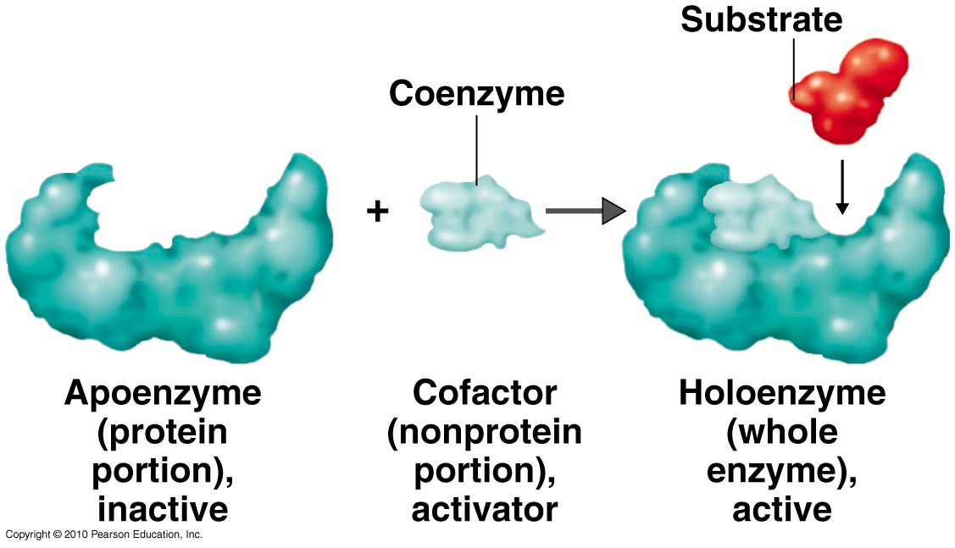

Slide 10
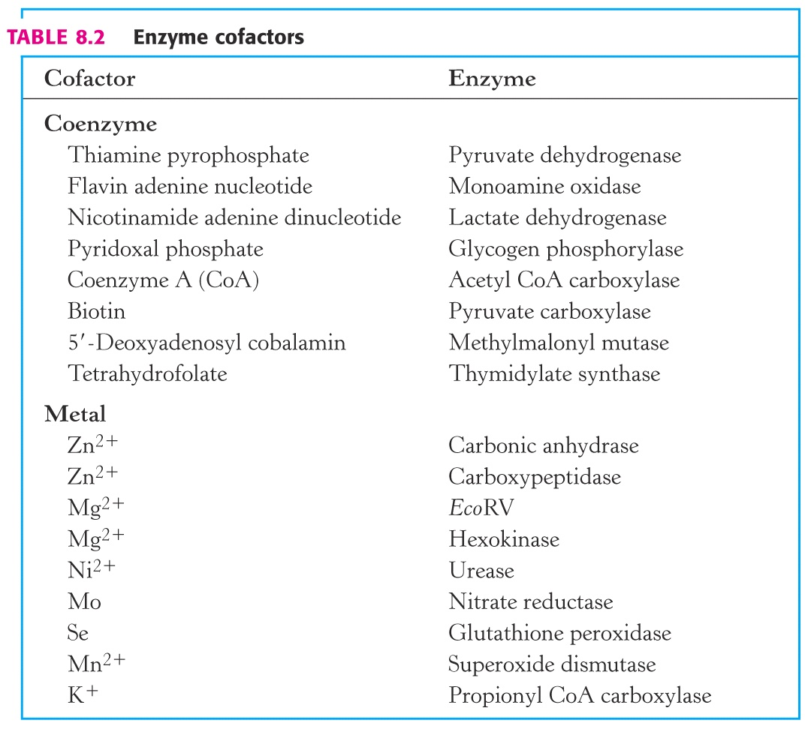
Notes:
10

Slide 11
How do proteins catalyze reactions?
A: Stabilizing transition state intermediate in the enzyme/substrate complex by
  Acid base catalysis
  Electrostatic interactions
  Covalent catalysis (forming intermediates)
  Proximity and orientation effects
  Strain on chemical bonds
  Changes in reaction conditions
Notes:
11

Slide 12
Enzyme-Substrate Complex and Active Site
Active site – region that binds substrates and cofactors
  Catalytic group – amino acids involved
  Promotes transition state stabilization
  3-d structure – cleft/crevice, and amino acids can be greatly separated in primary sequence
  Active site is a small fraction of molecular volume
  Substrates bound by multiple weak interactions
    10⁻² to 10⁻⁸ M eqm binding constants (-3 to -12 kcal/mol); covalent bonds are -50 to -110 kcal/mol
  Specificity depends on defined arrangement of atoms in active site.
    Lock and key or induced fit
Notes:
12

Slide 13
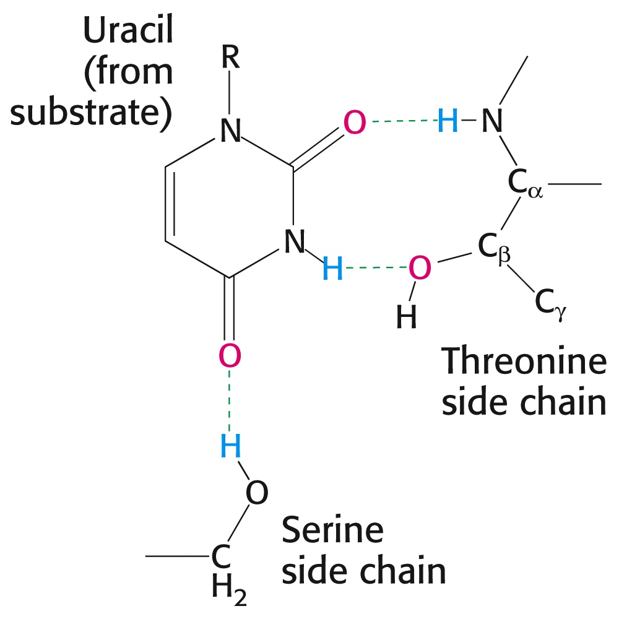
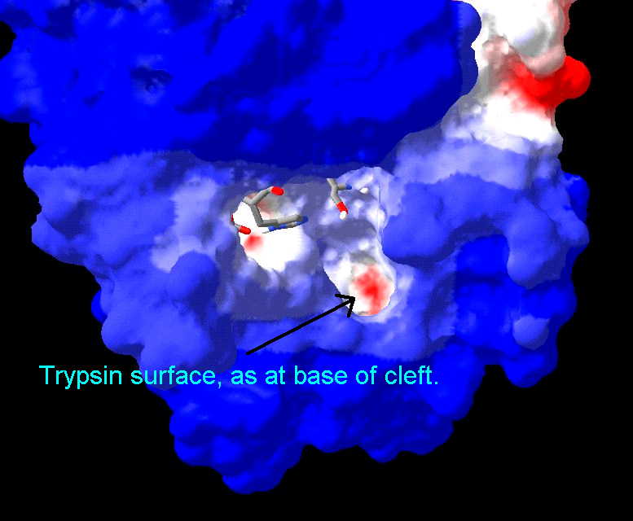
Active sites
Notes:
13

Slide 14
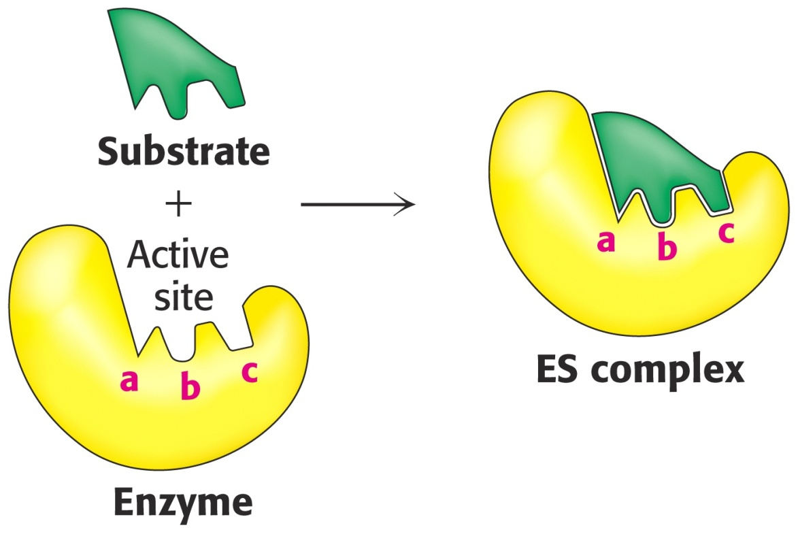
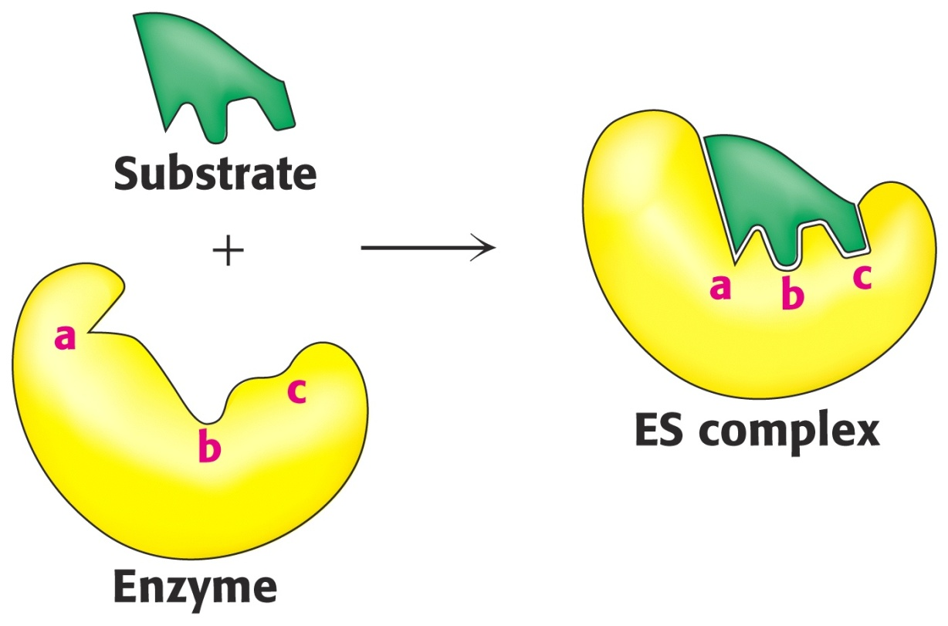
Lock & Key
Induced Fit
14
Notes:
14

Slide 15
How do enzymes catalyze?
Induced-fit model:
Binding of the reactants (substrates) to the enzyme changes the enzyme’s structure
  The enzyme changes shape
This change puts strain on the bonds of the reactants making them easier to break and rearrange
  The substrate(s) becomes twisted
The strained reactants are said to be in a transition state

Slide 16
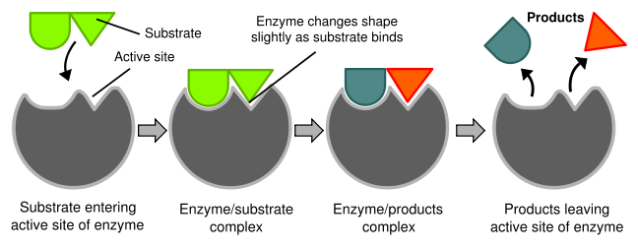
Induced Fit Model

Slide 17
Thermodynamics review
Std State = pH 7
  If H⁺ involved, its activity is 1 at std. state
“Spontaneous” rxn
  ΔG < 0
Notes:
17

Slide 18
Thermodynamcs vs. Kinetics
ΔG‡
Free Energy G
Substrate
ΔG_{cat}‡
ΔG_{rxn}
Product
Reaction Coordinate
Thermodynamics: ΔG_{rxn} determines if the reaction is spontaneous
Kinetics – activation energy barrier DG‡ determines the rate of reaction
Catalyst/enzyme – lowers DG‡ by stabilizing the transition state, does not change the free energy of products or reactants
Notes:
18

Slide 19
Kinetics review
Enzymes increase rate of reaction by lowering
Notes:
19

Slide 20
How do enzymes lower E_{A}?
Help substrates get together: A reaction can’t occur unless substrates collide, enzymes help bring them together.
Orient substrates: On their own, substrates collide randomly; enzymes bring them together in the proper orientation for the reaction to occur.
Promote acid-base reactions: Enzyme may act like a H+ donor or acceptor to destabilize a bond.
Exclude water: The removal of water may allow nonpolar or hydrophobic reactions to occur.

