Slide 1
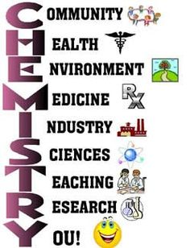
426 Chem. Bioinorganic Chemistry
Part IV. Biominerals
M. H. Al-Qunaibit

Slide 2
Outline- Part IV
Biomineralization.
Biomineral types and functions.
Calcium.
Calcium carbonates biomaterials.
Calcium hydrogen phosphates.

Slide 3
Biomineralization
“Biomineralization links soft organic tissues, which are compositionally akin to the atmosphere and oceans, with the hard materials of the solid Earth. It provides organisms with skeletons and shells while they are alive, and when they die these are deposited as sediment in environments from river plains to the deep ocean floor. It is also these hard, resistant products of life which are mainly responsible for the Earth’s fossil record. Consequently, biomineralization involves biologists, chemists, and geologists in interdisciplinary studies at one of the interfaces between Earth and life.” (Leadbeater and Riding 1986)

Slide 4
Biomineralization
Biomineralization is:
-The study of the formation, structure and properties of inorganic solids deposited in biological systems.
Stephen Mann “Biomineralization: Principles and concepts in Bioinorganic materials chemistry, Oxford University Press, 2001
-Crystallization under biological control.

Slide 5
Biomineralization
It involves selective extract and uptake of elements from the local environment and incorporating them into functional structures under strict biological control.
Elements (e g Ca, Fe, P…) are recycled for millions of years through complex processes involving biomineralization.

Slide 6
Biomineralization
The formation of biominerals involves the following hierarchy of control mechanisms:
Chemical control (solubility, supersaturation, nucleation).
Spatial control (confinement of crystal growth by boundaries such as cells, subcompartments, and even proteins in the case of ferritin).

Slide 7
Biomineralization
3. Structural control (nucleation is favoured on a specific crystal face).
4. Morphological control (growth of the crystal is limited by boundaries imposed by organic material that grows with time).
5. Constructional control (interweaving inorganic and organic materials to form a higher order structure, such as bone).

Slide 8
Biomineralization
Demineralization is the opposite process.
Example:
Bone is continually being dissolved and reformed. During pregnancy, bones tend to be “attacked” for their Ca (demineralized).
Depleted or damaged bones are restored by remineralization.
Bio-mineralization
Demineralization
Remineralization

Slide 9
Biomineralization
Nature is very well at controlling mineralization processes to produce single crystals and polycrystalline and amorphous structures.
The biomineral often fulfils a structural role in the organism, for example as teeth bones or shells.

Slide 10
Outline- Part IV
Biomineralization.
Biomineral types and functions.
Calcium.
Calcium carbonates biomaterials.
Calcium hydrogen phosphates.

Slide 11
Biomineral Types and Functions
Biomineralzation offers organisms more than structural support and mechanical strength:
protection
Motion
Cutting and grinding
Buyoyancy
Optical, magnetic and gravity sensing.
Storage.

Slide 12
Biomineral Types and Functions
The types of materials associated with the former mentioned functions may be summarized as:
Calcium carbonate
Calcite and vaterite (shells, gravity sensors*, lenses)
Amorphous phases (calcium storage)
(2) Calcium phosphate
Bone (support and mobility)
b. Teeth (grinding)

Slide 13
Biomineral Types and Functions
Both calcium carbonate and phosphate have high lattice energies and low solubilities = stable thermodynamically.
*Gravity sensor in the inner ear is formed of crystals that are located on a membrane above sensory cells and any acceleration or change of posture that causes them to move results in an electrical signal to the brain. The crystals are uniform in size and spindle-shaped so that they move evenly without becoming hooked together.

Slide 14
Biomineral types and functions
(3) Silica
Diatom (algae) cell walls are made of amorphous, hydrated SiO₂(silica) and exhibit highly regular porous patterns which are hierarchically arranged from the nano- to micrometer scale. The silica structures are produced by polycondensation of Si(OH)₄ (silicic acid) molecules which occurs in a specific intracellular compartment.
Notes:
Iron

Slide 15
Biomineral types and functions
(4) Iron oxides
Examples:
Magnetic bacteria (microcompass)
Iron teeth (in Chitons which are marine mollusks with a dorsal shell of calcareous plates)
(5) Metal sulphides
Notes:
Iron

Slide 16
Biomineralization
Each of the mineral classes includes one or more phases that contain water and/or hydroxyl groups. These hydrated forms comprise about 60% of the biogenic minerals.
Why hydrated?
Hydrated phases are favored over anhydrated counterparts by significantly lowering energetic barriers to nucleation and growth from aqueous solution.

Slide 17
Biomineral types and functions
Biominerals can be either infinite covalent networks or ionic.
Covalent networks include silicates, which occur extensively in the plant world.
Ionic biominerals are mainly based on calcium salts, and exploit the high lattice energy and low solubilities of these compounds.

Slide 18
Biomineral types and functions
Biominerals are true minerals, but they can be distinguished from their inorganically produced counterparts as:
They have unusual external morphologies.
many are actually composites or agglomerations of crystals separated by organic material.

Slide 19
Biomineral types and functions
Different morphologies of Silica

Slide 20
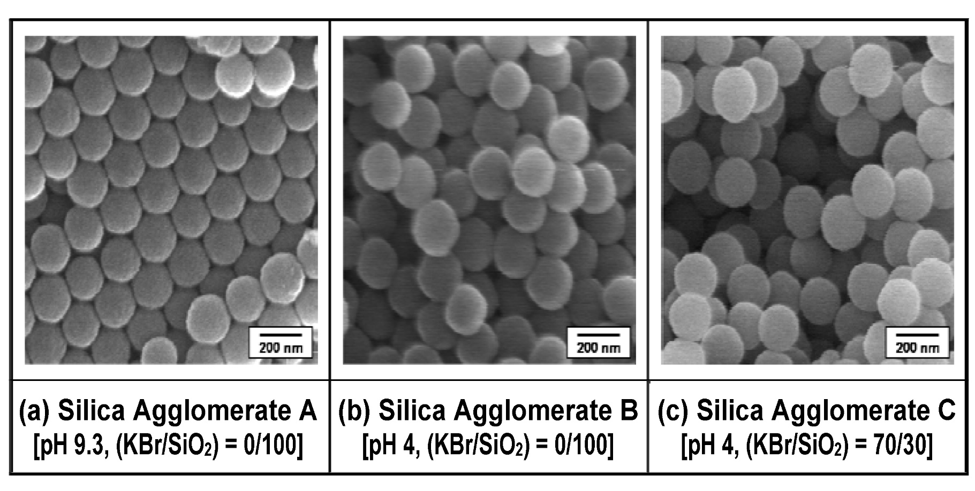
Biomineral types and functions

Slide 21
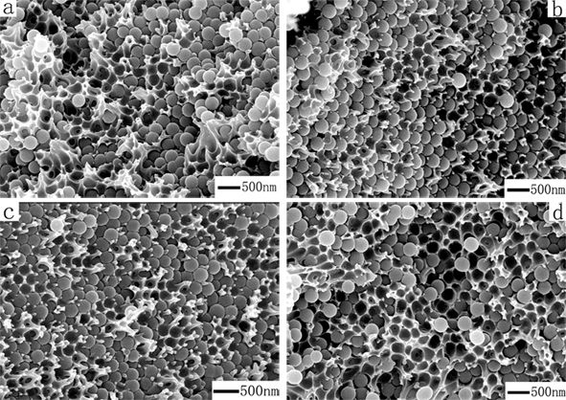
Biomineral types and functions
Silica/Polyamide-Imide Composite

Slide 22
Outline- Part IV
Biomineralization.
Biomineral types and functions.
Calcium.
Calcium carbonates biomaterials.
Calcium hydrogen phosphates.

Slide 23
Calcium
Is the fifth most abundant element in the Earth’s crust but only the seventh most common in seawater due to the low solubility of CaCO₃
Calcium is a component of biominerals and is also coordinated by proteins, notably those involved in cell signalling and muscle action.
Calcium compounds are used in exoskeletons (external skeleton that supports and protects an animal's body), bones, teeth, and other devices.

Slide 24
Calcium
Calcium occurs widely in its carbonate form as limestone, marble, and chalk, and it is a major component of biominerals, such as shells and coral.
Calcium phosphate (hydroxyapatite) is the mineral component of bones and teeth.

Slide 25
Outline- Part IV
Biomineralization.
Biomineral types and functions.
Calcium.
Calcium carbonates biomaterials.
Calcium hydrogen phosphates.

Slide 26
Calcium Carbonate Biominerals
Over 50 biominerals have been identified of which calcium carbonate is one of the most common.
Most of the calcium carbonate mineral deposits were formed by sea creatures that manufactured shells and skeletons of calcium carbonate.

Slide 27
Calcium carbonate biominerals
There are six CaCO₃ minerals with different structures, with calcite and aragonite -being the most thermodynamically stable- are the most deposited in biological systems.
Notes:
Crystals can sometimes be grown around a template, which is then removed to produce a porous structure, or the addition of certain chemicals can cause different shapes of crystals to grow from a particular solution.
Similarly the growth of bone, which is mainly calcium hydroxyapatite Ca5(PO4)3(OH)2, is being investigated, including the development of synthetic bone materials.

Slide 28
Calcium carbonate biominerals
Example:
In pearls and mother-of-pearl, very small CaCO₃ crystals are deposited to form smooth, hard,
lustrous layers of alternating layers of calcite and aragonite (2 crystalline types of it) that make the shell very strong as they have different preferred directions of fracture and resist breaking under pressure.
Notes:
Crystals can sometimes be grown around a template, which is then removed to produce a porous structure, or the addition of certain chemicals can cause different shapes of crystals to grow from a particular solution.
Similarly the growth of bone, which is mainly calcium hydroxyapatite Ca5(PO4)3(OH)2, is being investigated, including the development of synthetic bone materials.

Slide 29
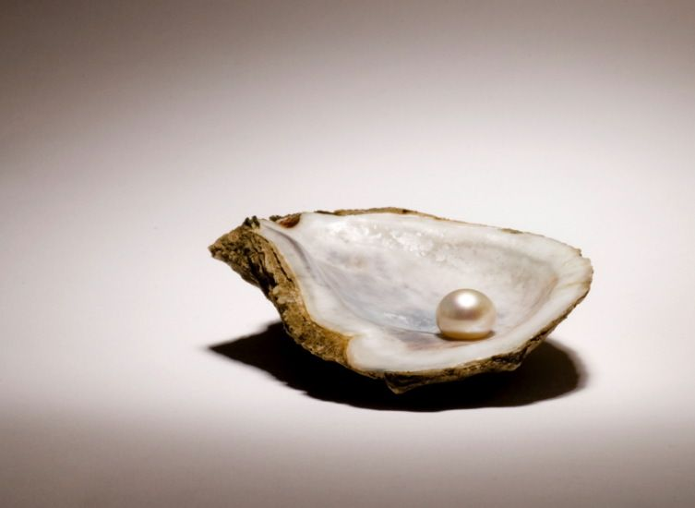
Calcium carbonate biominerals
The thickness of the layers is similar to the wavelength of light, which produces the interference effects and the observed pearlescence.
Many attempts are being made to
replicate these complicated crystal
growth patterns of CaCO₃ in the
laboratory.
Notes:
Crystals can sometimes be grown around a template, which is then removed to produce a porous structure, or the addition of certain chemicals can cause different shapes of crystals to grow from a particular solution.
Similarly the growth of bone, which is mainly calcium hydroxyapatite Ca5(PO4)3(OH)2, is being investigated, including the development of synthetic bone materials.

Slide 30
Calcium carbonate biominerals
When animals die, their shells settle on the sea floor and were compressed to form limestone and chalk.
Notes:
https://www.youtube.com/watch?v=m07OvPEoR6g
https://www.youtube.com/watch?v=T18E58vOTus

Slide 31
https://www.youtube.com/watch?v=m07OvPEoR6g&t=1s
https://www.youtube.com/watch?v=T18E58vOTus

Slide 32
Outline- Part IV
Biomineralization.
Biomineral types and functions.
Calcium.
Calcium carbonates biomaterials.
Calcium hydrogen phosphates.

Slide 33
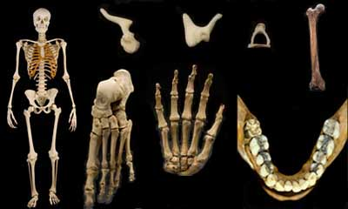
Calcium Hydrogenphosphates
The principal mineral present in bone and teeth is hydroxyapatite, Ca₅(OH)(PO₄)₃. The mineral apatite is the partially fluoride-substituted Ca₅(OH,F)(PO₄)₃.

Slide 34
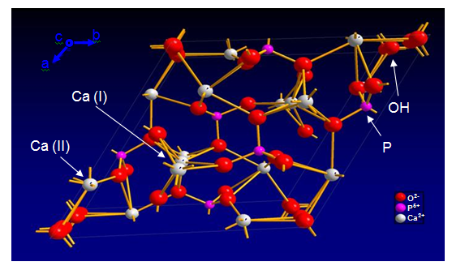
Calcium Hydrogenphosphates
The structure consists of Ca²⁺ ions coordinated by three PO₄³⁻ and OH⁻ groups to produce a rigid three-dimensional structure.

Slide 35
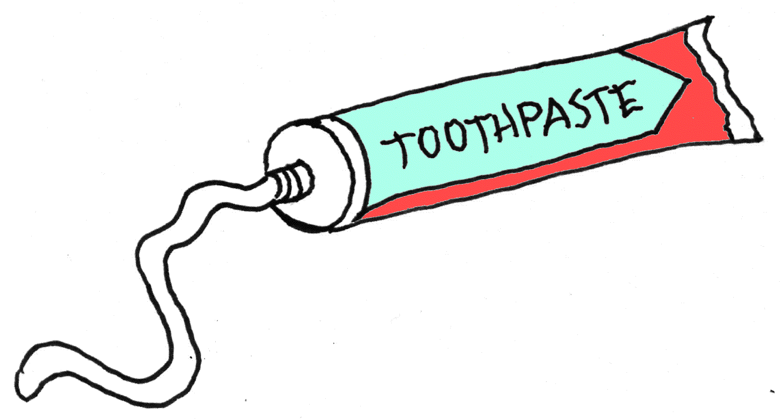
Calcium Hydrogenphosphates
Bone and teeth are unique bio-composites based on hydroxyapatite.
Fluoride treatment for teeth:
F-apatite has 10³ lower solubility product that OH-apatite.
F-containing tooth paste works!

Slide 36
Pathogenic Mineralization
Examples:
Kidney stones
Notes:
https://www.youtube.com/watch?v=ky4rIo8Ro4I

Slide 37
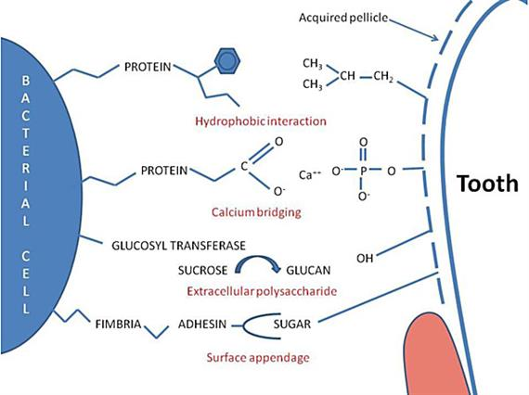
Pathogenic Mineralization
Dental calculus
Notes:
https://www.youtube.com/watch?v=NFIQcLXycjE

Slide 38
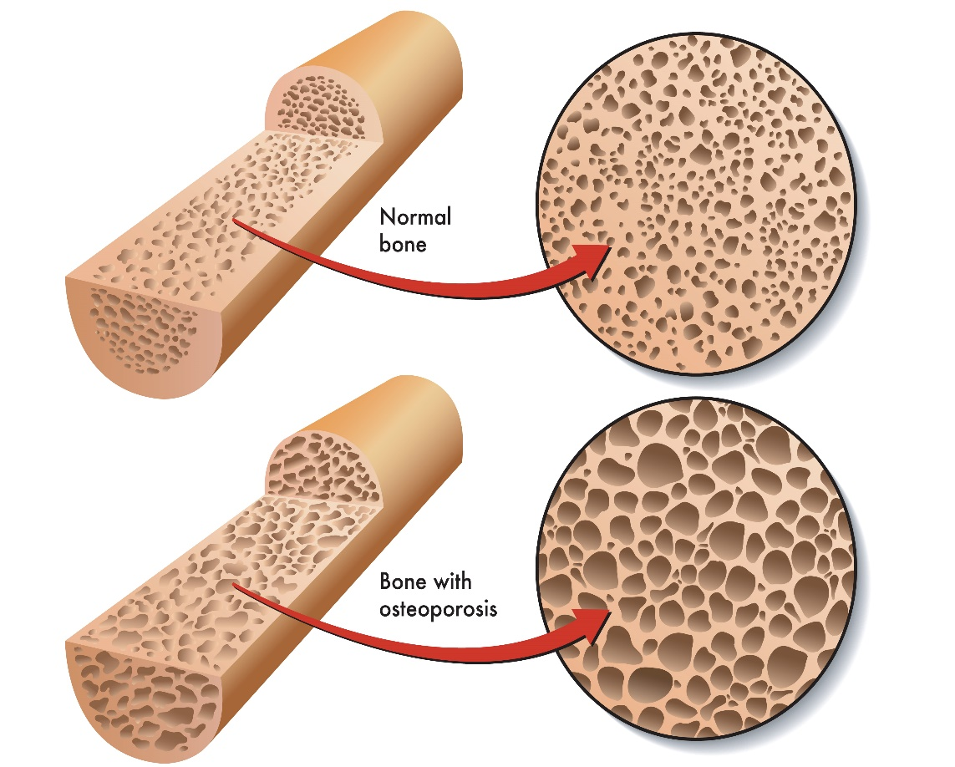
Pathogenic Mineralization
Osteoporosis.
Notes:
https://www.youtube.com/watch?v=eYGkT6OrBk0
https://www.youtube.com/watch?v=TZcB8c9mqbY
https://www.youtube.com/watch?v=fac-uaPH-mo

Slide 39
https://www.youtube.com/watch?v=ky4rIo8Ro4I
https://www.youtube.com/watch?v=TZcB8c9mqbY
https://www.youtube.com/watch?v=eYGkT6OrBk0

