Slide 1
SDS-Polyacrylamide Gel Electrophoresis
Lab#4
BCH 462 [practical]

Slide 2
Objectives:
-Separation of protein fractions using SDS-PAGE.

Slide 3
SDS-Polyacrylamide Gel Electrophoresis
-Sodium Dodecyl Sulfate-Polyacrylamide gel Electrophoresis (SDS-PAGE), is a technique widely used in biochemistry ,forensics, genetics and molecular biology to separate and identify proteins according to their molecular weight.
-This method separates proteins based primarily on their molecular weights.

Slide 4
Principle:
Sodium Dodecyl Sulfate [SDS]: is a detergent which denature proteins by binding to the hydrophobic regions, all non-covalent bonds will disrupted and the proteins acquire a negative net charge.
-So, the proteins samples are having uniformed structure and charge → the separation will depend on their molecular weight only.
-Small proteins migrate faster through the gel under the influence of the applied electric field.
The number of SDS molecules that bind is proportional to the size of the protein,
Thereby in the electrical field, protein molecules move towards the anode (+) and separated only according to their molecular weight.
A Concurrent treatment with a disulfide reducing agent such as β-mercaptoethanol or DTT (dithiothreitol) further breaks down the macromolecules into their subunits.

Slide 5
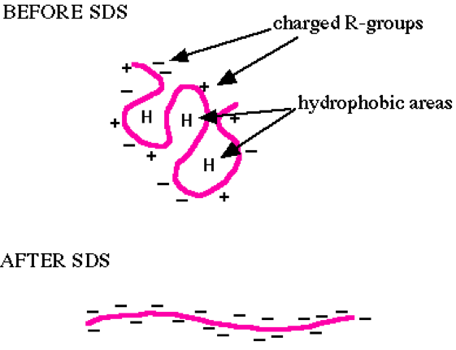

Slide 6
-the proteins samples are having uniformed structure and charge → the separation will depend on their molecular weight only.
-SDS-treated proteins have very similar charge-to-mass ratios, and similar shapes. During PAGE, the rate of migration of SDS-treated proteins is effectively determined by molecular weight.
-Small proteins migrate faster through the gel under the influence of the applied electric field, whereas large proteins are successively retarded, due to the sieving effect of the gels.

Slide 7
polyacrylamide gel:
- The polyacrylamide gel is formed by co-polymerization of acrylamide and a cross-linking
By N,N’-methylene-bis-acrylamide ” bis-acrylamide “.
To polymerize the gel a system, consisting of ammonium persilfate (initiator) and tetramethylene ethylene diamin (TEMED) is added[catalyst].

Slide 8
SDS-Polyacrylamide Gel Electrophoresis

Slide 9
SDS-Polyacrylamide Gel Electrophoresis Buffers and solutions:
1- SDS-PAGE, Running buffer (5x) pH 8.4:[?]
Tris-HCl
Glycine
SDS
2-SDS-PAGE, disruption buffer:[?]
10% (w/v) SDS [?]
1M Tris/HCl, pH 6.8
Glycerol [?]
β-Mercaptoethanol [?]
Bromophenol blue [?]

Slide 10
3-SDS-PAGE, Stain: [?]
Glacial acetic acid
Methanol
Coomassie brilliant blue R[?]
4-SDS-PAGE, de-stain:[?]
Glacial acetic acid
Methanol

Slide 11
5-Sample preparation:
40µl of protein sample + 10 µl of disruption buffer→ boil the mixture 3minets at 99C̊ .
6-Separation gel [?]contents:
Volume of stock solution required to make 12% polyacrylamide gel | Stock solutions
2.0 ml | 1.5 M Tris/HCl, pH 8.8
3.2 ml | Acrylamide stock
2.8 ml | Water
80 µl | 10% SDS
100 µl | 10% Ammonium persulphate (fresh)
20 µl | TEMED

Slide 12
7-Stacking gel [?] contents:
Volume of stock solution required to make 12% polyacrylamide gel | Stock solutions
1.0 ml | 0.5M Tris/HCl, pH6.8
1.0 ml | Acrylamide stock
3.0 ml | Water
80 µl | 10% SDS
100 µl | 10% Ammonium persulphate (fresh)
20 µl | TEMED

Slide 13
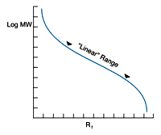
Figeur: graph of log MW vs. Rf is sigmoidal, it is nearly linear for a range of molecular weights excluding very small and very large M wt.
(Figure has been taken from http://www.nationaldiagnostics.com/article_info.php/articles_id/55)
The migration of the SDS-treated proteins towards the anode[+] is aversely proportional to the logarithms of their molecular weights, or more simply expressed: Small proteins migrate faster through the gel.

Slide 14
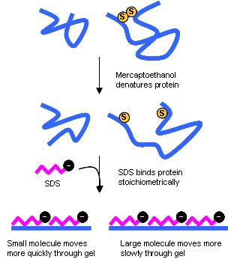

Slide 15
Applications:
1. To detect the purity of the protein.
2. Determine of protein molecular weight.
http://www.youtube.com/watch?v=EDi_n_0NiF4

