Slide 1
Differential staining
Gram stain
Ziehl Neelsen stain

Slide 2
Differential Stain
Requires the use of at least 3 chemical reagents.
Primary Stain: stain all the cells.
Decolorizing agent: may or may not remove the primary stain from the entire the cell or only from certain cell structure.

Slide 3
3. Counter stain: It will stain the washed out areas only, if the primary stain is not washed out the counter stain can’t be absorbed(the cell or it’s components will hold the primary stain)

Slide 4
Gram stain
The most important differential stain used in bacteriology.
Demonstrates 2 or more items( shape and color).
One of the first steps of identification and differentiation of bacterial species.

Slide 5
Gram stain
It divides bacterial cell into 2 major groups:
Gram +ve organisms: are organisms that resist decolorizing and retain the crystal violet iodine complex, They appear Purple.
Gram –ve organisms: are organisms that give up the complex and are decolorized thus accept the counter stain, They appear RED

Slide 6
Reagents used:
Primary stain: crystal violet.
Mordant: iodine.
Decolorizer: alcohol-acetone.
Counter stain: safranin.

Slide 7
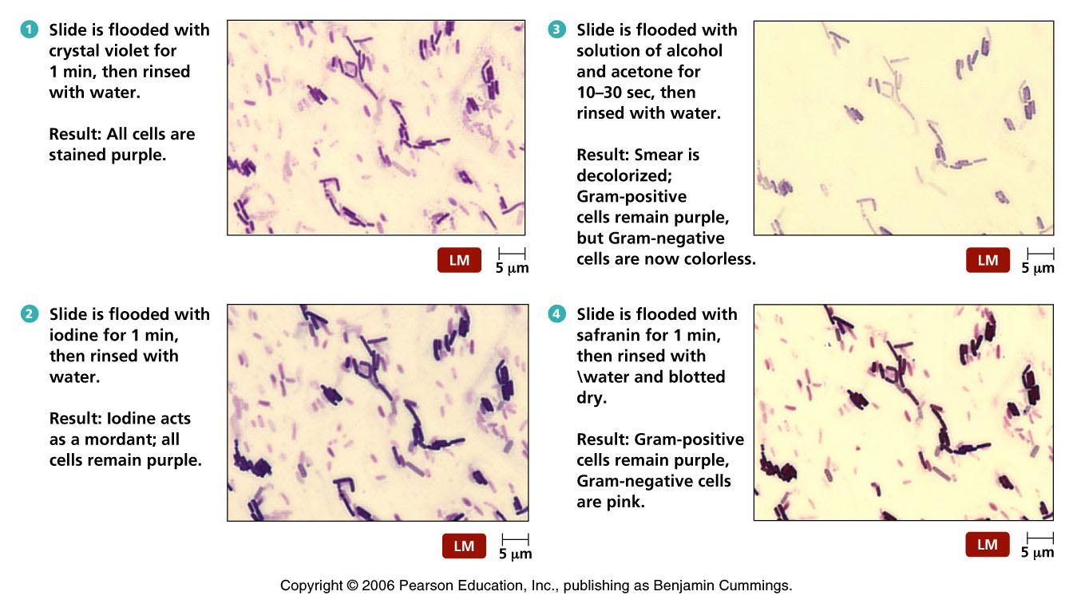

Slide 8
Gram stain
There are many theories to explain the differences but none is completely satisfactory
The most valid theory correlates the Gram reaction with differential permeability of cell
Gram –ve cells have more lipid content and thinner cell wall than Gram +ve cells
Lipids are soluble in decolorizer (acetone)
Pore size of cell wall increases by removal of lipid. This leads to removal of crystal violet-iodine complex. Thus counter stain enters and stains cell

Slide 9
Gram stain
Factors affecting Gram reaction:
Improper heat fixing of the smear.
Cell density (thick smear may not decolorize as rapidly).
Concentration and freshness of reagents.
length and accuracy of washing.
Nature, concentration and duration of decolorizer.
Age of bacterial culture.

Slide 10
Gram stain steps
Apply Crystal violet for 1 minute
Wash with D.water
Apply Iodine for 1 minute
Wash with D.water
Decolorize with Acetone for 7 seconds
Wash with D. water
Apply Safranin for 1 minute
Wash with D. water

Slide 11
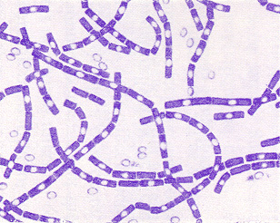
Gram positive rods

Slide 12
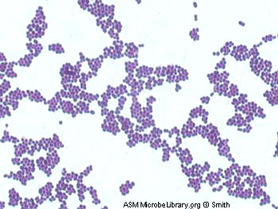
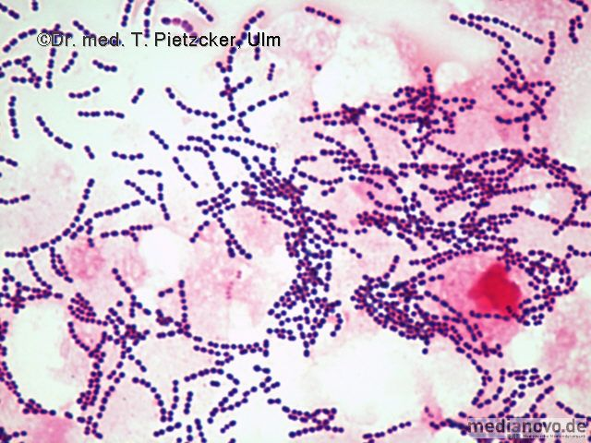
Gram +ve cocci

Slide 13
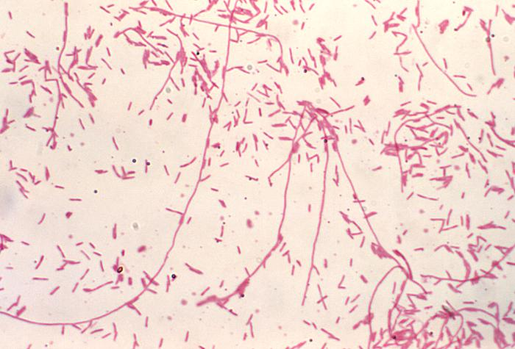
Gram –ve organisms

Slide 14
Gram mixture Gram +ve and Gram –ve organisms

Slide 15
Ziehl Neelsen Technique ZN Acid Alcohol Fast stain
Used to demonstrate acid fastness of bacteria especially species belonging to genus “Mycobacterium”.
The cell wall of these bacteria contain a wax-like lipid called mycolic acid, this makes the cell wall very impermeable and will not stain with commonly used stains.

Slide 16
AAFB))Acid Alcohol Fast Bacilli
In this technique AAFB will retain the primary stain even after washing with the strong acid alcohol decolorizer
Reagents
1- Primary stain : Carbol fuchsin
2- Decolorizer: 3% acid Alcohol
3- counter stain: Methylene blue

Slide 17
AAFB steps
Apply Carbol fuchsin for 10 minutes
Heat the slide by passing a flame under the slide
Wash with water
Apply acid alcohol for 3-5 minutes
Wash with water
Counter stain with methylene blue for 1 min
Wash with water

Slide 18
AAFB
AAFB organisms retain primary stain and are not affected by strong acid alcohol decolorizer so the color will be red
Other organisms will stain blue
Heat was applied to increase the uptake of the primary stain by bacterial cell wall of AAFB
A strong decolorizer Acid Alcohol is used
Timing of staining is extended

Slide 19
AAFB

