Slide 1
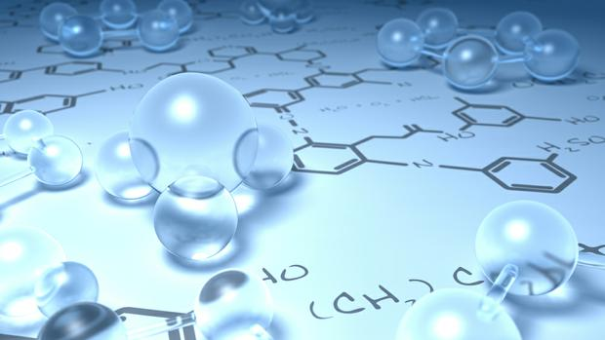
By
Dr. Mohamed El-Newehy
Chemistry Department, College of Science, King Saud University
http://fac.ksu.edu.sa/melnewehy

Slide 2
Unsaturated Hydrocarbons
Alkynes

Slide 3
The Structure of Alkynes
- Alkynes are ydrocarbons that contain a carbon–carbon triple bond.
- Alkynes are also known as Acetylenes.
- General formula is C_{n}H_{2n-2}
- Hybridization; sp-hybridized orbitals
- The angle between them is 180°.
- A Linear.

Slide 4
Nomenclature of Alkynes
- The simplest members of the Alkenes series are C₂ & C₃
- Named are derived from the corresponding alkanes by replacing the –ane ending by –yne.
- IUPAC rules as discussed for Alkenes .
- Example:
3-Chloro-2,7-dimethyl-4-nonyne

Slide 5
Physical Properties of Alkynes
- Physical State
Alkynes occur at room temperature are gases, liquids, and solids.
C2 to C4 are gases,
C5 to C17 are liquids,
C18 and larger alkynes are wax –like solids.
- Solubility
Alkynes are nonpolar compounds.
Their solubility “ Like dissolve like”
Alkynes are soluble in the nonpolar solvents;
carbon tetrachloride, CCl₄ and benzene,
Alkynes are insoluble in polar solvents like water.
- Boiling Points & Melting Points
The boiling points and melting points of normal hydrocarbons increase with increasing molecular weight.
The greater the number of branches, the lower the boiling point.

Slide 6
Acidity of Alkynes
- A hydrogen atom on a triply bonded carbon (Terminal Alkyne) is weakly acidic and can be removed by a very strong base ( as Sodium amide).
- Internal alkynes (Non-Terminal Alkyne) have no exceptionally acidic hydrogens.
- Relative Acidity of the Hydrocarbon.

Slide 7
Preparation of Alkynes
1) Dehydrohalogenation of Alkyl dihalides

Slide 8
Preparation of Alkynes
2) Reaction of Sodium Acetylide with Primary Alkyl Halides
Acetylene
Monosubstituted Acetylenes

Slide 9
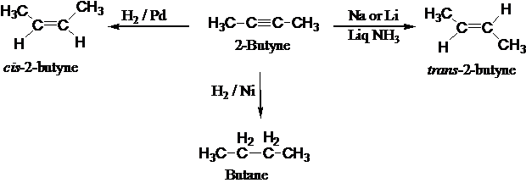
Reactions of Alkenes
Electrophilic Addition Reactions
1. Addition of Hydrogen: Hydrogenation
- With an ordinary nickel or platinum catalyst, alkynes are hydrogenated all the way to alkanes.
- However, a special palladium catalyst (called Lindlar’s catalyst) can control hydrogen addition so that only one mole of hydrogen adds. In this case, the product is a cis alkene.

Slide 10
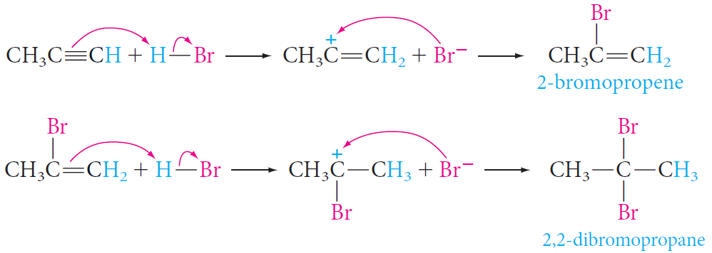
Reactions of Alkenes
Electrophilic Addition Reactions
2. Addition of Halogen: Halogenation
- Bromine adds as follows; In the first step, the addition occurs mainly trans.
3. Addition of Hydrogen Halide
- With unsymmetric triple bonds and unsymmetric reagents, Markovnikov’s Rule is followed in each step, as shown in the following example:

Slide 11
Reactions of Alkenes
Electrophilic Addition Reactions
4. Addition of Water: Hydration
Addition of water to alkynes requires not only an acid catalyst but mercuric ion as well.
The mercuric ion forms a complex with the triple bond and activates it for addition.
Although the reaction is similar to that of alkenes, the initial product—a vinyl alcohol or enol—rearranges to a carbonyl compound.
Notes:
dicular

