Slide 1

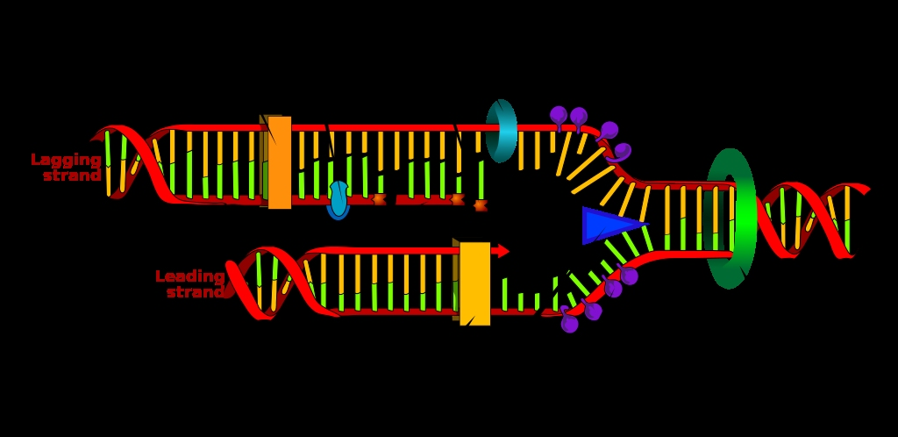
LECTURE (4 and 5)
DNA replication

Slide 2
Lecture contents
DNA replication
Types of DNA replication
The replication mechanism
Summary of replication mechanism
Some terminology
1
2
3
4
5

Slide 3
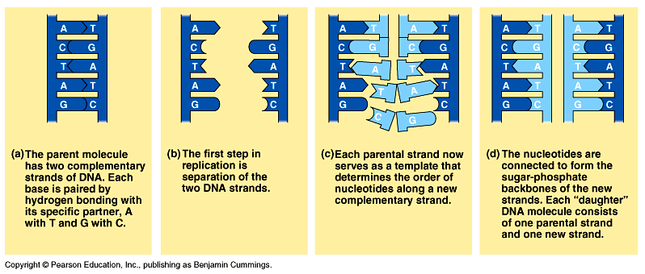
DNA replication
When a cell copies a DNA molecule, each strand serves as a template for ordering nucleotides into a new complimentary strand.
  Nucleotides line up along the template strand according to the base-pairing rules.
  The nucleotides are linked to form new strands (complementary).

Slide 4
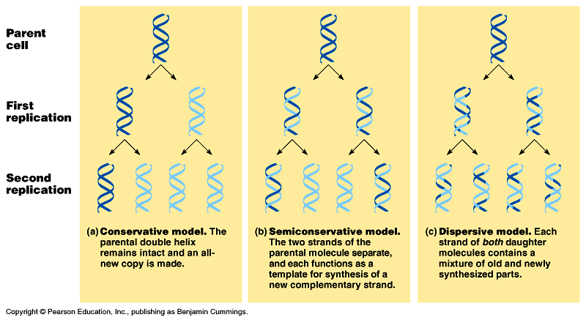
Types of DNA replication
Semiconservative replication (the most common and accepted by Watson and Crick). The double helix replicates each of the daughter molecules and will have one old strand and one newly made strand.
The other two models are the conservative and the dispersive models

Slide 5
For Semiconservative DNA Replication
During DNA replication, base pairing enables existing DNA strands to serve as templates for new complimentary strands
Several enzymes and other proteins carry out DNA replication:
Helicase, and single strand binding proteins
Primase,
Polymerase,
Ligase.
Topoisomerase
The ends of DNA molecules are replicated by a special mechanism. (telomerase)

Slide 6
Type of DNA replication enzymes

Slide 7
A large team of enzymes and other proteins carries out DNA replication: The Replication Mechanism
It takes E. coli less than an hour to copy each of the 5 million base pairs in its single chromosome and divide to form two identical daughter cells.
A human cell can copy its 6 billion base pairs and divide into daughter cells in only a few hours.
This process is remarkably accurate, with only one error per billion nucleotides.
A helicase; untwists and separates the template DNA strands at the replication fork.
Single-strand binding proteins; keep the unpaired template strands apart during replication and protects ssDNA from nucleases.(A nuclease is a phosphodiesterase that cleaves one of the two bridging P-O bonds, 3´ or 5´, in a nucleic acid polymer)
Topoisomerase: cuts the phosphodiester bonds on both DNA strands of the dsDNA. Therefore, this enzyme releases the supercoil strain and reforms the phosphodiester bonds. This enzyme uses ATP as an energy source.

Slide 8
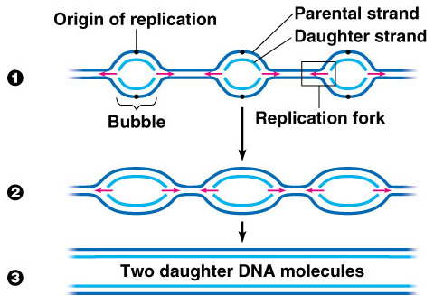
The Replication Mechanism
The replication of a DNA molecule begins at special site called origin of replication which is a single specific sequence of nucleotides that is recognized by the replication enzymes.
Replication enzymes separate the strands, forming a replication “bubble”.
  Replication proceeds in both directions until the entire molecule is copied.
In eukaryotes, there may be hundreds or thousands of bubbles (each has origin sites for replication) per chromosome.
  At the origin sites, the DNA strands separate forming a replication “bubble” with replication forks at each end.
  The replication bubbles elongate as the DNA is replicated and eventually fuse.

Slide 9
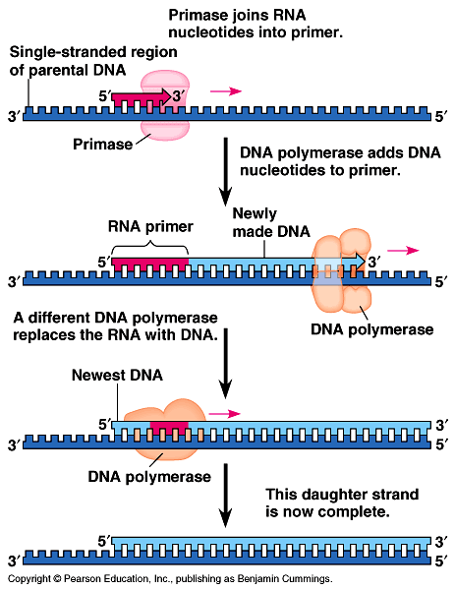
Primer: (a short segment of RNA, 10 nucleotides long) is required to start a new chain.
Primase: (an RNA polymerase) links ribonucleotides that are complementary to the DNA template into the primer. Able to synthesize primers using free NTPs with ssDNA as a template.
DNA polymerases: catalyze the elongation of new DNA at a replication fork. After formation of the primer, DNA polymerases can add deoxyribonucleotides to the 3’ end of the ribonucleotide chain.
Another DNA polymerase later replaces the primer ribonucleotides with deoxyribonucleotides complimentary to the template.

Slide 10
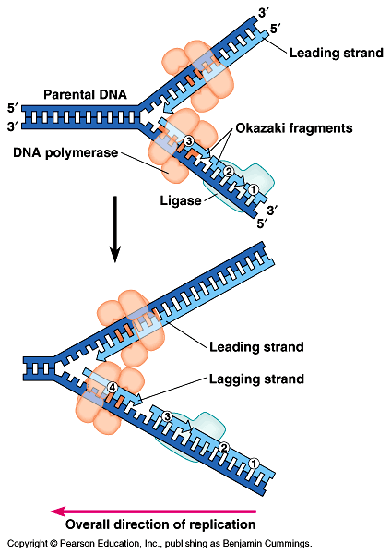
The Replication Mechanism
DNA polymerases can only add nucleotides to the free 3’ end of a growing DNA strand.
A new DNA strand can only elongate in the 5’->3’ direction.
At the replication fork, one parental strand (3’-> 5’ into the fork), the leading strand, can be used by polymerases as a template for a continuous complimentary strand.
The other parental strand (5’->3’ into the fork), the lagging strand, is copied away from the fork in short segments
(Okazaki fragments).
Okazaki fragments (each about 100-200 nucleotides) are joined by DNA ligase to form the sugar-phosphate backbone of a single DNA strand.

Slide 11
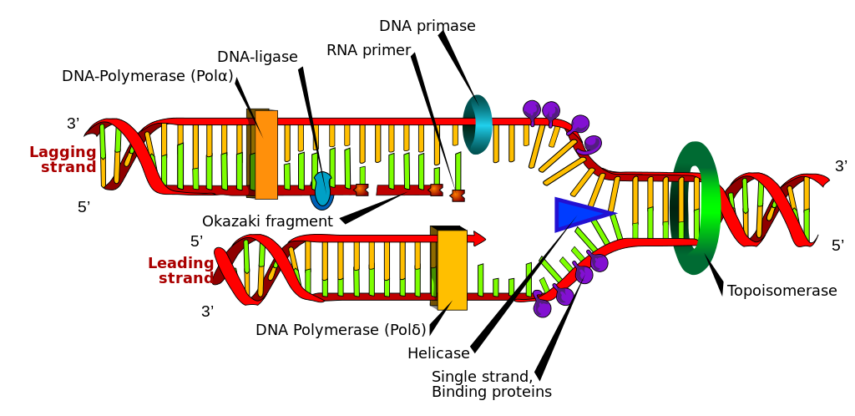
The Replication Mechanism

Slide 12
Summary of DNA replication mechanism
The two DNA-strands separate forming replication bubbles.
Each strand functions as a template for synthesizing new complementary & lagging strands via primers, polymerase and ligase.
5
3
T
A
C
T
G
A
C
A
G
A
G
G
G
A
T
A
C
T
Primer
T
C
T
3
5
Complementary (leading) strand
Templates
Polymerase
Ligase
T
A
C
T
G
A
C
3
5
Lagging strand (complementary)
Okazaki fragments

Slide 13
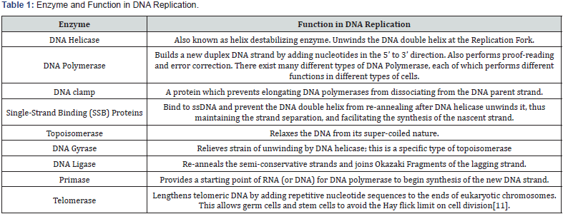

Slide 14
Replication fidelity
A major function of replicative DNA polymerases is to replicate DNA with very high accuracy.
The fidelity of DNA replication relies on nucleotide selectivity of replicative DNA polymerase, exonucleolytic proofreading, and postreplicative DNA mismatch repair (MMR).
Proofreading activity that assists most of the replicative polymerases is responsible for the removal of incorrectly incorporated nucleotides from the primer terminus before further primer extension.
It is estimated that proofreading improves fidelity by 2–3 orders of magnitude

Slide 15
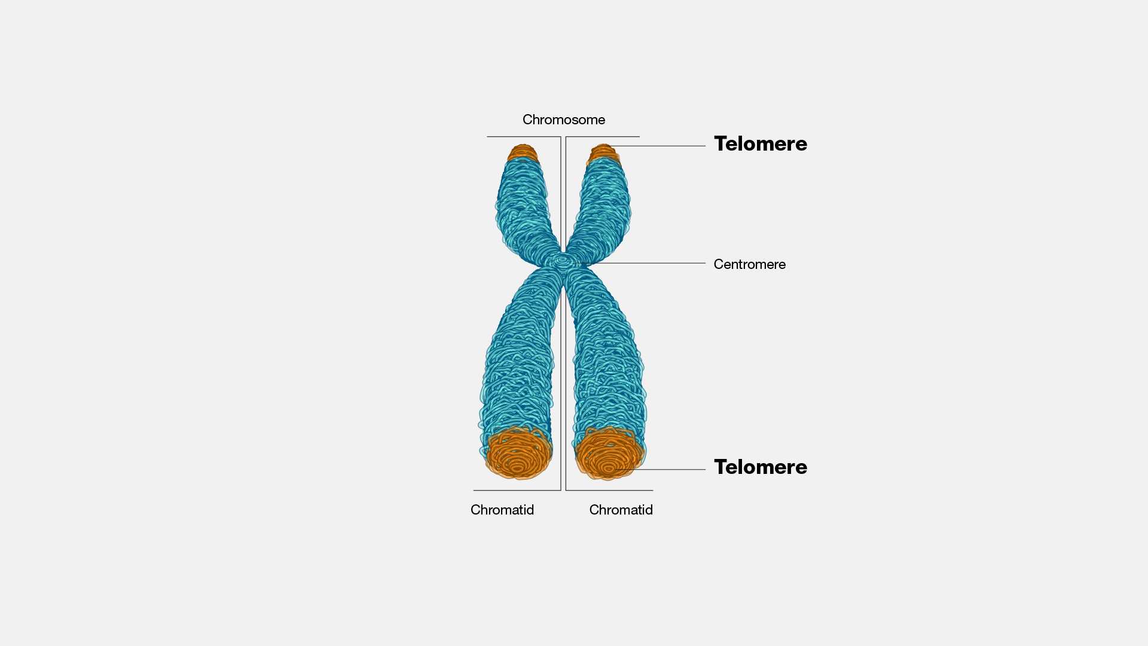
Telomeres
A telomere is a region of repetitive DNA sequences at the end of a chromosome.
Telomeres protect the ends of chromosomes from becoming frayed or tangled.
Each time a cell divides, the telomeres become slightly shorter.
Eventually, they become so short that the cell can no longer divide successfully, and the cell dies
At the very end of the telomere is a sort of knot not called the "T-loop," which keeps the chromosome ends from all sticking together.
Telomerase is the enzyme responsible for the maintenance of the length of telomeres by addition of guanine-rich repetitive sequences.
Telomerase activity is exhibited in gametes and stem and tumor cells

Slide 16
How Are Different Types of Cells Created and Maintained?
By differential gene expression.
The same genetic information is in all 100 trillion cells of any one person.
Different cells use the same blueprint in different ways
How?
In essence, the control of gene expression occurs by regulating the flow of information from DNA to protein.

Slide 17
Basic Genetic Mechanisms are Universal
The storage of genetic information in DNA, the use of an RNA intermediate that is reading three-letter words, and the mechanism of protein synthesis are essentially the same in all organisms.
Among other things, this means cancer can be studied productively in flies or yeast.
It also means that human genes can be expressed in a plant or mouse genes in yeast.

Slide 18
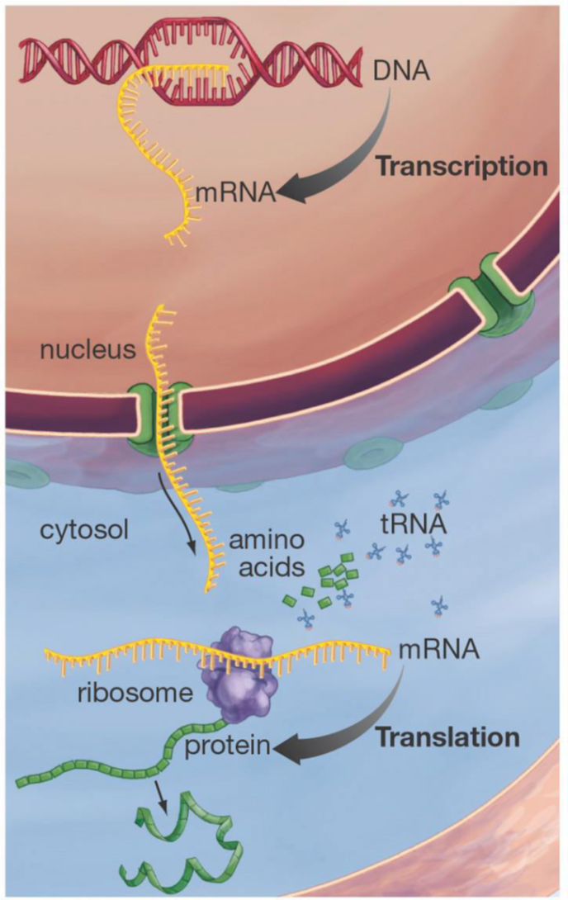
Central Dogma
DNA ---------→ RNA---------→Protein
• This unidirectional flow equation represents the Central Dogma (fundamental law) of molecular biology.
• This is the mechanism whereby inherited information is used to create actual objects, namely enzymes and structural proteins.
• An exception to the central dogma is that certain viruses (retroviruses) make DNA from RNA using the enzyme reverse transcriptase.

Slide 19
Gene Expression
• Genes are DNA sequences that encode proteins (the gene product)
• Gene expression refers to the process whereby the information contained in genes begins to have effects on the cell.
• DNA encodes and transmits the genetic information passed down from parents to offspring.

Slide 20
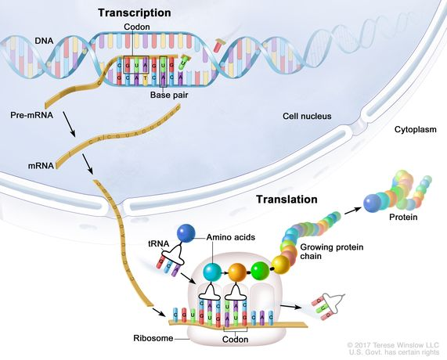

Slide 21
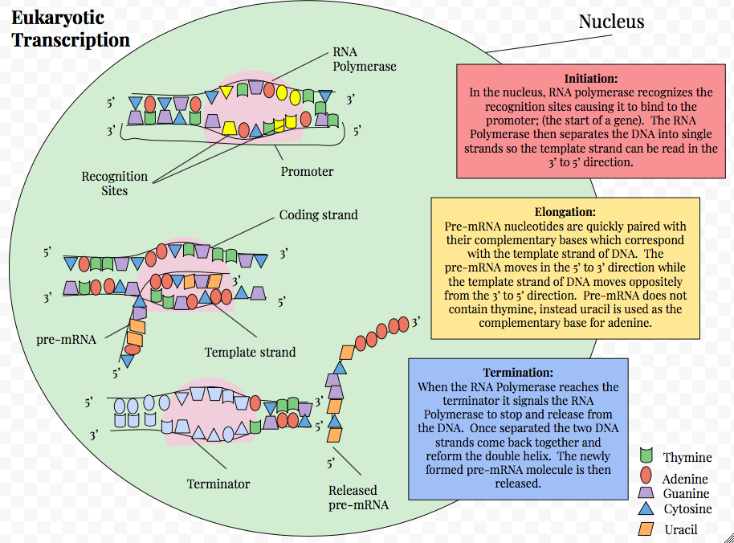
Transcription is a Key Step in Gene Expression

Slide 22
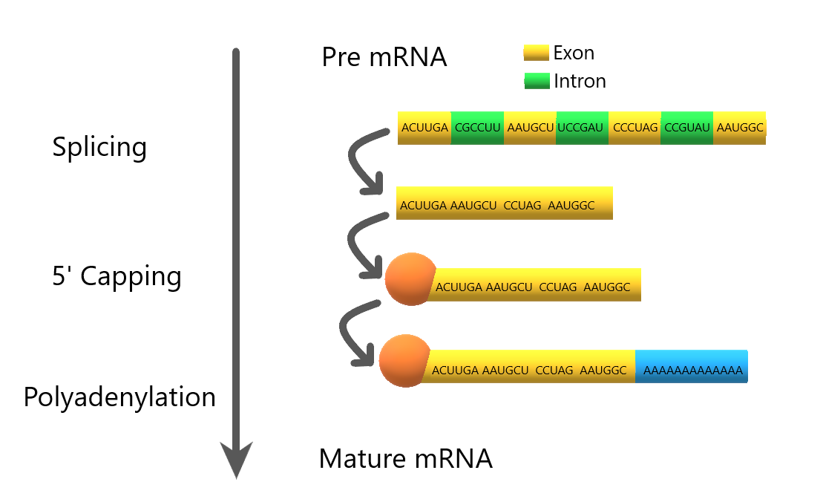
Eukaryotic Genes are Segmented
Genes are made of parts represented in the mRNA (exons) and parts that are transcribed but not present in the mRNA (introns).
In some genes more than 90% of the pre-mRNA is destroyed, never to appear in the mRNA.
Introns are removed from the primary transcript and exons are spliced together to make mRNA.

Slide 23
Alternative Splicing
The human genome consists of an estimated 20,000 protein-coding genes which can give rise to a much greater number of proteins.
Alternative splicing is one of the main processes that account for the increased protein-to-gene ratio.
In fact, alternative splicing is reported to be responsible for 40% of protein modifications
It involves the formation of multiple mRNA products from a single pre-mRNA, and many of these mRNA products are then translated into proteins that may have distinct structures or functions

Slide 24
Alternative Splicing
This important process, therefore, increases the coding capacity of a given gene, and it has been reported that more than 95% of pre-mRNAs are alternatively spliced in mammals
Research into alternative splicing has gathered momentum over the past two decades.
Alternative splicing is heavily regulated. However, like most biological processes, alternative splicing is open to faults, which can result in disease.
It has been suggested that around 33% of mutations that cause disease affect splicing

Slide 25
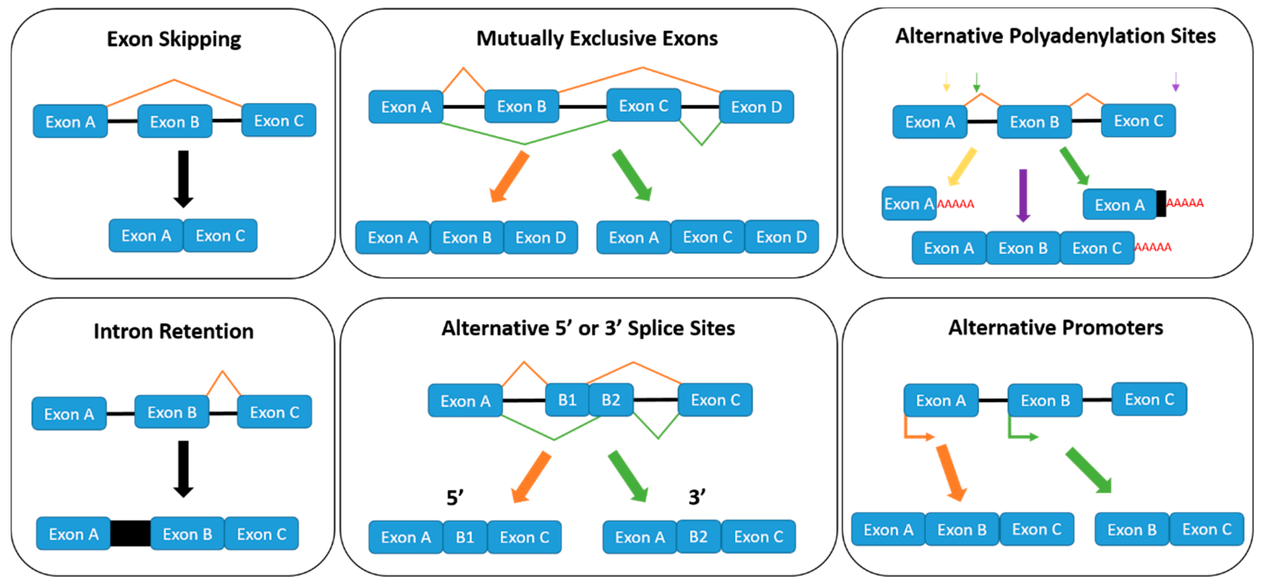
Different Alternative Splicing

Slide 26
Genetic code
The alphabet of the genetic code contains only four letters (A,T,G,C).
A number of experiments confirmed that the genetic code is written in 3-letter words, each of which codes for a particular amino acid.
A nucleic acid word (3 nucleotide letters) is referred to as a codon.

Slide 27
The Genetic Language Uses 4 Letters Written Into 3-Letter Words

Slide 28
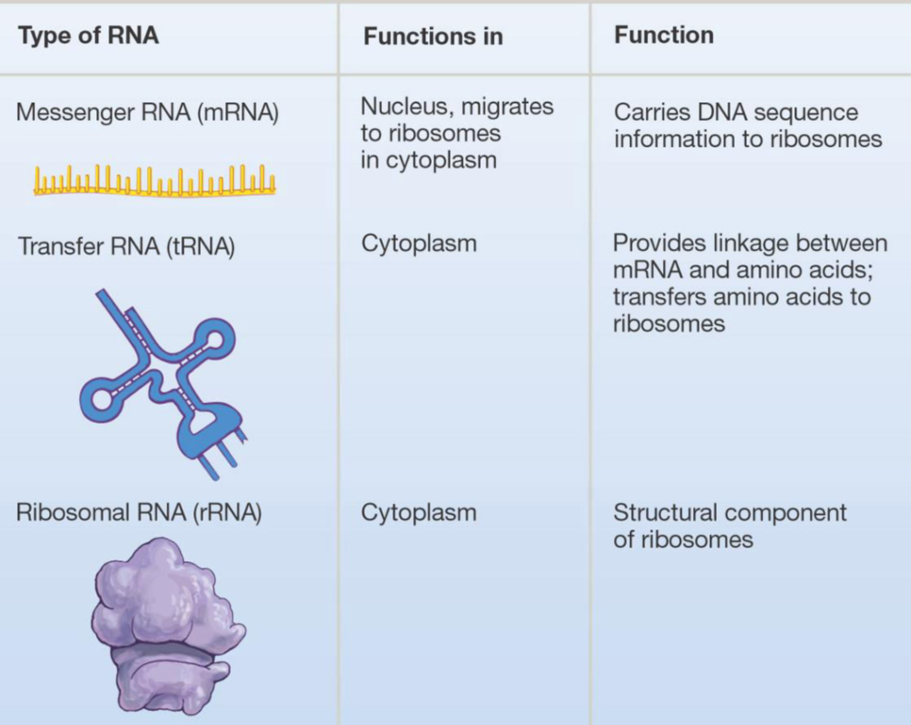
There are Different RNAs with Distinct Functions

Slide 29
Some Terminology
Helicase: untwists the double helix to separate the DNA strands by forming replication bubbles.
Replication enzymes: separates DNA strands, forming a replication “bubble”.
Replication bubble: formed at the origin sites of replication as DNA strands separate, and hence, replication forks formed at each end.
Replication site: it is also called origin of replication which is a single specific sequence of nucleotides that is recognized by the replication enzymes and at which replication starts.
Primer: is a short piece of RNA (10 nucleotide long) which is synthesised by primase and used to initiate the leading strands of the new DNA.

Slide 30
Some Terminology
DNA-polymerase: builds up the new DNA strand by adding nucleotides to the primer (from 5’ to 3’ end).
Leading strand: the elongation strand (5’ - 3’ into the fork) that initiate the new DNA after recognizing the sequence of the primer by special proteins.
Lagging strand: Is the other parental strand (5’ - 3’ into the fork), is copied away from the fork in short segments (Okazaki fragments).
Okazaki fragments: the newly formed segments (5’ - 3’, away from the fork) then, form the lagging strand when connected by ligase towards the fork.
DNA-ligase: joins the Okazaki fragments of the newly formed bases to form the new lagging DNA strand.

Slide 31
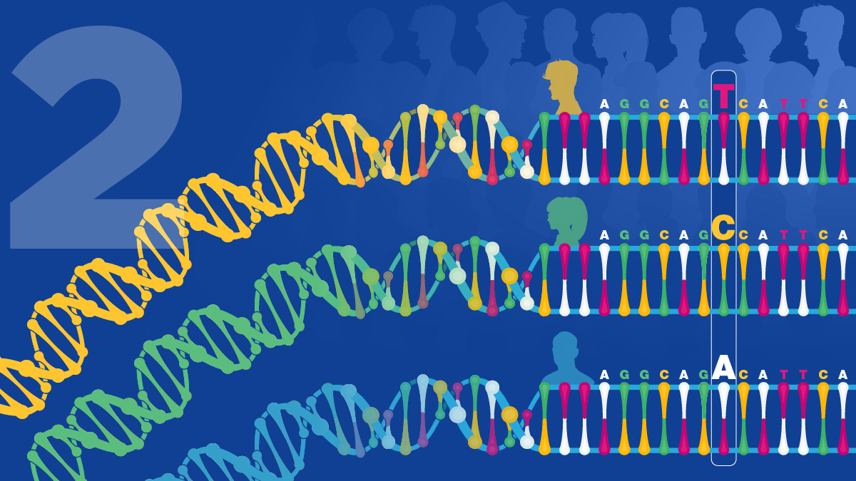
THANK YOU ……

