Slide 1
Chapter 3
Consumer Markets and Consumer Buyer Behavior

Slide 2
Consumer Markets and Consumer Buyer Behavior
Topic Outline
Model of Consumer Behavior
Characteristics Affecting Consumer Behavior
Types of Buying Decision Behavior
The Buyer Decision Process
The Buyer Decision Process for New Products

Slide 3
Model of Consumer Behavior
Consumer buyer behavior : the buying behavior of final consumers, individuals and households, who buy goods and services for personal consumption
Consumer market : all of the personal consumption of final consumers
Notes:
Note to Instructor
Discussion Question
What have you recently purchased that cost over $100? Write down all the reasons you purchased this particular item.
Because students are all consumers—it is interesting to start the class with a discussion of products they have recently purchased. When you ask them why they purchased a particular item or product, you can bring them through many topics in this chapter including the characteristics that affect consumer behavior (cultural, social, personal, and psychological). You can also try to determine the process they went through including how and where they searched for information and how they evaluated their alternatives. Finally, ask them how they feel about their purchase (postpurchase behavior). This discussion will lead nicely to the next slide which is the Model of Buyer Behavior.

Slide 4
Model of Consumer Behavior
Notes:
Note to Instructor
Figure 5.1 Understanding the whys of buying behavior is very difficult. Says one expert, “The mind is a whirling, swirling, jumbled mass of neurons
bouncing around…”
It is interesting to talk about the buyer’s black box and one of the largest challenges in marketing is to understand what happens in this black box. Students will enjoy this video by Derren Brown. It is unclear how he obtains his results and how scientific this is, but it will certainly have students realize the mystery of the consumer’s brain.

Slide 5
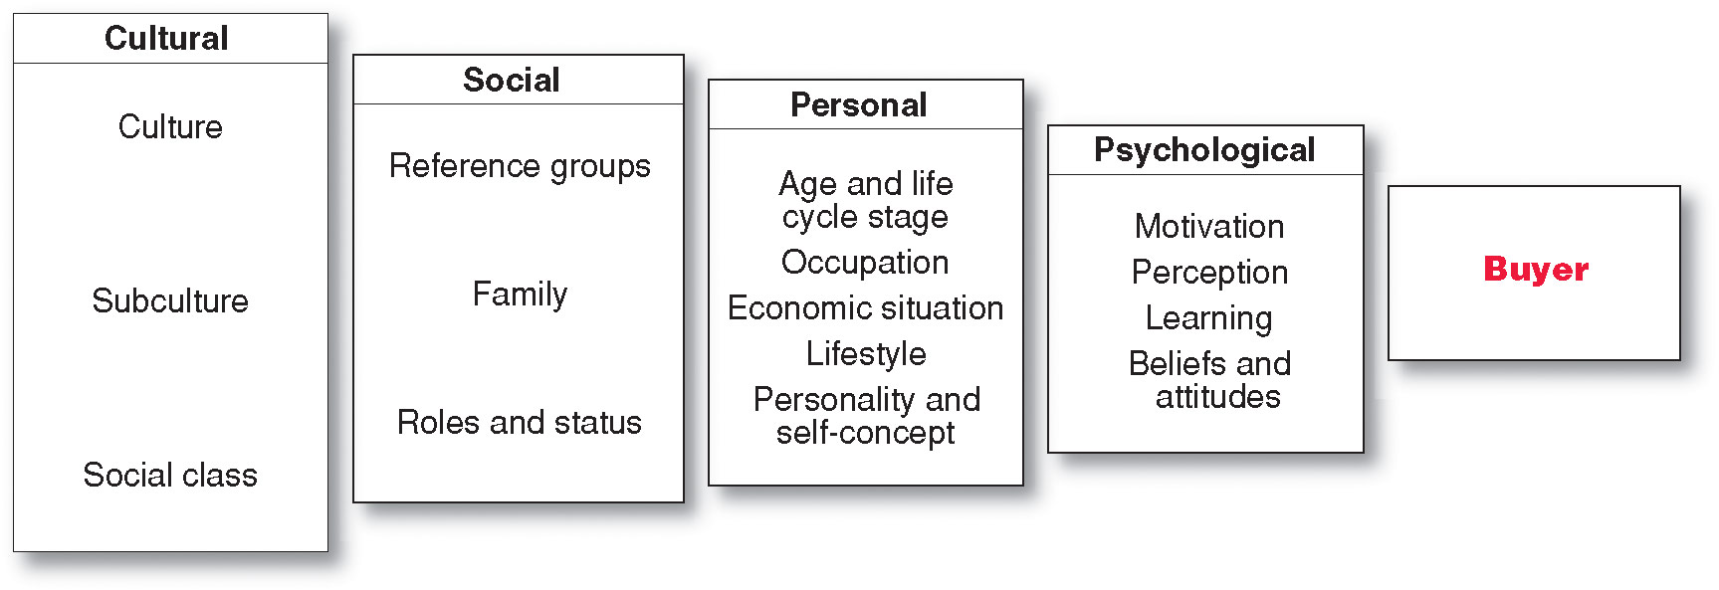
Characteristics Affecting Consumer Behavior
Factors Influencing Consumer Behavior
Notes:
Many levels of factors
affect our buying
behavior—from broad cultural and
social influences to motivations, beliefs,
and attitudes lying deep within us. For
example, why did you buy that specific
cell phone?

Slide 6
Characteristics Affecting Consumer Behavior
Culture is the learned values, perceptions, wants, and behavior from family and other important institutions
Notes:
Look for cultural shifts to discover new product opportunities. For instance, the shift toward a greater concern for fitness results in new foods, fitness centers, equipment, clothing.

Slide 7
Characteristics Affecting Consumer Behavior
Social Factors
Family is the most important consumer-buying organization in society
Social roles and status are the groups, family, clubs, and organizations that a person belongs to that can define role and social status
Notes:
Note to Instructor
Discussion Question
What brands do you purchase because it is what their parents used? Why do you think this occurs?

Slide 8
Characteristics Affecting Consumer Behavior
Personal Factors
Occupation affects the goods and services bought by consumers
Economic situation includes trends in:
Personal income
Savings
Interest rates

Slide 9
Characteristics Affecting Consumer Behavior
Psychological Factors
Motivation
Perception
Learning
Beliefs and attitudes

Slide 10
Characteristics Affecting Consumer Behavior
Psychological Factors
Beliefs and Attitudes
Belief is a descriptive thought that a person has about something based on:
Knowledge
Opinion
Faith

Slide 11
Types of Buying Decision Behavior
Complex buying behavior
Dissonance-reducing buying behavior
Habitual buying behavior
Variety-seeking buying behavior
Notes:
Some purchases are
simple and routine, even
habitual. Others are far more
complex—involving extensive
information gathering and
evaluation—and are subject to
sometimes subtle influences. For
example, think of all that goes into a
new car buying decision.

Slide 12
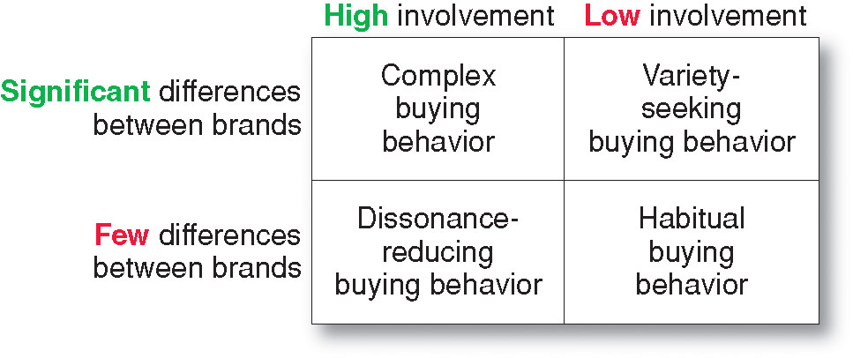
Types of Buying Decision Behavior
Four Types of Buying Behavior
Notes:
Buying behavior varies greatly for
different types of products. For example,
someone buying an expensive new PC
might undertake a full information gathering
and brand evaluation process.

Slide 13
The Buyer Decision Process
Buyer Decision Making Process
Notes:
The actual purchase
decision is part of a much
larger buying process—starting with
need recognition through how you feel
after making the purchase. Marketers
want to be involved throughout the
entire buyer decision process.

Slide 14
The Buyer Decision Process
Need Recognition
Occurs when the buyer recognizes a problem or need triggered by:
Internal stimuli
External stimuli
Notes:
The buying process starts long
before the actual purchase and
continues long after. In fact, it
might result in a decision not to
buy. Therefore, marketers must
focus on the entire buying process,
not just the purchase decision.
Internal stimuli when one of the person’s normal needs—for example,
hunger or thirst—rises to a level high enough to become a drive
External stimuli. For example, an advertisement or a discussion with a friend
might get you thinking about buying a new car.

Slide 15
The Buyer Decision Process
Information Search
Sources of Information
Personal sources—family and friends
Commercial sources—advertising, Internet
Public sources—mass media, consumer organizations
Experiential sources—handling, examining, using the product

Slide 16
The Buyer Decision Process
Evaluation of Alternatives
How the consumer processes information to arrive at brand choices
Notes:
Note to Instructor
This Web link brings you to PriceGrabber—an online comparison shopping site. What is interesting on this site is on the left hand side, you can search by features. These features help a consumer know how to evaluate a product. For instance, this example is laptop computers and one can search by processing speed, processor type, screen size, etc.

Slide 17
The Buyer Decision Process
Purchase Decision
The act by the consumer to buy the most preferred brand
The purchase decision can be affected by:
Attitudes of others
Unexpected situational factors

Slide 18
The Buyer Decision Process
Post-Purchase Decision
Customer satisfaction is a key to building profitable relationships with consumers—to keeping and growing consumers and reaping their customer lifetime value

Slide 19
The Buyer Decision Process for New Products
Adoption process is the mental process an individual goes through from first learning about an innovation to final regular use.
Stages in the process include:
Awareness
Interest
Evaluation
Trial
Adoption

Slide 20
All rights reserved. No part of this publication may be reproduced, stored in a retrieval system, or transmitted, in any form or by any means, electronic, mechanical, photocopying, recording, or otherwise, without the prior written permission of the publisher. Printed in the United States of America.
Copyright © 2012 Pearson Education, Inc.
Publishing as Prentice Hall

