Slide 1
Quantitative Proteins Estimation by Biuret method
BCH302 [Practical]

Slide 2
Importance of determining concentration of protein :
Quantitative assays ➔ determine the concentration of a substance.
Protein assays are one of the most widely used methods in life science research.
Estimation of protein concentration is necessary in protein purification, cell biology, molecular biology and other research applications.
Is necessary before processing protein samples for isolation, separation and analysis.

Slide 3
Specificity and Sensitivity of a method:
Sensitivity of an assay is a measure of how little of the analyte the method can detect.
Specificity of an assay relates to how good the assay is in discriminating between the requested analyte and interfering substances.

Slide 4
Most familiar spectrophotometric methods for Determination of proteins concentration :
Bicinchoninic acid method
Biuret
Lowry
Bradford
Warburg Christian (A280/A260)
There are a wide variety of protein assays available, but each assay has its own advantages and limitations.
The factors that you should consider in choosing a method:
Sensitivity.
The presence of interfering substance.
Time available of the assay.

Slide 5
Standard curve:
It is a graph that shows the relationship between different known concentrations of a substance and the absorbance at a specific wave length.
Standard curve are most commonly used to determine the concentration of a unknown substance, using serial dilution of solutions of known concentrations[standard solution], such as (Bovine serum Albumin) BSA and casein.
There is a linear relationship between absorbance and concentration.

Slide 6
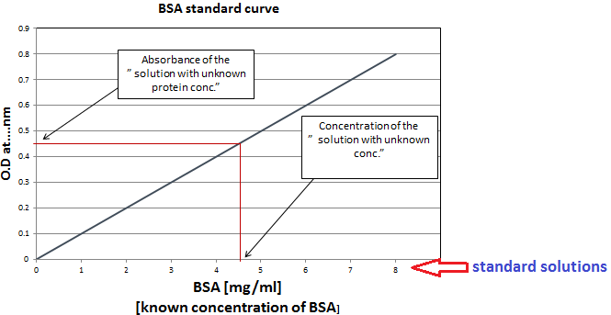
Determination of unknown concentration by standard curve:

Slide 7
Practical part

Slide 8
Objectives:
Determination of an unknown concentration for protein sample by Biuret method.
Getting familiar with standard curve.

Slide 9
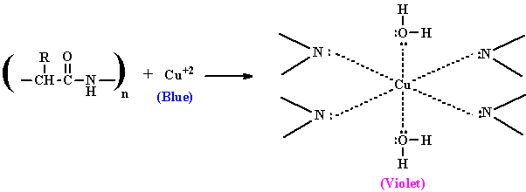
Biuret method:
Principle:
In this reaction, proteins form a purple colored complex with CuSO₄ (copper sulfate) in a strongly alkaline solution.
When peptide bonds in proteins and peptides treated with an alkaline solution of dilute copper sulfate (Biuret reagent ) a violet color is formed ➔ A positive test is indicated by the formation of a violet color.
The color density is proportional to amount of proteins present.

Slide 10
From lower to higher concentration
There is a linear relationship between purple colour developed and concentration.

Slide 12
Experiment 1 : Estimation of protein concentration by Biuret method
Method:
Set up 8 tubes as follows:
Let the tubes stand at room temperature for 10 min.
Read absorbance at 540 nm against the blank.
Tube | Water (ml) | Bovine serum albumin Standard Concentration [5g/l] | sample [unknown concentration] | Biuret reagent( ml )
Blank | 2 | - | - | 3
1 | 1.6 | 0.4 | -
2 | 1.2 | 0.8 | -
3 | 1 | 1 | -
4 | 0.8 | 1.2 | -
5 | 0.6 | 1.4 | -
6 | 0.4 | 1.6 | -
Unknown concentration sample | - | - | 2

Slide 13
Experiment 1 : Estimation of protein concentration by Biuret method
Results:
Plot a standard curve for absorbance at 540 nm against Albumine std. concentration (mg/dl).
From the standard curve find out the unknown protein concentration.
Tube | Albumin concentration (mg/dl) [X- axis] | Absorbance at 540nm [Y-axis]
1 | C₁ X V₁ = C₂ X V₂ 500 x 0.4 = ? x 2
2
3
4
5
6

