Slide 1
King Saud University College of Engineering IE – 341: “Human Factors Engineering” Spring – 2016 (2nd Sem. 1436-7H)
Chapter 10. Human Control of Systems (Compatibility) – Part I
Prepared by: Ahmed M. El-Sherbeeny, PhD

Slide 2
Contents
Introduction
Spatial Compatibility
Applications
Movement Compatibility
Applications
Modal Compatibility (from ch. 3)
Application

Slide 3
Introduction
Human function in system control:
Receive information
Select action mode
Execute action
Human action:
Becomes control input to the system
Remember (Ch. 1) output of 1 system ⇒ input to another system
Output of system: usually as feedback regarding effects of action
Then human function starts again (as listed above, and so forth)
Human functions involved with system control:
Compatibility (discussed here; most important), also:
Tracking (not discussed here)
Supervisor control (not discussed here)
Notes:
Source: Sander and McCormick (Ch. 10), 1993

Slide 4
Cont. Introduction
Compatibility:
Considers relation between controls and displays
Determines how easy and convenient people choose and perform correct actions given several alternatives
Definition:
“degree to which relationships are consistent with human expectations”
Types of compatibility
Conceptual, Spatial, Movement, and Modality (discussed in ch. 3)
Discuss here: spatial and movement i.t.o. relation between control & display
Effect of compatibility:
Faster learning
Faster reaction/response time (RT)
Less errors
Higher user satisfaction
Notes:
Source: Sander and McCormick (Ch. 10), 1993
i.t.o.: in terms of

Slide 5
Cont. Introduction
Effect of non-compatibility:
People can get used to non-compatible (“out of sync”) systems, but:
There’s higher information processing burden on user (i.e. more thinking)
Under stress conditions: user may make compatible (i.e. natural response) ⇒ which (here) will be incorrect response ⇒ error or accident
Special considerations for compatibility relationships
Some are stronger than others
E.g. when shared by a larger group of population than others
Sometimes it is necessary to violate a compatibility relationship to make use of another one
E.g. study by Bergum (1981) for subject group 93% expected upward movement of pointer ⇒ increase 71% (of same group) expected numbers to increase: top to bottom!
Notes:
Source: Sander and McCormick (Ch. 10), 1993

Slide 6
Spatial Compatibility
Notes:
Cognitive: المعرفي

Slide 7
Spatial Compatibility
Types of spatial compatibility
Physical similarities of displays and controls
Physical arrangement of displays and controls
Physical similarities of displays and controls
Involves design of displays/controls in order to have similar:
Physical features
Modes of operation
Case 1: study by Fitts and Seeger (1953)
Three displays / three controls (all combinations used) (see next slide)
Displays: lights in various arrangements
With light operation ⇒ subject moves stylus along corresponding channel to turn light off
Each group of subjects attempted each of 9 possible combinations
Performance measured as: RT, errors, information lost (bits)
Results:
Best performance: when stimulus panel resembled response panel
Best combinations (S_{a}-R_{a}, S_{b}-R_{b} , S_{c}-R_{c})
Notes:
Source: Sander and McCormick (Ch. 10), 1993

Slide 8
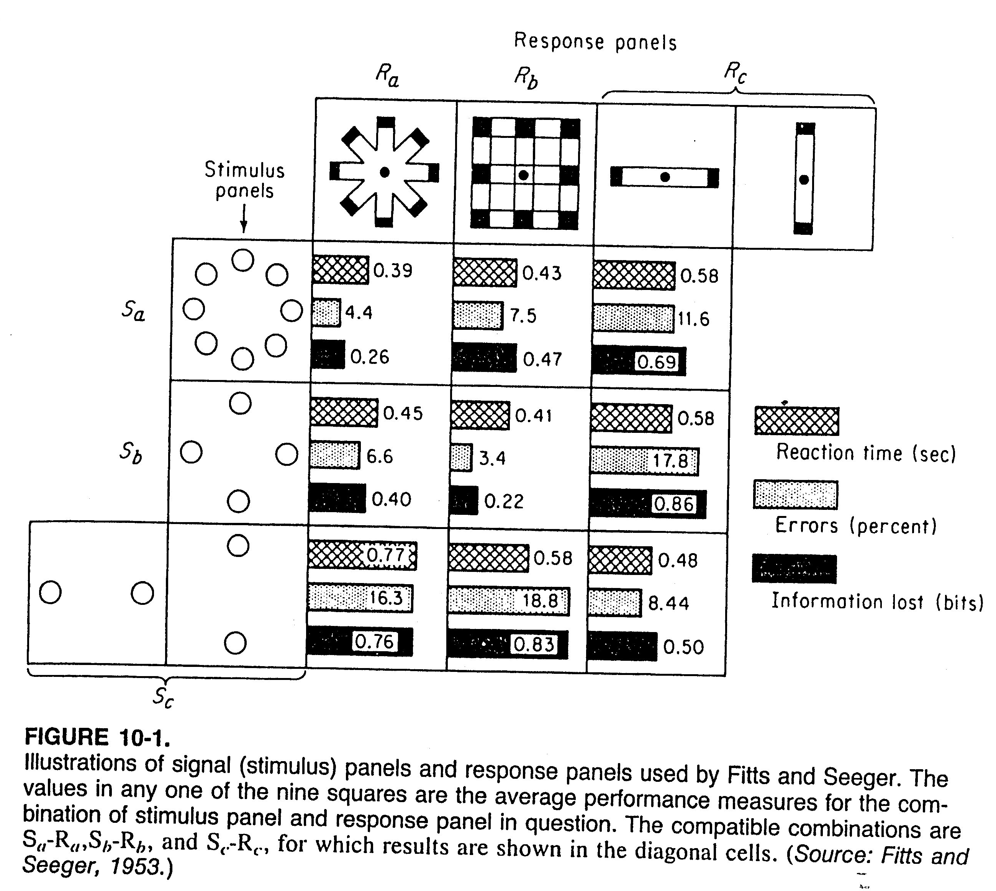
Cont. Spatial Compatibility
Cont. A. Physical similarities of displays and controls
Notes:
Source: Sander and McCormick (Ch. 10), 1993

Slide 9
Cont. Spatial Compatibility
Cont. A. Physical similarities of displays and controls
Case 2: keyboard and screen (Bayerl, et al, 1988)
Keys on keyboard arranged as:
Rows on top or
Columns on one side (see next slide)
Meaning of keys depends on software (as screen label for each key)
Authors compared different screen vs. keyboard layouts, i.t.o:
Mean time to find and press keys (i.e. RT)
Result:
RT is smaller (i.e. higher compatibility) when labels (on screen) and keyboard configurations are physically similar
Notes:
Source: Sander and McCormick (Ch. 10), 1993

Slide 10
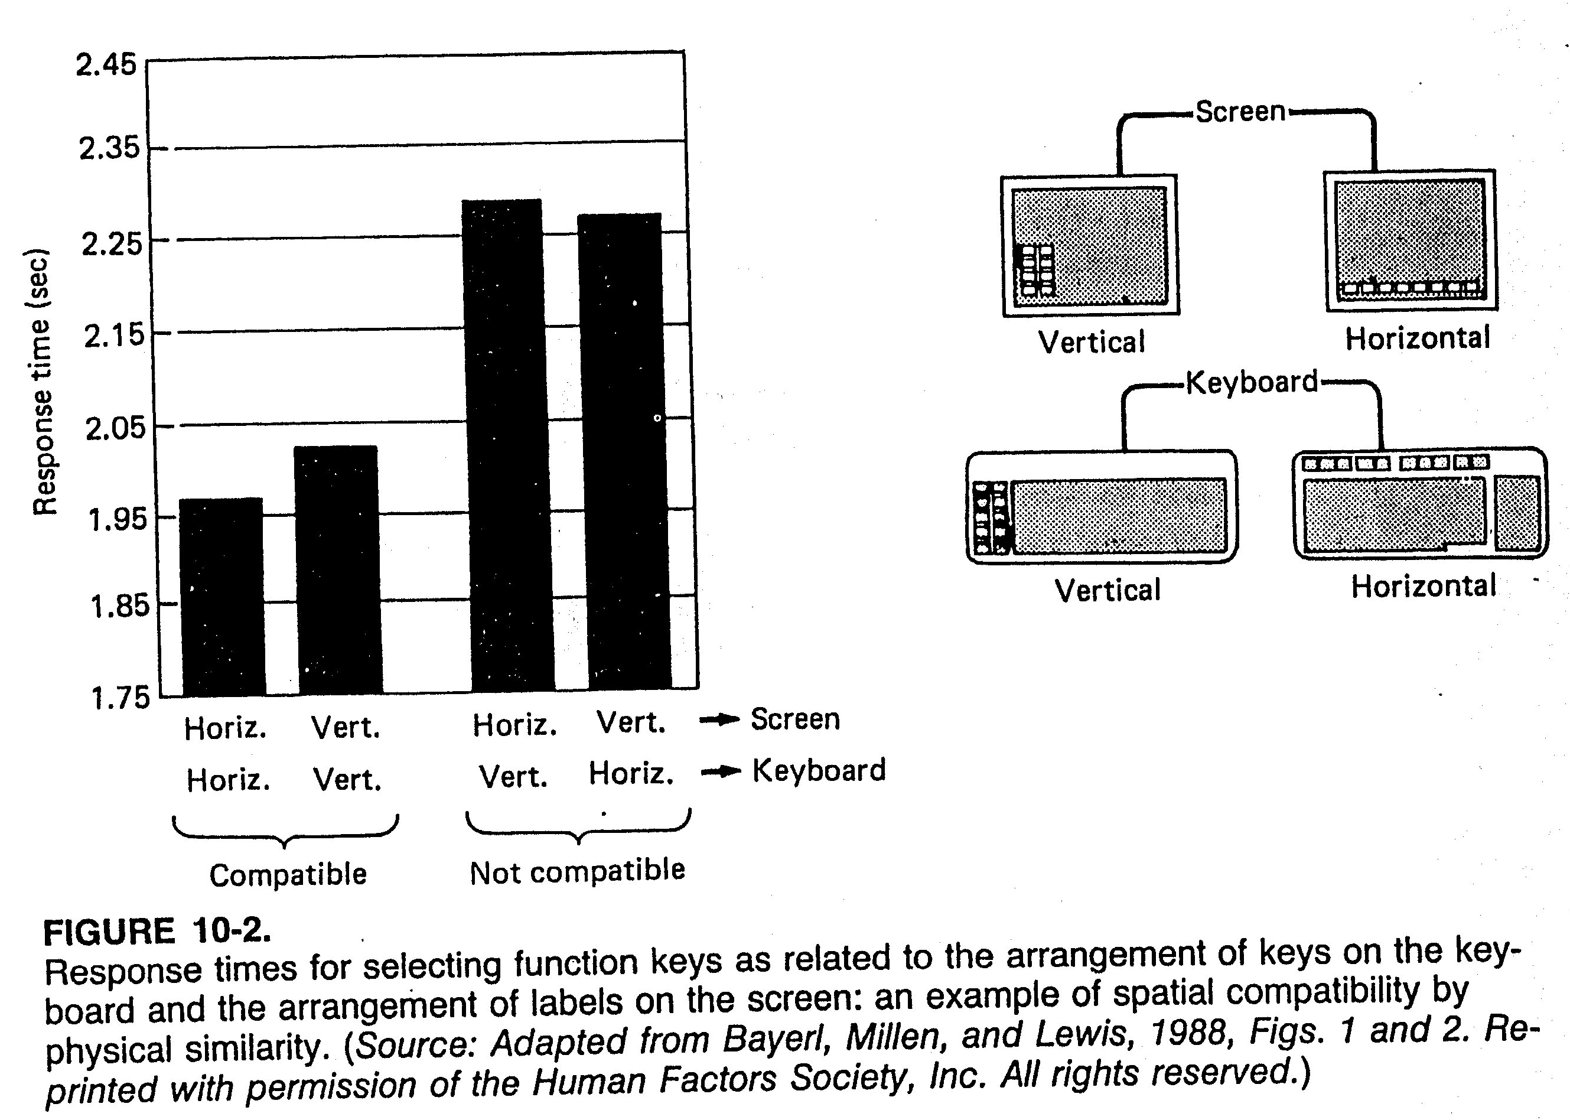
Cont. Spatial Compatibility
Cont. A. Physical similarities of displays and controls
Notes:
Source: Sander and McCormick (Ch. 10), 1993

Slide 11
Cont. Spatial Compatibility
Physical arrangement of displays and controls
This involves applications of findings of first two experiments
Most famous: burner control arrangement on 4-burner stove
Control-Burner arrangement experiments
Several studies conducted (Chapanis, 1959; Ray, 1979) (see next slide)
Subjects:
Presented with various arrangements of controls / burners
Asked to turn on specific burners
Number of errors recorded
Results:
Two studies similarly ranked various arrangements
Exercise: rank arrangements on following slide from best to worst
Notes:
Source: Sander and McCormick (Ch. 10), 1993
Best arrangement: I (offset burners), then for aligned burners: II

Slide 12
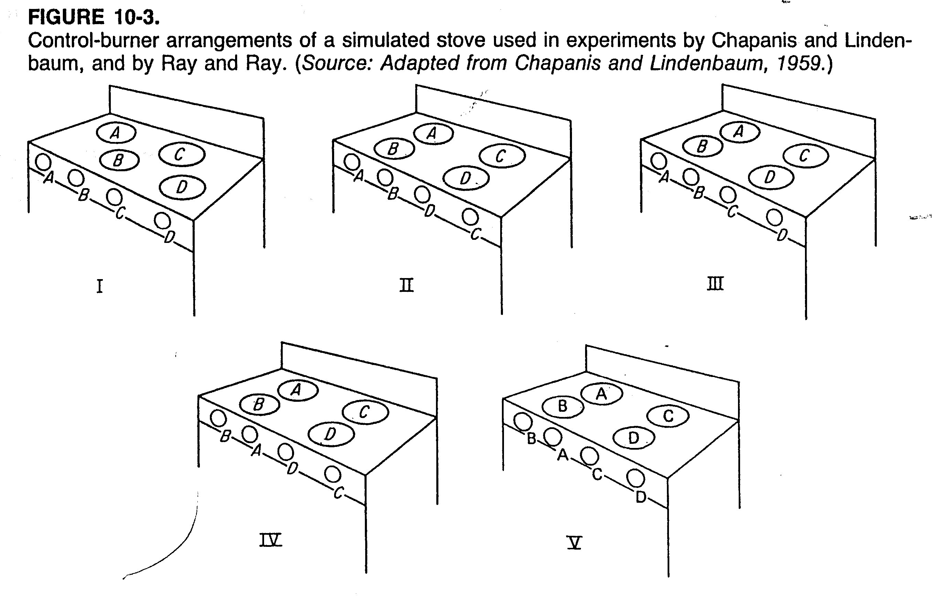
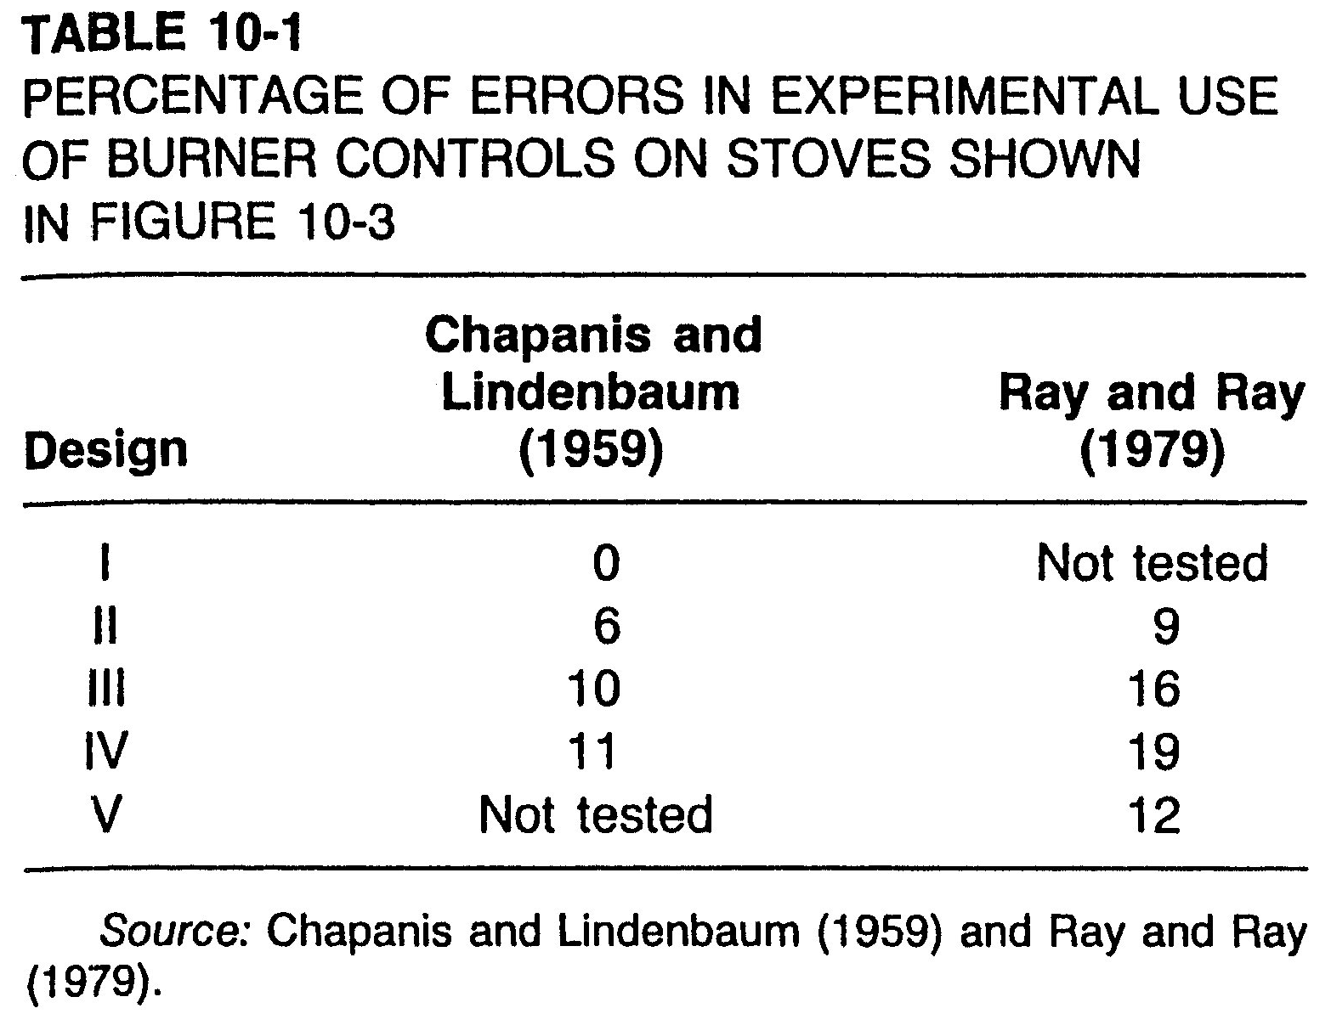
Cont. Spatial Compatibility
Cont. B. Physical arrangement of displays and controls
Notes:
Source: Sander and McCormick (Ch. 10), 1993

Slide 13
Cont. Spatial Compatibility
Cont. B. Physical arrangement of displays and controls
Cont. Control-Burner arrangement experiments
Another experiment (Shinar, 1978):
Subjects asked to indicate burners for unmarked controls ⇒
31% chose arrangement III
25% chose arrangement II (yet with less errors than III)
Conclusions:
People don’t always choose options resulting in optimum performance
Better to use performance measures (vs. subjective measures) to decide on best display/control arrangements
Notes:
Source: Sander and McCormick (Ch. 10), 1993

Slide 14
Cont. Spatial Compatibility
Cont. B. Physical arrangement of displays and controls
Cont. Control-Burner arrangement experiments
Another experiment (Osborne, 1987):
Added “sensor lines” to stove top (see next slide):
Lines are drawn from controls to corresponding displays
Senor lines: either partial or complete set
They used arrangement II (from first experiments)
Offset arrangement (from first experiments) also added for comparison
Which do you think gave: least RT, least errors?
Results: sensor lines ⇒ greatly reduced RT, almost eliminated errors
Errors | Response Time | Arrangement
0 | $$917 ms$$ | Offset (I)
0 | $$980 ms$$ | Aligned (II) – complete sensor lines
0 | $$997 ms$$ | Aligned (II) – partial sensor lines
$$6−9 \%$$ | Most time* | Aligned (II) – no sensor lines
Notes:
Source: Sander and McCormick (Ch. 10), 1993
* Text states that adding sensor lines reduced RT by 113 ms, but how much was the original RT?

Slide 15
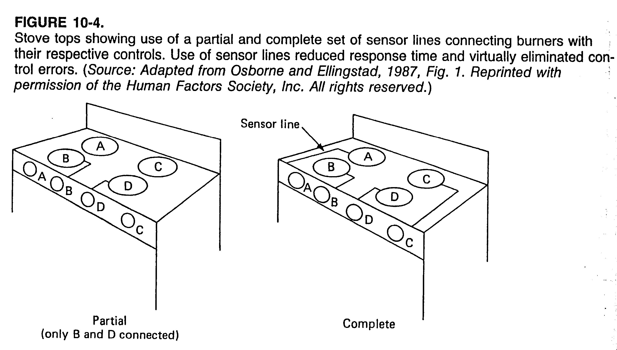
Cont. Spatial Compatibility
Cont. B. Physical arrangement of displays and controls
Notes:
Source: Sander and McCormick (Ch. 10), 1993

Slide 16
Cont. Spatial Compatibility
Cont. B. Physical arrangement of displays and controls
Cont. Control-Burner arrangement experiments
Watch example in YouTube video:
“Ergonomics and Design” (from start until 4:06)
https://youtu.be/LAKlmdMHpdE?list=PLV-xlApuz3HbJ66G4pqxzdYO7o_3xZEi1
Note the Stove example
Notes:
Source: Sander and McCormick (Ch. 10), 1993
* Text states that adding sensor lines reduced RT by 113 ms, but how much was the original RT?

