Slide 1
King Saud University College of Engineering IE – 341: “Human Factors Engineering” Fall – 2017 (1st Sem. 1438-9H)
Chapter 10. Human Control of Systems Compatibility – Part II (Movement, Modality)
Prepared by: Ahmed M. El-Sherbeeny, PhD

Slide 2
Contents
Introduction
Spatial Compatibility (p1)
Applications
Movement Compatibility (p2)
Applications
Modality Compatibility (from ch. 3)
Application

Slide 3
Movement Compatibility
Notes:
Cognitive: المعرفي

Slide 4
Movement Compatibility
Cases when movement compatibility is important:
Movement of control device to follow (e.g. right) movement of display
Movement of control device to control movement of display (e.g. radio)
Movement of control device to produce specific system response (e.g. turning steering wheel left/right)
Movement of display indicator with no related response (e.g. clock)
Population stereotypes:
This is expectation of people regarding movement relationships
Some stereotypes are stronger than others
Factors affecting movement compatibility:
Features of controls and displays
Physical orientation (i.e. position) of user (e.g. is user in same/different plane than control?)
Notes:
Source: Sander and McCormick (Ch. 10), 1993

Slide 5
Cont. Movement Compatibility
Principles of movement compatibility:
Rotary Controls and Rotary Displays in Same Plane
Rotary Controls and Linear Displays in Same Plane
Movement of Displays and Controls in Different Planes
Movement Relationships of Rotary Vehicular Controls
Movement Relationships of Power Switches
Orientation of Operator and Movement Relationships
Discussion
Notes:
Source: Sander and McCormick (Ch. 10), 1993

Slide 6
Cont. Movement Compatibility
Cont. Principles of movement compatibility:
Rotary Controls and Rotary Displays in Same Plane:
Fixed rotary scales with moving pointers
Moving scales with fixed pointers
Fixed rotary scales with moving pointers:
Well-established principles
CW rotation of control ⇒
CW rotation of pointer
Increase in value of variable
CCW rotation of control ⇒
CCW rotation of pointer
Decrease in value of variable
Notes:
Source: Sander and McCormick (Ch. 10), 1993

Slide 7
Cont. Movement Compatibility
Cont. Principles of movement compatibility:
Rotary Controls and Rotary Displays in Same Plane:
Fixed rotary scales with moving pointers
Moving scales with fixed pointers
Moving scales with fixed pointers (Bradley, 1954):
Scale should rotate in same direction (AKA “direct drive”) as its knob
Scale numbers should increase: left to right
Control should turn CW to increase settings
Note, not possible to implement all 3 principles at the same time (in one setup)
Can you test this from figures on right?
Notes:
Source: Sander and McCormick (Ch. 10), 1993

Slide 8
Cont. Movement Compatibility
Cont. Principles of movement compatibility:
Rotary Controls and Rotary Displays in Same Plane:
Fixed rotary scales with moving pointers
Moving scales with fixed pointers
Moving scales with fixed pointers (Bradley, 1954)
Experiment by Bradley: (next slide)
Only two principles can be achieved at the same time
Tested various control-display assemblies
Criteria:
starting errors (initial movement in wrong direction)
setting errors (incorrect settings)
rank-order preferences of subjects (i.e. subjective preference)
Results: most important principles (in desc. order of preference)
Direct linkage (“drive”) between control and display (A & B) (most imp)
Scale numbers increase left to right
CW control movement ⇒ increased setting (least imp)
Notes:
Source: Sander and McCormick (Ch. 10), 1993

Slide 9
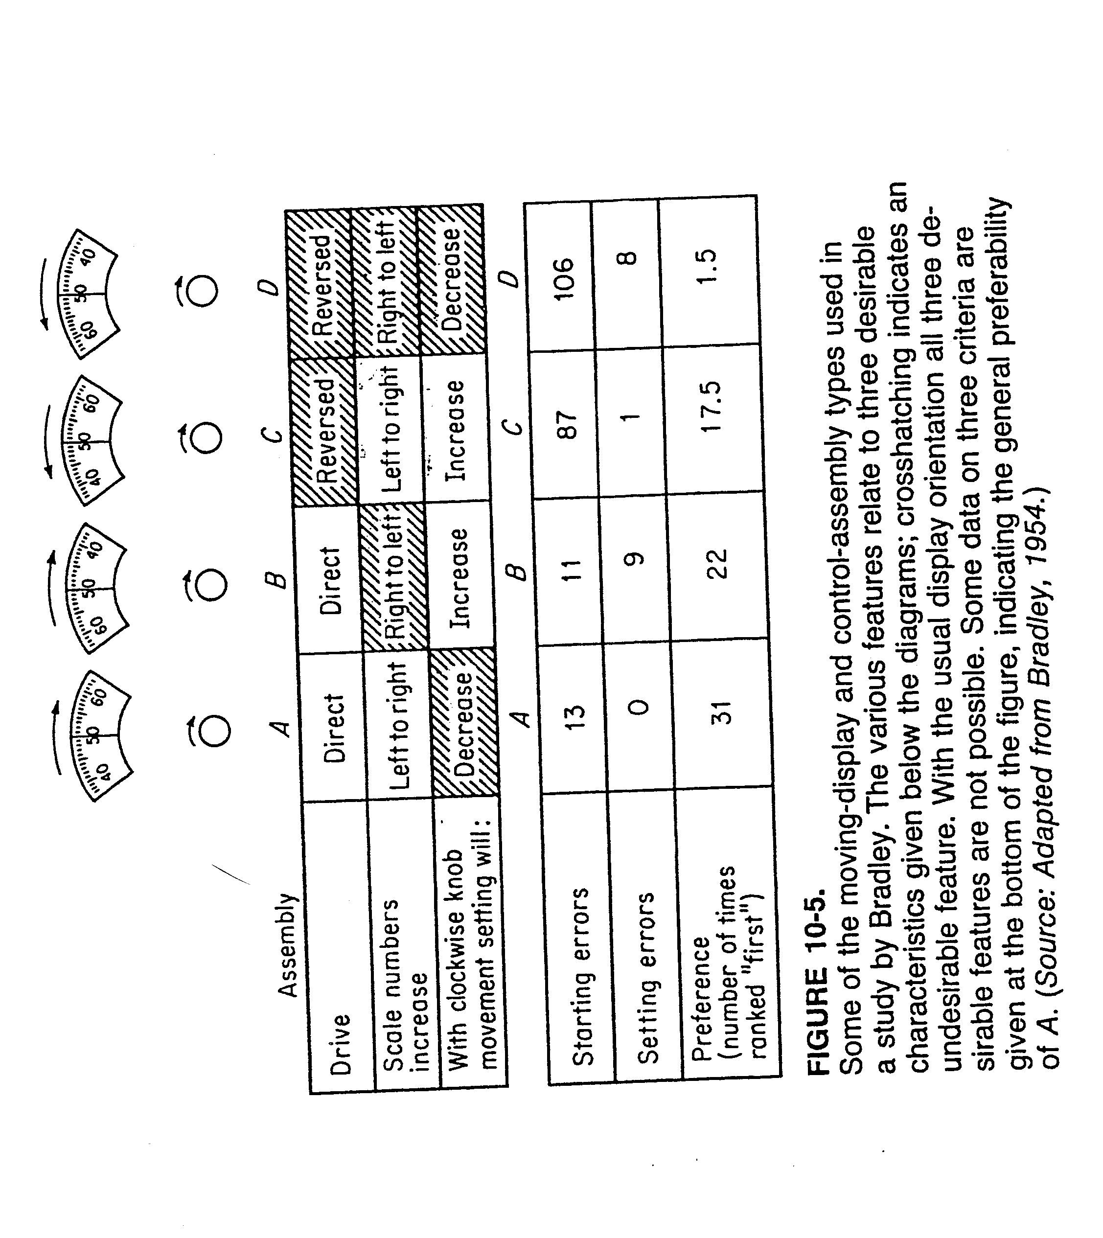
Cont. Movement Compatibility
Notes:
Source: Sander and McCormick (Ch. 10), 1993

Slide 10
Cont. Movement Compatibility
Cont. Principles of movement compatibility:
Rotary Controls and Linear Displays in Same Plane
Control can be placed: above, below, to left, or to right of display
Three Compatibility principles:
Warrick’s principle (Warrick, 1947):
pointer on display should move in same direction as the side of control nearest to it is
Note, this applies only when control is located to side of display
e.g. when control is on right ⇒ CW rotation will make pointer go up
Two more principles (Brebner, 1976), specifically for vertical displays:
Scale side principle: pointer should move in same direction as side of control knob which is on same side as scale markings on display*
This works when control is top / bottom / side of vertical display
Clockwise-for-increase principle: when people turn rotary control CW ⇒ value of display increases no matter where control is (relative to display)
Three principles compared on next slide (1976, 1981)
Notes:
* e.g. when scale markings are pointing to the right, then moving the control CW will make pointer follow my hand (down), and vice versa

Slide 11
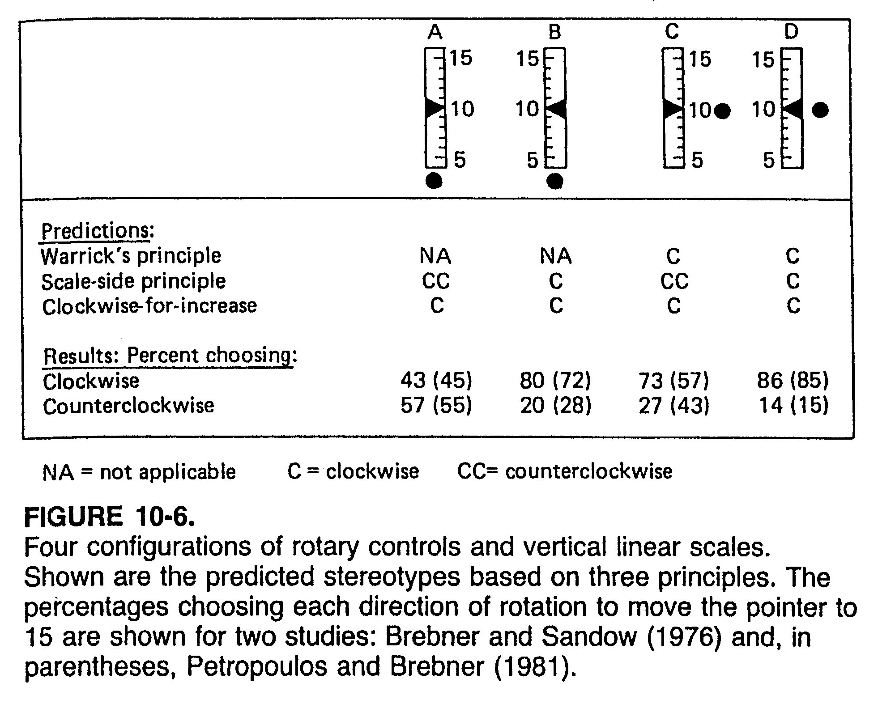
Cont. Movement Compatibility
Notes:
Q: Can you justify why controls are shown on right and bottom only?
A: bottom, since top will block display below; right, since right-handed person can see display on left

Slide 12
Cont. Movement Compatibility
Cont. Principles of movement compatibility:
Movement of Displays and Controls in Different Planes (i.e. 3-D device)
Investigated types:
Rotary controls with linear displays (in different planes)
Stick-type controls with linear displays (in different planes)
Principles for rotary controls (Holding,1957):
General CW for increase
Helical/screwlike hand tendency for movement:*
CW rotation is associated with moving away from individual
CCW rotation is associated with moving towards individual
Notes:
* Applies here for right-handed person

Slide 13
Cont. Movement Compatibility
Cont. Principles of movement compatibility:
Cont. Movement of Displays and Controls in Different Planes (i.e. 3-D device)
Stick-type controls with linear displays
Case 1: study by Spragg, Finck, and Smith (1959)
Investigated 4 combinations of control-display movements (next slide)
Involved with tracking task
For horizontally mounted stick (vertical plane):
Up-up relationship (i.e. move control up ⇒ display moves up): preferred
Up-down relationship: less preference
For vertically mounted stick (horizontal plane):
Less difference between forward-up and forward-down relationship

Slide 14
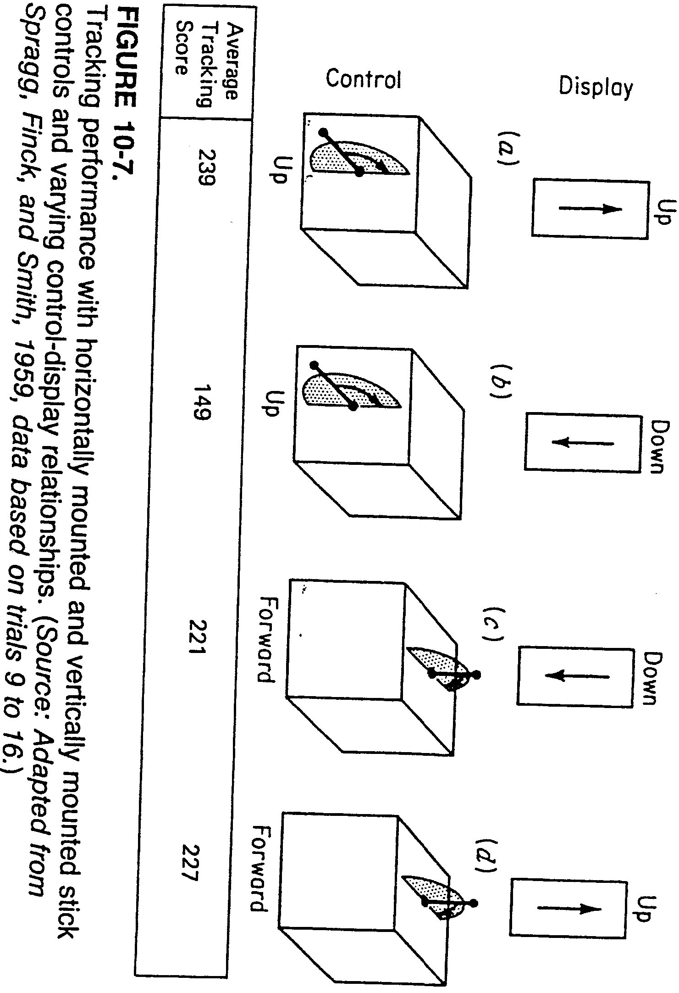
Cont. Movement Compatibility

Slide 15
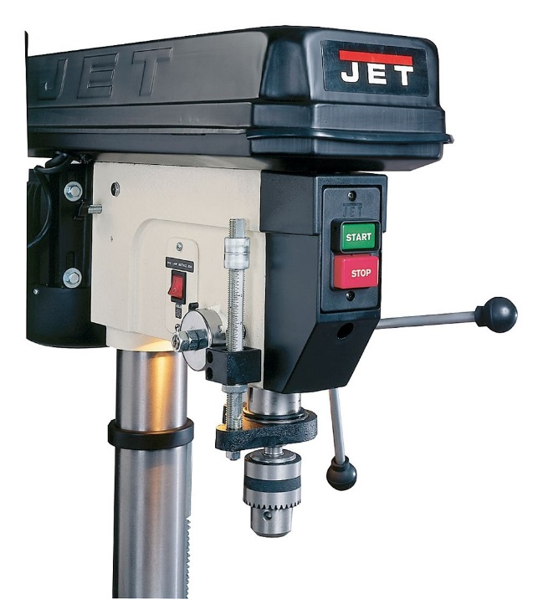
Cont. Movement Compatibility
Cont. Principles of movement compatibility:
Cont. Movement of Displays and Controls in Different Planes (i.e. 3-D device)
Cont. Stick-type controls with linear displays
Case 2: study by Grandjean (1988)
Used results from earlier experiment
Conducted experiment shown in next slide
Note, Simpson (1988) found some reservations to these results:
When Controlling up-down movement is required e.g. drill presses, scoops
Stereotype: to move component up ⇒ need to move control forward
Another stereotype: to move component down ⇒ move control lever aft (behind)
Conclusion: use fore/aft control to raise/lower components (vs. up/down movements)

Slide 16
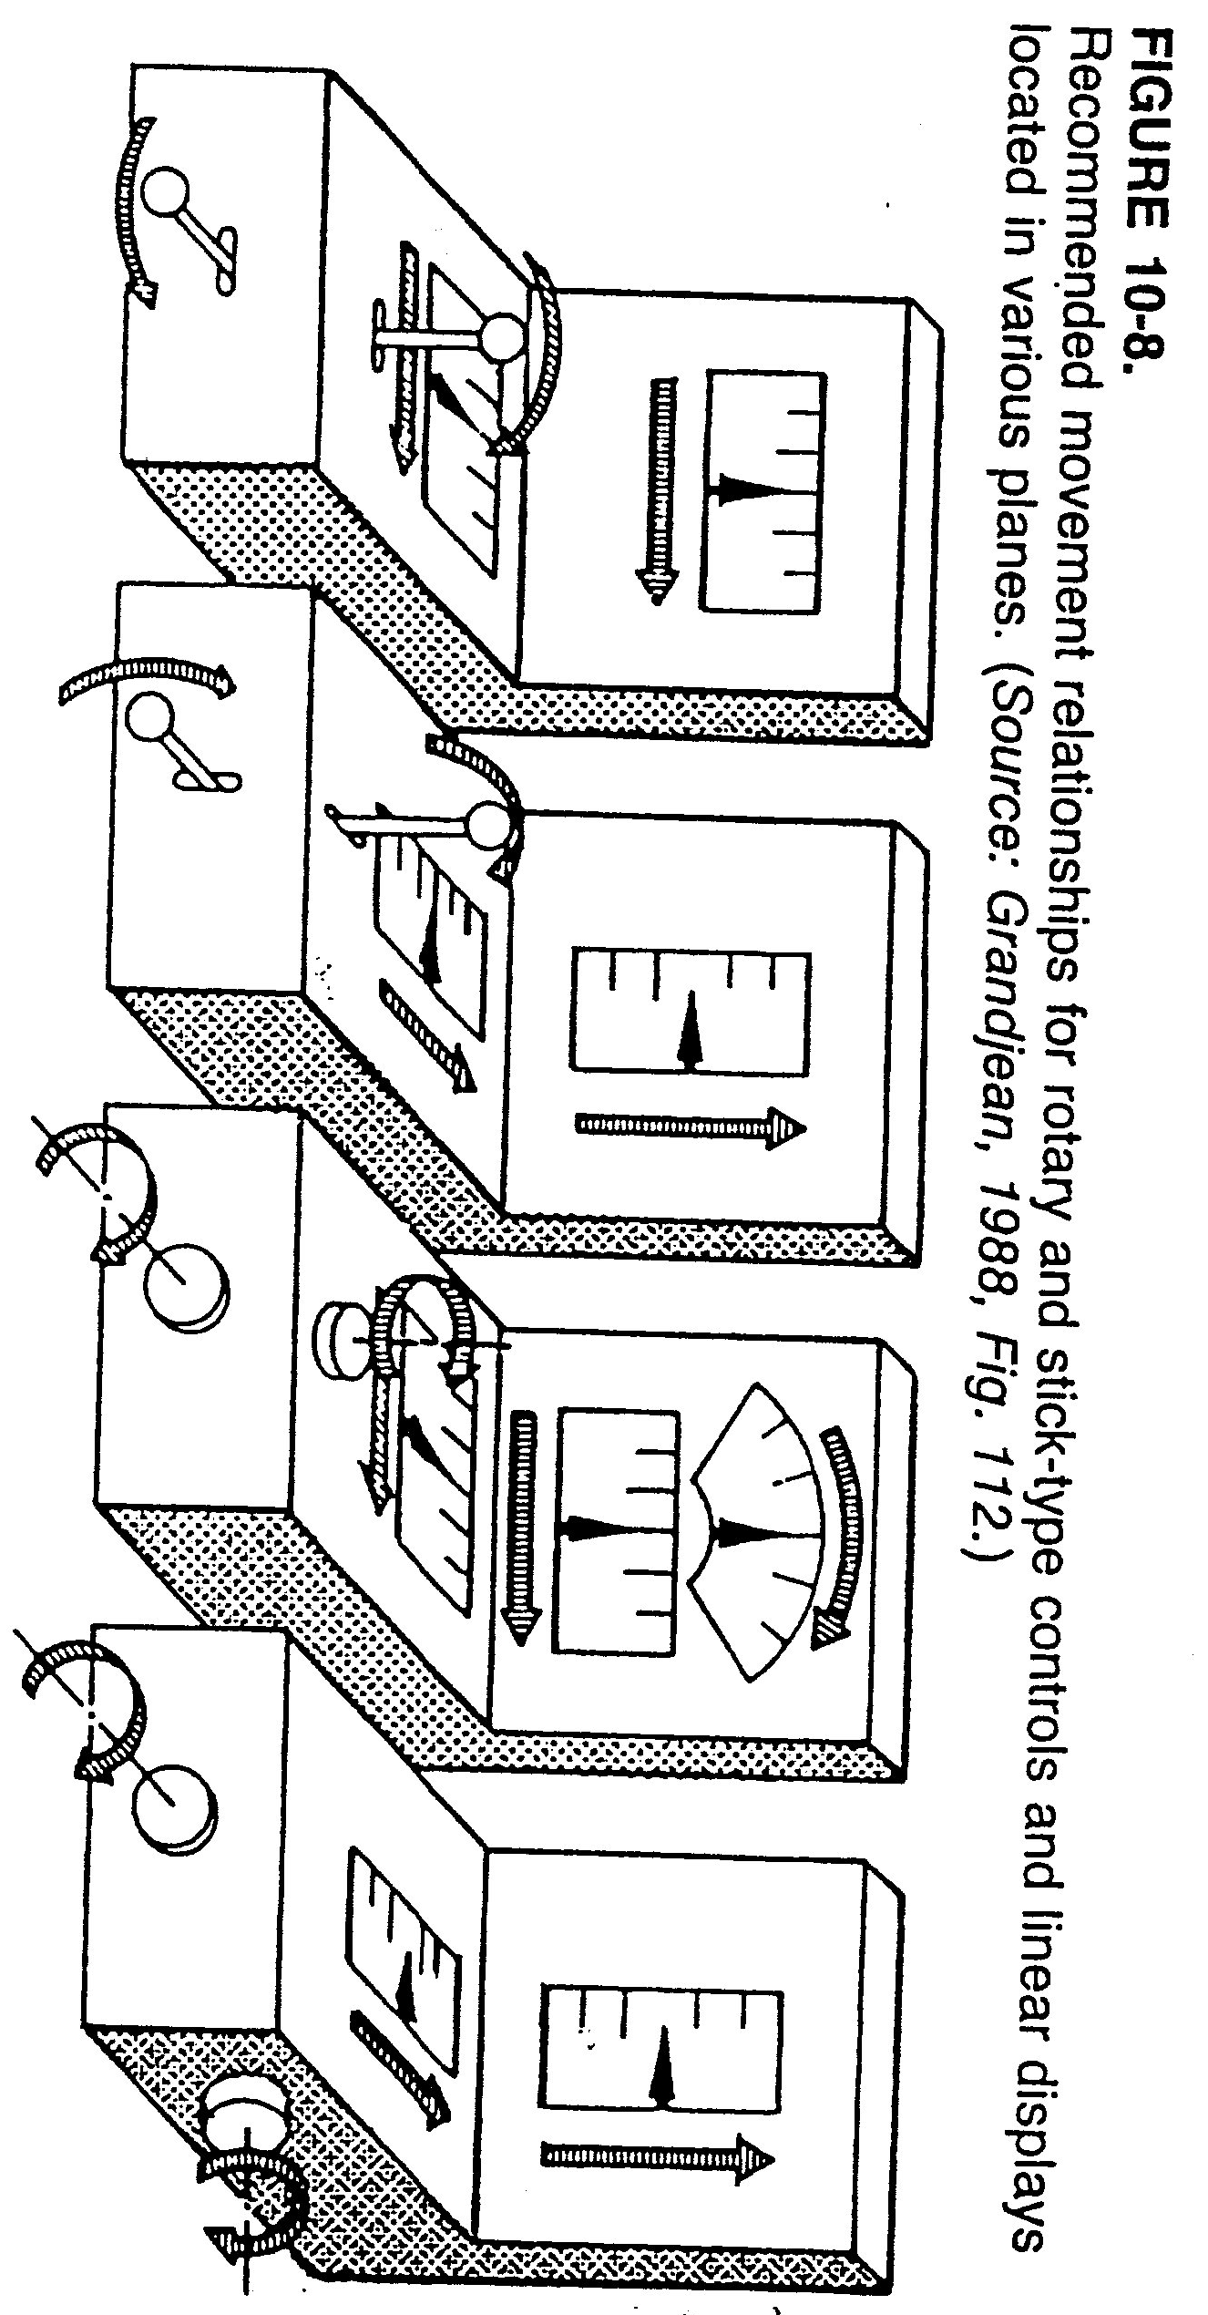
Cont. Movement Compatibility

Slide 17
Cont. Movement Compatibility
Cont. Principles of movement compatibility:
Movement Relationships of Rotary Vehicular Controls
In car, there is no “display” of system “output”
There is just “response” of vehicle (to control)
Compatibility Principles
If wheel is in horizontal plane ⇒ operator orients him/herself to forward point of control
If wheel is in vertical plane ⇒ operator orients him/herself to top of control (see next slide)
Case study: shuttle cars for underground coal miners:
Control wheel exists for controlling left/right turns
Wheel is on right side of car relative to driver as car goes in one direction
Thus, when going in opposite direction ⇒ wheel is on driver’s left
Result: new drivers have significant problem learning to control cars
Can you suggest solution?

Slide 18
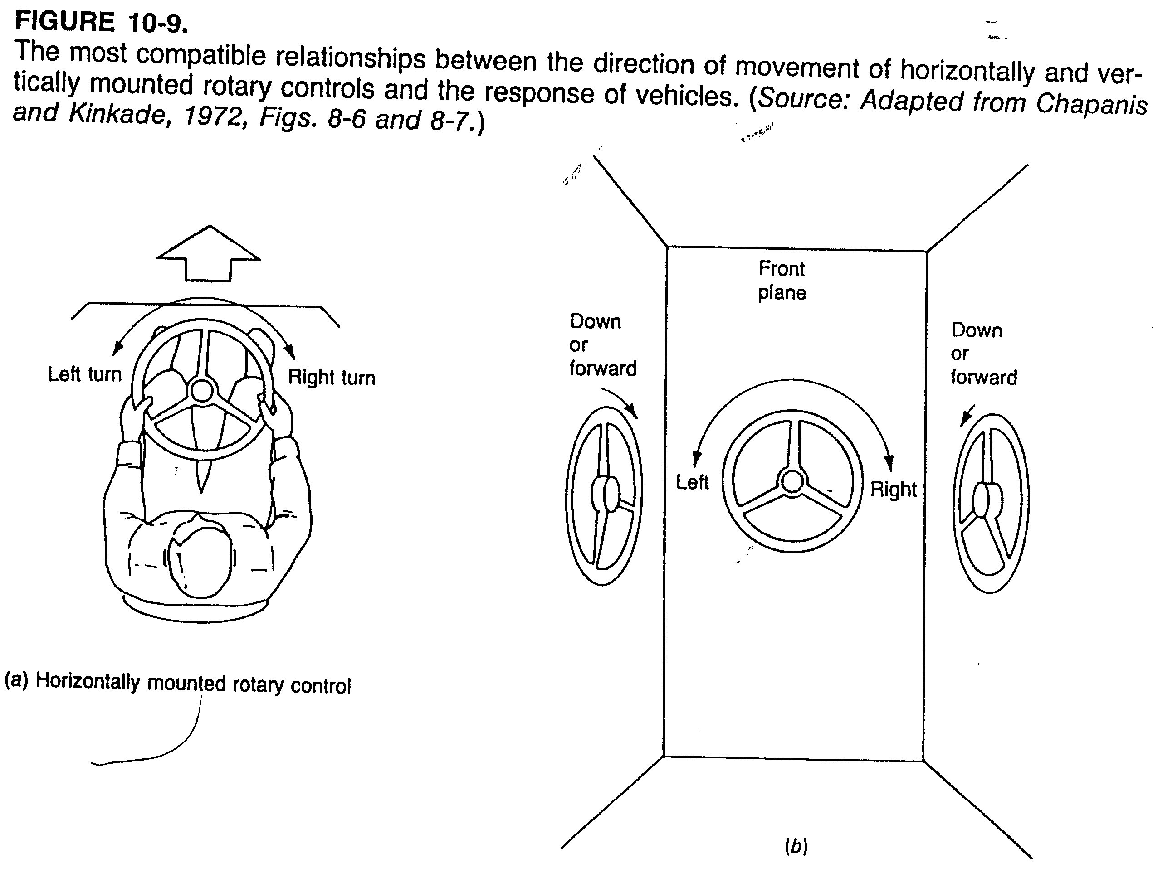
Cont. Movement Compatibility

Slide 19
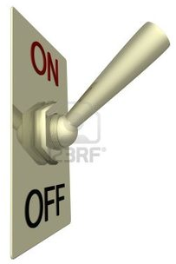
Cont. Movement Compatibility
Cont. Principles of movement compatibility:
Movement Relationships of Power Switches
US stereotype: up = on, down = off
UK stereotype: opposite
What about left-right operation?
Experiment: Lewis (1986)
Measure: %ge of subjects choosing option:
Up = on (97%)
Right = on (71%)
Away = on (52%)
Conclusions:
Stick with vertical power switches (as shown)
Other orientations are not encouraged

Slide 20
Cont. Movement Compatibility
Cont. Principles of movement compatibility:
Orientation of Operator and Movement Relationships
Previous cases: operator faces display, control in front of body
In some situations: operator looking at $90°$ or $180°$ angle from control
e.g.: adjusting car’s right mirror remotely on dashboard (in front of driver) ⇒ mirror is at $90°$ angle to right of control
Three principles of directional compatibility:
Experiments conducted by Worringham and Beringer (1989), next slide
Subjects were shown target on monitor, asked to move cursor to target using control lever
Measure: mean RT (to first movement)
Control-display compatibility
Control movement in one direction ⇒ parallel movement of cursor on display, independent of operator position or orientation
i.e. it doesn’t matter which way operator is facing

Slide 21
Cont. Movement Compatibility
Location of screen
Direction of arm movement for rightward cursor

Slide 22
Cont. Movement Compatibility
Cont. Principles of movement compatibility:
Orientation of Operator and Movement Relationships
Cont. Three principles of directional compatibility:
Control-display compatibility
Visual-motor compatibility
Direction of motion of cursor in subject’s visual field while looking at display = same as direction of motor response if looking at controlling limb
e.g. to move cursor to right as subject looks at display ⇒ move control to right (just as if you were looking at control)
This compatibility produced shortest RT
Visual-trunk compatibility
Direction of movement of cursor in subject’s visual field while looking at display = same as direction of movement control relative to subject’s trunk
e.g. to move cursor to right as subject looks at display ⇒ move control right from body centerline (regardless of head/body position)

Slide 23
Cont. Movement Compatibility
Cont. Principles of movement compatibility:
Discussion
Clear stereotypes exist (yet not universal, and not in every case)
When stereotype is not present, or when principles are in conflict:
Designer must make decision, e.g.:
Design control-display relationships to match those existing in other systems already being used by intended population
Choose relationship that is logical/explainable (this also makes it easier to train people to use it)
In absence of stereotype, previous experience, and logical principle:
Base design decision on empirical tests of possible relationships using intended user population

Slide 24
Modality Compatibility
Notes:
Cognitive: المعرفي

Slide 25
Modality Compatibility
What modality compatibility* refers to:
Some stimulus-response modality combinations: more compatible with certain tasks than others
Study by Wickens, Sandry, and Vidulich (1983):
Participants performed either (see next slide),
Verbal task (respond to command, “turn on radar beacon tacan**”)
Spatial task (bring cursor over a specified target)
Each task presented through either,
Auditory (A) modality (speech)
Visual (V) modality (display on screen)
Participant responded either by,
Speaking (S) response
Manually (M) performing the command
Results shown in next slide (all presentation/response modalities):
RT measured for each of the presentation/response modalities
Most compatible combinations (fastest performance):
Verbal task: A presentation with S response
Spatial task: V presentation with M response
Note, can you explain findings above? ***
Notes:
* From chapter 3 (note this is highly related to Table 3-1, pp 53) and experiment shown in modality compatibility (Ch. 3)
** tacan: aviation measuring device
* * *: refer to attention resource theories

Slide 26
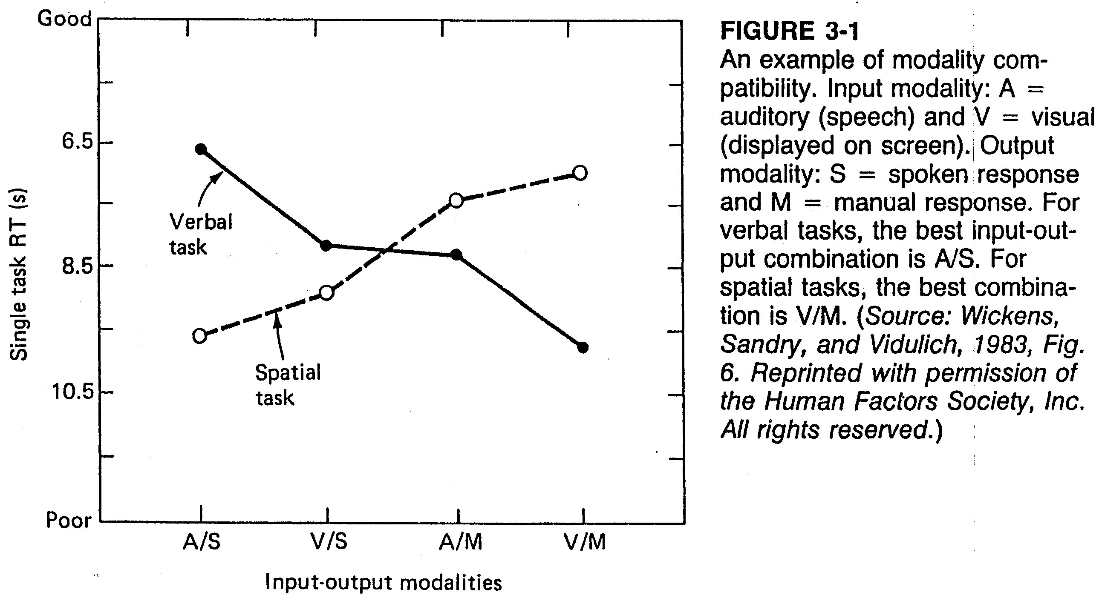
Cont. Modality Compatibility

Slide 27
References
Human Factors in Engineering and Design. Mark S. Sanders, Ernest J. McCormick. 7th Ed. McGraw: New York, 1993. ISBN: 0-07-112826-3.

