Slide 1
King Saud University College of Engineering IE – 462: “Industrial Information Systems” Fall – 2018 (1st Sem. 1439-40H)
Chapter 4
Structured Analysis and Functional
Architecture Design – p2 – DFD – i - Fundamentals
Prepared by: Ahmed M. El-Sherbeeny, PhD

Slide 2
Lesson Overview
Modeling IIS – (p1)
Integrated Computer-Aided Manufacturing Definition 0 (IDEF0) – (p1)
Data Flow Diagram (DFD) – (p2)

Slide 3
Functional/Process Modeling Data Flow Diagram (DFD)

Slide 4
Functional/Process Modeling
Remember: two methodologies for designing a functional architecture, known as “structured analysis” techniques:
data flow diagrams (1979), widely used by information system professionals in all industries
structured analysis and design technique (SADT) (1988), adapted for manufacturing enterprises under the name integrated computer-aided manufacturing definition 0 (IDEF0)
Both methodologies are based on graphical notations used to describe information flows among processes of the enterprise being documented

Slide 5
Functional/Process Modeling
Graphically represent the processes that capture, manipulate, store, and distribute data
between a system and its environment
and among system components
Useful for depicting purely logical information flows
DFDs differ from system flowcharts which depict a procedure (see next slide)
Notes:
Process/Functional Modeling: النمذجة الوظيفية / نمذجة العمليات

Slide 6
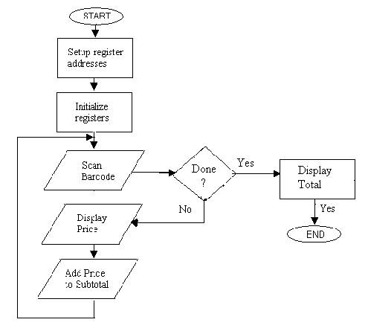
System Flowchart (example)
Notes:
Note, flowcharts are better than DFDs in depicting the details of physical systems (i.e. equipment, such as terminals and permanent storage)

Slide 7
DFDs vs. IDEF0
Data Flow Diagrams (DFD), aka Data Flow Analysis (DFA) is an alternative to IDEF0 that is widely used in all industries, both in modeling:
manufacturing, and
service processes and operations
It differs from IDEF0 in that it focuses exclusively on business processes and the information that flows among processes, ignoring (unlike IDEF0):
material flows
mechanisms, and
controls

Slide 8
DFA/DFD Modeling Primitives

Slide 9
Components of DFD
Data flow diagrams are constructed using four symbols:
Process
Data Flow
Data Store
Sources and Sinks

Slide 10
Components of DFD
Process:
work or actions performed on data (inside the system) so that they are transformed, stored, or distributed
represents people/procedures that transform data
each process must have data entering it and exiting it (otherwise it does not belong in a DFD)
Gane and Sarson symbol: - upper portion is used to indicate the number of the process; - lower portion is a name for the process (e.g. Generate Paycheck, Calculate Overtime Pay)

Slide 11
Components of DFD (cont.)
Data flow:
arrows indicate the direction in which the data move (i.e. “data in motion,” from one place in a system to another)
“data” is a general concept; e.g. data sent to a computer file, or information given from one process to another process
note, arrows are not used to indicate physical flow of materials (as in IDEF0)
arrow is labeled with a meaningful name for data in motion (e.g. Customer Order, Sales Receipt, or Paycheck)

Slide 12
Components of DFD (cont.)
Data store:
place where data are preserved as a record inside the system (“data at rest”)
e.g. computer file or paper filing cabinet
note, there is no explicit construct in IDEF0 that is analogous to a data store
Gane and Sarson symbol: - left end: a small box used to number the data store - inside the main part of the rectangle is a meaningful label for the data store, such as Student File, Transcripts, or Roster of Classes

Slide 13
Components of DFD (cont.)
Sources and sinks:
external entity that is origin –source – or destination – sink– of data (outside the system)
it represents how at the boundaries, DFA system interacts with outside people, processes, organizations, other information systems (note, this is similar to IDEF0 model)
Sources: entities outside the system that provide data input to the system (usually trigger events in the system); e.g. customer
Sinks: entities outside the system that receive data
note, same entity may be both a source and a sink if it both sends data to and receives data from the system
sources/sinks have a name that states what the external agent is (e.g. Customer, Teller, Inventory Control System)

Slide 14
Components of DFD (cont.)
Sources and sinks (cont.):
Sources and sinks, do not consider the following:
Interactions that occur between sources and sinks
What a source or sink does with information (i.e. source or sink is a “black box”)
How to control or redesign a source or sink (assumed to be fixed)
How to provide sources and sinks direct access to stored data (since they cannot directly access or manipulate data stored within the system)

Slide 15
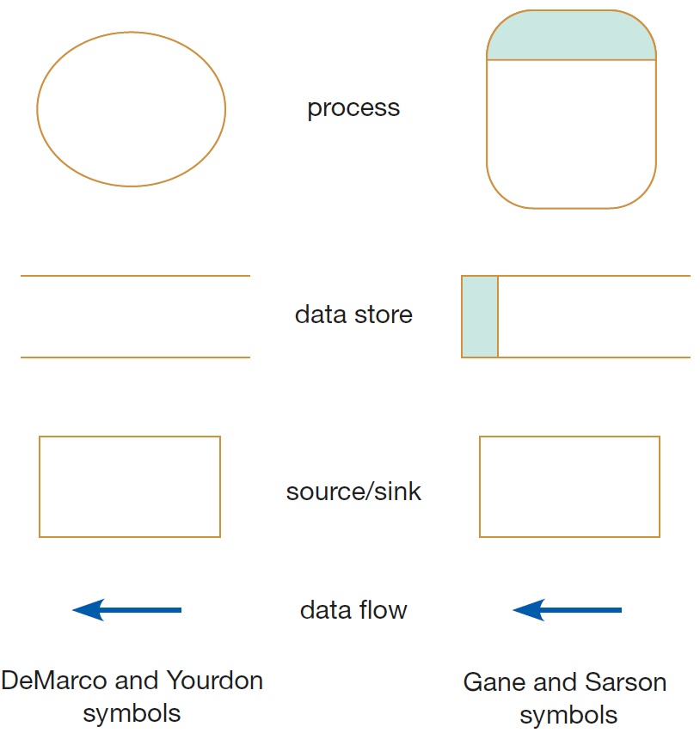
DFD Symbols/Notation
Notes:
Gane and Sarson symbols are adopted by this reference (Modern Systems Analysis and Design. Valacich & George); note, both standards were developed in 1979

Slide 16
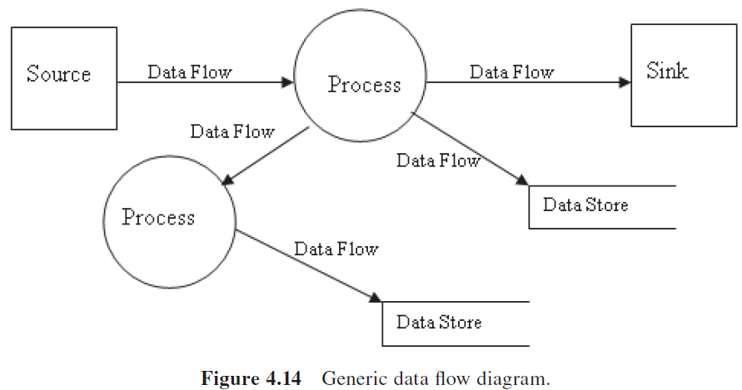
DFD Symbols/Notation (contd.)
Notes:
The source of this diagram is from the course textbook (Design of Industrial Information Systems. Boucher & Yalcin)

Slide 17
Components of DFD (cont.)
Sources and sinks (cont.):
Careful not to confuse whether something is a source/sink or a process within a system:
occurs most often when the data flows in a system cross office or departmental boundaries (see e.g.)
students are then tempted to identify the second office as a source/sink (to emphasize that data moved from one physical location to another)
we are not concerned with where the data are physically located, rather how they are moving through the system and how they are being processed
if the other office is controlled by your system ⇒ then you should represent the second office as one or more processes

Slide 18
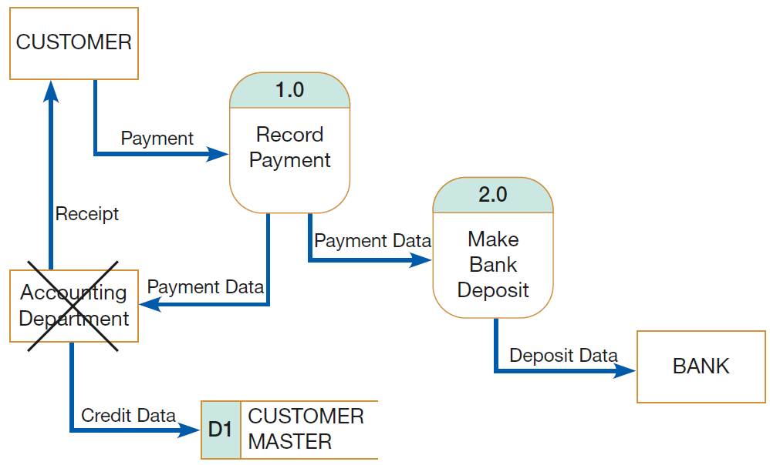
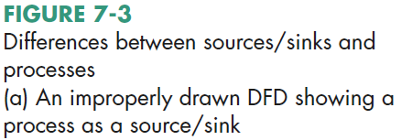
Components of DFD (cont.)

Slide 19
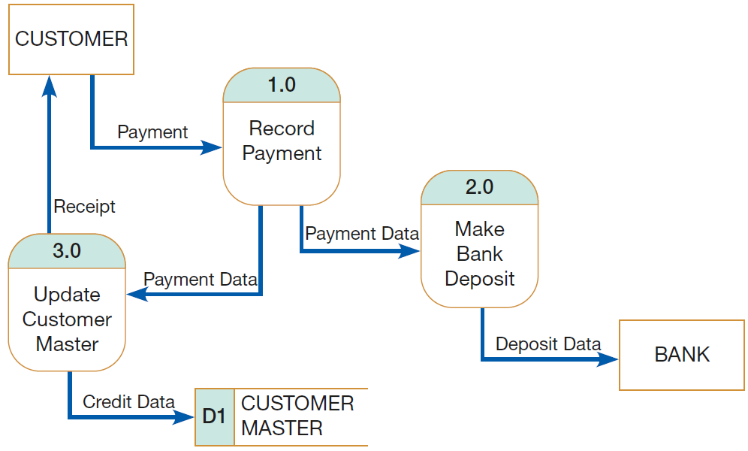
Components of DFD (cont.)

Slide 20
Sources
Design of Industrial Information Systems. Thomas Boucher, and Ali Yalcin. Academic Press. First Ed. 2006. Chapter 4.
Modern Systems Analysis and Design. Joseph S. Valacich and Joey F. George. Pearson. Eighth Ed. 2017. Chapter 7.

