Slide 1
King Saud University College of Engineering IE – 462: “Industrial Information Systems” Fall – 2018 (1st Sem. 1439-40H)
Chapter 4
Structured Analysis and Functional
Architecture Design – p2 – DFD – iii – Case Studies
Prepared by: Ahmed M. El-Sherbeeny, PhD

Slide 2
Lesson Overview
Modeling IIS – (p1)
Integrated Computer-Aided Manufacturing Definition 0 (IDEF0) – (p1)
Data Flow Diagram (DFD) – (p2)
Fundamentals
Diagramming Rules
Case Studies
Inventory Control System (Hoosier Burger)
Business Process Reengineering (IBM Credit)
Electronic Commerce Application (PVF)
IDEF0 to DFD (Food Manufacturing Company)

Slide 3
Case Study 1 – Using DFD in Inventory Control System – “Hoosier Burger”

Slide 4
Case Study 1: HB Inventory Control System
Introduction:
Remember: Hoosier Burger food-ordering system generates two types of usage data,
goods sold and
inventory
At end of each day, manager, (Bob) generates inventory report that tells him
how much inventory should have been used,
items associated with each sale
Bob uses a manual inventory control system

Slide 5
Case Study 1: HB Inventory Control System

Slide 6
Case Study 1: HB Inventory Control System
Bob’s Hoosier Burger Inventory System:
3 sources of data come from outside:
suppliers
provide invoices (i.e. system input)
food-ordering system inventory report
returns payments and orders (i.e. outputs to suppliers)
provide inventory counts (i.e. system inputs)
stock on hand
also provides inventory counts (i.e. system inputs)
We can now create the context diagram shown in Figure 7-14 for the system
Notes:
Note, that suppliers also provide supplies (but this can’t be shown on a DFD)

Slide 7
Case Study 1: HB Inventory Control System

Slide 8
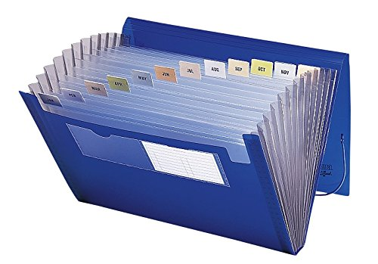
Case Study 1: HB Inventory Control System
Bob’s Hoosier Burger Inventory System (cont.):
When Bob receives invoices from suppliers,
he records their receipt on an invoice log sheet,
and files the actual invoices in his accordion file
Using the invoices, Bob records the amount of stock delivered on stock logs:
these are paper forms posted near the point of storage for each inventory item

Slide 9
Case Study 1: HB Inventory Control System

Slide 10
Case Study 1: HB Inventory Control System
Hoosier Burger’s Stock Log Form:
Minimum order quantities* appear on the log form:
stock level at which orders must be placed in order to avoid running out of an item
Stock log also has spaces for entering:
starting amount:
entered on the sheet when Bob logs stock deliveries
amount delivered, and
amount used for each item:
entered on sheet after Bob has compared amounts of stock used according to a physical count and according to the numbers on the inventory report (generated by the food-ordering system)**
Notes:
* Minimum order quantities (MOQ) are called reorder quantities on the stock log form;
** since there may be error/waste when reporting this (during the food-making process)

Slide 11
Case Study 1: HB Inventory Control System
Hoosier Burger’s Stock Log Form (cont.):
Hoosier Burger has standing daily delivery orders
for some perishable items that are used every day(e.g. burger buns, meats, and vegetables)
Bob determines which orders need to be placed by comparing,
minimum order quantities and
the amount of stock on hand
Bob uses the invoices,
determines which bills need to be paid, and
carefully records each payment

Slide 12
Case Study 1: HB Inventory Control System
Main Elements of Bob’s Inventory System:
Key processes (see level-0 DFD):
account for anything added to inventory
account for anything taken from inventory
place orders
pay bills
Key data used by the system:
inventories counts (used by the system) and
stock-on-hand counts
Key data output by the system:
orders
payments

Slide 13
Case Study 1: HB Inventory Control System
Notes:
Note, mathematically, inventory level is last day's starting amount + amount delivered - amount used; and this is compared to MOQ (below) to determine whether or not we need make a new order for the next working day

Slide 14
Case Study 1: HB Inventory Control System
Revised DFD for Bob’s Inventory System:
Bob would like to add 3 additional functions:
data on new shipments should be entered into an automated system, thus:
no more paper stock log sheets
shipment data will stay as current as possible (i.e. will be entered into the system as soon as the new stock arrives at the restaurant)
system should determine automatically whether a new order should be placed,
i.e. Bob would no longer worry whether Hoosier Burger has enough of everything in stock at all times

Slide 15
Case Study 1: HB Inventory Control System
Revised DFD for Bob’s Inventory System (cont.):
Bob would like to add 3 additional functions (cont.):
Bob would like to be able to know, at any time, the approximate inventory level for each good in stock
for some items (e.g. buns), Bob can visually inspect the amount in stock and determine approximately how much is left and how much more is needed before closing time
for other items, however, Bob may need a rough estimate of what is in stock more quickly than he can estimate via a visual inspection

Slide 16
Case Study 1: HB Inventory Control System
Revised DFD for Bob’s Inventory System (cont.):
Compare between original and revised DFDs:
new Process 5.0 allows for querying the inventory data to get an estimate of how much of an item is in stock
Bob’s 2 other requests for change can both be handled within the existing logical view of the inventory system
Notes:
Querying: سؤال/بحث; note this querying process saves Bob worry and effort involved with visually or roughly estimating inventory levels (manually)

Slide 17
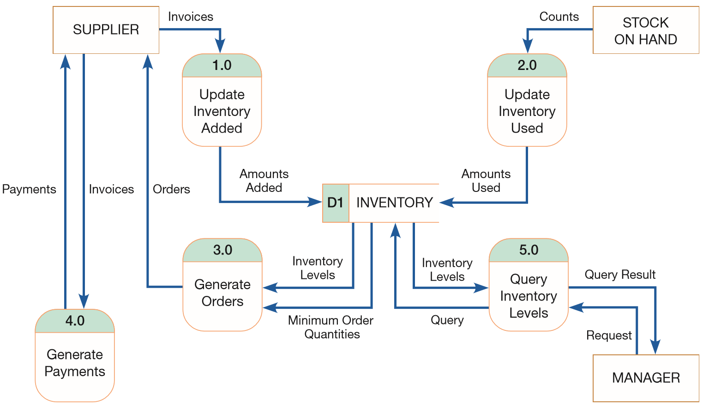
Case Study 1: HB Inventory Control System
Notes:
Can you note how this DFD is different than the previous level-0 DFD?

Slide 18
Case Study 2 – Using DFDs in Business Process Reengineering (BPR) – “IBM Credit Corporation”

Slide 19
Case Study 2: BPR – IBM Credit
IBM Credit Corporation:
Case study by Hammer and Champy (1993)
IBM Credit Corporation
provides financing for customers making large purchases of IBM computer equipment
analyzes deals proposed by salespeople and writes the final contracts governing those deals
it typically took six business days to process each financing deal
Notes:
Hammer, M., and J. Champy. 1993. Reengineering the Corporation. New York: Harper Business.

Slide 20
Case Study 2: BPR – IBM Credit
Steps in processing each financing deal:
salesperson calls in with a proposed deal
clerk logs it and writes details on a piece of paper
second person:
enters data into a computer system and
checks client’s creditworthiness
writes details on a piece of paper and carries paper (along with original documentation) to a loan officer
loan officer:
modifies standard IBM loan agreement for the customer
involves separate computer system from one used in step 2

Slide 21
Case Study 2: BPR – IBM Credit
Steps in processing each financing deal (cont.):
details of modified loan agreement:
sent on to the next station in the process
different clerk determines interest rate for loan
again, this involves its own information system
quote letter is created at the next stop:
using resulting interest rate and
all of the paper generated up to this point
quote letter is sent via overnight mail back to the salesperson
DFD illustrates the overall process, people, computers, and shows it is not that complicated

Slide 22
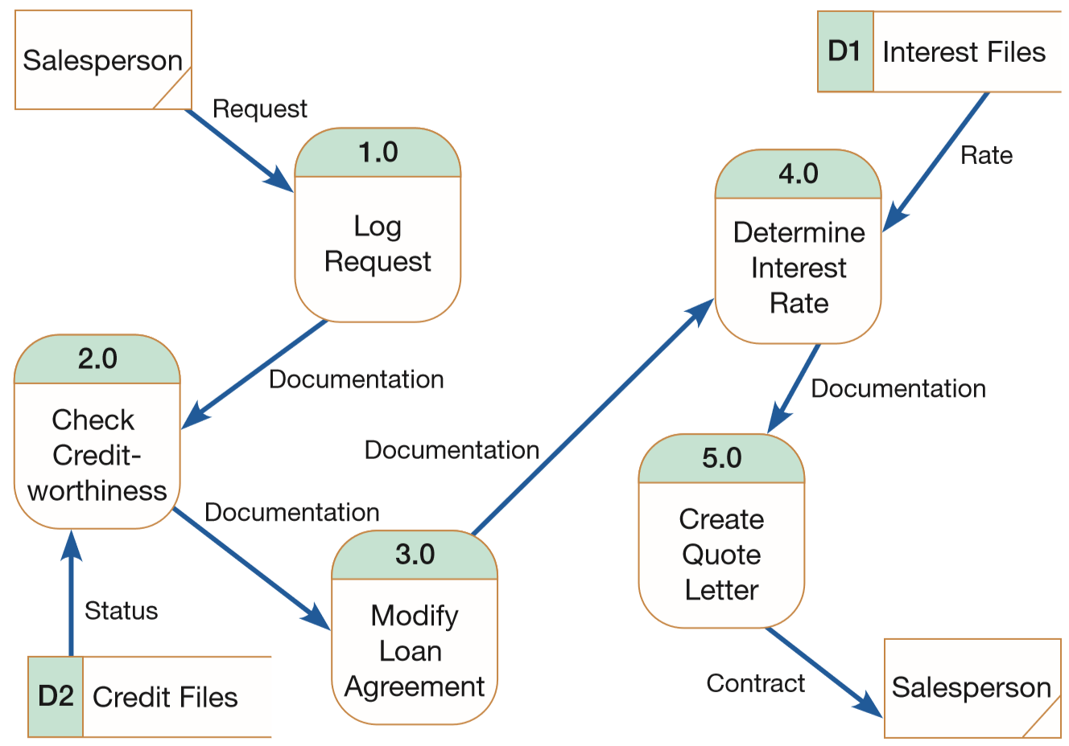
Case Study 2: BPR – IBM Credit
Notes:
Q: Can you guess what level DFD this is? Level-0 DFD; Q: why does the box for the External entity “Salesperson” have a slash? That’s because it is repeated (see rule T, page 195)

Slide 23
Case Study 2: BPR – IBM Credit
Steps after applying Business Process Reengineering:
five sets of task specialists were replaced with generalists:
call from the field goes to a single clerk
clerk does all the work necessary to process the contract
i.e. now only 1 person: checks for creditworthiness, modifies basic loan agreement, & determines appropriate interest rate
company still has specialists for few cases that are significantly different from routine encounters
process is now supported by a single computer system

Slide 24
Case Study 2: BPR – IBM Credit
Steps after applying BPR (cont.):
Note some differences in revised DFD vs original DFD
compare the number of process boxes
lack of documentation flow in revised DFD (⇒ process is much simpler, cuts down dramatically on any chance of documentation getting lost between steps)
Redesigning process from beginning to end:
allowed IBM Credit Corporation to increase the number of contracts it can handle by 100-fold!
i.e. allowed company to handle 100 times more work in the same amount of time and with fewer people

Slide 25
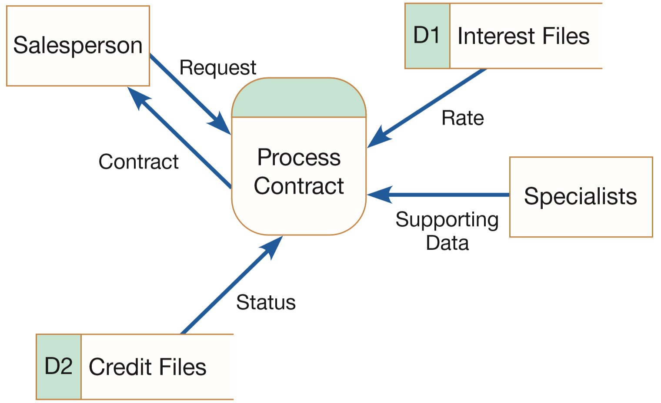
Case Study 2: BPR – IBM Credit
Notes:
Q: Can you guess what level DFD this is? Level-0 (not context diagram); note almost the same external entities, external data flow, data stores, yet processes and data flow is much reduced

Slide 26
Case Study 3 – Using DFDs in Electronic Commerce Application – “Pine Valley Furniture” WebStore

Slide 27
Case Study 3: PVF Furniture Webstore
Background:
Process modeling (using DFD) is similar to the process followed for other applications
Pine Valley Furniture (PVF) made a project to sell furniture products over the Internet (i.e. webstore)
Objectives:
analyze webstore’s high-level system structure,
develop a level-0 DFD for those requirements

Slide 28
Case Study 3: PVF Furniture Webstore
Steps in translating webstore system structure into DFD:
Senior systems analyst (Jim Woo)
first, completed JAD (Joint Application Design) session
then adopted following steps to create DFD for webstore:
Identify level-0 –major system– processes:
examined the outcomes of the JAD session, and
defined system structure of webstore system
he identified six high-level processes, which were the “work” or “action” parts of the website (see Table 7-4)
note how each process corresponds to major processing items listed in the system structure
Notes:
Remember how JAD was one of the methods/approaches used in SDLC

Slide 29
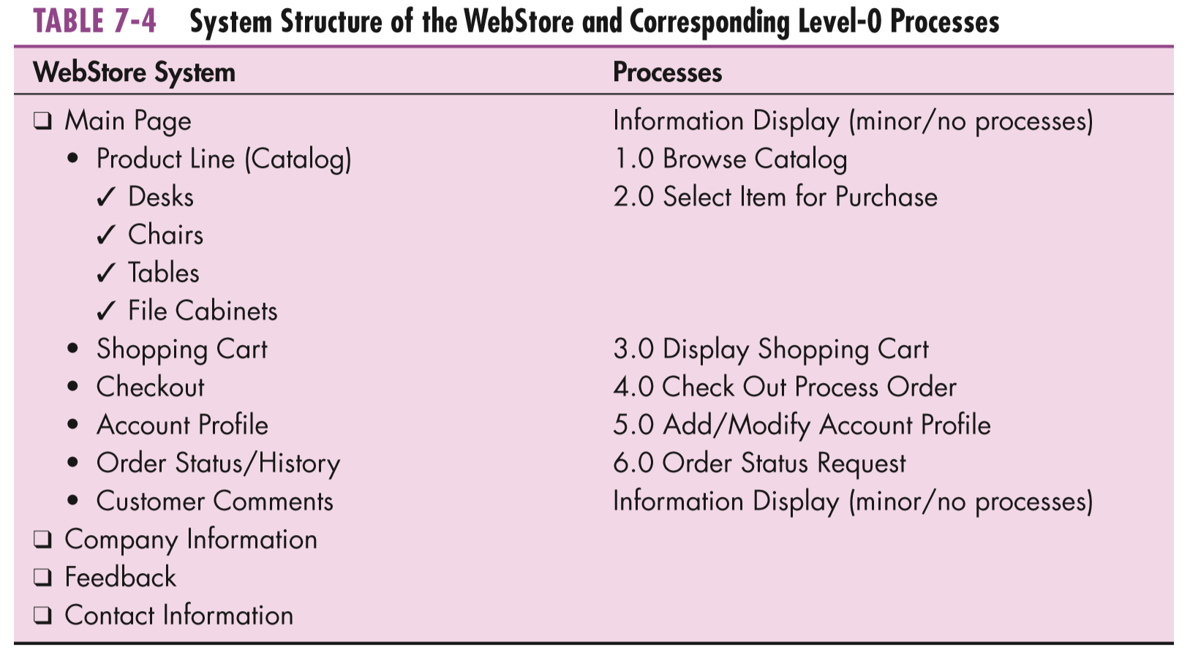
Case Study 3: PVF Furniture Webstore

Slide 30
Case Study 3: PVF Furniture Webstore
Translating webstore system structure into DFD (cont.):
Determine existing PVF systems with which webstore can exchange information:
Customer Tracking System (for managing customer information)
info. is passed from webstore system to this system when customer opens an account
Purchasing Fulfillment System (for tracking orders)
info. is stored in this system when an order is placed, and
retrieves status info. on a prior order (at customer request)
These 2 existing systems will be
“sources” (providers) of information, and
“sinks” (receivers) of information
for webstore system

Slide 31
Case Study 3: PVF Furniture Webstore
Translating webstore system structure into DFD (cont.):
Determine additional data sources (i.e. data stores):
access to inventory database
to produce an online product catalog
webstore shopping cart
a temporary database
used to store the items a customer wants to purchase
shopping cart data can be deleted once transaction is completed
Jim used these steps to develop level-0 DFD for webstore system

Slide 32
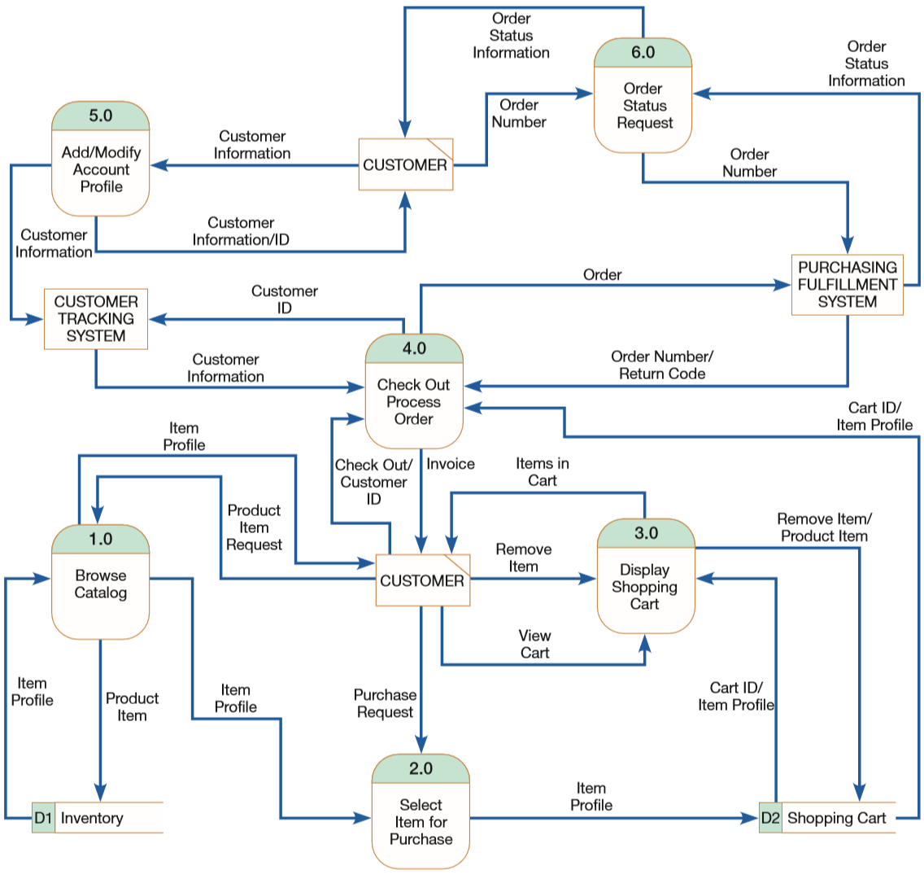
Notes:
Note again here that the External entity “Customer” has a slash? That’s because it is repeated (see rule T, page 195) to avoid clutter

Slide 33
Case Study 3: PVF Furniture Webstore
Results of developing DFD for webstore:
good understanding of information flow through the webstore
good understanding of customer interaction with the system
good understanding of how the webstore shares information with existing PVF systems
Note, each of these high-level processes needs (eventually) to be further decomposed before system design could proceed
Also, another outcome of this analysis activity is conceptual data modeling (discussed later)

Slide 34
Case Study 4 – Converting IDEF0 Model to DFD – Food Manufacturing Company

Slide 35
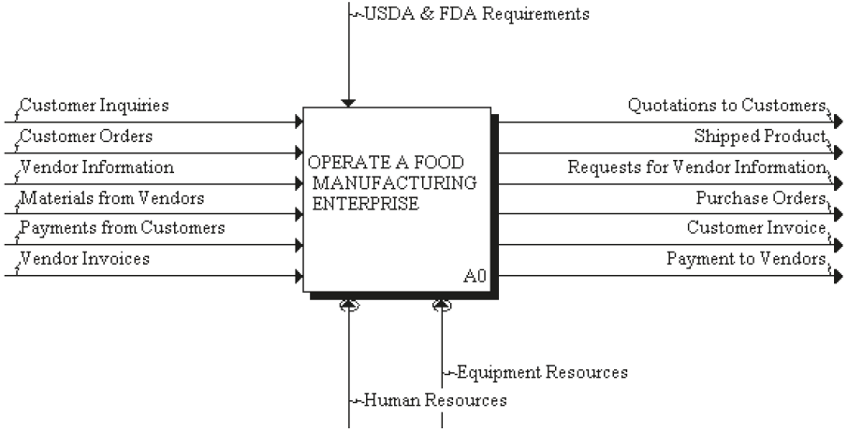
An Integrated IDEF0 Model of an Entire Manufacturing Enterprise
Top-level view of the enterprise: Node A0
USDA: US Dept. of Agriculture
FDA: Food & Drug Administration

Slide 36
Decomposition of Node A0
A0 — Operate a Food Manufacturing Enterprise
A1 — Manage Sales and Order Process
A2 — Plan for Manufacture
A3 — Manufacture Product
A4 — Control Finished Goods

Slide 37
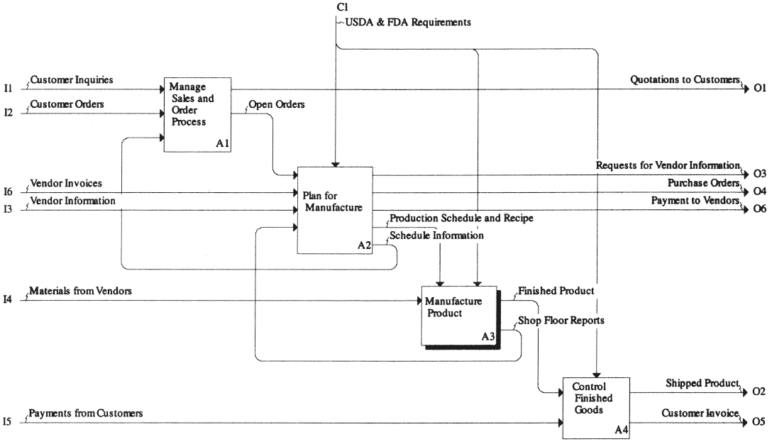
Decomposition of Node A0
Notes:
Notice how node A3 has been highlighted (in order to emphasize that it will be the focus of the next decomposition)

Slide 38
Decomposition of Node A3
A0 — Operate a Food Manufacturing Enterprise
A1 — Manage Sales and Order Process
A2 — Plan for Manufacture
A3 — Manufacture Product
A31 — Control Incoming Materials
A32 — Control Stored Material
A33 — Control Production Processes
A4 — Control Finished Goods

Slide 39
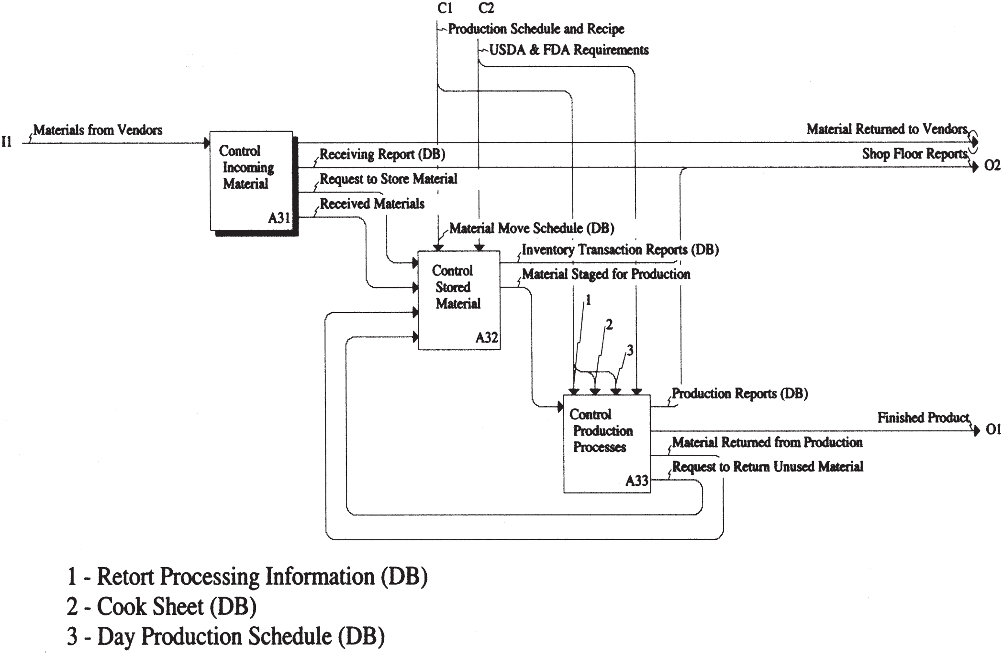
Hierarchic Decomposition Illustrated: Node A3

Slide 40
Decomposition of Node A3
Production schedule and recipe documents:
retort processing information
“retort”: chamber of superheated water for sterilizing packaged food products
cook sheet
formula that must be used for each product; includes ingredients and equipment settings
day production schedule
which production lines will be used to produce each of the products to be made that day, and order of production (for multiple products)
material move schedule
tells forklift truck operator which lots of ingredients to transfer from storage to production

Slide 41
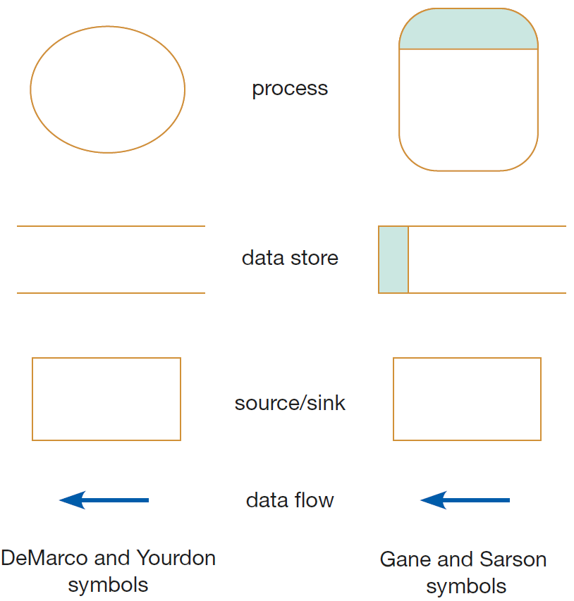
DFD Symbols/Notation (Reminder)
Notes:
Note, for data store, our textbook (Modern Systems Analysis and Design. Joseph S. Valacich and Joey F. George. Pearson. Eighth Ed. 2017. Chapter 7.) uses some hybrid (mix) symbol between the two notations shown above

Slide 42
Context DFD of Node A32
There are 3 source entities at boundary of system (A32):
receiving (i.e. input from Node A31)
production planning (i.e. input from Node A2), and
production (i.e. feedback from Node A33)
Receiving (Node A31):
this is the entity in charge of the process “Control Incoming Material”
receiving is a “trigger” for process “Control Stored Materials” (i.e. it initiates an action in the process when it makes a “request to store materials”)
Notes:
Remember, material flow is not accounted for in DFD diagrams!

Slide 43
Context DFD of Node A32 (cont.)
There are 3 source entities at boundary of system (A32):
receiving (i.e. input from Node A31)
production planning (i.e. input from Node A2), and
production (i.e. feedback from Node A33)
Production planning department (Node A2)
source of another trigger
trigger (“material move schedule”) is to move raw material from warehouse to work in process – WIP
Notes:
Remember, material flow is not accounted for in DFD diagrams!

Slide 44
Context DFD of Node A32 (cont.)
There are 3 source entities at boundary of system (A32):
receiving (i.e. input from Node A31)
production planning (i.e. input from Node A2), and
production (i.e. feedback from Node A33)
Production (Node A33)
“request to return unused materials” from production supervisor is another trigger to the process
raw material that has been moved into production but not used must be returned to storage
Finally, the process sends (i.e. as output) an Inventory Transaction Report to a data store (see context DFD)
Notes:
Note how the data store was already indicated in the IDEF0 model at Node A32 as DB

Slide 45
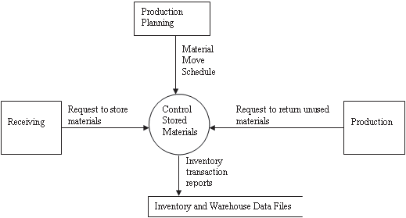
Context DFD of Node A32 (cont.)
Notes:
Note, how here the context diagram includes a data store (i.e. using a different standard than the one in the reference that has been discussed so far Design of Industrial Information Systems. Thomas Boucher, and Ali Yalcin. Academic Press. First Ed. 2006. Chapter 4.; also note how Node A32 has now become our “system” (as we did previously with Hoosier Burger)

Slide 46
Decomposition of Context Data Flow Diagram
The overall structure of the data flow diagram hierarchy is often shown in a process hierarchy chart
Process hierarchy chart:
series of block diagrams
show the hierarchic relationship among processes that are documented in the data flow diagrams

Slide 47
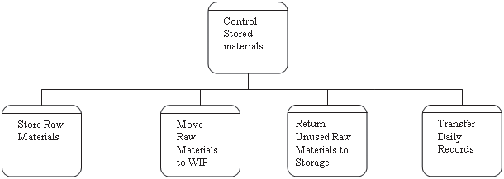
Decomposition of Context Data Flow Diagram
The hierarchic process function:
Notes:
Note how the process symbols used here are the same as those used in the Gane and Sarson system.

Slide 48
Decomposition of Context Data Flow Diagram
The context process (Control Stored Materials) is composed of four level-0 processes (see level-0 DFD):
Store Raw Materials
Move Raw Materials to WIP
Return Unused Raw Materials to Storage
Transfer Daily Records
Notes:
Note, level-0 is called level-1 in the source: Modern Systems Analysis and Design. Joseph S. Valacich and Joey F. George. Pearson. Eighth Ed. 2017. Chapter 7.

Slide 49
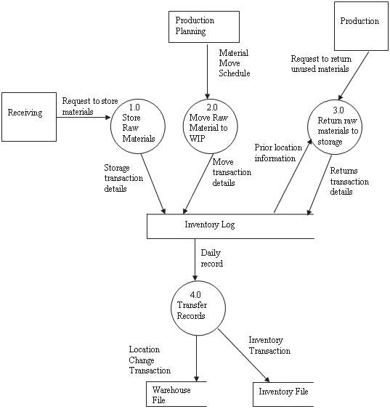
Decomposition of Control Stored Materials: First-Level (Level-0) DFD
Notes:
Note again here how (unlike in IDEF0 decompositions) all flows are those of data flows; also note that this diagram combines source/sinks + external data flows (from context diagram) as well as sub-processes from process hierarchy chart and adds internal data flow and data stores; also note how data store in context diagram (inventory and warehouse data files) was split into two data stores here (warehouse file and inventory file)

Slide 50
Description of Decomposition of “Control Stored Materials”
Store raw materials:
Receiving requests forklift truck driver to move material from the loading dock to inventory storage
Driver takes the material to the warehouse
Driver places the material in the required location
Driver then records the following in the log,
material
location used, and
date and time of the transaction
Notes:
This is the detailed documentation that must accompany DFDs (as mentioned in previous lessons)

Slide 51
Description of Decomposition of “Control Stored Materials”
Move raw material to WIP:
Forklift truck driver is given the schedule of material moves from storage to the factory floor
Each time the driver makes a move,
raw material inventory is debited and
status of the warehouse location is updated
This is done by indicating a transaction to relieve inventory in the log:
recording the material
material location
date and time of the transaction

Slide 52
Description of Decomposition of “Control Stored Materials”
Return unused raw material to storage:
Some materials that are brought to the factory floor may be returned if they are not used during production
Upon request from production supervisor,
driver takes material back to storage and
logs the credit entry into the log

Slide 53
Description of Decomposition of “Control Stored Materials”
4. Transfer records:
Forklift truck driver’s inventory log is used as the primary record for updating
warehouse records and
inventory records
This process is done at the end of the shift
Materials management checks for any discrepancies between the receiving report and actual location of material
i.e. by comparing the log with the receiving report

Slide 54
Videos to Watch
What is DFD? Data Flow Diagram Symbols and More https://youtu.be/6VGTvgaJllM
How to Draw Data Flow Diagram? https://youtu.be/ztZsEI6C-mI
DFD Diagram 0 https://youtu.be/Ik85hZkyYPA
Notes:
Note, some videos regard Context Diagram as Level-0 Diagram, Level-0 DFD as Level-1, etc.

Slide 55
Sources
Modern Systems Analysis and Design. Joseph S. Valacich and Joey F. George. Pearson. Eighth Ed. 2017. Chapter 7.
Design of Industrial Information Systems. Thomas Boucher, and Ali Yalcin. Academic Press. First Ed. 2006. Chapter 4.

