Slide 1
King Saud University College of Engineering IE – 462: “Industrial Information Systems” Fall – 2018 (1st Sem. 1439-40H)
Chapter 4:
Structured Analysis and Functional
Architecture Design – p1 – IDEF0 - ii
Prepared by: Ahmed M. El-Sherbeeny, PhD

Slide 2
Lesson Overview
Modeling IIS – (p1)
Integrated Computer-Aided Manufacturing Definition 0 (IDEF0) – (p1)
Data Flow Diagram (DFD) – (p2)

Slide 3
Functional Modeling Integrated Computer-Aided Manufacturing Definition 0 (IDEF0) – cont’d

Slide 4
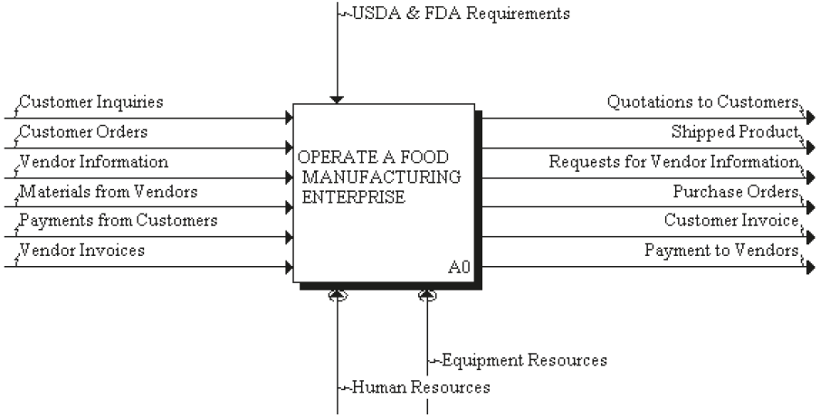
An Integrated IDEF0 Model of an Entire Manufacturing Enterprise
Top-level view of the enterprise: Node A0
USDA: US Dept. of Agriculture
FDA: Food & Drug Administration
Notes:
Q: what is the Saudi equivalent of USDA and FDA? A: Saudi Food and Drug Authority; Saudi Office of Agricultural Affairs

Slide 5
Decomposition of Node A0
A0 — Operate a Food Manufacturing Enterprise
A1 — Manage Sales and Order Process
A2 — Plan for Manufacture
A3 — Manufacture Product
A4 — Control Finished Goods

Slide 6
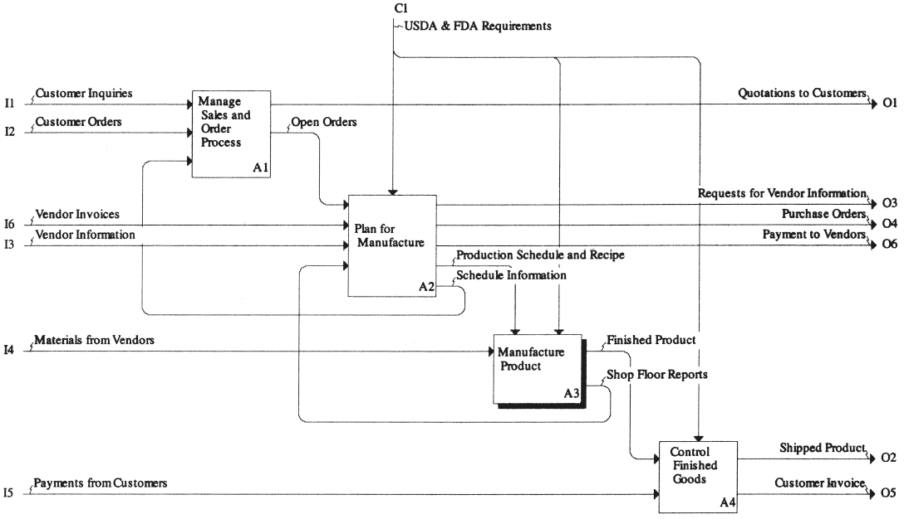
Decomposition of Node A0
Notes:
Notice how node A3 has been highlighted (in order to emphasize that it will be the focus of the next decomposition)

Slide 7
Decomposition of Node A3
A0 — Operate a Food Manufacturing Enterprise
A1 — Manage Sales and Order Process
A2 — Plan for Manufacture
A3 — Manufacture Product
A31 — Control Incoming Materials
A32 — Control Stored Material
A33 — Control Production Processes
A4 — Control Finished Goods
Notes:
Node A3 was taken here as a sample (i.e. could be done also on A1, A2, A4)

Slide 8
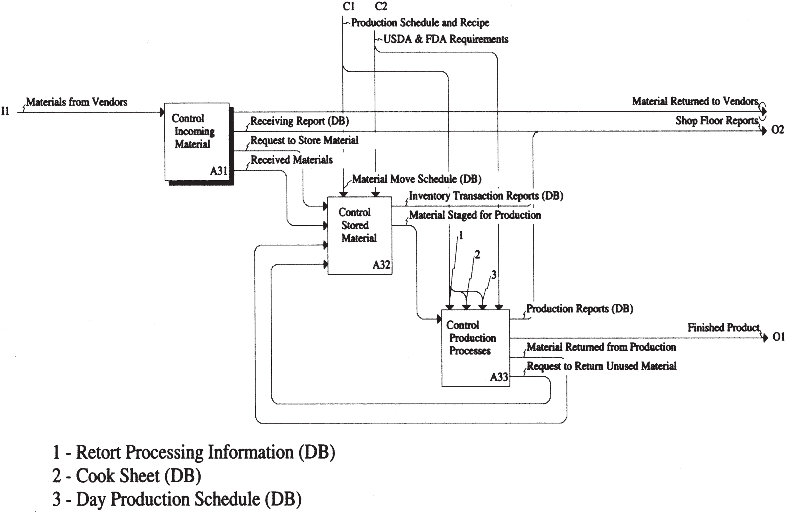
Decomposition of Node A3
Notes:
Notice here how node A31 is highlighted

Slide 9
Decomposition of Node A3
Concept of tunneling
e.g. output of activity A31, labeled “Material Returned to Vendors”
Note the tunnel on the arrowhead of the arc
A tunnel arrow can represent:
an external arrow that did not appear in the parent diagram (i.e. it has a hidden source) or,
an arrow that goes to another activity but does not appear explicitly on the destination activity (i.e. a hidden destination)
Tunneling is used when it is not convenient to show all I’s, O’s, controls, or mechanisms at every level of the hierarchy
Notes:
Q: which type of tunnel arrowhead is shown here? (hidden source as it did not appear in the parent diagram (Decomposition of node A0)

Slide 10
Decomposition of Node A3
Concept of bundling
e.g. node A2 provides a control for activity node A3 called “production schedule and recipe”
Production schedule: daily schedule for production of a particular product
Recipe includes:
Steps in the production process
Materials/ingredients used at each step to make the product, and
Critical operating parameters of the production line (e.g. temperatures, time settings for cooking and sterilization)
Notes:
Q: can you mention another example of bundling in the previous diagrams? USDA and FDA requirements

Slide 11
Decomposition of Node A3
Production schedule and recipe documents:
retort processing information
“retort”: chamber of superheated water for sterilizing packaged food products
cook sheet
formula that must be used for each product; includes ingredients and equipment settings
day production schedule
which production lines will be used to produce each of the products to be made that day, and order of production (for multiple products)
material move schedule
tells forklift truck operator which lots of ingredients to transfer from storage to production

Slide 12
Decomposition of Node A3
Indication of DB on control documents
DB: database
This informs reader that this is information that is derived from some data source (e.g. electronic)
Note, this notation is not part of the IDEF0 methodology (only added here for convenience)

Slide 13
Decomposition of Node A31
A0 — Operate a Food Manufacturing Enterprise
A1 — Manage Sales and Order Process
A2 — Plan for Manufacture
A3 — Manufacture Product
A31 — Control Incoming Materials
A311 — Confirm Validity of Shipment
A312 — Inspect condition of materials
A313 — Receive Materials
A32 — Control Stored Material
A33 — Control Production Processes
A4 — Control Finished Goods

Slide 14
Decomposition of Node A31
Elemental nodes
Elemental level is the most detailed level of analysis of functions
We will focus on node A31, Control Incoming Material
Elemental nodes
should be prepared with those individuals within the enterprise who are actors in the process
should give clear conceptual understanding of the processes that are taking place and
should give information requirements at each stage of the process
elemental nodes are described in detail in next slides

Slide 15
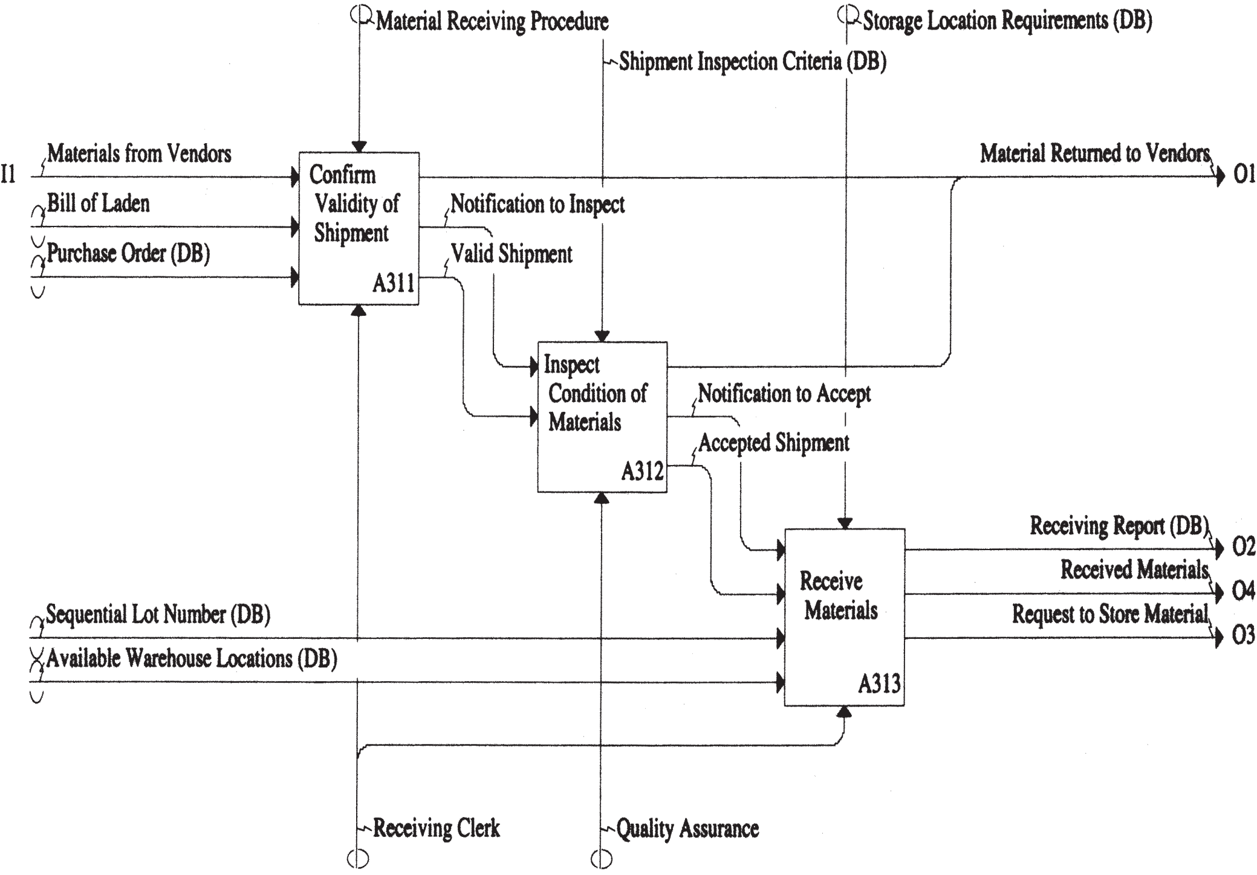
Decomposition of Node A31

Slide 16
Decomposition of Node A31
Node A311: Confirm validity of shipment
Try to trace the story/narrative here on the decomposition chart
First, the shipment arrives
The receiving clerk (note the mechanism arc) compares,
paperwork that comes with the shipment (bill of laden) with the
enterprise’s purchase order (PO)
If the material in the 2 inputs (BOL and PO) are matching ⇒ shipment is accepted
otherwise, the shipment is refused (return to vendor)
This procedure is defined as the “material receiving procedure” (by the enterprise management)
Notes:
Laden: حمولة/شحنة

Slide 17
Decomposition of Node A31
Node A312: Inspect condition of material
Receiving clerk notifies quality assurance (QA) that material has arrived
⇒ QA personnel examine condition of truck contents (using shipment inspection criteria):
e.g. broken containers can result in a partial/total rejection of the shipment
Note, this is not an inspection of the quality of individual materials
such testing is performed in quality control (QC) lab after the material is stored in the warehouse and before it is used in production
When quality assurance clears the shipment for acceptance, the receiving clerk is notified

Slide 18
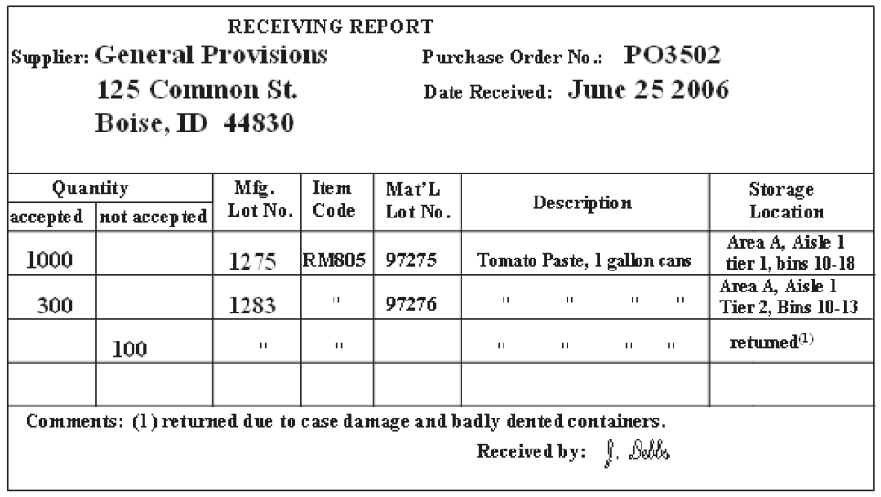
Decomposition of Node A31
Node A313: Receive materials
Record of shipments: on a form called a receiving report

Slide 19
Decomposition of Node A31
Node A313: Receive materials (contd.)
Upon accepting shipment, the receiving clerk:
shipment is unloaded and made available for storage
assigns lot numbers to accepted material
lot numbers are assigned as sequential numbers and obtained by the clerk from a data source (DB)
clerk also assigns material to storage location based on material location requirements/location availability
forklift truck operator is informed of the location to which the material should be moved (indicated by the output arrow “Request to Store Raw Materials”)
Notes:
Note, data requirements for the execution of these functions will be addressed in the next chapter

Slide 20
Sources
Design of Industrial Information Systems. Thomas Boucher, and Ali Yalcin. Academic Press. First Ed. 2006. Chapter 4.
Some useful videos:
AI0Win Tutorial - Manage a Coffee Shop (https://youtu.be/kHDNlFclsiY)
Rework IDEF0 Process Mapping (Free Simulation) https://youtu.be/sqlNNt4m8QA

