Slide 1
King Saud University College of Engineering IE – 462: “Industrial Information Systems” Fall – 2018 (1st Sem. 1439-40H)
Chapter 4:
Structured Analysis and Functional
Architecture Design – p1 – IDEF0 - i
Prepared by: Ahmed M. El-Sherbeeny, PhD

Slide 2
Lesson Overview
Modeling IIS – (p1)
Integrated Computer-Aided Manufacturing Definition 0 (IDEF0) – (p1)
Data Flow Diagram (DFD) – (p2)

Slide 3
Modeling IIS
This is first step in design of IIS for an industrial enterprise
The design proceeds from a definition of a business model of the enterprise; this business model (IS model ) is a description of
the functions of the business, (or manufacturing operations)
the data requirements, and
the interactions between the functions and data requirements
Functional or activity architecture describes a conceptual model of the activities that operate the business (or manufacturing operations) and the relationships between those activities

Slide 4
Modeling IIS
The word architecture denotes the fact that the model has a layered structure
A related conceptual model of the firm is the informational or data architecture; this is a model of the information requirements needed to perform the functions of the business
Functional and informational architectures, when taken together, form a high-level blueprint for the implementation of computer integration in the enterprise

Slide 5
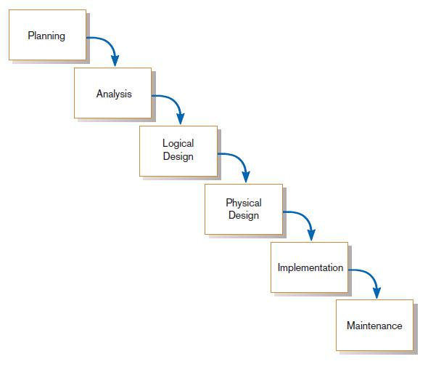
Modeling IIS
There are three layers of system design to consider in an information system project:
Conceptual
Implementation and
Execution
Conceptual layer consists of logical design of functional and data requirements
Notes:
Remember Waterfall SDLC

Slide 6
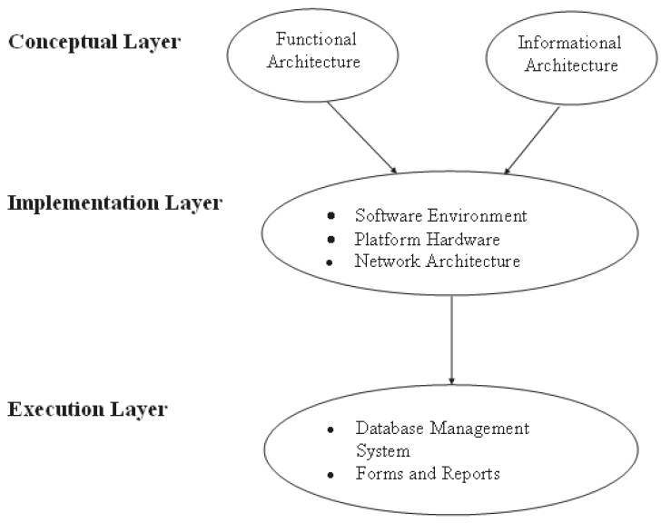
Layers of IS Design Process

Slide 7
Modeling IIS
When a conceptual design is complete, the next step is to implement the blueprint in hardware and software
This is the implementation layer that requires the selection of
database management system
hardware platforms, and
communication medium

Slide 8
Modeling IIS
At the execution layer, the conceptual model and implementation techniques are coded in software in terms of forms and reports
Forms and reports are used to interface with the individuals performing the functions defined in the functional architecture

Slide 9
Modeling IIS
Two methodologies for designing a functional architecture, known as “structured analysis” techniques:
data flow diagrams (1979), widely used by information system professionals in all industries
structured analysis and design technique (SADT) (1988), adapted for manufacturing enterprises under the name integrated computer-aided manufacturing definition 0 (IDEF0)
Both methodologies are based on graphical notations used to describe information flows among processes of the enterprise being documented (described next)

Slide 10
Functional Modeling Integrated Computer-Aided Manufacturing Definition 0 (IDEF0)

Slide 11
IDEF0 Methodology Modeling Primitives
IDEF0 (integrated computer-aided manufacturing definition 0) is a modeling methodology for designing and documenting hierarchic, layered, modular systems
The activity box is used to describe a function being performed in the enterprise
Function can be either a
material conversion function (machining a part), or
information conversion function (processing a requisition for ordering materials)

Slide 12
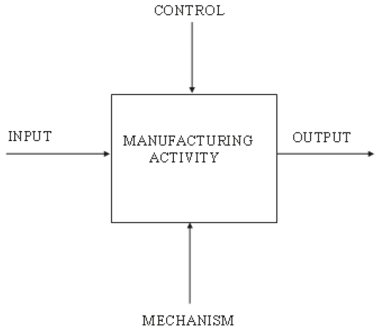
IDEF0 Activity Box and Connecting Arrows

Slide 13
IDEF0 Activity
Inputs: items that are transformed by the function
a workpiece to be machined, or
a requisition information to be transformed into a purchase order
Outputs: result of the transformation process provided by the activity
finished component after machining, or
a purchase order

Slide 14
IDEF0 Activity
Mechanisms: means by which a function is realized
Mechanism in material conversion of a workpiece to a finished component might require (as mechanisms):
a lathe and
lathe operator
Information conversion to process a requisition into a purchase order:
Could involve a purchasing agent as the mechanism

Slide 15
IDEF0 Activity
A control is a condition or set of conditions that guide or constrain the performance of the activity
Machining activity example: parts may require a numerical control parts program
Information conversion example: requisition processing function may require adherence to set of company rules or purchasing policy (e.g. purchasing only from approved vendors)
Notes:
Requisition: حجز / ضبط

Slide 16
IDEF0 Activity
Activity box and four arcs provide a concise expression:
- an input is transformed …
- into an output …
- by an activity (function) …
- performed by a mechanism …
- and governed by a control
The specific activity, inputs, outputs, mechanisms, and controls are defined by the situation being modeled

Slide 17
IDEF0 Activity
Grammatical convention used in naming activities and arcs:
Activities represent actions being performed and are labeled with verb phrases
Inputs, outputs, mechanisms, and controls represent things and are labeled with noun phrases

Slide 18
IDEF0 Hierarchic decomposition
IDEF0 is a top-down modeling approach
The first layer is a single activity box that describes the overall function of the enterprise, organization, or process within the enterprise that is the subject of the model
This overall activity is then decomposed into its major sub-activities at the second layer
Functions are related to each other by their material flows and information flows
For example, the output material or information of one activity may provide the input to another activity

Slide 19
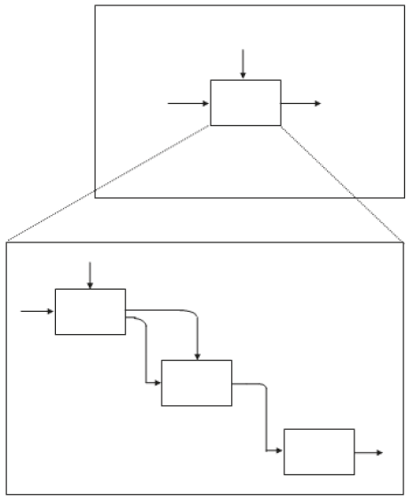
IDEF0 Activity
Relationship among levels in IDEF0 methodology

Slide 20
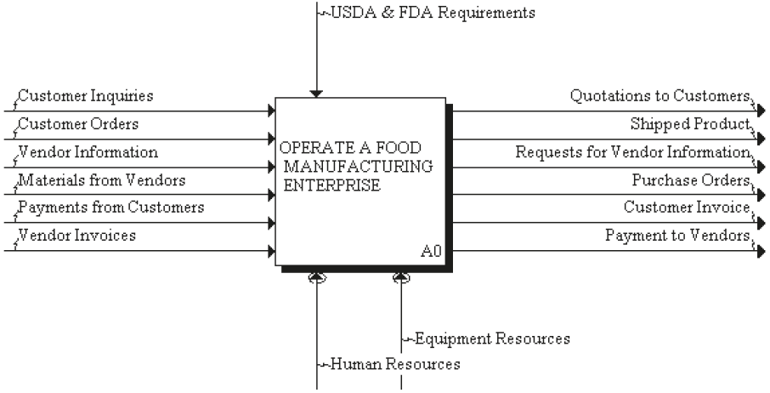
An Integrated IDEF0 Model of an Entire Manufacturing Enterprise
Top-level view of the enterprise: Node A0
USDA: US Dept. of Agriculture
FDA: Food & Drug Administration
Notes:
Q: what is the Saudi equivalent of USDA and FDA? A: Saudi Food and Drug Authority; Saudi Office of Agricultural Affairs

Slide 21
Elements of the A0 Activity
A0: high-level view of the enterprise and its interactions with the outside world
Related Inputs (I) and Outputs (O):
Customer inquiries (I) ⇒ Quotations to customers (O)
Customer orders (I) ⇒ Shipped product (O)
Customer invoice (O) ⇒ Payments from customers (I)
Request for vendor information (O) ⇒ Vendor information (I)
Purchase orders (O) ⇒ Materials from vendors (I)
Vendor invoice (I) ⇒ Payments to vendors (O)

Slide 22
Elements of the A0 Activity
In summary: operation of a manufacturing enterprise can be viewed as three interrelated processes:
Physical flow of materials; e.g. input materials from vendors is transformed (i.e. the manufacturing process) into the output shipped product
Information flow; e.g. vendor information and quotation to customers
Financial flow; e.g. payments from customers and payments to vendors
Outside controls: USDA, FDA (important class of standards)
Mechanisms: human resources and equipment resources; these convert inputs to outputs
Notes:
Q: can you identify these inputs/outputs in the last slide?

Slide 23
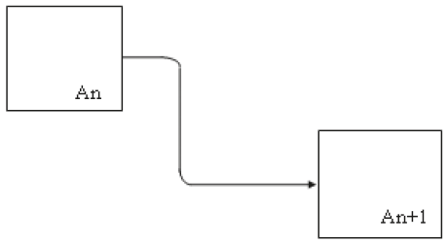
Decomposition of Node A0
Decomposing node A0 identifies four major activities at the next level:
A1: Manage Sales and Orders Process,
A2: Plan for Manufacture,
A3: Manufacture Product, and
A4: Control Finished Goods
Inputs and outputs of the parent activity are inherited by the child)
e.g. customer inquiries and customer orders are handled by the sales organization and are inputs to node A1
e.g. finished product leaves the enterprise from finished goods inventory (shown as an output of activity A4)
Simple output/input relationship

Slide 24
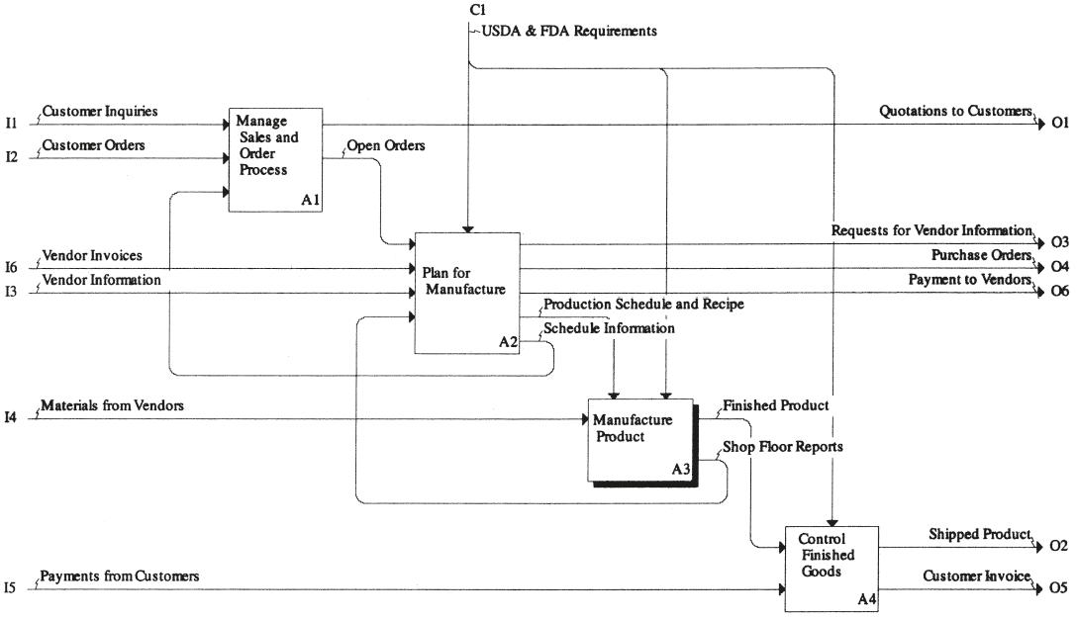
Decomposition of node A0

Slide 25
Decomposition of Node A0
Note the activity flow relationship:
When several activity boxes are drawn at the same level of decomposition, they are ordered by sequential order/dominance
e.g. “Manage Sales and Order Processes” activity precedes “Plan for Manufacture” activity, etc.
For ease of diagramming, IDEF0 methodology recommends using a staircase pattern whenever possible
Also recommended: at each level of decomposition, from three to six child activities be created from each parent

Slide 26
Decomposition of Node A0
Decomposition of a parent activity is determined by the analyst in conjunction with enterprise personnel
The breakdown structure of an activity into its main child activities is usually written in an indented list
The following indented list applies at this point:
A0 — Operate a Food Manufacturing Enterprise
A1 — Manage Sales and Orders Process
A2 — Plan for Manufacture
A3 — Manufacture Product
A4 — Control Finished Goods

Slide 27
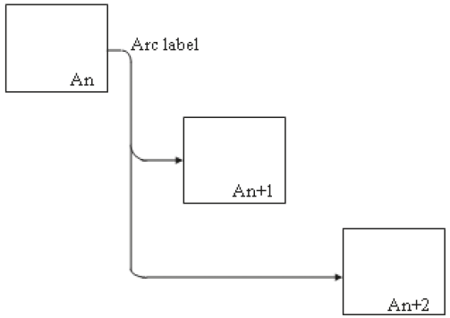
Connecting flows between activities
Parallelism: simultaneous flow to more than one activity
This is more common with a flow of information than with a flow of physical entities

Slide 28
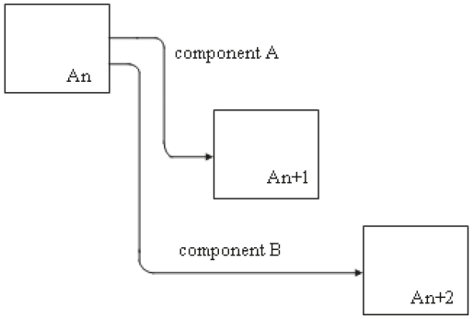
Connecting flows between activities
Distribution of flows to more than one activity

Slide 29
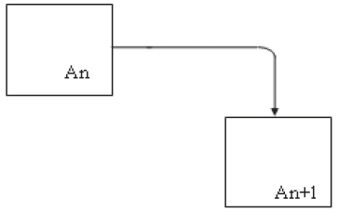
Connecting flows between activities
One activity can provide inputs, controls, or both to other activities
activity An controlling activity An+1
Simple output/input relationship

Slide 30
Connecting flows between activities
Q: how to avoid confusion in deciding whether an arc is either an input to an activity or a control?
If entity represented by arc is converted into some other form by the activity, it is clearly an input; e.g. activity A4 converts finished product into shipped product
If entity represented by arc directs the activity as to how it will perform its function, it is clearly a control; e.g. “production schedule and recipe” is information that tells activity A3 what products will be produced on a specific day (production schedule) and how these products will be produced (recipe)

Slide 31
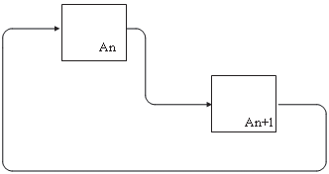
Connecting flows between activities
Feedback: occurs when information generated in a subsequent activity is used by a prior activity in the activity diagram
e.g. relationship between A1: Manage Sales and Order Process and A2: Plan for Manufacture (i.e. to know delivery dates for customer quotation, you must know planned mfg. schedule)*
activity An + 1 providing feedback to activity An
Notes:
* Note how this is another interesting distinction between an input and a control (i.e. scheduling information here only provides information for staff to assist them in providing quotations for new orders); i.e. essentially the same information can be a control on one activity (production schedule and recipe) and an input to another activity (schedule information)

Slide 32
Connecting flows between activities
Note, we have not shown mechanisms in the decomposition of node A0
Mechanisms are only required at the elemental level of the modeling process (i.e. when a specific activity is identified at the lowest level of the hierarchy)

Slide 33
Sources
Design of Industrial Information Systems. Thomas Boucher, and Ali Yalcin. Academic Press. First Ed. 2006. Chapter 4.
Some useful videos:
Function modelling using IDEF0: The basics of functions, inputs, outputs, mechanisms and controls (https://youtu.be/xyO5n6Ay-1I)
AI0Win Tutorial - Manage a Coffee Shop (https://youtu.be/kHDNlFclsiY)

