Slide 1
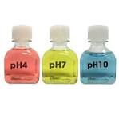
Buffers

Slide 2
Buffers
Buffer is a solution which resist large changes in the pH by partially absorbing addition of the H⁺ or OH⁻ ions to the system.
Acidic buffer: mixture of weak acid and its salt of strong base.
Basic buffers: mixture of weak base and its salt of strong acid.
Buffers resist changes in pH upon the addition of limited amounts H⁺ of or OH⁻.
Buffer pH does change upon the addition of H⁺ of or OH⁻ but the change is much less than that would occur in case of buffer absence.

Slide 3
Mechanism of Action of Buffers
Example of buffer CH3COOH / CH3COO⁻
When H⁺ is added to the buffer:
CH3COO⁻ + H⁺ CH3COOH
When OH⁻ is added to the buffer:
CH3COOH + OH⁻ CH3COO⁻ + H₂O
The buffer absorb the effect of H⁺ or OH⁻ as possible as it can.
https://www.youtube.com/watch?v=8U5tP6GL9wM
Notes:
A plasmid is an extra-chromosomal element

Slide 4
Buffer Capacity
The ability of a buffer to resist changes in the pH is referred
to as a buffer capacity.
The no. of moles of H⁺ that must be added to one liter of the buffer in order to decrease the pH by one unit.
The no. of moles of OH⁻ that must be added to one liter of the buffer in order to increase the pH by one unit.
Notes:
A plasmid is an extra-chromosomal element

Slide 5
Buffer Capacity Continue
$β=\frac{2.3Ka\text{[}\text{H}\text{+}\text{][}\text{C}\text{]}}{\left(Ka+\text{[}\text{HA}\text{]}\right)2 }$
$βmax=$ 0.575 [C]
In the equation:
$β$ = buffer capacity
[H⁺] = hydrogen ion concentration of the buffer
[C]= total concentration of buffer components = [HA] + [A⁻] .
https://www.youtube.com/watch?v=g_ZK2ABUjvA
Notes:
A plasmid is an extra-chromosomal element

Slide 6
Preparation of Buffers

Slide 7
Preparation of Buffers
Example: what are the concentrations of HOAc and OAC⁻
in 0.2M acetate buffer, pH=5, ka=1.7*10⁻⁵ , pka=4.77?
Concentration of the buffer = [HA] + [A⁻]
0.2 = [CH3COOH] + [CH3COO⁻]
Assume [A⁻] = y thus, [HA] = 0.2 – y
$pH=\text{pK}\text{a}\text{ + }\text{log}\frac{\text{[}\text{A}\text{−}\text{]}}{\text{[}\text{HA}\text{]}}$
$\text{5 }\text{= }\text{4.77 }\text{+ }\text{log} \frac{y}{0.2−y}$
$anti\log{0.23= \frac{y}{0.2−y}}$
1.7 = $\frac{y}{0.2−y}$
$y=0.34 −1.7y$
$y= \frac{0.34}{2.7}$
$y=0.126 molar.$
Since [HA] = 0.2 –y then [HA] = 0.2 – 0.126 = 0.074 molar.

Slide 8
Preparation of Buffers Continue
Example: Describe the preparation of 3liters of 0.2M acetate buffer, pH=5starting from solid sodium acetate trihydrate MW=136 and a 1M solution of acetic acid, pka=4.77?
From the previous example [HA] = 0.074 molar, [$\text{A}\text{−}$] = 0.126molar
No. of moles of HA = M * V_{(L)}
= 0.074 * 3 = 0.222 mole
From HA molarity (1M), M = No. of moles / V_{(L)} thus,
V = No. of moles / M = 0.222 / 1 = 0.222 L
No. of moles of $\text{A}\text{−}$ = M * V_{(L)}
= 0.126 * 3 = 0.378mole
No. of moles $\text{A}\text{−}$= wt_{g} /MW
0.378 = wt_{g} / 136
Wt = 51.4 g
To prepare 3L buffer, dissolve 51.4g of the solid sodium acetate trihydrate with 222ml of the 1M acetic acid and make up the volume to 3 L with water.

Slide 9
Polyprotic Acids
H₂A H⁺ + HA⁻ H⁺ + A²⁻
K_{a1} = K_{a2} =
Polyprotic acid ionizes in a successive steps.
For most common weak diprotic acids, K_{a1} > K_{a2}
The pH of a solution of H₂A is established almost exclusively by the 1st ionization.
pH = pK_{a1}$+log\frac{\text{[}\text{HA}\text{−}\text{]} }{\text{[}\text{H}\text{2}\text{A}\text{] }}$
pH = pK_{a2}$+log\frac{\text{[}\text{A}\text{2}\text{−] }}{\text{[}\text{HA}\text{−}\text{] }}$
[H⁺] [HA⁻]
[H⁺] [A²⁻]
[H₂A]
[HA⁻]

Slide 10
Titration of a weak diprotic acid with strong base

Slide 11
Dissociation of a H₃PO₄
H₃PO₄ H⁺ + H₂PO₄⁻ H⁺ + HPO₄²⁻ H⁺ + PO₄³⁻
K_{a1} = K_{a2} = K_{a3}=
For H₃PO₄ : K_{a1} > K_{a2} >K_{a3}
pH = pK_{a1}$+log\frac{\text{[}\text{H}\text{2}\text{PO} \text{−] }}{\text{[}\text{H}\text{3}\text{PO}\text{4}\text{]} }$
pH = pK_{a2}$+log\frac{\text{[}\text{HPO}\text{4}\text{2}\text{−] }}{\text{[}\text{H}\text{2}\text{PO}\text{4}\text{−}\text{]} }$
pH = pK_{a3}$+log\frac{\text{[}\text{PO}\text{4}\text{3}\text{−] }}{\text{[}\text{HPO}\text{4}\text{2}\text{−] }}$
[H⁺] [H₂PO₄⁻]
[H⁺] [HPO₄²⁻]
[H⁺] [PO₄³⁻ ]
[H₃PO₄]
[H₂PO₄⁻]
[HPO₄²⁻]

Slide 12
Titration of a H₃PO₄ with strong base

Slide 13
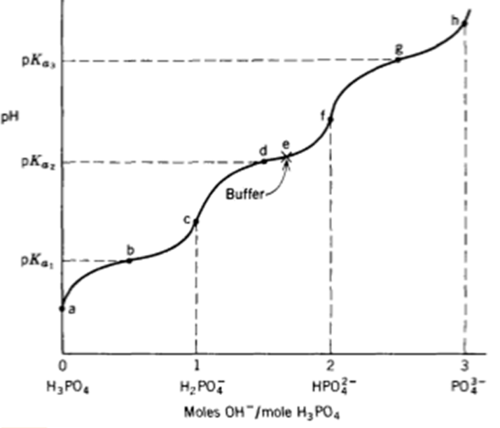
Example: Describe the preparation of 10 liters of 0.045M potassium phosphate buffer, pH= 7.5? pK_{a1}= 2.12 , pK_{a2}= 7.21 , pK_{a3}= 12.32?.
H₃PO₄ H⁺ + H₂PO₄⁻ H⁺ + HPO₄²⁻ H⁺ + PO₄³⁻
The pH > K_{a2} thus, the 2 major ionic species present are H₂PO₄⁻ (conjugate acid) and HPO₄²⁻ (conjugate base)
The buffer can be prepared by several ways as:
by mixing KH₂PO₄ and K₂HPO₄ in proper proportions.
by starting with KH₂PO₄ and converting a portion of it into K₂HPO₄ by adding KOH.
by starting with K₂HPO₄ and converting a portion of it into KH₂PO₄ by adding strong acid as HCl.

Slide 14
Regardless of which method is used, first calculate the proportion and amounts of the 2 ionic species in the buffer.
No. of moles = M * V_{(L)} = 0.045 *10
= 0.45 moles
pH = pK_{a2}$+log\frac{\text{[}\text{HPO}\text{4}\text{2}\text{−] }}{\text{[}\text{H}\text{2}\text{PO}\text{4}\text{−}\text{]} }$
7.5 = 7.2 $+log\frac{\text{[}\text{HPO}\text{4}\text{2}\text{−] }}{\text{[}\text{H}\text{2}\text{PO}\text{4}\text{−}\text{]} }$
0.3 = $log\frac{\text{[}\text{HPO}\text{4}\text{2}\text{−] }}{\text{[}\text{H}\text{2}\text{PO}\text{4}\text{−}\text{]} }$
Antilog 0.3 = $\frac{\text{[}\text{HPO}\text{4}\text{2}\text{−] }}{\text{[}\text{H}\text{2}\text{PO}\text{4}\text{−}\text{]} }$
2 = $\frac{\text{[}\text{HPO}\text{4}\text{2}\text{−] }}{\text{[}\text{H}\text{2}\text{PO}\text{4}\text{−}\text{]} }$
So the ratio is $\frac{2}{1}$ that is $\frac{\text{[}\text{HPO}\text{4}\text{2}\text{−] }}{\text{[}\text{H}\text{2}\text{PO}\text{4}\text{−}\text{]} }$ =$\frac{2}{1}$
$\frac{2}{3}$ * 0.45 mole = 0.3 mole of $\text{HPO}\text{4}\text{2}\text{− }$is needed and $\frac{1}{3}$ * 0.45 mole = 0.15 mole of $\text{H}\text{2}\text{PO}\text{4}\text{−}$ is needed.

Slide 15
From mixing KH₂PO₄ and K₂HPO₄:
wt_{g} of K₂HPO₄ = no. of moles * MW
= 0.3 *174 = 52.2g
wt_{g} of KH₂PO₄ = no. of moles * MW
= 0.15 * 136 = 20.4g
Dissolve the two solutes in some water and make up the volume to 10L by water.
From KH₂PO₄ and KOH:
Start with KH₂PO₄ (position c) and add sufficient KOH to convert $\frac{2}{3}$of the H₂PO₄⁻ to HPO₄²⁻ (position e).
wt_{g} of KH₂PO₄ = no. of moles * MW
= 0.45 * 136 = 61.2g.
wt_{g} of KOH = no. of moles * MW
= 0.3 * 56 = 16.8g.
Dissolve the two solutes in some water and make up the volume to 10L by water.
OH⁻
H₂PO₄⁻ HPO₄²⁻

Slide 16
From K₂HPO₄ and HCl:
As the ratio we want to end up with is $\frac{\text{[}\text{HPO}\text{4}\text{2}\text{−] }}{\text{[}\text{H}\text{2}\text{PO}\text{4}\text{−}\text{]} }$ =$\frac{2}{1}$ thus we want to convert only $\frac{1}{3}$ of the HPO₄²⁻ to H₂PO₄⁻
Suppose we have solid K₂HPO₄ and a 2M HCl
wt_{g} of K₂HPO₄ = no. of moles * MW
= 0.45 * 174 = 78.3g.
No. of moles of HCl = $\frac{1}{3}$ * 0.45 mole = 0.15 mole of HCl
M = No. of moles / V_{(L)} thus, V_{(L)} = No. of moles /M
V_{(L)} = No. of moles /M
=0.15 / 2
= 0.075L
Dissolve 78.3g of the K₂HPO₄ in a little water then add 75ml of the 2M HCl and make up the volume up to 10 liters with water.
H⁺
HPO₄²⁻ H₂PO₄⁻

Slide 17
Titration of a H₃PO₄ with strong base

Slide 18
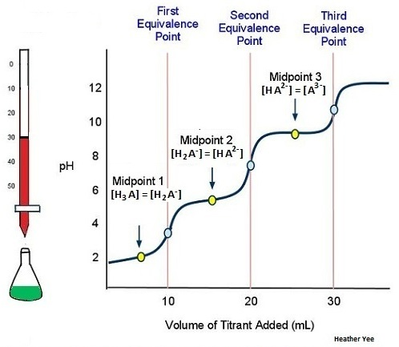

Slide 19
Examples of Buffers

Slide 20
Physiological Buffers
Importance of Buffers in Physiological Systems:
Processes that take place in living organisms are called physiological processes such as blood circulatory system, respiration etc.
The internal pH of most living cells is close to 7.0. The pH of human blood is 7.4.
A blood pH of below 7 or above 7.8 can cause death within minutes. So buffering of blood pH is very important to stabilize it around 7.4.
pH plays an important role in almost all biological processes. Small change in pH i.e. decreased or high pH can cause metabolic implications in human body like acidosis and alkalosis.
Where metabolism is involved there would be definitely a need of buffer as within cells metabolism is associated with the release of protons (H⁺) i.e. decrease in pH or uptake of protons (H⁺) i.e. increase in pH.

Slide 21
Physiological Buffers
Important buffers that are dominant in human body are:
1. Bicarbonate buffers
2. Phosphate buffers
3. Protein buffers

Slide 22
Physiological Buffers
Bicarbonates buffers (Buffering in blood)
Blood is a biological fluid in which Carbonic acid and Hydrogen carbonate buffer system plays an important role in maintaining pH around 7.40.
In this buffer, carbonic acid (H₂CO₃) act as a weak acid and hydrogen carbonate ion (HCO₃⁻) act as conjugate base of a weak acid or salt of weak acid.
H₂CO₃ ↔ H⁺ + HCO₃⁻
H₂CO₃₊ OH⁻ ↔ H2O + HCO₃⁻
When there is excessive amount of H⁺ in the blood, it is consumed by HCO₃⁻ forming carbonic acid that is a weak acid which does not alter the blood pH so much and when there is excessive amount of OH⁻ in the blood, it is consumed by H₂CO₃ as it will release the H⁺ ions upon excess amount of OH⁻ in the blood forming H₂O.
Proportion of carbonic acid and hydrogen carbonate is also very much important in blood. Carbonic acid concentration is controlled by respiration through lungs while hydrogen carbonate concentration is controlled by urination through kidneys.
Carbonic acid buffer system is a critical buffer for blood as in the absence of this buffer system. the pH may fall below this normal value within blood producing a condition a condition called acidosis ( acidosis may be respiratory or metabolic acidosis) or the pH may rise above normal level producing a condition known as alkalosis (alkalosis may be respiratory or metabolic alkalosis).

Slide 23
Physiological Buffers
Phosphate buffer (Buffering of internal cell fluids)
The phosphate buffer system works in the internal fluid of all cells. This buffer system consists of dihydrogen phosphate ions (H₂PO₄⁻) as a weak acid and hydrogen phosphate ions (HPO₄²⁻) as a conjugate base of weak acid. These two ions are in equilibrium with each other as indicated by the chemical equation below.
H₂PO₄⁻ ↔ H⁺ + HPO₄²⁻
H₂PO₄⁻ +OH⁻ ↔ H2O + HPO₄²⁻
If additional hydrogen ions enter the cellular fluid, they are consumed in the reaction with HPO₄²⁻, and the equilibrium shifts to the left. If additional hydroxide ions enter the cellular fluid, they react with H₂PO₄⁻, producing HPO₄²⁻, and shifting the equilibrium to the right. In the absence of phosphate buffer from cell fluid, sharp changes in pH of cell fluids may cause cell death or improper working of different proteins and cell organelles present within the cell.

Slide 24
Physiological Buffers
Protein buffer (Buffering in Cells and Tissues)
Proteins are mainly composed of amino acids. These amino acids contain functional groups that act as weak acid and bases when there are sharp changes in pH in order to stabilize the pH within the body cells.
In short it can be said that proteins act as buffers themselves. Protein is a significant buffer the main buffering site for protein is cells and tissues but even in blood it act as a buffer consuming hydrogen ions produced due to the dissociation of the carbonic acid into hydrogen bicarbonate. To understand the proteins as a buffer we have to look into the structure of amino acids which consists of
carboxyl group (COOH)
amino group (NH₂)
hydrogen atom
R group
From the above four groups COOH and NH₂ act as buffer systems for acidic and basic conditions.

Slide 25
At a near neutral pH, like the pH of blood, the carboxyl group is actually COO⁻ instead of COOH. Then, if a protein finds itself in a more acidic solution, the carboxyl group will be able to take on the extra hydrogen ions and return to the COOH configuration.
At a near neutral pH, like in blood, the amino group is actually NH₃⁺ rather than just NH₂. It actually tends to carry an extra hydrogen ion on it at a normal pH. Then, if a protein finds itself in a more basic environment, its amino groups on its amino acids can actually release their hydrogen ions and return to NH₂.
As all cells and tissues are composed of proteins mainly so in the absence of protein buffer the sharp changes in pH may cause cell death or tissue damage of a living organisms.

