Slide 1
Biochemical Calculations
Prepared by Amal Albati
Office: Building 5, 3rd floor, 5T251

Slide 2
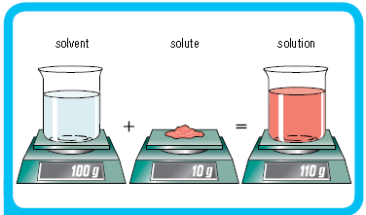
Solution Composition
Solute is the substance being dissolved.
Solvent is the liquid in which the solute is dissolved.
A solute is dissolved in a solvent.
an aqueous solution has water as solvent.

Slide 3
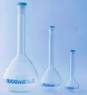
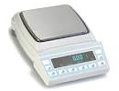
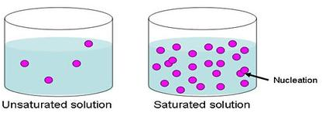
Aqueous Solution
The majority of reactions occur in solutions.
There are several ways to express the concentration of a substance in a solution based on:
The volume
The weight
Degree of saturation
Notes:
A plasmid is an extra-chromosomal element

Slide 4
Concentrations based on Volume
Molarity(M)
Normality (N)
Osmolarity (Osm)
Activity (a)
Weight/volume percent (w/v %)
Volume/volume percent (v/v%)
Milligram percent (mg %)

Slide 5
Molarity
Molarity (M) = the number of moles of solute per liter of solution
= No. of moles of solute / V_{(L)}
No. of moles = wt_{g} /MW ( molecular weight)
1 mole contains Avogadro’s number of molecules per liter (6.023 x 10²³).
Molar concentrations are usually given in square brackets.
Example: [NaOH] = molarity of Sodium Hydroxide.

Slide 6
Molarity Continue
Example:
A solution of NaCL had 0.8 moles of solute in 2 liters of
solution. What is its molarity?
M = No. of moles / V_{(L)}
M = 0.8 / 2
M = 0.4 molar

Slide 7
Molarity Continue
Example:
How many grams of solid NaOH are required to prepared 500 ml of 0.04 M solution?
M = No. of moles / V_{(L)}
500 ml = 500 ÷1000 = 0.5 L
no. of moles = 0.04 ×0.5
no. of moles = 0.02 mole
MW of NaOH = 23 + 16 + 1 = 40 g/ mole
wt in grams = no. of moles ×MW
wt in grams = 0.02 ×40
wt in grams = 0.8 grams

Slide 8
Normality
Normality (N) = the number of equivalents of solute per liter of solution
= No. of equivalents / V_{(L)}
No. of equivalents = wt_{g} of solute / equivalents weight (EW)
EW= MW of solute / n
n represents the number of the replaceable hydrogen (in acids) or hydroxyl ions ( in bases) per molecule.
n represents the number of electrons gained or lost per molecule (in oxidizing or reducing agents).
N=n*M
For example a 0.01 M solution of H₂So₄ is 0.02 N

Slide 9
Normality Continue
Example:
What is the normality of H₂So₄ solution that contains 24.5g of solute in a total volume of 100ml?
N=n*M
n=2
M = No. of moles / V_{(L)}
100 ml = 100 ÷1000 = 0.1L
No. of moles = wt_{g} /MW
MW of H₂So₄ = 2 + 32 + (16*4) = 98g
No. of moles = 24.5/ 98
No. of moles = 0.25 mole
M = No. of moles / V_{(L)}
M=0.25/0.1 = 2.5 molar
N=n*M
N=2*2.5 = 5 normal

Slide 10
Normality Continue
Example:
What is the normality of H₂So₄ solution that contains 24.5g of solute in a total volume of 100ml?
Normality (N) = No. of equivalents / V_{(L)}
No. of equivalents = wt_{g} of solute / equivalents weight (EW)
EW= MW of solute / n
MW of H₂So₄ = 2 + 32 + (16*4) = 98g
EW= 98/ 2= 49
No. of equivalents = wt_{g} of solute / equivalents weight (EW)
= 24.5 g / 49= 0.5 eq
Normality (N) = No. of equivalents / V_{(L}
=0.5 / 0.1 = 5 Normal

Slide 11
Osmolarity
Osmolarity = the molarity of particles in a solution.
KCl = 2 particals.
CaCl₂ = 3 particals.
The osmolarity of non dissociable substance = its molarity.
The osmolarity of dissociable substance =n*M
n = no. of ions produced per molecule.
It is used when study living cells and tissues.

Slide 12
Osmolarity Continue
Example:
A solution of KCl with 0.03M, what would be its osmolarity?
The osmolarity of dissociable substance =n*M
osmolarity = 2 * 0.03
= 0.06 osmolar

Slide 13
ISOTONIC
ISO - means alike
TONICITY - refers to osmotic activity of body fluids; tells the extent that fluid will allow movement of water in & out cell.
Means that solutions on both sides of selectively permeable membrane have established equilibrium.

Slide 16
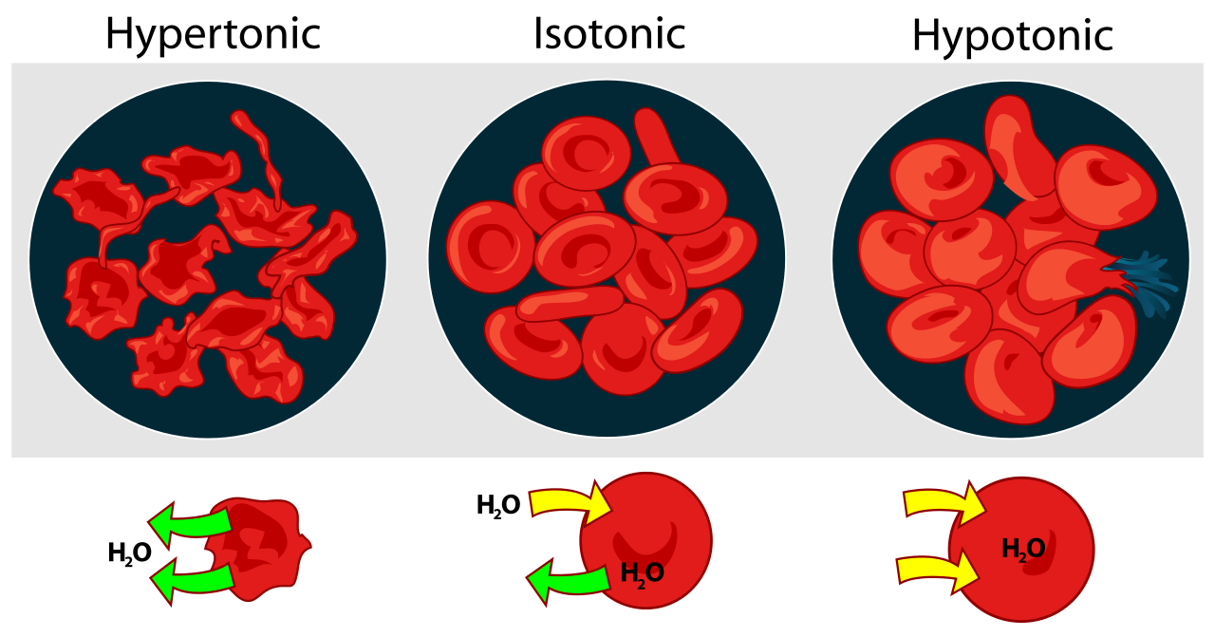

Slide 17
Osmolarity Continue
Example:
When you want to study RBC and its osmolarity in the cytoplasm is 0.308 osmolar. What do you think the osmolarity of the in vitro solution should be?
0.308 osmolar.
Example:
Classify these solution in regards to the RBC osmolarity
1- 0.56 osmolar
2-0.21 osmolar
3- 0.154M NaCl

Slide 18
Osmolarity Continue
Example:
Classify these solution regards the RBC osmolarity
1- 0.56 osmolar
2-0.21 osmolar
3- 0.154M NaCl
---
1= Hypertonic
2= Hypotonic
3= osmolarity =n*M = 2 * 0.154 = 0.308 osmolar so it is isotonic.

Slide 19
Weight / volume percent
Weight/volume percent (w / v %) = the weight in g of a
solute per 100 ml of solution.

Slide 20
Milligram percent
Milligram percent ( mg%) = The weight in mg of a solute
per 100 ml of solution.
Mostly used in clinical laboratories.
Example:
Blood glucose level of 200mg/dl means there is a 200mg
glucose in 100ml of blood.

Slide 21
Volume / volume percent
Volume /volume percent (v / v %) = the volume in ml of a
solute per 100 ml of solution.

Slide 22
Concentrations based on Weight
Weight/Weight percent (w/w %).
Molality.

Slide 23
Weight/weight percent
Weight/weight percent (w/w%) = the weight in g of a solute per 100 g of solution.
The concentration of many commercial acids are given in term of w/w %.
In order to calculate the volume of a stock solution needed for a certain preparation, we must know the density.
The following equation is usually used.
The density of water is 1gm/ml.
ρ= density = weight/volume
Wt (g) of pure substance requested = volume of stock solution needed (ml) * ρ *% as decimal of the stock solution

Slide 24
Weight/weight percent Continue
Example:
Describe the preparation of 2 liters of a 0.4M HCl solution starting with a concentrated (stock) solution of HCl with 28% w/w%, the specific gravity id 1.15?
No. of moles of pure HCl needed = M*V
= 0.4* 2 = 0.8 moles
MW of HCl = 1+35.5 = 36.5 g/mole
The weight in grams of pure HCl needed = no. of moles* MW
= 0.8* 36.5
= 29.2g

Slide 25
Weight/weight percent Continue
From the stock, 28 g of pure HCl in 100 grams solution
29.2g of pure HCl in ? grams solution
= (29.2 * 100) / 28
= 104.3 grams.
ρ= weight/volume thus volume = weight / density
volume = weight / density
= 104.3 / 1.15
= 90.7 ml
so the volume of the stock HCl needed is 90.7ml and make up the volume to 2 liters with distilled water.

Slide 26
Weight/weight percent Continue
Example:
Describe the preparation of 2 liters of a 0.4M HCl solution starting with a concentrated (stock) solution of HCl with 28% w/w%, the specific gravity id 1.15?
No. of moles of pure HCl needed = M*V
= 0.4* 2 = 0.8 moles
MW of HCl = 1+35.5 = 36.5 g/mole
The weight in grams of pure HCl needed = no. of moles* MW
= 0.8* 36.5
= 29.2g

Slide 27
Weight/weight percent Continue
Since Wt (g) of pure substance requested = volume of stock solution needed (ml) * ρ * % as decimal of the stock solution thus, volume = wt / (ρ * % )
The volume = 29.2 / ( 1.15 * 0.28)
= 90.7 ml
so the volume of the stock HCl needed is 90.7ml and make up
the volume to 2 liters with distilled water.

Slide 28
Molality
Molality = the number of moles of solute per 1000 grams of solvent.
Solution = solvent + solute.
Example:
Calculate the molality of a concentrated HCl stock solution which has a 28% w/w%, S.G= 1.15?
Since the weight of solution = weight of solvent + weight of solute.
Thus, the weight of solvent = weight of solution - weight of solute.
= 100g – 28 g
= 72g
MW of HCl = 1+35.5 = 36.5 g/mole
No. of moles of solute = 28 / 36.5
= 0.77 mole

Slide 29
Molality Continue
0.77 mole of solute in 72 g of solvent
? mole of solute in 1000 g of solvent
No. of moles of solute 1000 g of solvent = ( 0.77 * 1000) / 72
= 10.69 moles
The molality is 10.69

Slide 30
Saturation Degree
Saturated solution
is one where the concentration is at a maximum - no more solute is able to dissolve at a given temperature.
A saturated solution represents an equilibrium.
Unsaturated Solution
less than the maximum amount of solute for that temperature is dissolved in the solvent.
No solid remains in flask.
Supersaturated
Solvent holds more solute than is normally possible at that temperature.

Slide 31
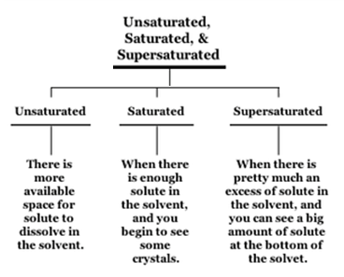

Slide 32
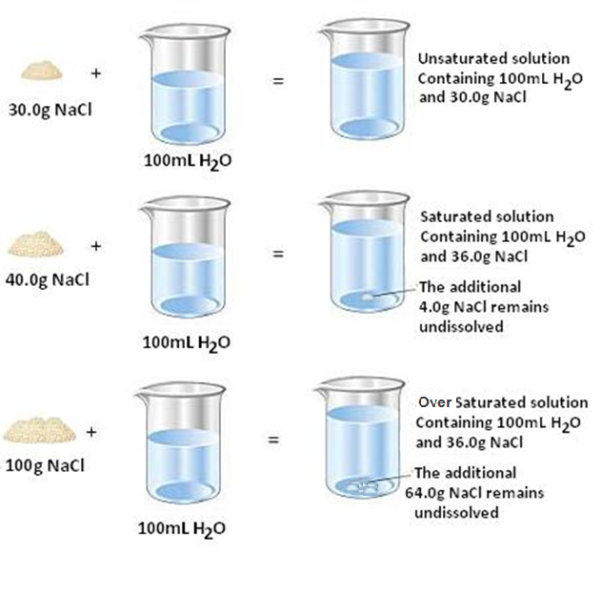

Slide 33
Concentrations based on Saturation Degree
Percent saturation= the concentration of salt in solution as a
percent of the maximum concentration possible at a given
temperature.
At the equation above:
Volume is the volume of the saturated salt needed.
S1 is the initial low saturation ( used as a decimal).
S2 is the final high saturation ( used as a decimal).
This is to the volume to be added to 100 ml at saturation S1.
Volume (ml) = 100 (S2-S1)
1-S2

Slide 34
Concentrations based on Saturation Degree Continue
Example:
How many ml of a saturated ammonium sulfate solution must be added to 40ml of a 20% saturated solution to reach a final solution of 70%?
Volume (ml) = ( 100 * (S2-S1)) / (1-S2)
= ( 100 * (0.7-0.2)) / (1-0.7)
= ( 100 * 0.5) / (0.3)
= 50 / 0.3
= 166.6 ml
Since 100 ml of solution need 166.6 ml saturated solution
40 ml of solution need ? ml
The volume needed is (40* 166.6) / 100 = 66.64ml of saturated solution needed to be added to 40 ml of 20% saturated ammonium sulfate solution to reach a final solution of 70%.

Slide 35
Units Conversion

