Slide 1
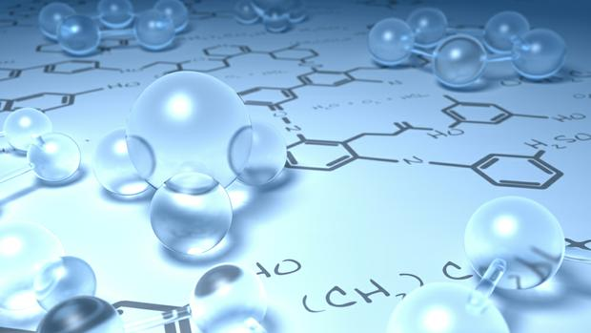
By
Dr. Mohamed El-Newehy
Chemistry Department, College of Science, King Saud University
http://fac.ksu.edu.sa/melnewehy

Slide 2
Unsaturated Hydrocarbons
Alkenes

Slide 3
The Structure of Alkenes
- Alkenes are ydrocarbons that contain a carbon–carbon double bond.
- Alkenes are also Olefins.
- General formula is C_{n}H_{2n}
- The simplest members of the Alkenes series are C₂ & C₃
- Hybridization; sp²-hybridized orbitals
- The angle between them is 120°.
- A trigonal planar.

Slide 4
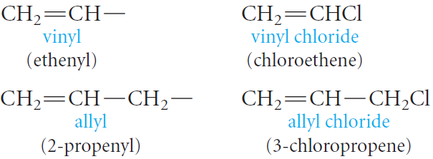
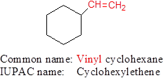
Nomenclature of Alkenes
Common Names
- The simplest members of the alkene and alkyne series are frequently referred to by their older common names, ethylene, acetylene, and propylene.
- Two important groups also have common names; They are the vinyl and allyl groups.
- These groups are used in common names.

Slide 5
Nomenclature of Alkenes
The IUPAC Rules
The IUPAC rules for naming alkenes are similar to those for alkanes, but a few rules must be added for naming and locating the multiple bonds.
1. The ending -ene is used to designate a carbon–carbon double bond.
2. Select the longest chain that includes both carbons of the double bond.
3. Number the chain from the end nearest the double bond so that the carbon atoms in that bond have the lowest possible numbers.
If the multiple bond is equidistant from both ends of the chain, number the chain from the end nearest the first branch point.

Slide 6
Nomenclature of Alkenes
The IUPAC Rules
4. Indicate the position of the multiple bond using the lower numbered carbon atom of that bond.
NOTES
The root of the name (eth- or prop-) tells us the number of carbons, and the ending (-ane, -ene, or -yne) tells us whether the bonds are single, double, or triple.
No number is necessary in these cases, because in each instance, only one structure is possible.
With four carbons, a number is necessary to locate the double bond.

Slide 7
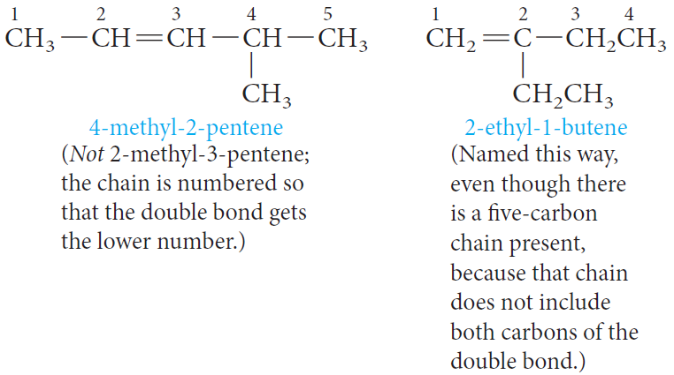
Nomenclature of Alkenes
The IUPAC Rules
- Branches are named in the usual way.

Slide 8
Nomenclature of Alkenes
The IUPAC Rules
- With cyclic alkenes, we start numbering the ring with the carbons of the double bond.
- In cyclic alkenes, a number is not needed to denote the position of the functional group, because the ring is always numbered so that the double bond is between carbons 1 and 2.
- Put the lowest substituent number into the name not in the direction that gives the lowest sum of the substituent numbers.

Slide 9
Nomenclature of Alkenes
The IUPAC Rules
- For example, 1,6-dichlorocyclohexene is not called 2,3-dicyclohexene because 1,6-dichlorocyclohexene has the lowest substituent number (1), even though it does not have the lowest sum of the substituent numbers (1+6=7 versus 2+3=5).

Slide 10
Nomenclature of Alkenes
The IUPAC Rules
Example: Write the structural formula of 4-Isopropyl-3,5-dimethyl-2-octene.
1) The parent carbon chain is an Octene.
The double bond is located between the 2nd and 3rd carbons.
2) Two methyl groups are attached on the parent carbon chain, one on carbon 3 and the other on carbon 5.
3) An isopropyl group is attached on carbon 4.
4) Put the missing hydrogens to get the correct structure.

Slide 11
Physical Properties of Alkenes
- Physical State
Alkenes occur at room temperature are gases, liquids, and solids.
C2 to C4 are gases,
C5 to C17 are liquids,
C18 and larger alkenes are wax –like solids.
- Solubility
Alkenes are nonpolar compounds.
Their solubility “ Like dissolve like”
Alkenes are soluble in the nonpolar solvents;
carbon tetrachloride, CCl₄ and benzene,
Alkenes are insoluble in polar solvents like water.
- Boiling Points & Melting Points
The boiling points and melting points of normal hydrocarbons increase with increasing molecular weight.
The greater the number of branches, the lower the boiling point.

Slide 12
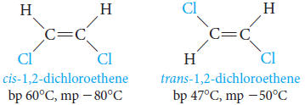
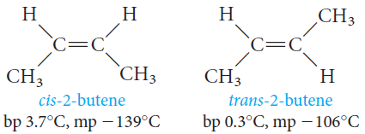
Geometric Isomerism in Alkenes
- In alkenes, geometric isomerism is due to restricted rotation about the carbon - carbon double bond.
A) when W differs from X and Y from Z, Alkenes exist as geometric isomers
- cis isomer; when two similar groups are on the same side of the double bond.
- trans isomer; when two similar groups are on the opposite sides of the double bond.
- They have different physical properties and can be separated by fractional crystallization or distillation.

Slide 13
Geometric Isomerism in Alkenes
- In alkenes, geometric isomerism is due to restricted rotation about the carbon - carbon double bond.
B) If (W = X or Y = Z), geometric isomerism is not possible.

Slide 14
Geometric Isomerism in Alkenes
- For alkenes with four different substituent such as
Another system, the E, Z system,
- Basically, the E,Z system works as follows;
Arrange the groups on each carbon of the C=C bond in order of priority
- The priority depends on atomic number:
The higher the atomic number of the atom directly attached to the double-bonded carbon, the higher the priority.
- Thus, in structure (I),
Cl > F, and CH₃ > H.

Slide 15
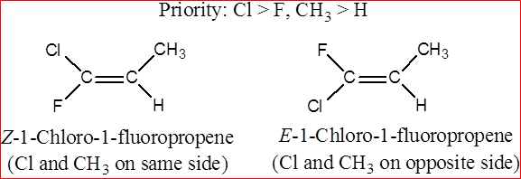
Geometric Isomerism in Alkenes
- If the two groups of higher priority are on the same side of the C=C plane,
The isomer is labeled Z; (from the German zusammen, together).
- If the two groups of higher priority are on opposite sides of the C=C plane,
The isomer is labeled E; (from the German entgegen, opposite).

Slide 16
Preparation of Alkenes
- Alkenes are prepared by Elimination of an atom or group of atoms from adjacent carbons to form carbon-carbon double bond.
1) Dehydration of Alcohols
- When an alcohol is heated in the presence of a mineral acid catalyst, It readily loses a molecule of water to give an alkene.
- The acid catalysts most commonly used are sulfuric acid, H₂S0₄, and phosphoric acid, H₃P0₄.

Slide 17
Preparation of Alkenes
1) Dehydration of Alcohols

Slide 18
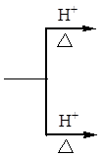
Preparation of Alkenes
1) Dehydration of Alcohols
Which Alkene Predominates?; Saytzeff’s Rule
The loss of water from adjacent carbon atoms, can give rise to more than one alkene.
Example: the dehydration of 2-butanol.
2-butene is the major (with two alkyl substituents attached to C=C)
Saytzeff’s Rule applies
In every instance in which more than one Alkene can be formed
the major product is always the alkene with the most alkyl substituents attached on the double-bonded carbons.
Notes:
dicular

Slide 19
Preparation of Alkenes
1) Dehydration of Alcohols
Mechanism of Dehydration of Alcohols
Step 1. Protonation of the alcohol.
Step 2. Formation of a carbocation.
Step 3. Loss of a proton from the carbocation.
regenerates the acid catalyst and forms the alkene.
Notes:
dicular

Slide 20
Preparation of Alkenes
1) Dehydration of Alcohols
- Classes of Carbocations
according to the number of carbon atoms attached to the positively charged carbon.
Generally
1. The dehydration of alcohols requires an acid catalyst.
2. The predominant alkene formed follows Saytzeffs rule.
3. The reaction proceeds via a carbocation intermediate.
4. The stabilities of carbocations and the ease of dehydration of alcohols follows the order 3° > 2° > 1°.
Notes:
dicular

Slide 21
Preparation of Alkenes
2) Dehydrohalogenation of Alkyl Halides
- Alkenes can also be prepared under alkaline conditions.
heating an alkyl halide with a solution of KOH or NaOH in alcohol, yields an alkene.
3) Dehalogenation of Vicinal Dibromides
Notes:
dicular

Slide 22
Reactions of Alkenes
- The chemistry of alkenes can be divided into two general types of reactions:
(1) Electrophilic Addition Reactions
Addition of Symmetric and Unsymmetric Reagents to symmetric Alkenes.
1. Addition of Hydrogen: Catalytic Hydrogenation
2. Addition of Halogens: Halogenation
Addition of Unsymmetric Reagents to Unsymmetric Alkenes; Markovnikov’s Rule.
1. Addition of Hydrogen Halides
2. Addition of Sulfuric Acid
3. Addition of Water: Hydration
4. Addition of HOX: Halohydrin Formation
(2) Substitution Reactions
(3) Oxidation Reactions
1. Ozonolysis
2. Oxidation Using KMnO₄
Notes:
dicular

Slide 23
Reactions of Alkenes
Electrophilic Addition Reactions
1. Addition of Hydrogen: Hydrogenation
Addition of a mole of hydrogen to carbon-carbon double bond of Alkenes in the presence of suitable catalysts to give an Alkane.

Slide 24
Reactions of Alkenes
Electrophilic Addition Reactions
2. Addition of Halogen: Halogenation
When an alkene is treated at room temperature with a solution of bromine or chlorine in carbon tetrachloride to give the corresponding vicinal dihalide (two halogens attached to adjacent carbons)
- Iodine is too unreactive and will not add to the double bond.
- Fluorine is too reactive and reacts explosively with an alkene.

Slide 25
Reactions of Alkenes
Electrophilic Addition Reactions
3. Addition of Acids
- A variety of acids add to the double bond of alkenes.
The hydrogen ion (or proton) adds to one carbon of the double bond, and the remainder of the acid becomes connected to the other carbon.
- Acids that add in this way are the hydrogen halides (H-F, H-Cl, H-Br, H-I), sulfuric acid (H-OSO₃H) and water (H-OH).
Note that
- Any electron-deficient species is called an electrophile.
- Any electron-rich species is called a nucleophile.
Notes:
dicular

Slide 26
Reactions of Alkenes
Electrophilic Addition Reactions
3. Addition of Acids
- The addition of H—A to an alkene is believed to be a two-step process.
Step 1. The hydrogen ion (the electrophile) attacks the ∏-electrons of the alkene, forming a C—H bond and a carbocation.
Step 2. The negatively charged species A: - (a nucleophile) attacks the carbocation and forms a new C—A bond.
- The attack by an electrophilic reagent on the ∏-electrons, falls in a general category called electrophilic addition reactions.
Notes:
dicular

Slide 27
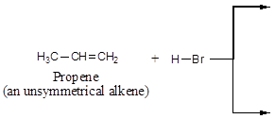
Reactions of Alkenes
Electrophilic Addition Reactions
3.1. Addition of Hydrogen Halide
Alkenes react with hydrogen chloride, HC1, hydrogen bromide, HBr and hydrogen iodide, HI, to form alkyl halides, RX.
Examples;
Notes:
dicular

Slide 28
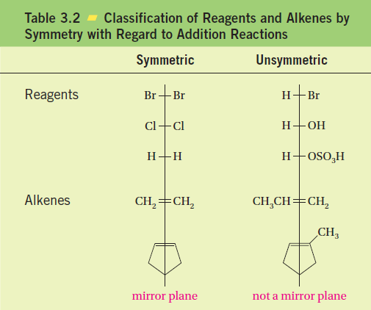
Reactions of Alkenes
Electrophilic Addition Reactions
- Reagents and alkenes can be classified as either symmetric or unsymmetric with respect to addition reactions.
If a reagent and/or an alkene is symmetric, only one addition product is possible.
But if both the reagent and the alkene are unsymmetric, two products are, in principle, possible.
Notes:
dicular

Slide 29
Reactions of Alkenes
Electrophilic Addition Reactions
Markovnikov’s Rule
In electrophilic addition of H—X to Unsymmetrical Alkenes the hydrogen of the hydrogen halide adds to the double-bonded carbon that bears the greater number of hydrogen atoms and the negative halide ion adds to the other double-bonded carbon.
Notes:
dicular

Slide 30
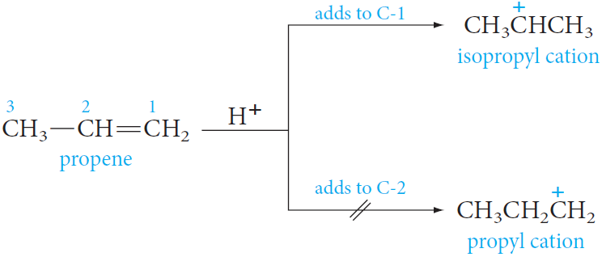
Reactions of Alkenes
Electrophilic Addition Reactions
Explanation for Markovnikov’s Rule
Example; the addition of HBr to propene
- In modern terms Markovnikov’s rule can be restated:
The addition of an unsymmetrical reagent HX to an unsymmetrical alkene proceeds in such a direction as to produce the more stable carbocation.
Notes:
dicular

Slide 31
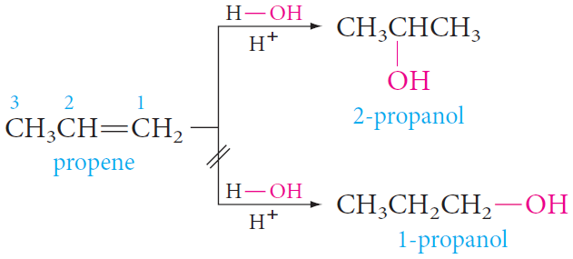
Reactions of Alkenes
Electrophilic Addition Reactions
3.2. Addition of Water: Hydration
If an acid catalyst is present, water (as H-OH) adds to alkenes and the product is alcohol.
Notes:
dicular

Slide 32
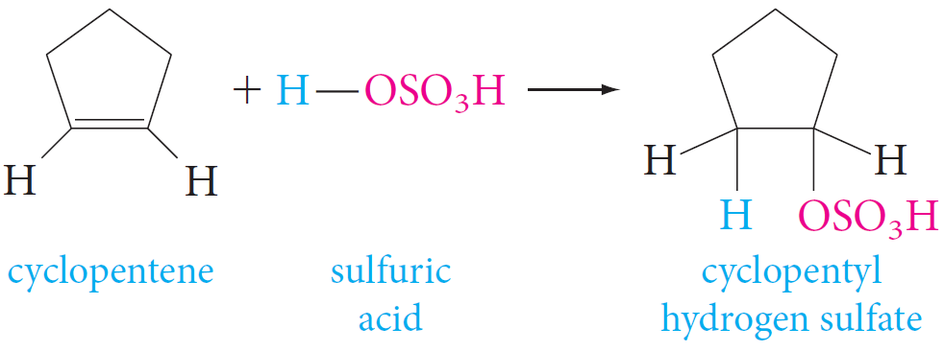
Reactions of Alkenes
Electrophilic Addition Reactions
3.3. Addition of Sulfuric Acid
- Cold concentrated sulfuric acid adds across the double bond of alkenes to give alkyl hydrogen sulfate.
- Addition of sulfuric acid to alkenes also follows Markovnikov’s rule.
Notes:
dicular

Slide 33
Reactions of Alkenes
Electrophilic Addition Reactions
3.2. Addition of HOX: Halohydrin Formation
- When an alkene is treated with aqueous chlorine or aqueous bromine, the addition product is a halohydrin.
When Cl₂ is used, the product is a chlorohydrin.
When Br₂ is used, the product is a bromohydrin.
Notes:
dicular

Slide 34
Reactions of Alkenes
Electrophilic Addition Reactions
3.4. Addition of HOX: Halohydrin Formation
- The reaction proceeds as if hypochlorous acid, HO—Cl, or hypobromous acid, HO—Br, were the adding reagent.
The electrophile is chloronium ion, Cl⁺, or bromonium ion, Br⁺.
The nucleopbile is hydroxide ion, OH⁻.
- Addition of HOX also follows Markovnikov’s rule.
Notes:
dicular

Slide 35
Reactions of Alkenes
Oxidation Reactions
1. Ozonolysis
The first product, a molozonide, is formed by cycloaddition of the oxygen at each end of the ozone molecule to the carbon–carbon double bond.
This product then rearranges rapidly to an ozonide (explosive if isolated).
They are usually treated directly with a reducing agent, commonly zinc and aqueous acid, to give carbonyl compounds as the isolated products.
Notes:
dicular

Slide 36
Reactions of Alkenes
Oxidation Reactions
1. Ozonolysis
- Ozonolysis can be used to locate the position of a double bond.
- For example, ozonolysis of 1-butene gives two different aldehydes, whereas 2-butene gives a single aldehyde.
Notes:
dicular

Slide 37
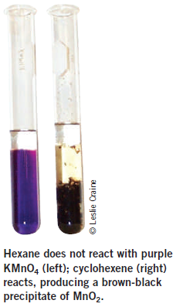
Reactions of Alkenes
Oxidation Reactions
2. Oxidation Using KMnO4
Alkenes react with alkaline potassium permanganate to form glycols (compounds with two adjacent hydroxyl groups).
Notes:
dicular

