Slide 1
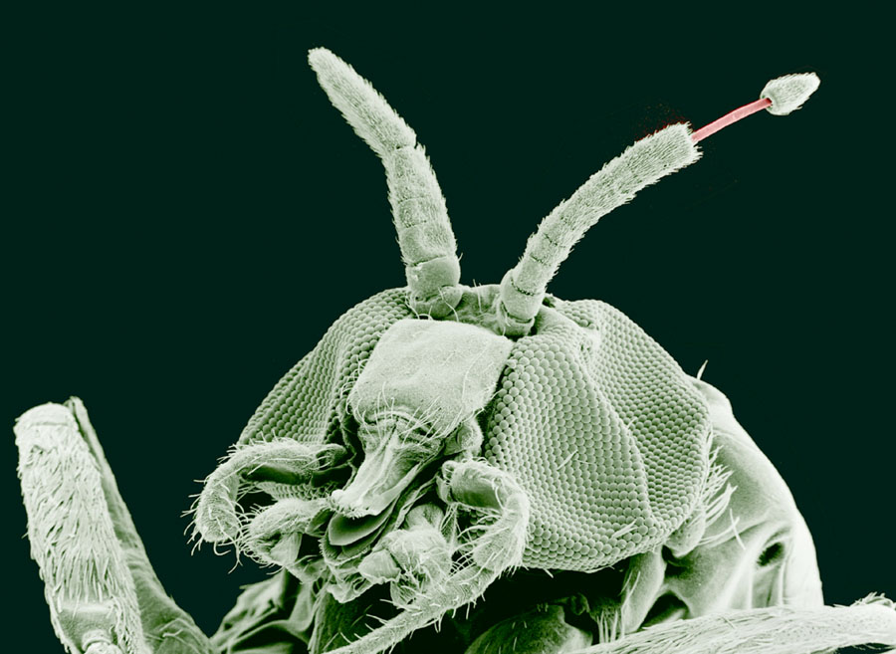
Insect Antennae

Slide 2
The antennae are a pair of sense organs located near the front of an insect's head capsule. Although commonly called "feelers", the antennae are much more than just tactile receptors. They are usually covered with olfactory receptors that can detect ordor molecules in the air (the sense of smell).
Many insects also use their antennae as humidity sensors, to detect changes in the concentration of water vapour.
Mosquitoes detect sounds with their antennae, and many flies use theirs to gauge air speed while they are in flight.

Slide 3
Although antennae vary widely in shape and function, all of them can be divided into three basic parts:
scape -- the basal segment that articulates with the head capsule
pedicel -- the second antennal segment.
flagellum -- all the remaining "segments" (individually called flagellomeres).

Slide 4
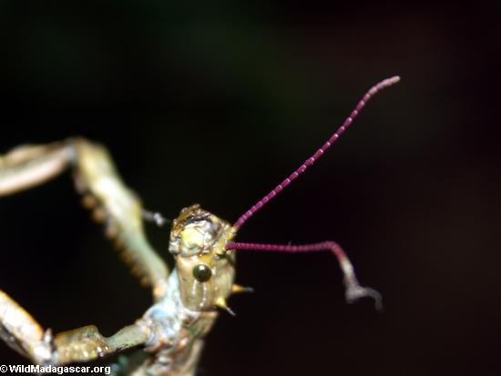
Types of antennae

Slide 5
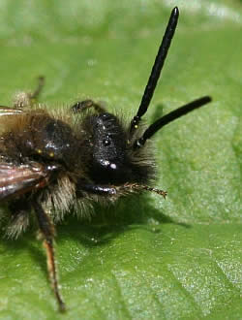
Filiform antennae:
This is the most basic form of insect antennae.
This basic structure is modified in a wide variety of ways.
This means that a number of different types may be recognised. (Orthroptera)

Slide 6
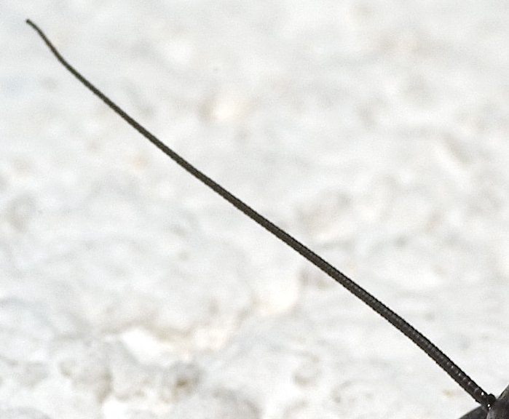
Setaceous - There are many joints. The antenna tapers gradually from the base to the tip e.g. Cockroaches, Stoneflies.

Slide 7
Moniliform - The round segments make the antenna look like a string of beads e.g. Beetles.

Slide 8
Serrate - the segments are angled on one side giving the appearance of a saw edge e.g. Beetles.

Slide 9
Pectinate - The segments are longer on one side. This gives the appearance of a comb e.g. Sawflies (related to wasps) and Beetles.

Slide 10
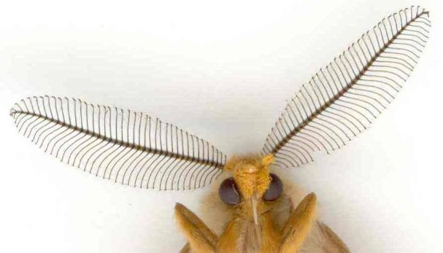
Bipectinate: The segments are longer on two .
side

Slide 11
Clavate - the segments become wider towards the tip of the antenna. This may be gradual along its length, or a sudden increase and therefore mainly affecting the last few joints and giving the appearance of a club e.g. Butterflies and Beetles.

Slide 12
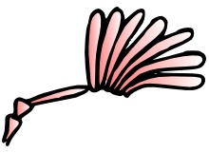
Lamellate - the segments towards the end are flattened and plate-like. This gives the appearance of a fan e.g. Beetles

Slide 13
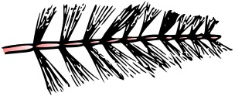
Plumose and Piplumose - the segments each have a number of fine thread-like branches. This gives the appearance of a feather e.g. Flies.

Slide 14
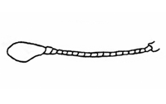
Capitates: Capitate antennae are abruptly clubbed at the end. Ex. Butterflies.

Slide 15
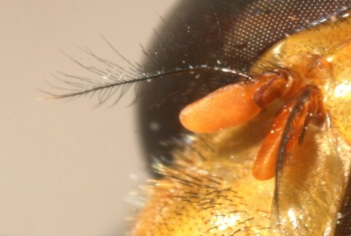
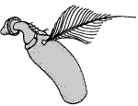
Aristate: pouch-like with lateral bristle. Ex. House flies

Slide 16
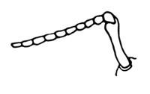
Geniculate: there is an abrupt bend or elbow part of the way along the antenna e.g. Ants and Beetle

Slide 17
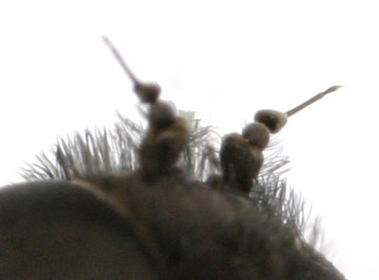
Stylate: having a pointed process, a style. Aristate is similar, but the process is off-center

Slide 18
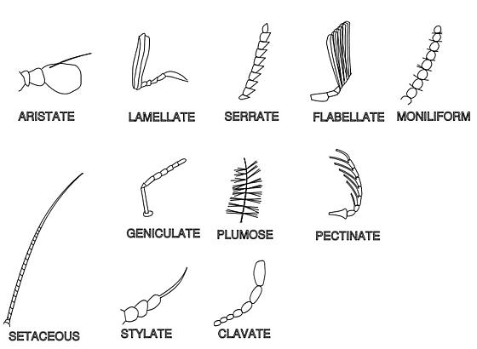

Slide 19
