Slide 1
NURS 500 1st Semester 1438-1439
Research Process

Slide 2
Fundamental Research Terms
Concept /Construct
Variable:
Continuous /Discrete
Dependent/ Independent
Conceptual/ Operational Variables
Quantitative (Numeric Data), Qualitative (Narrative data)
Relationship ( bond or a connection between phenomena), cause & effect
Polit & Beck (2017)

Slide 3
Research Process
Research process is the examination and analysis of systematically gathered facts about a particular problem.
The aim of research process is the discovery or validation of knowledge.
It is the systematic process of problem solving.
Polit & Beck (2017)

Slide 4
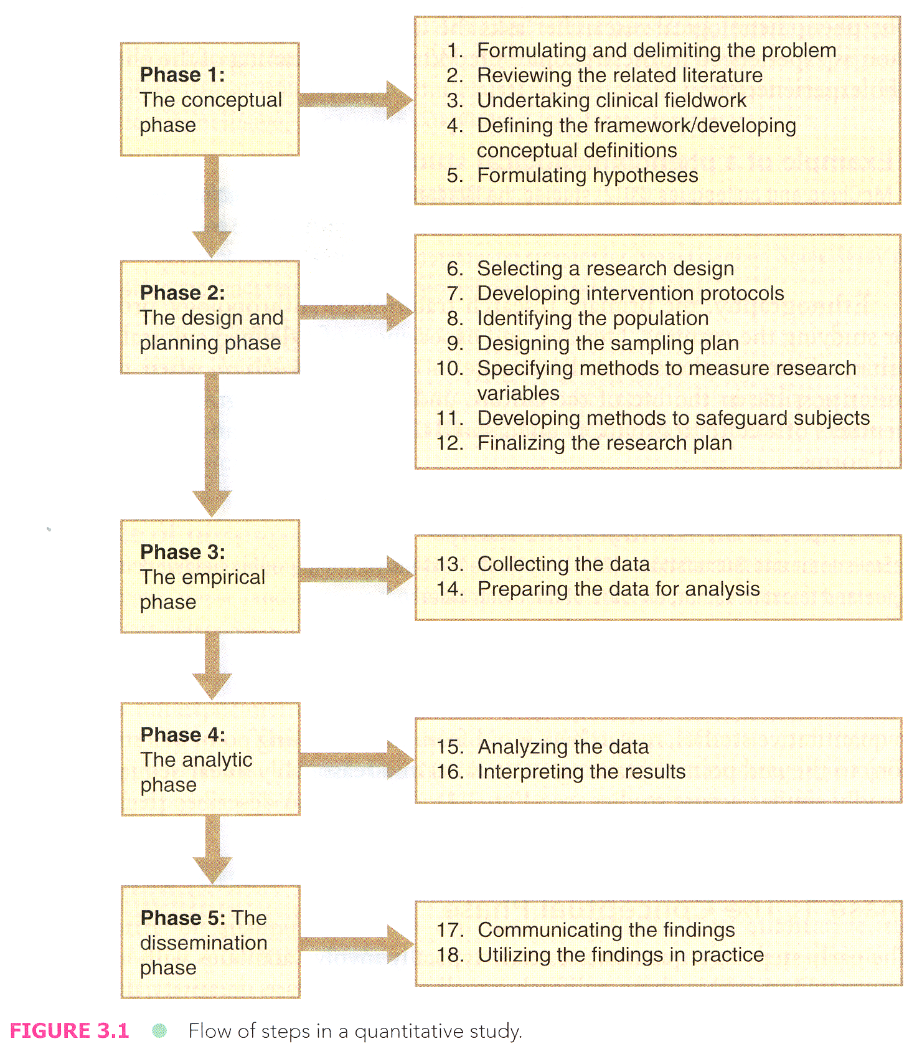
Polit & Beck (2017)

Slide 5
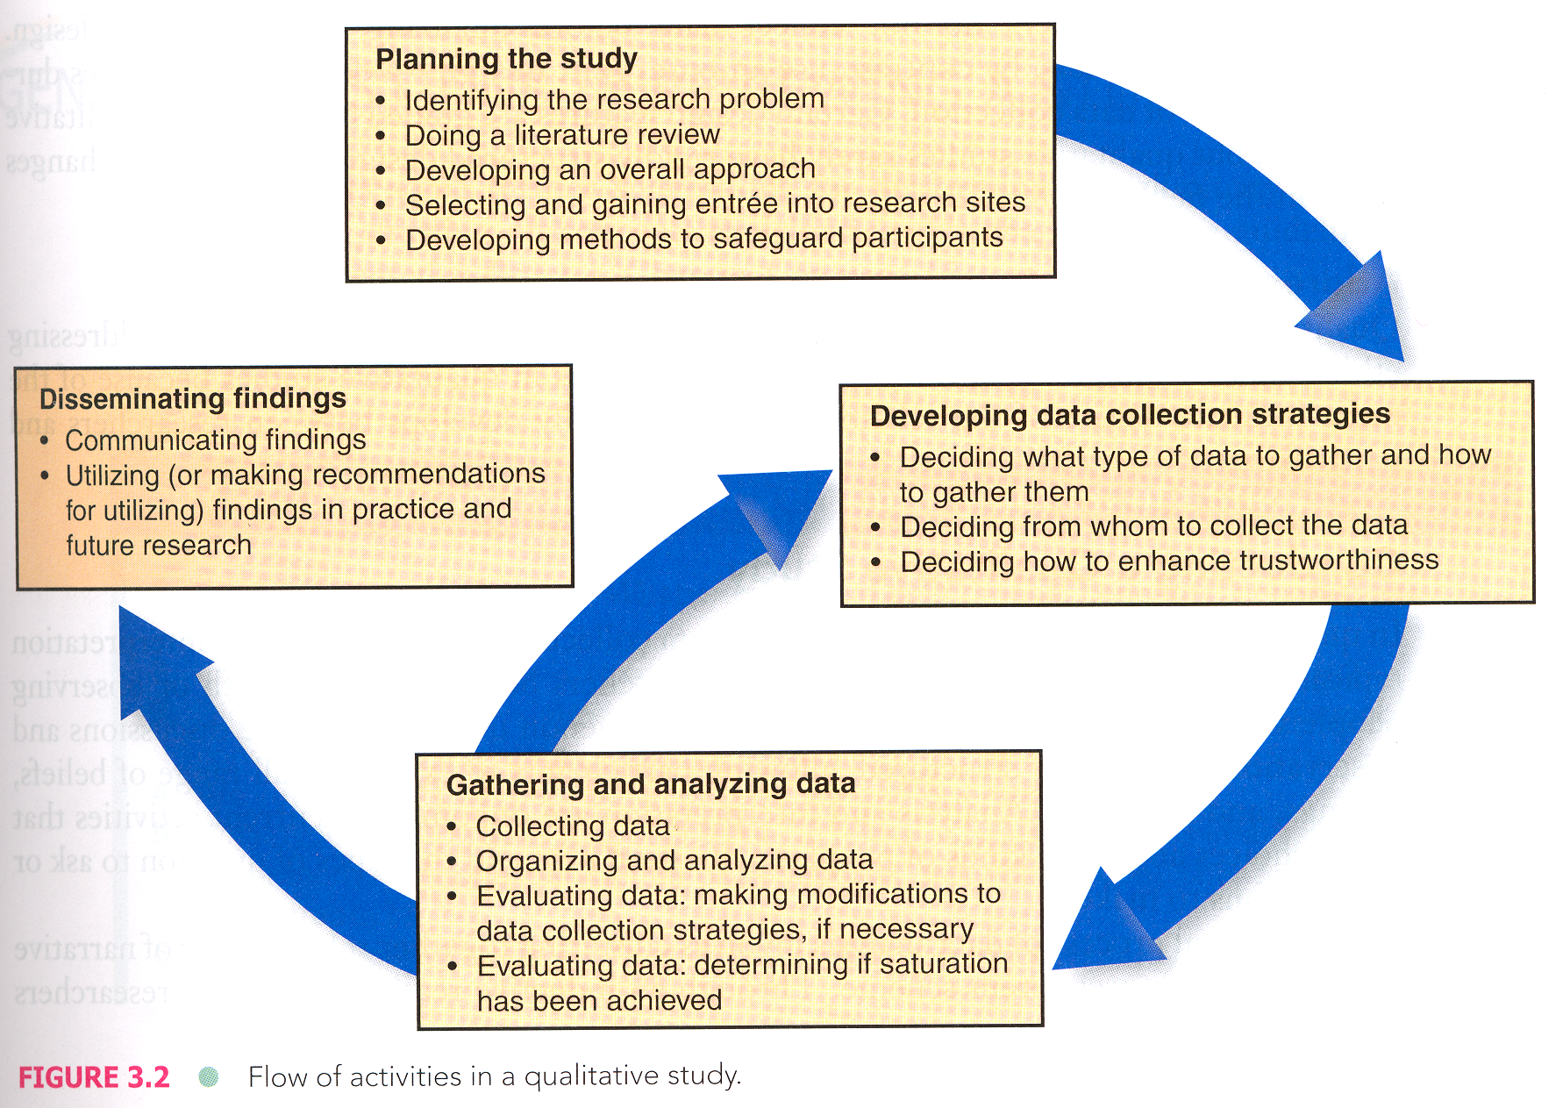
Polit & Beck (2017)

Slide 6
Research Journal Articles
The article should include five major sections:
Abstract,
Introduction,
Methods,
Results,
Discussion, and
References
Polit & Beck (2017)

Slide 7
Ethical Issues in Nursing Research
NIH Certificate submission
Basic Ethical Principles
Respect for Persons
Beneficence
Justice
Polit & Beck (2017)

