Slide 1
ريادة الأعمال Entrepreneurship
3rd
Lecture
أساسيات ريادة الأعمال
Entrepreneurship Basics

Slide 2
Contents
Entrepreneurship Definition
Entrepreneurship types
Why Entrepreneurship?
Entrepreneur Characteristics

Slide 3
Definition
A French word.
Notes:
Definition:
Entrepreneur is A French word.
Webster's dictionary "Entrepreneur is one who organizes and directs a business undertaking, assuming the risk for the sake of profit"
"Entrepreneurship is the art and skill of founding a business"
It is kind of culture, behavior, traits, and attributes of doing business orientates somehow in a different or innovative way and by assuming some level of risks.
Other definitions:
"someone who makes money in a new way"
"someone who creates new wealth through innovation"
"Someone people who works for himself"
"An entrepreneur is his own boss"
An entrepreneur is someone who recognize an opportunity to start a business that other people may not have noticed-and jumps on it. (Steve & Caroline:4)

Slide 4
Definition
Webster's dictionary
Alshumaimeri
Steve & Caroline
Notes:
Definition:
Entrepreneur is A French word.
Webster's dictionary "Entrepreneur is one who organizes and directs a business undertaking, assuming the risk for the sake of profit"
Alshumaimeri "Entrepreneurship is the art and skill of founding a business“
An entrepreneur is someone who recognize an opportunity to start a business that other people may not have noticed-and jumps on it. (Steve & Caroline:4)
It is kind of culture, behavior, traits, and attributes of doing business orientates somehow in a different or innovative way and by assuming some level of risks.
Other definitions:
"someone who makes money in a new way"
"someone who creates new wealth through innovation"
"Someone people who works for himself"
"An entrepreneur is his own boss"

Slide 5
Definition
It is kind of culture, behavior, traits, and attributes of doing business orientates somehow in a different or innovative way and by assuming some level of risks.
Notes:
Definition:
Entrepreneur is A French word.
Webster's dictionary "Entrepreneur is one who organizes and directs a business undertaking, assuming the risk for the sake of profit"
Alshumaimeri "Entrepreneurship is the art and skill of founding a business“
An entrepreneur is someone who recognize an opportunity to start a business that other people may not have noticed-and jumps on it. (Steve & Caroline:4)
It is kind of culture, behavior, traits, and attributes of doing business orientates somehow in a different or innovative way and by assuming some level of risks.
Other definitions:
"someone who makes money in a new way"
"someone who creates new wealth through innovation"
"Someone people who works for himself"
"An entrepreneur is his own boss"

Slide 6
Entrepreneurship Types
Social Entrepreneurship
Notes:
Social Entrepreneurships: is a way of solving social problems by using entrepreneurial genius.
It has been argued that social entrepreneurs are not different from traditional entrepreneurs except that they do not prioritise the making of profits and put more emphasis on social rather than commercial result.

Slide 7
Entrepreneurship Types
Entrapreneurship
Notes:
Intrapreneurship is the act of behaving like an entrepreneur while working within a large organization. (Corporate Entrepreneurship), (Employee Entrapreneurship),
- In other words, the intrapreneur is an entrepreneur within an existing organization.
A corporate social entrepreneur (CSE) is defined as "an employee of the firm who operates in a socially entrepreneurial manner; identifying opportunities for and/ or championing socially responsible activity; in addition to helping the firm achieve its business targets.
An Employee Intrapreneur "Intrapreneurship refers to employee initiatives in organizations to undertake something new, without being asked to do so."
Employees, such as marketing executives or perhaps those engaged in a special project within a larger firm.
the intrapreneur focuses on innovation and creativity, and transforms an idea into a profitable venture, while operating within the organizational environment.

Slide 8
Entrepreneurship Types
Women Entrepreneurship
Notes:
Recently, there has been a rise in the number of women-owned businesses, which presently account for about 12% of all firms in the country, including 16% of the large manufacturing firms (AlMunajjed, 2010). Saudi women hold more than $13 billion in local bank accounts that could potentially be invested in the local economy (Knowledge@Wharton, 2010).

Slide 9
Entrepreneurship Types
Digital
Entrepreneurship
Notes:
use the Internet and the information and communication technology as a tool for creating business and trend opportunities.
Digital entrepreneurship is a subcategory of entrepreneurship in which some or all of what would be physical in a traditional organization has been digitized
Thus, digital entrepreneurship implies an entrepreneur-ship that is associated with some degree of digital goods or services, or with other forms of digital activity

Slide 10
Entrepreneurship Types
Green Entrepreneurship "ecopreneurship"
Notes:
Green Entrepreneurship "ecopreneurship" (Mariotti and Glackin 2010)
Enterprise activities that avoid harm to the environment or help to protect the environment"

Slide 11
Entrepreneurship Types
Public Sector Entrepreneurship
Notes:
Public sector entrepreneurship Public sector organizations are usually large and exist to meet the needs of society rather than make a profit, so they take on many of the characteristics of corporate and social entrepreneurship. However they are owned by the state or general public and so have distinctive entrepreneurial characteristics and challenges. Public sector organizations need to be innovative and entrepreneurial if they are to deliver high- quality services in a fast- changing environment. The introduction of market forces into the public sector in many countries encouraged more entrepreneurial approaches in the delivery of services.

Slide 12
Entrepreneur Characteristics
leader
Ethical
Not afraid of risk and failure
Open for new opportunity
Creative
Independent
Confident

Slide 13
مشاهدة برنامج إضاءات في استضافته لمجموعة عقال لرواد الأعمال
http://www.alarabiya.net/programs/2012/09/21/239350.html

Slide 14
Why Entrepreneurship in Saudi Arabia

Slide 15
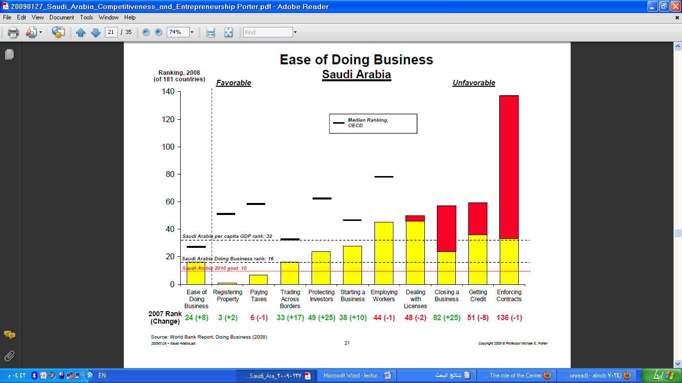
Notes:
Criteria:
Ease of doing business
Registering property
Paying taxes
Trading across borders
Protecting investors
Starting a business
Employing workers
Dealing licenses
Closing a business
Getting credit
Enforcing contracts

Slide 16
Entrepreneurship in Saudi Arabia
Large, youthful and growing population.
High level of unemployment (12- 28%).
Growing markets with many undefended niches.
Stable economy with a prudent investment posture.
Modest income taxes.
Large and sustain government investments in the economy.
Notes:
TEA (total entrepreneurial activity) هي نسبة السكان الذين يشاركون في إنشاء مشروع تجاري أو أصحاب مديري الشركات الجديدة

Slide 17
Entrepreneurship in Saudi Arabia
Increasing foreign interest in investing in the Middle East.
Emerging venture capital industry.
Opportunity to serve the entire region.
Notes:
TEA (total entrepreneurial activity) هي نسبة السكان الذين يشاركون في إنشاء مشروع تجاري أو أصحاب مديري الشركات الجديدة

