Slide 1
Qualitative tests of Proteins
BCH302 [Practical]

Slide 2
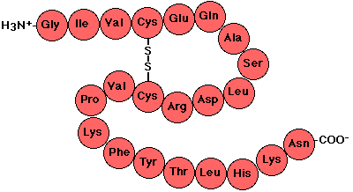
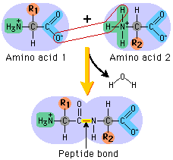
Proteins :
Proteins are polymers of amino acids.
Amino acid molecules in proteins are covalently joined together through a linkage, termed a peptide bond.
How peptide bond formed?
➔ By removal of the elements of water (dehydration) from the α-carboxyl group of one amino acid and the α-amino group of another.

Slide 3
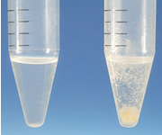
Proteins precipitation :
The solubility of proteins is affected by pH, temperature, salts, heavy metal salts...etc.
The change of one of these factors will lead to protein precipitation and/ or denaturation.
Proteins precipitation is widely used in downstream processing of biological products in order to concentrate proteins and purify them from various contaminants.

Slide 4
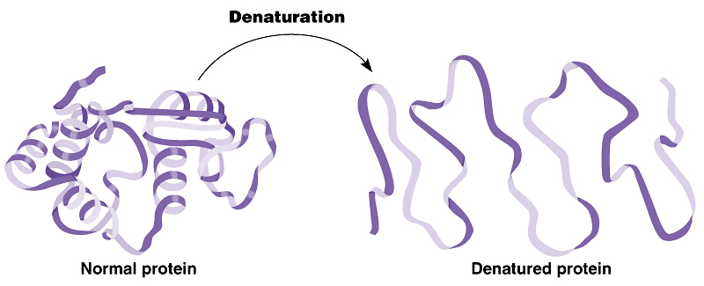
Proteins denaturation:
Denaturation is a process in which the proteins losing its quaternary structure, tertiary structure and secondary structure, by application of some external factor or compound such as a strong acid or base, an organic solvent (e.g., alcohol or chloroform), or heat.
No alteration on the molecule's primary structure, i.e., without cleavage of any of the primary chemical bonds that link one amino acid to another.
Protein will become more viscous, decreased solubility and aggregation, and protein become inactive.

Slide 5
Practical part

Slide 6
Qualitative tests of proteins
Biuret test: detect the presence of peptides or proteins.
Effect of salt concentration on the protein solubility.
Precipitation of proteins by acids.
Precipitation of protein by salts of heavy metals.
Protein denaturation.
1
2
3
4
5

Slide 7
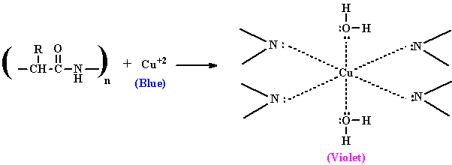
Experiment 1 : Biuret test
Objective:
To detect the presence of a protein or peptides.
Principle:
In this reaction, proteins form a purple colored complex with CuSO₄ (copper sulfate) in a strongly alkaline solution.
When peptide bonds in proteins and peptides treated with an alkaline solution of dilute copper sulfate (Biuret reagent ) a violet color is formed ➔ A positive test is indicated by the formation of a violet color.
The color density is proportional to amount of proteins present.
This test is specific for the peptide bond, positive result (purple color) will given if the substance have two or more peptide bonds (three or more amino acids).
Note: Despite its name, the reagent does not in fact contain biuret , the test is so named because it also gives a positive reaction to the peptide-like bonds in the biuret molecule.
(peptide bond)
purple color
Biuret complex

Slide 8
Experiment 1 : Biuret test
Method:
1. Add 2ml of protein Albumin in one tube.
2. In another tube add 2ml of water.
2. Add 1 ml of biuret reagent to all tubes and mix well.
Results:
Tube | Observation
Albumin (protein)
water
Blue color is the biuret reagent color

Slide 9
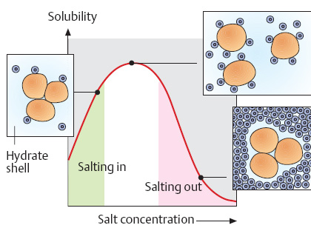
Experiment 2 : Effect of salt concentration on the protein solubility
Objective:
To investigate the effect of different salt concentration on protein solubility.
Principle:
The low salt concentration solutions make protein solubility increased using the attraction of salt ions to the functional groups of the protein (this called salting in).
High salt concentration causes the protein to precipitate (decrease the solubility) since salt ions, in this case, compete with the protein molecules in binding water molecules (this called salting out).
Notes:
1.Each protein can be precipitated at specific salt concentration.
2.It is reverse process, the protein can again become soluble when we add water .

Slide 10
Experiment 2 : Effect of salt concentration on the protein solubility
Method:
1.Label one tube as A.
2. Add 2ml of albumin.
3. Add drops of 0.1M NaCl solution, Concentrate your vision on the tube while adding.
4. Record your results.
5. In the same tube add few amounts of 100% solid (NH₄)₂SO₄ , shake it well.
6. Record your results.
7. Compare between the two results.
Results:
Tube | Observation
Albumin + NaCl
Albumin+100%saturate (NH₄)₂SO₄

Slide 11
Experiment 3 : Acid precipitation of proteins
Objective:
To investigate the effects of strong acids on the protein solubility.
Principle:
This test depend on affecting solubility of the protein as a function of changes in pH.
In highly acidic media, the protein will be positively charged, which is attracted to the acid anions that cause them to precipitate.
Applications:
Detection of small amount of protein in urea sample.
Stop the enzyme reaction.

Slide 12
Experiment 3 : Acid precipitation of proteins
Method:
1.Label two tubes A and B.
2. In tube A: add 3 ml of conc. nitric acid (HNO₃) CAREFULLY.
3. Then, Using a dropper add drops of albumin on the inner wall of tube A to form a
layer up the acid.
4. Record your results.
5. In tube B: Add 3 ml of the albumin solution.
6. Then add 5-7 drops of TCA solution CAREFULLY.
7. Record your results.
Results:
Tube | Observation
Albumin + HNO₃
Albumin+TCA
A
B

Slide 13
Experiment 4 : Precipitation of proteins by salts of heavy metals
Objective:
To identify the effect of heavy metal salt on protein.
Principle:
Heavy metal salts usually contain Hg⁺², Pb⁺², Ag⁺¹ Tl⁺¹, Cd⁺² and other metals with high atomic weights.
Heavy metal salt will neutralize the protein.
By the negative charge of protein will bind with positive charge of metal ion ➔ then the protein will precipitate as insoluble metal protein salt.
Applications:
To eliminate the poisoning by palladium Pb++ ,......mercury salts Hg++
Notes:
TL ➔ Thallium
Cd ➔ Cadmium

Slide 14
Experiment 4 : Precipitation of proteins by salts of heavy metals
Method:
1.Label two tubes A and B.
2. In tube A and B add 1 ml of Albumin sample.
3. In tube A: using a dropper add few drops of AgNO₃.
4. Record your results.
5. In tube B: using a dropper add few drops of HgCl_{2 .}
6. Record your results.
Results:
Tube | Observation
Albumin + AgNO₃
Albumin + HgCl₂

Slide 15
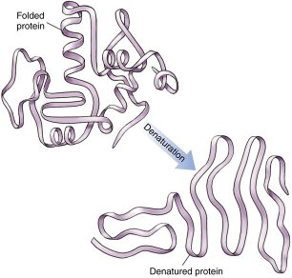
Experiment 5 : Protein denaturation by heating
Objective:
To investigate the effect of high temperature on protein structure.
Principle:
Non-covalent bond can be broken by heating, leading to protein denaturation and the precipitation.

Slide 16
Experiment 5 : Protein denaturation by heating
Method:
1- Take 3 ml of protein Albumin.
2- Place it in a boiling water bath for 5-10 minutes
3-Remove aside to cool to room temperature.
4-Note the change.
Results:
Tube | Observation
Albumin + heating

