Slide 1
King Saud University College of Engineering IE – 341: “Human Factors” Fall – 2016 (1st Sem. 1437-8H)
Chapter 3. Information Input and Processing
Part – 2: Fitts’s Law
Prepared by: Ahmed M. El-Sherbeeny, PhD

Slide 2
Fitts’s Law
Fitts’s Law is used to reach a relation between
size of as well as distance to target
and speed (or response time, RT) to reach target
Target can be button on screen or break pedal, etc.
This has many (increasing) applications in HCI (human-computer interaction)
The most important finding: edges of a screen are easiest (i.e. shortest time) to reach: can you show how?
Notes:
* Hint, substitute

Slide 3
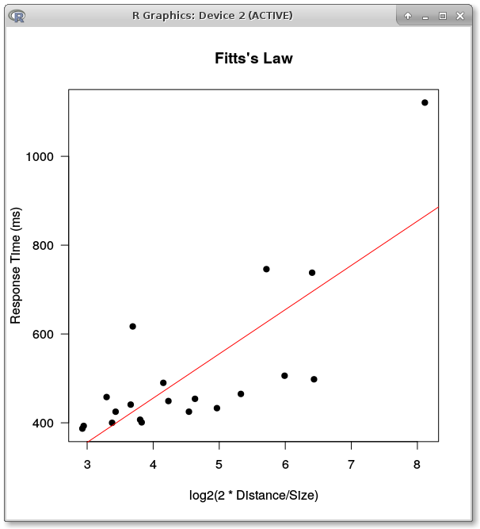
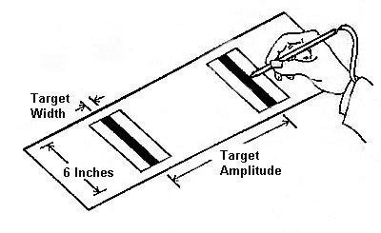
Fitts’s Law

Slide 4
Fitts’s Law
Fitts’s Law:
$$T=a+b\log_{2}\left(\frac{D}{W}+1\right)$$
D: distance to target (aka amplitude)
W: width of target (i.e. target size, e.g. button)
Note, there are different versions of Fitts’s Law (e.g. 2D/W instead of D/W + 1)

Slide 5
Fitts’s Law
Link to good video on Fitts' (or Fitts's) Law https://youtu.be/E3gS9tjACwU
Interactive Exercise on Fitts’s Law http://fww.few.vu.nl/hci/interactive/fitts/
Another interactive exercise and further explanation: http://www.psytoolkit.org/lessons/fitts.html

