Slide 1
240 Chem
Stereochemistry
Chapter 5

Slide 2
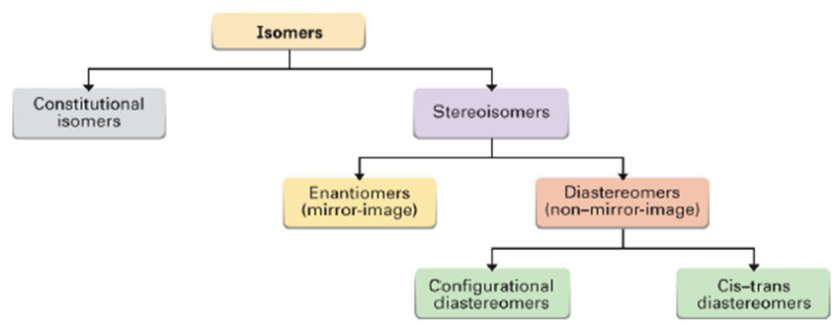
Isomerism
Isomers are different compounds that have the same molecular formula.

Slide 3
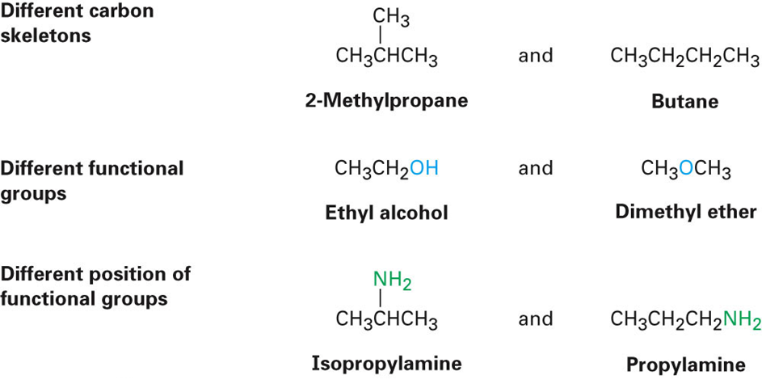
Constitutional isomers are isomers that differ because their atoms are connected in a different order.

Slide 4
Stereoisomers have their atoms connected in the same sequence (the same Constitution), but differ in the arrangement of their atoms in space.
Stereoisomers can be either enantiomers or diasteromers.
Enanatiomers are stereoisomers whose molecules are nonsuperimposable mirror images of each other.
All other Stereoisomers are diasteromers.
Diasteromers are stereoisomers whose molecules are not mirror images of each other. Includes cis, trans and configurational.

Slide 5
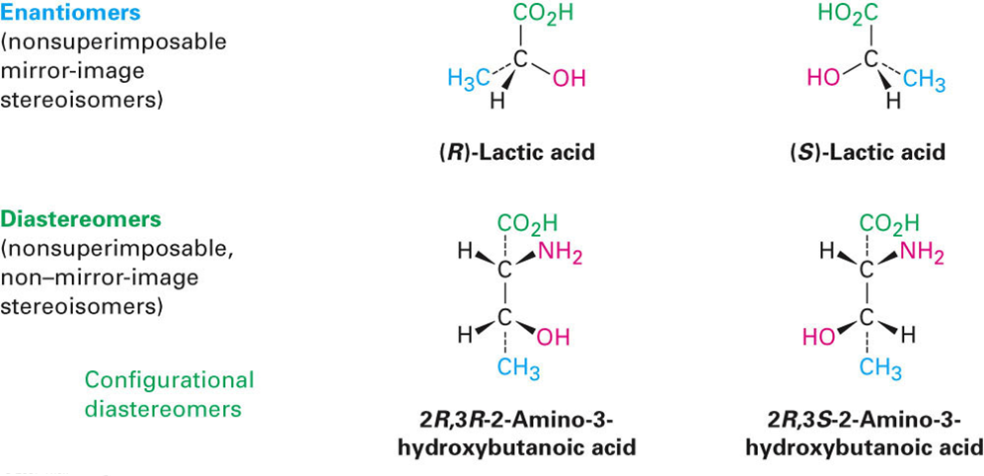
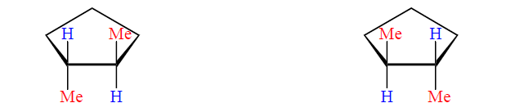
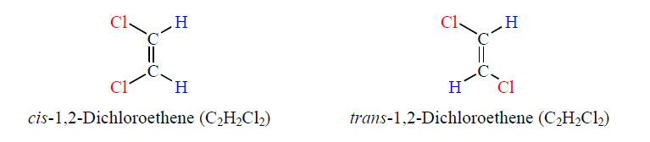
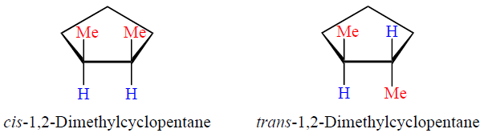
cis, trans
diasteromers

Slide 6
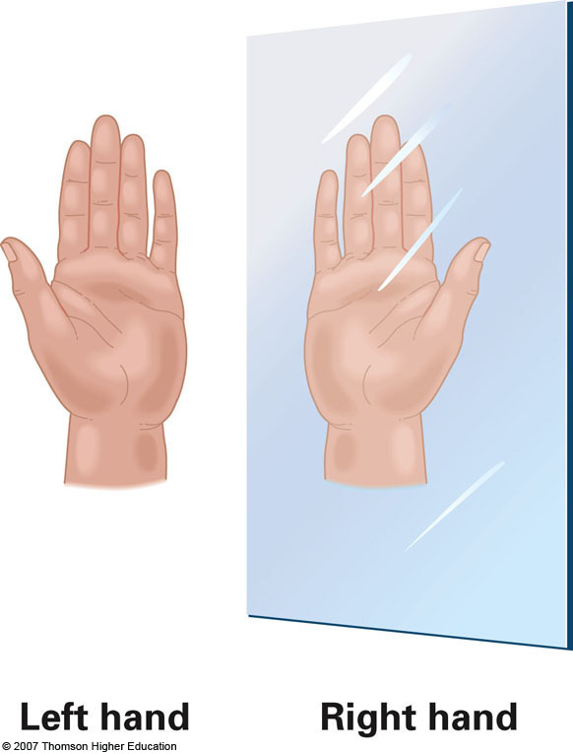
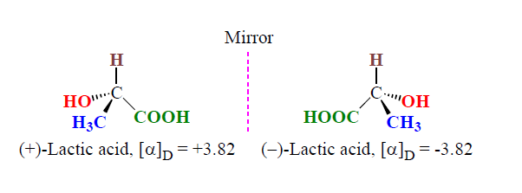
Enantiomers and Chiral Molecules
Enantiomers occur only with compounds whose molecules are chiral.
A chiral molecule is one that is not superposable on its mirror image (have handedness).
The relationship between a chiral molecule and its mirror image are said to be enantiomers of each other.

Slide 7
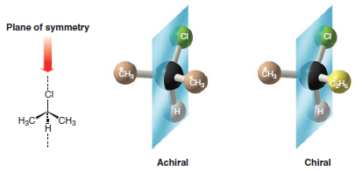
A plane of symmetry (also called a mirror plane) divides
an entire molecule into two pieces that are exact mirror images.
A molecule with a plane of symmetry is the same as its mirror image and is said to be achiral
The molecules that are superposable on their mirror images
are achiral.
The lack of a plane of symmetry is called “handedness”, chirality.

Slide 8
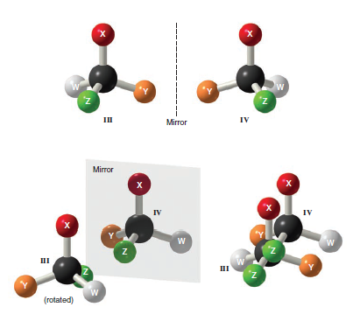
A single Chirality Center causes a Molecule
to be Chiral
A point in a molecule where four different groups (or
atoms) are attached to carbon is called a Chirality Center.
There are two nonsuperimposable ways that 4 different groups (or atoms) can be attached to one carbon atom.
A chiral molecule usually has at least one chirality center and enantiomeric forms are possible.

Slide 9
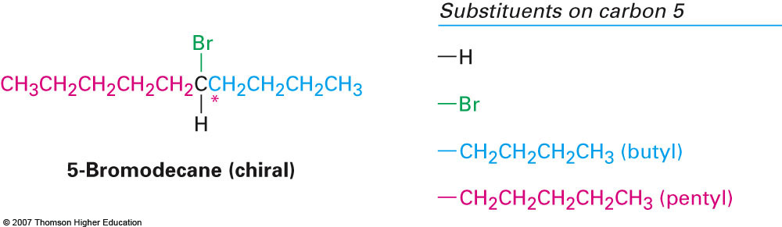
Chirality centers are often designated with an asterisk (*).
A tetrahedral carbon atom with four different groups
attached to it is an asymmetric carbon ( Chiral ) .

Slide 10
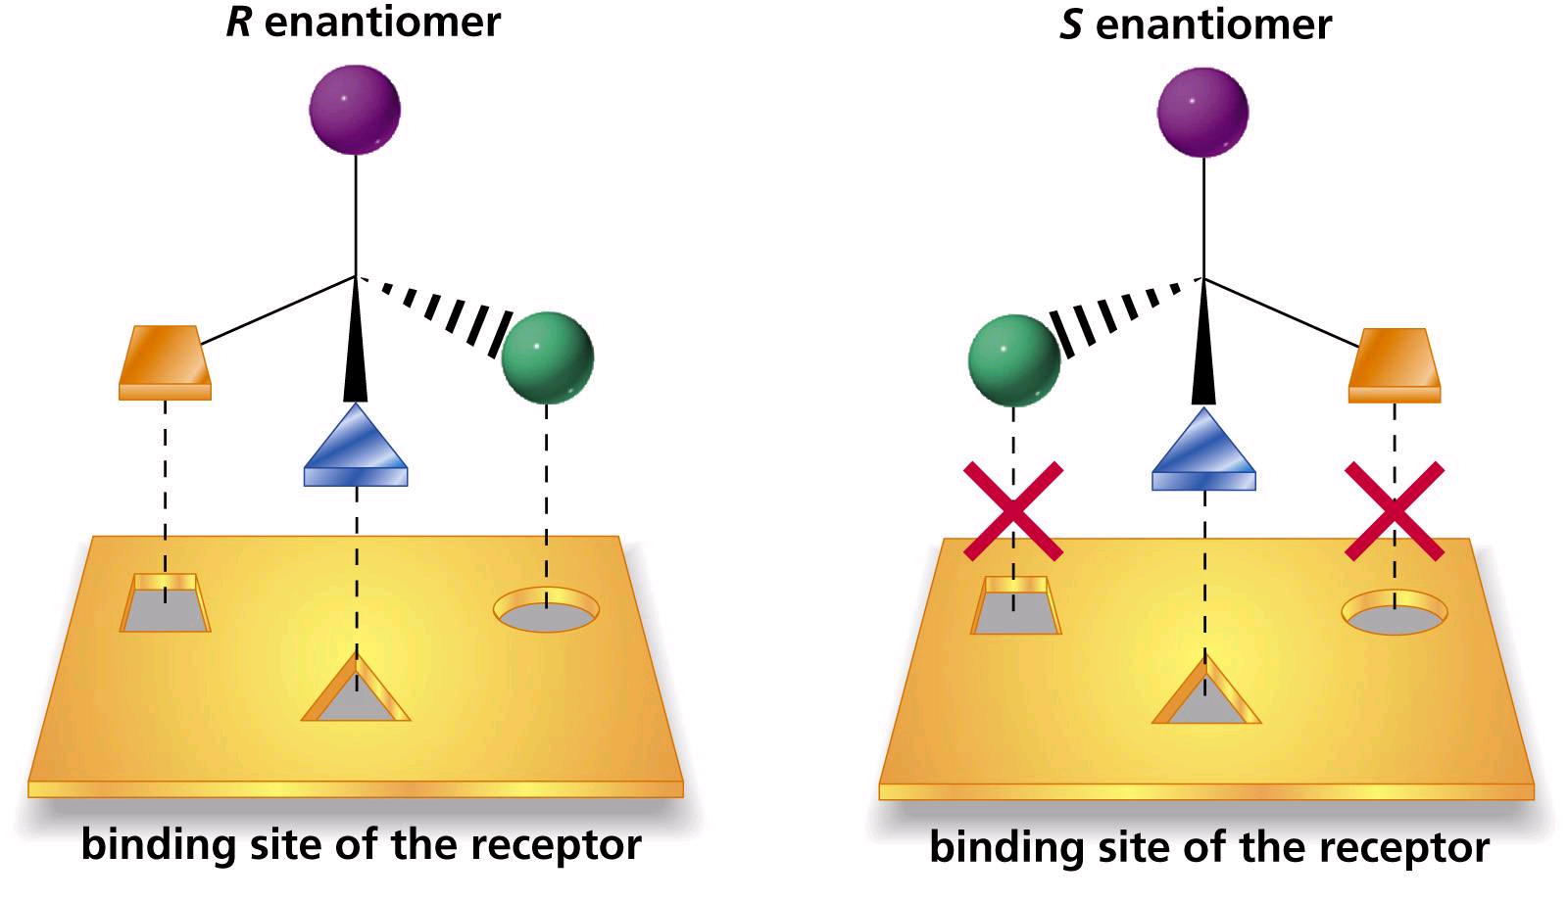
The Biological Importance of Chirality
Only one of the two enantiomers shown ( the right-hand one)
can achieve three-point binding with hypothetical binding site
( e.g., in an enzyme )

Slide 11
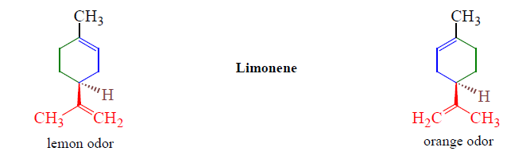
Chiral molecules can show their handedness in many ways,
including the way they affect human beings.
(+)-Limonene
(-)-Limonene

Slide 12
Properties of Enantiomers: Optical Activity
Enantiomers have identical physical properties such as boiling points, melting points, refractive indices, and solubilities in common solvents except optical rotations.
Enantiomers rotate the plane of plane-polarized light in equal amounts but in opposite directions.
Plane-Polarized Light
The light used to measure optical activity has two properties: consists of a single wavelength And it is plane-polarized.
Optical activity is the ability of a chiral substance to rotate the plane of plane-polarized light and is measured using an instrument called Polarimeter.

Slide 13
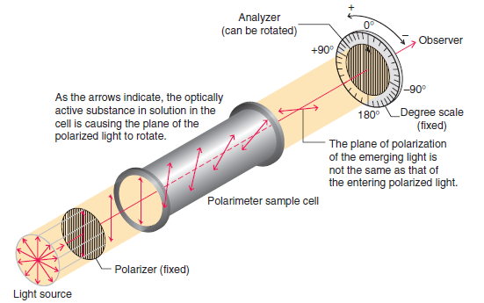
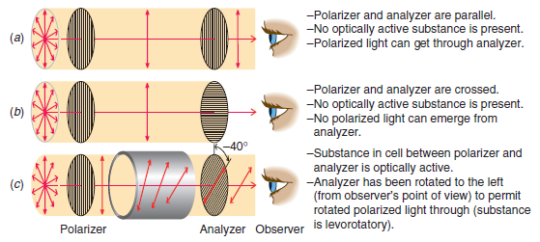
Polarimeter
A polarimeter measures the rotation of plane-polarized that has passed through a solution.
The angle between the entrance and exit planes is the optical rotation.
Rotation, in degrees, is [α]
Clockwise rotation is called dextrorotatory ( + )
Anti-clockwise is levorotatory ( - )

Slide 14

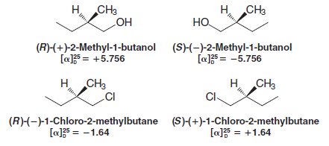
Examples:

Slide 15
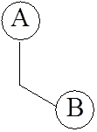
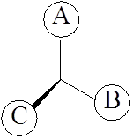
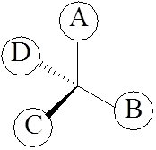
Naming Enantiomers:
The R,S-System or Cahn-Ingold-Prelog System
How to drew Three-Dimensional Formulas
Dashed wedge
Solid wedge
1
2
3
(R) and (S) are from the Latin words rectus and sinister:
R configuration: clockwise (rectus, “right”)
S configuration: counterclockwise (sinister, “left”)

Slide 16
How to Assign (R) and (S) Configurations
1- Each of the four groups attached to the stereocenter
is assigned a priority.
2- Priority is first assigned on the basis of the atomic number
of the atom that is directly attached to the stereocenter.
3- The group with the lowest atomic number is given
the lowest priority, (4); the group with next higher atomic
number is given the next higher priority, (3); and so on.
4- The group or atom with the lowest priority has to be bonded to a dashed wedge.
5- If the direction from highest priority (1) to the next highest (2) to the next (3) is clockwise, the enantiomer is designated R.
6- If the direction is counterclockwise, the enantiomer is designated S.

Slide 17
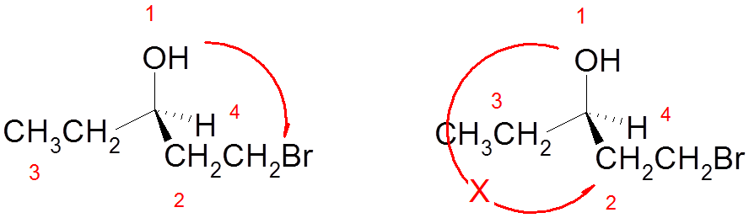
7- In drawing the arrow from group (1) to group (2), you can draw past the group with the lowest priority (4) but never draw past the group with the next lower priority (3)

Slide 18
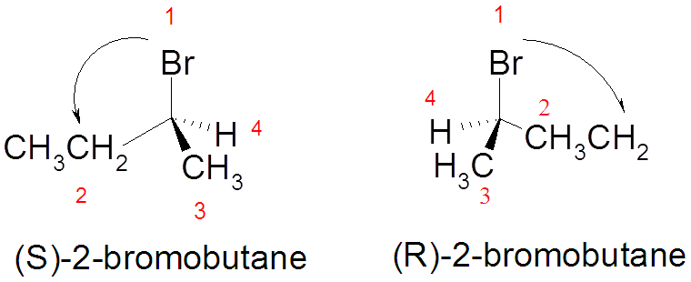
8- If the group with the lowest priority (4) is not bonded with a dashed wedge, switch two groups to make it bonded with a dashed wedge and switch again for any two groups without switching the lowest priority (4). As you switched the groups, also switch the configurations, i.e. if the molecule appears to be S then it is originally R , and if it appears to be R then it was originally S.

Slide 19
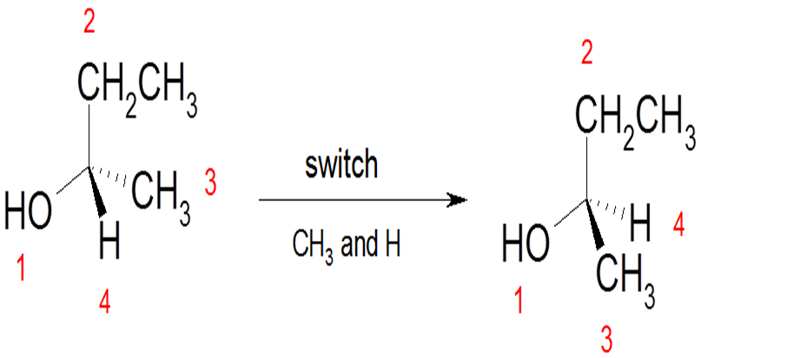
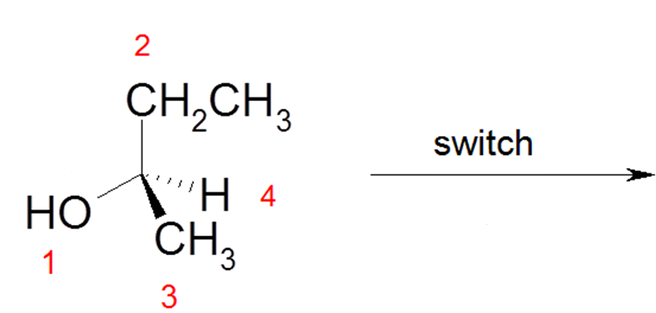
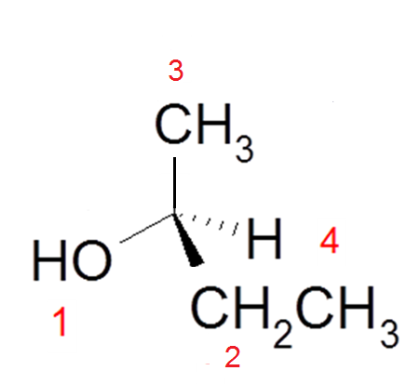

CH₂CH₃ and CH₃
S

Slide 20
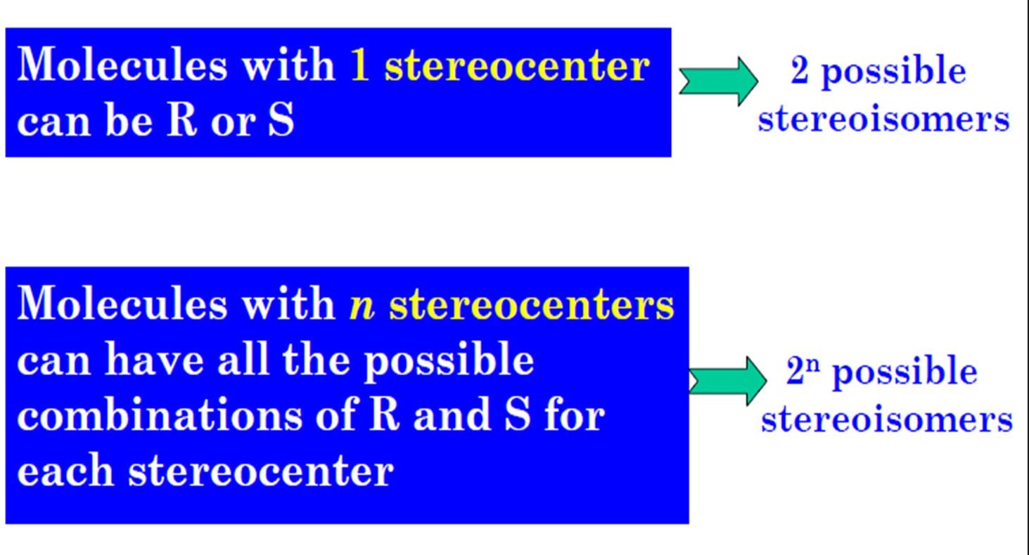
Molecules with More than One Stereocenter

Slide 21
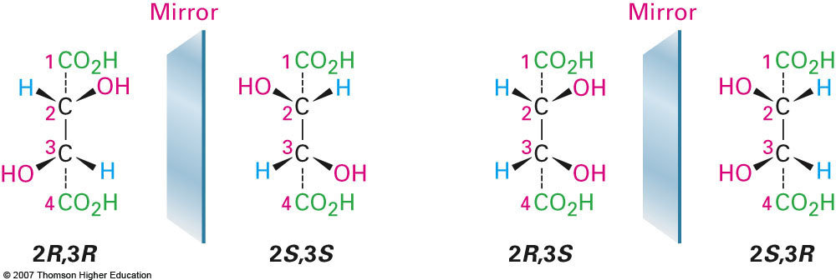
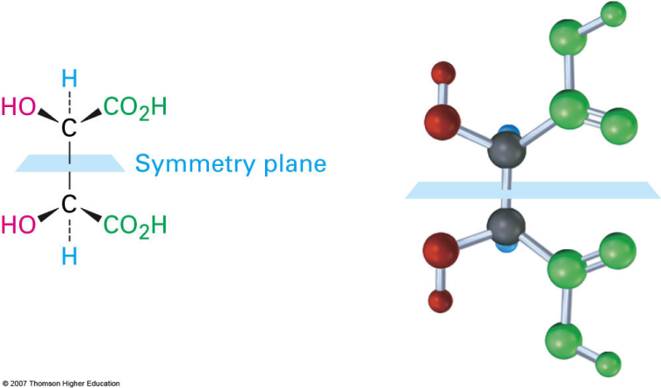
Example:
Tartaric acid has two chirality centers
One form is chiral and the other is achiral, but both have two chirality centers
An achiral compound with chirality centers is called a Meso Compound – it has a plane of symmetry
The two structures on the right in the figure are identical so the compound (2R, 3S) is achiral

Slide 22
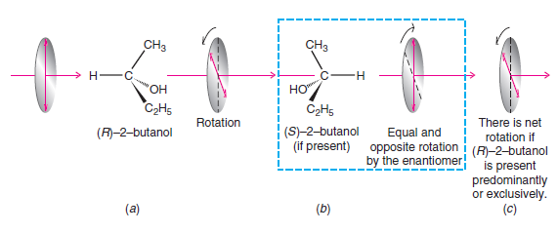
Racemic Mixture
A 50:50 mixture of two enantiomers is called a racemic mixture (or racemate or racemic form).
A racemic mixture causes no net rotation of plane-polarized light.

Slide 23
Example:

Slide 24
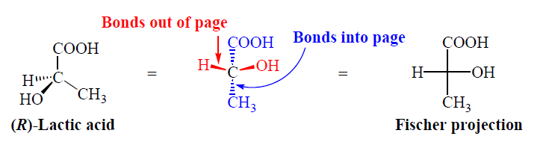
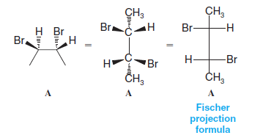
Fischer Projection Formulas
Fisher projection

Slide 25
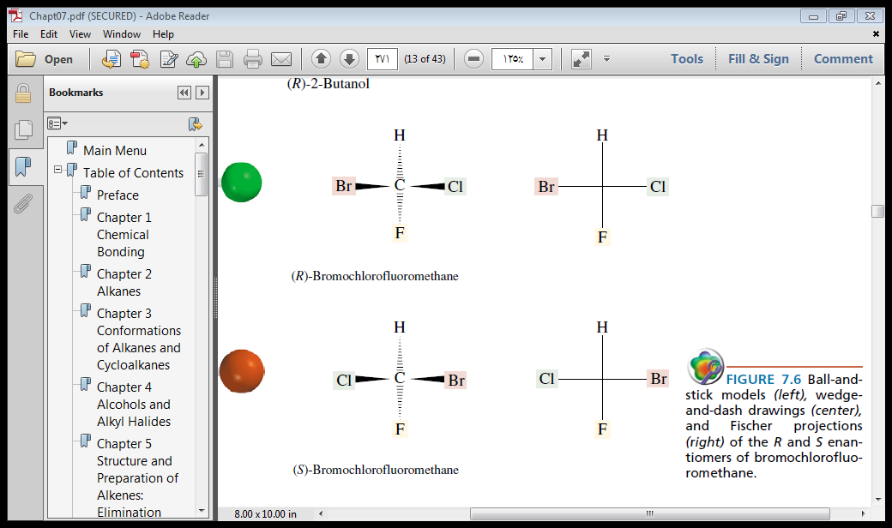
Assigning R,S Configuration to Fischer Projections
1- Assign priorities to the four substituents.
2- The group of the lowest priority has to be at the top.
3- Determine the direction of rotation in going from priority 1 to 2 to 3, and assign R or S configuration.
4- If the group with the lowest priority (4) is not at the top, switch two groups to make it on the top and switch again for any two groups without switching the lowest priority (4).

Slide 26
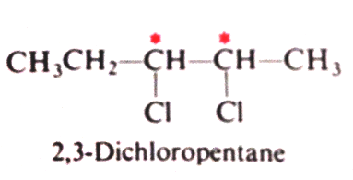
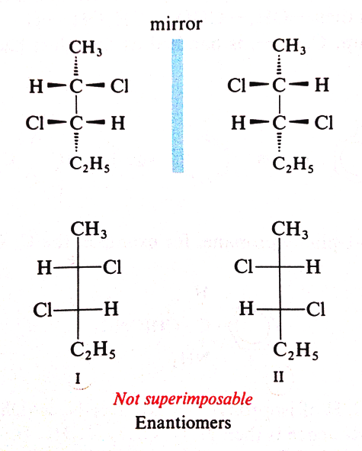
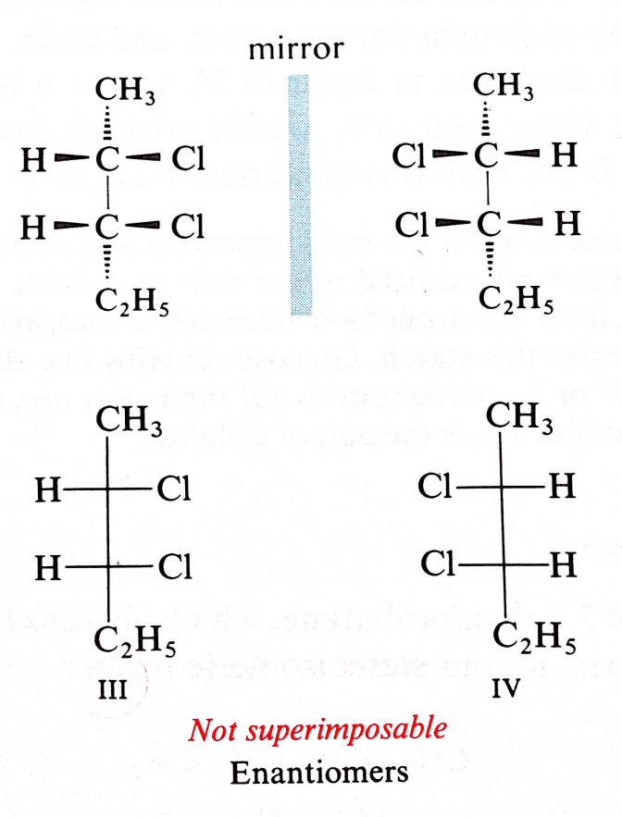
Example:
2S, 3S
2R, 3R
2S, 3R
2R, 3S

Slide 27
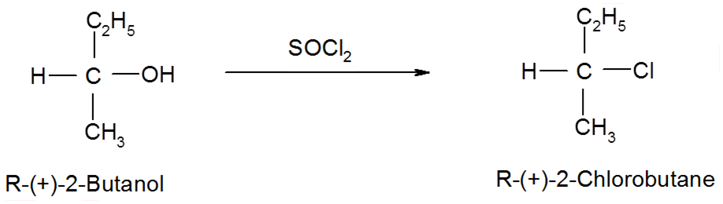
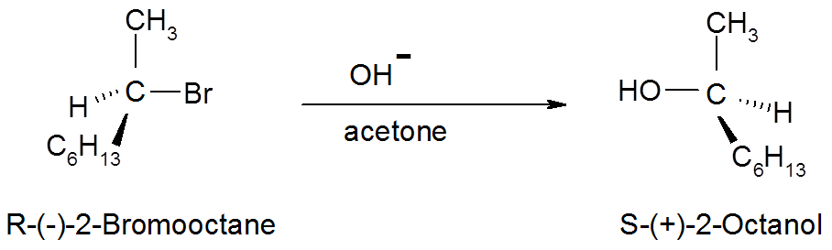
Stereochemistry of Organic Reactions
1- Retention of configuration:
2- Inversion of configuration: S_{N}2 Reactions

Slide 28
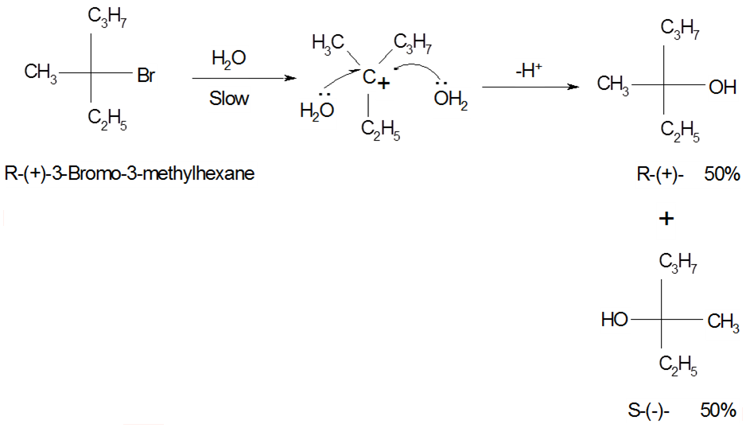
3- Racemization: S_{N}1 Reactions

