Slide 1
240 Chem
Unsaturated Hydrocarbons:
Alkenes, Cycloalkenes
and
Dienes
Chapter 3

Slide 2
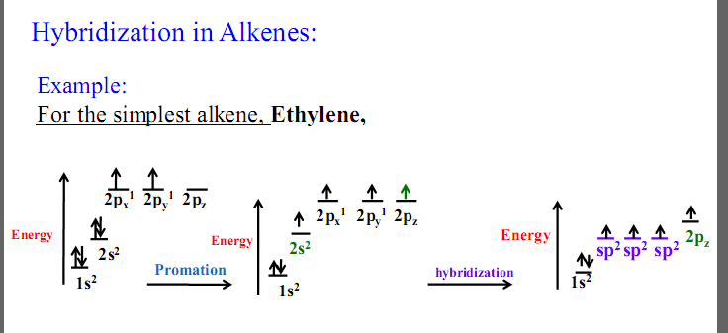
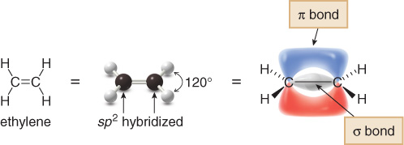
Alkenes or Olefines
Crabon-Carbon double bond
C_{n}H_{2n}
Hybridization in Alkenes:
1.34 A°

Slide 3
Nomenclature of Alkenes and Cycloalkenes
Common names:
-ane
-ylene
IUPAC rules:
Determine the parent name by selecting the longest chain that contains the double bond and change the ending of the name of the alkane of identical length from -ane to -ene.
Number the chain so as to include both carbon atoms of the double bond, and begin numbering at the end of the chain nearer the double bond. Designate the location of the double bond by using the number of the first atom of the double bond as a prefix.
In cycloalkenes, the double is always found between carbon 1 and carbon 2. It is therefore not necessary to specify the position of the double bond with a number. If substituents are present, the ring must numbered, starting from the double bond, in the direction that gives the substituents the lowest number(s).

Slide 4
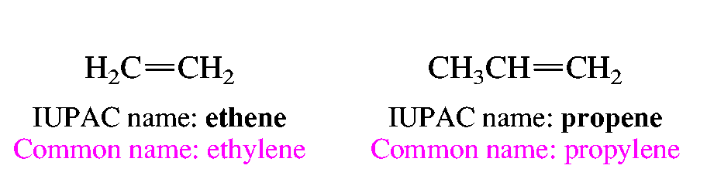
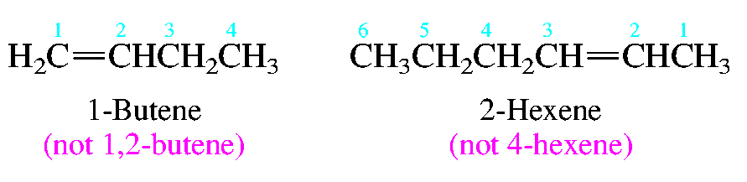
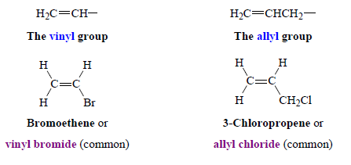
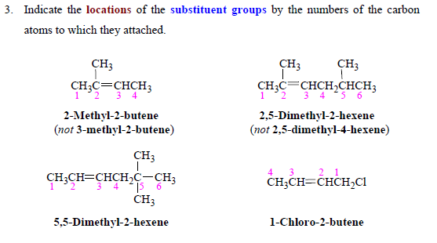
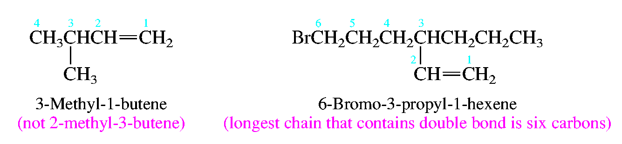
Substituent groups containing double bonds are:
CH₂=CH- vinyl (ethenyl) group
CH₂=CHCH₂- allyl group
CH₃-CH=CH- propenyl group
Examples:

Slide 5
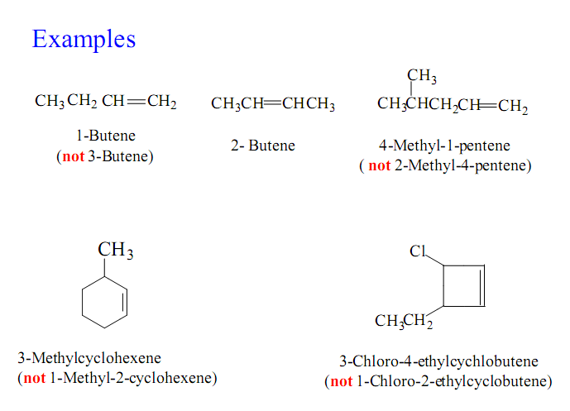
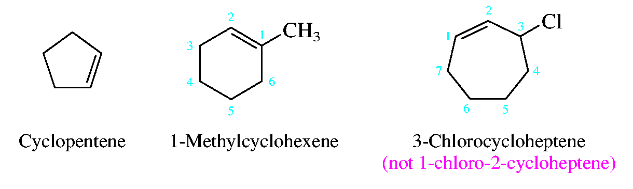
Vinylcyclohexane
-ene -ylidene
Methylenecyclohexane
(Methylidenecyclohexane)
Cyclobutylidenecyclohexane

Slide 6
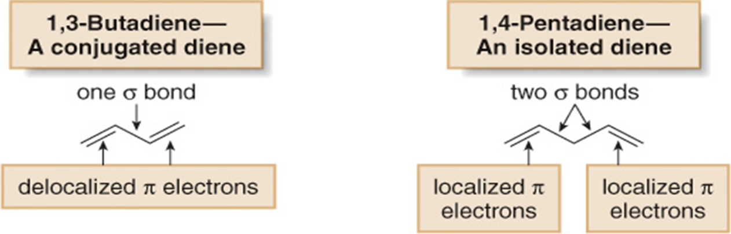
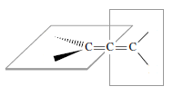
Structure and Nomenclature of Dienes
ene
adiene
1,2-Butadiene
A cumulted diene
An allene
sp
sp²

Slide 7
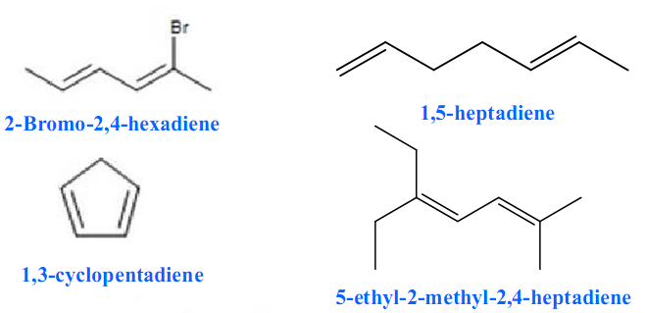
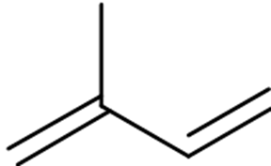
Examples:
2,3-Pentadiene
1,3-Cyclopentadiene
2-methyl-1,3-butadiene (isoprene)
5-Methyl-1,3-cycloheptadiene
1,3,5-Heptatriene
1,3,5,7-Cyclooctatetraene

Slide 8
Geometric Isomerism in Alkene
Case 1: Alkene with Tow different substituents
The cis-trans system
cis (identical or analogous substituents on same side)
trans (identical or analogous substituents on opposite sides)
If either vinyl carbon is bonded to two equivalent groups, then no geometric isomerism exists.
CH₃CH=CHCH₃ CH₃CH₂CH=CH₂
Yes No
CH₃
(CH₃)₂C=CHCH₃ CH₃CH=CCH₂CH₃
No Yes

Slide 9
Examples:
H₃C
CH₃
H₃C
H
C
C
C
C
H
H
H
CH₃
cis-2-Butene
trans-2-Butene
Cl
Cl
Cl
H
C
C
C
C
H
H
H
Cl
cis-1,2-dichloroethene
trans-1,2-dichloroethene

Slide 10
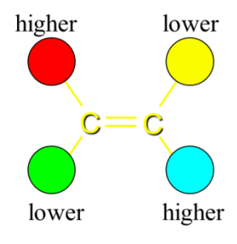

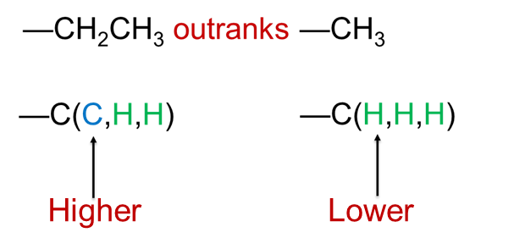
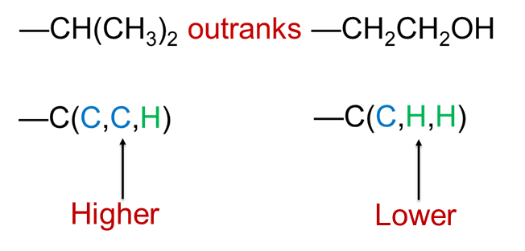
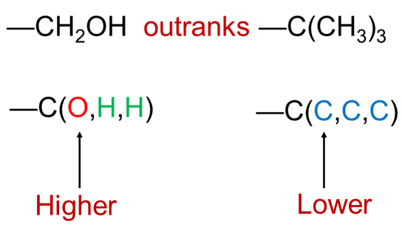
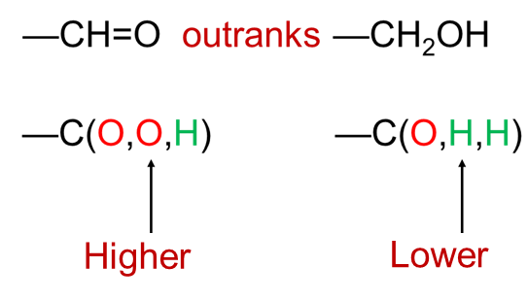
Case 2: Alkene with 3 or 4 different substituents
The E-Z System
E : Entgegen
higher ranked substituents on opposite sides
Z : Zusammen
higher ranked substituents on same side
Rules:
Higher atomic number gets higher priority
I > Br > Cl > S > P > F > O > N > C > H

Slide 11
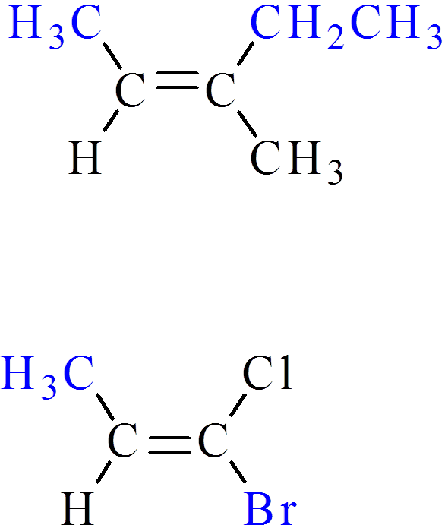
Examples:
E-1-bromo-1-chloropropene
Z-3-methyl-2-pentene
( 2E,4E)-2,4-Heptadiene
E-3-Isopropyl-2-hexene

Slide 12
Physical properties of alkenes
A Physical States and Solubilities
C₁-C₄
gases
C₅-C₁₈
liquids
More than C₁₈
solids
Alkenes are nonpolar compounds. Thus alkenes are soluble in
the nonpolar solvents such as carbon tetrachloride (CCl₄) and
benzene (C₆H₆), but they are insoluble in polar solvents such as water.

Slide 13
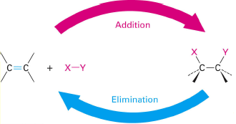
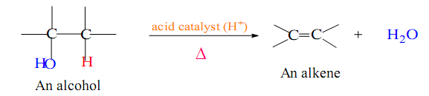
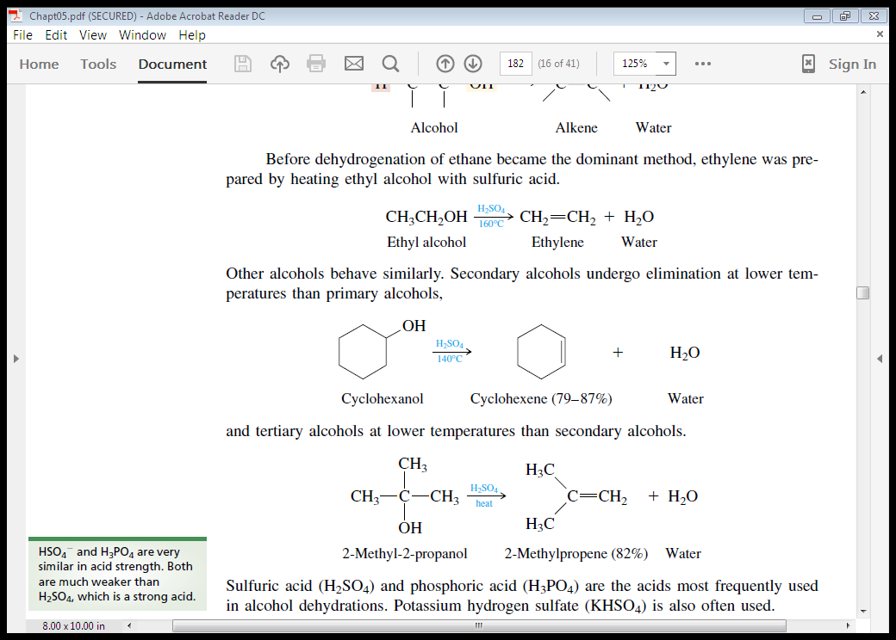

Preparation of alkenes
Alkenes can be prepared from alcohols and alkyl halides by Elimination Reactions.
1- Dehydration of Alcohols
Acid catalyst : H₂SO₄, H₃PO₄
Examples:
Primary Alcohol
Secondary Alcohol

Slide 14
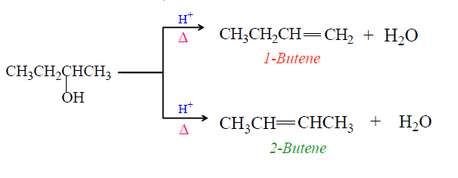
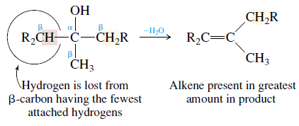
Tertiary Alcohol
Regioselectivity in Dehydration of Alcohols: Zaitsev’s Rule
How do you which one is major product?
Zaitsev’s Rule:
Hydrogen is preferably removed from the carbon with least no. of hydrogen since the alkene formed is more highly branched and is energetically more stable.

Slide 15
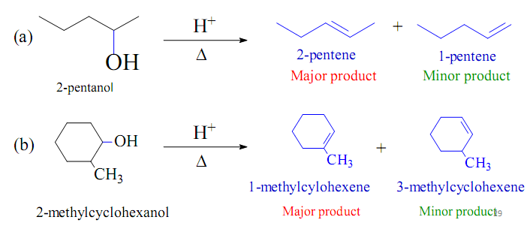
Zaitsev orientation:
Ease of formation of alkenes:
R₂C=CR₂ > R₂C=CHR > R₂C=CH₂, RCH=CHR > RCH=CH₂ > CH₂=CH₂
Stability of alkenes:
R₂C=CR₂ > R₂C=CHR > R₂C=CH₂, RCH=CHR > RCH=CH₂ > CH₂=CH₂
Examples:

Slide 16
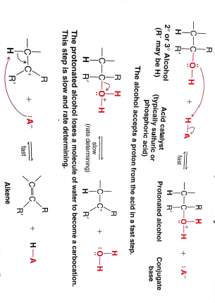
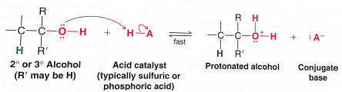
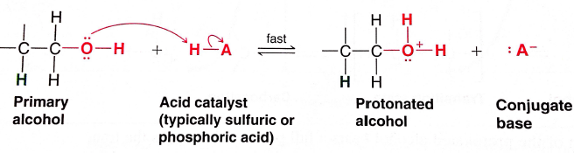
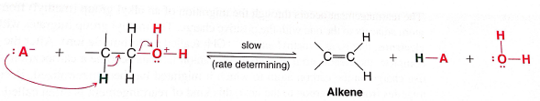
Dehydration of a Secondary or Tertiary Alcohol: An E1 Mechanism
Step 1
Step 2
Step 3
Dehydration of a Primary Alcohol: An E2 Mechanism
Step 1
Step 2

Slide 17
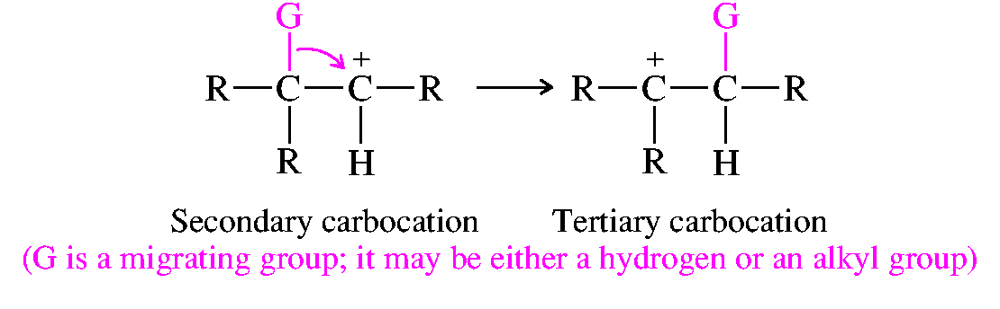
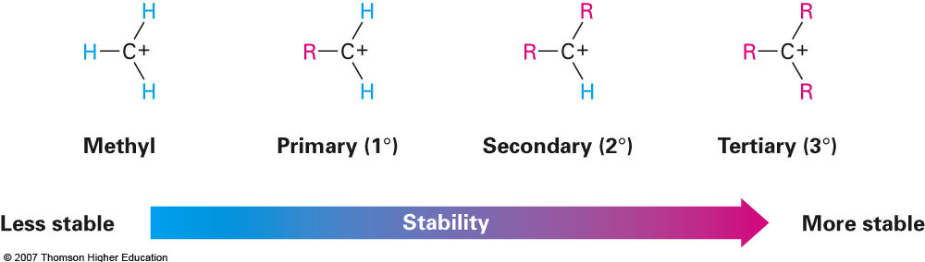
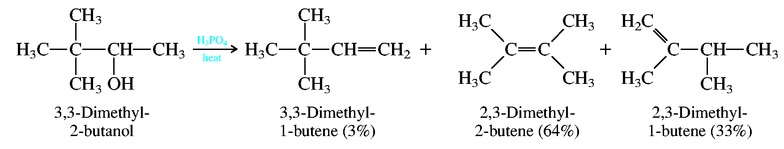
Rearrangement during Dehydration of Alcohols
Example:
methyl shift

Slide 18
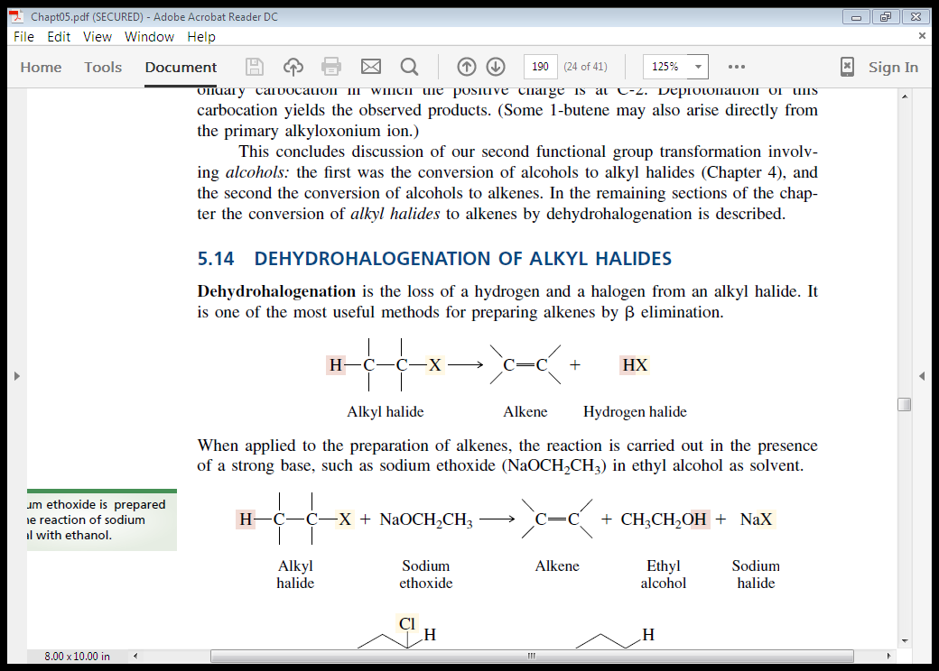
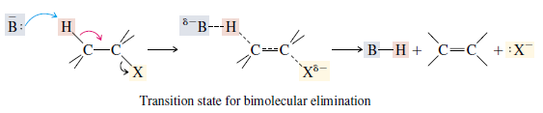
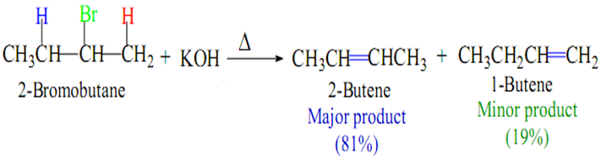

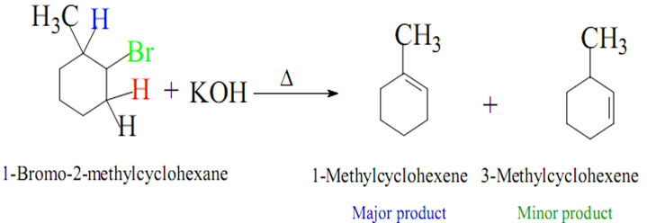
2- Dehydrohaloganation of Alkyl halides
Strong base
E2 Mechanism
In similar way to that in the dehydration of alcohol, Zaitsev’s Rule again applies; that is, the alkene with the most alkyl substitution on the double-bonded carbons predominates.
Examples:

Slide 19
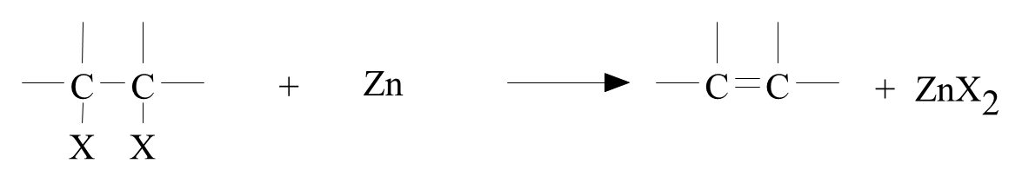
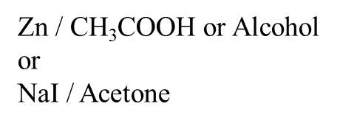
3- Dehaloganation of vicinal dihalides
Examples:

Slide 20
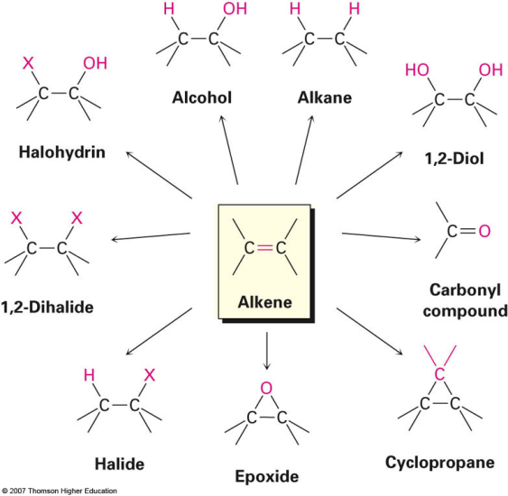
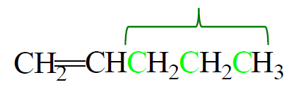
Reaction of alkenes
1- Addition reactions on the carbon-carbon double bond.
2- Substitution reactions on the saturated alkyl chain.
Addition reactions
Substitution reactions
Halogenation at High temperature

Slide 21
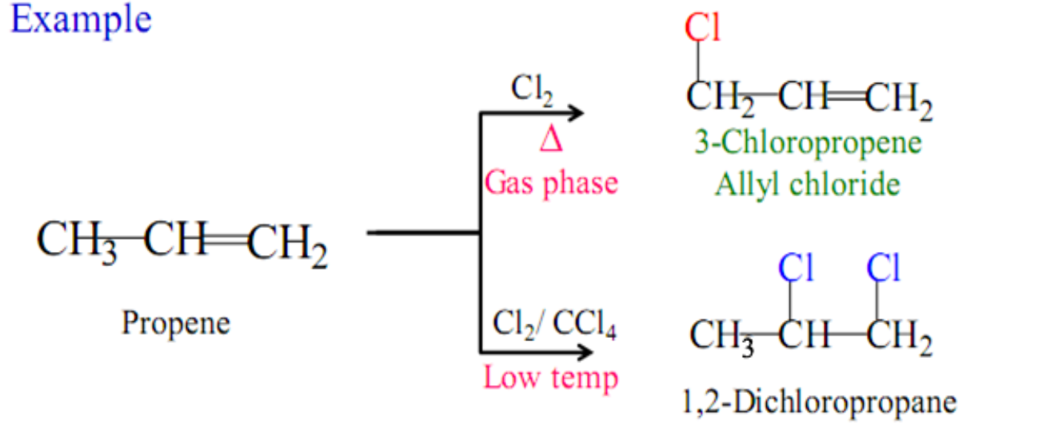
Substitution reactions
Halogenation at High temperature
Addition reaction:
low temperature
Absence of light
Substitution reaction:
High temperature
or Ultraviolet light
Allylic Halogenation

Slide 22
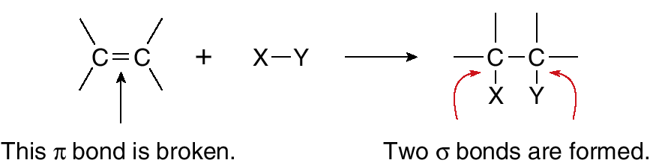
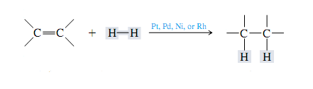
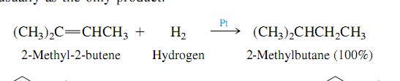
Addition reactions
Electrophilic Addition
1- Addition of Hydrogen: Catalytic Hydrogenation
Example:

Slide 23
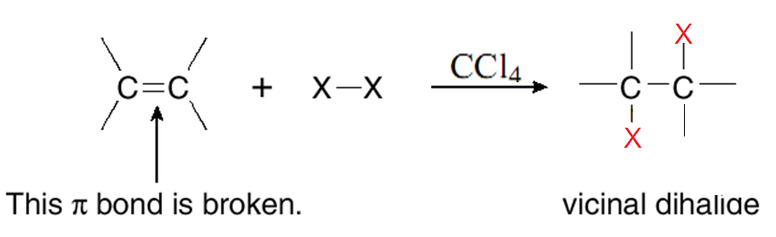
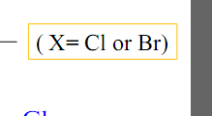
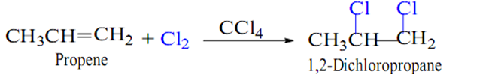
2- Addition of Halogens: Halogenation
Examples:

Slide 24
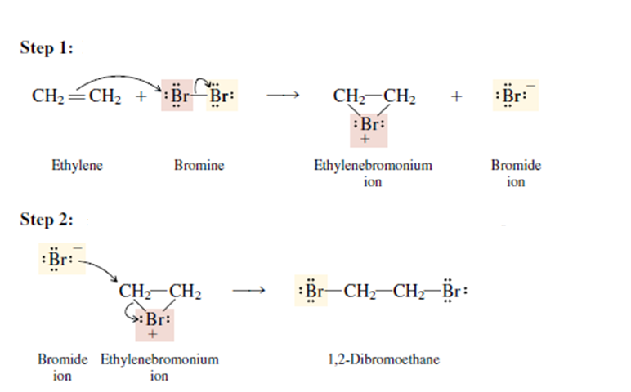
The Mechanism:
Step 1
Step 2

Slide 25
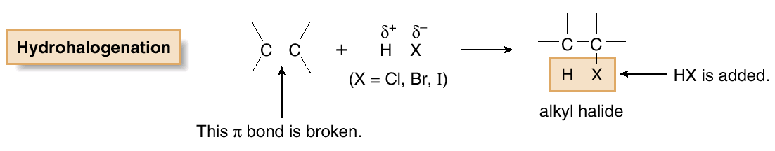
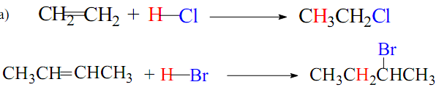

3- Addition of Hydrogen Halides: Hydrohalogenation
Examples:

Slide 26


The Mechanism:
Step 1
Step 2

Slide 27

Markovnikov’s Rule
With unsymmetrical alkene
In the addition of an acid to an alkene the hydrogen will go to the vinyl carbon that already has the greater number of hydrogens.

Slide 28


Anti Markovnikov’s Rule (Only HBr )
Electrophilic Addition
Free-radical Addition
In the addition of an acid to an alkene the hydrogen will go to the vinyl carbon that already has the lowest number of hydrogens.
The Mechanism:
Step 1
Step 2
Step 3
Step 4

Slide 29



4- Addition of Sulfuric acid
heat
(H-OSO₃H)
Addition of Sulfuric acid to alkenes also follows Markovnikov’s rule, as the example

Slide 30

The Mechanism:

Slide 31




5- Addition of Water : Hydration
Addition of HOH across the double bond is in accordance with Markovnikov’s rule, as the example
The Mechanism:
Step 1
Step 2
Step 3

Slide 32



6- Addition of HOX : Halohydrin Formation
The addition of the chloronium ion, Cl⁺ or bromonium ion, Br⁺ and
the hydroxide ion, OH⁻, follows the Markovnikov’s rule, as the example.

Slide 33


The Mechanism:
Step 1
Step 2

Slide 34



7- Oxidation of alkenes
1) Oxidation of alkenes with Permanganate (Baeyer test)
syn hydroxylation
Examples:
KMnO₄
H₂O
OH⁻, cold

Slide 35
2) Oxidation of alkenes with peroxy acid
Epoxide
anti hydroxylation
Examples:
2,3-butanediol
trans-1,2-cyclohexanediol

Slide 36



8- Ozonolysis
Oxidation of alkenes by ozone O₃
The ozonolysis reaction can be summarized by the following equation:
1) O₃
2) H₂O, Zn

Slide 37



Examples:
1) O₃
2) H₂O, Zn
1) O₃
2) H₂O, Zn
1) O₃
2) H₂O, Zn
1) O₃
2) H₂O, Zn

Slide 38


Preparation of Dienes
1- By acid catalyzed double dehydration
2- By dehydrohalogenation of dihalides

Slide 39


Reactions of Dienes
1- Addition of Halogens
+
1,2-addition
Major at low temperature
1,4-addition
Major at room temperature
1,2-addition
1,2-addition

Slide 40



2- Addition of Hydrogen
1,2-addition
1,4-addition
1,2-addition
1,2-addition

Slide 41


3- Addition of halogen acid
+
1,2-addition
Major at low temperature
1,4-addition
Major at room temperature
1,2-addition
1,2-addition

Slide 42

The Mechanism:

Slide 43



4- The Diels-Alder reaction
The Diels-Alder reaction is the conjugate addition of an alkene (dienophile) to a diene. The product of a Diels-Alder reaction is often called an adduct.
Because the Diels-Alder reaction leads to the formation of a ring, it is termed a 1,4-cycloaddition reaction.
Examples:

