Slide 1
240 Chem
Saturated Hydrocarbons:
Alkanes
and
Cycloalkanes
Chapter 2

Slide 2
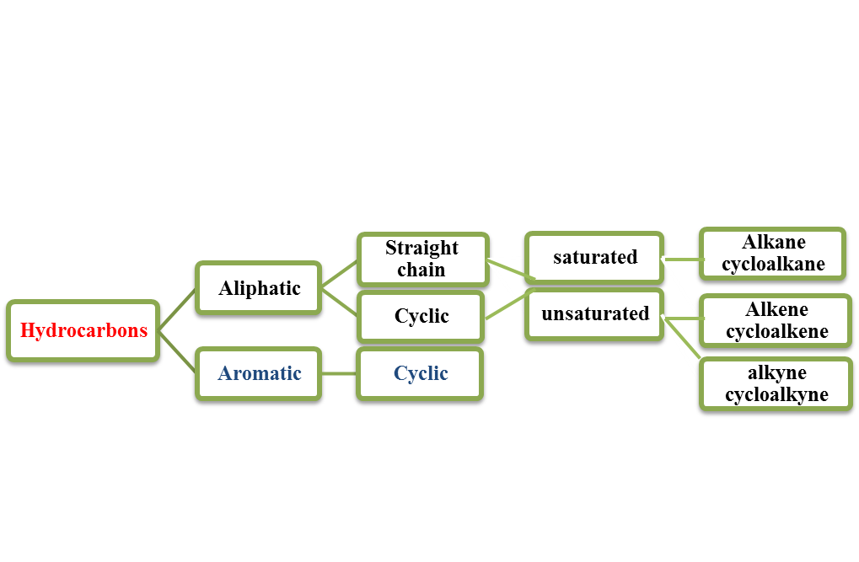
Hydrocarbons

Slide 3
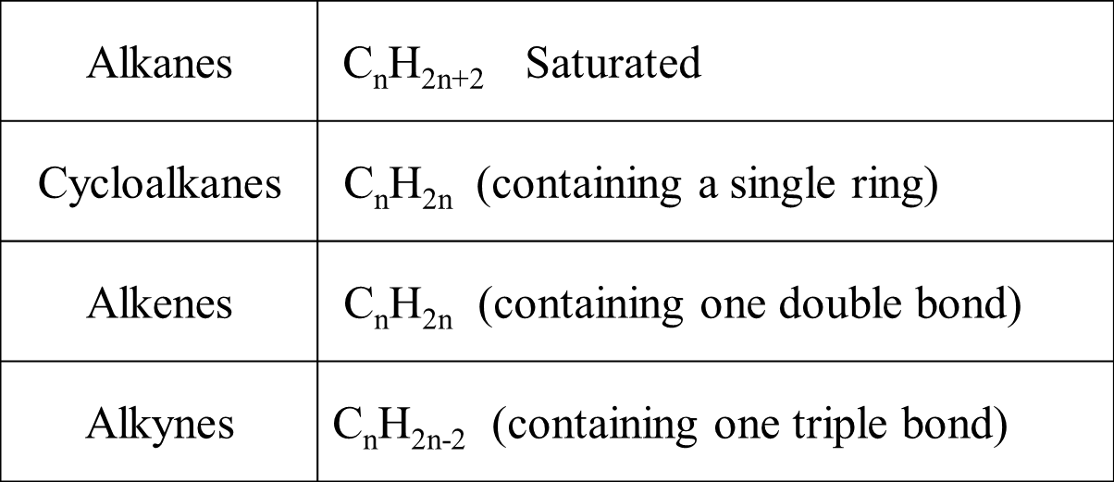
General Molecular Formula of Hydrocarbons
(Homologous Series)

Slide 4
Alkanes
C_{n}H_{2n+2} Saturated
-ane
Names, Molecular Formula and Structural Formula of the first Ten Alkanes
Carbon | Name | Molecular Formula | Structural Formula
1 | Methane | CH₄ | CH₄
2 | Ethane | C₂H₆ | CH₃CH₃
3 | Propane | C₃H₈ | CH₃CH₂CH₃
4 | Butane | C₄H₁₀ | CH₃CH₂CH₂CH₃
5 | Pentane | C₅H₁₂ | CH₃CH₂CH₂CH₂CH₃
6 | Hexane | C₆H₁₄ | CH₃(CH₂)₄CH₃
7 | Heptane | C₇H₁₆ | CH₃(CH₂)₅CH₃
8 | Octane | C₈H₁₈ | CH₃(CH₂)₆CH₃
9 | Nonane | C₉H₂₀ | CH₃(CH₂)₇CH₃
10 | Decane | C₁₀H₂₂ | CH₃(CH₂)₈CH₃

Slide 5

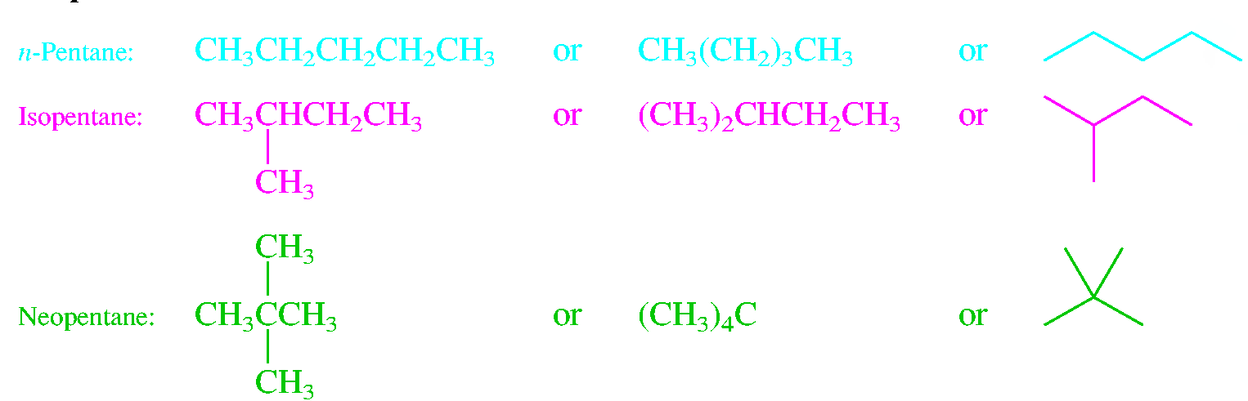
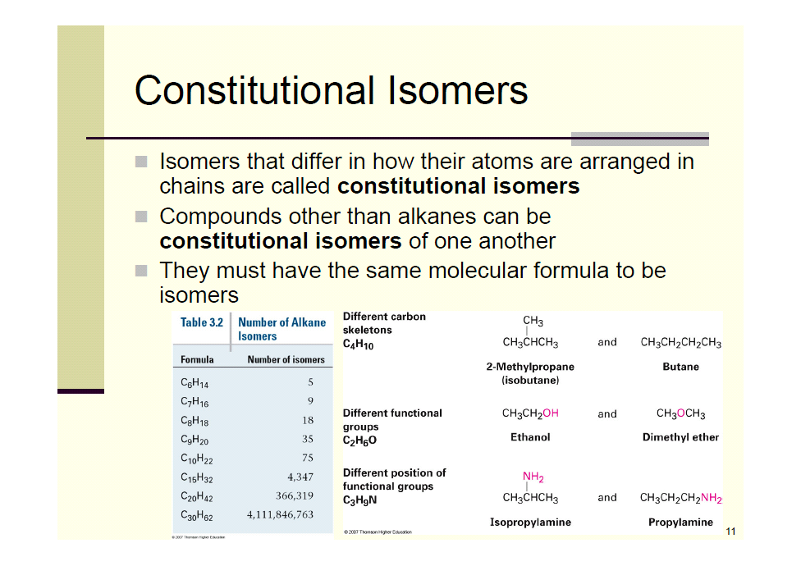
Structural Isomerism
structural isomers:
compounds with identical molecular formula and different structure
Examples:
C₄H₁₀
C₅H₁₂
C₂H₆O

Slide 6
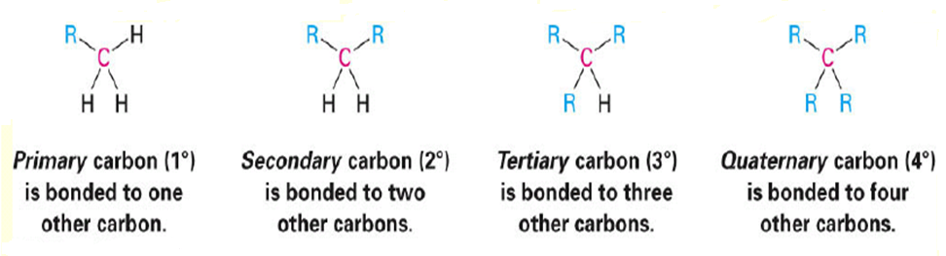
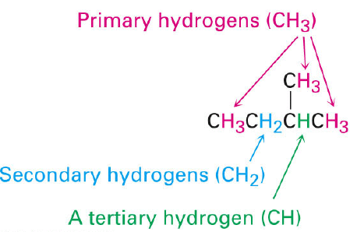
Classification of Carbon and Hydrogen Atoms
Hydrogens are also referred to as 1º, 2º or 3º according to the type of carbon they are bonded to.

Slide 7
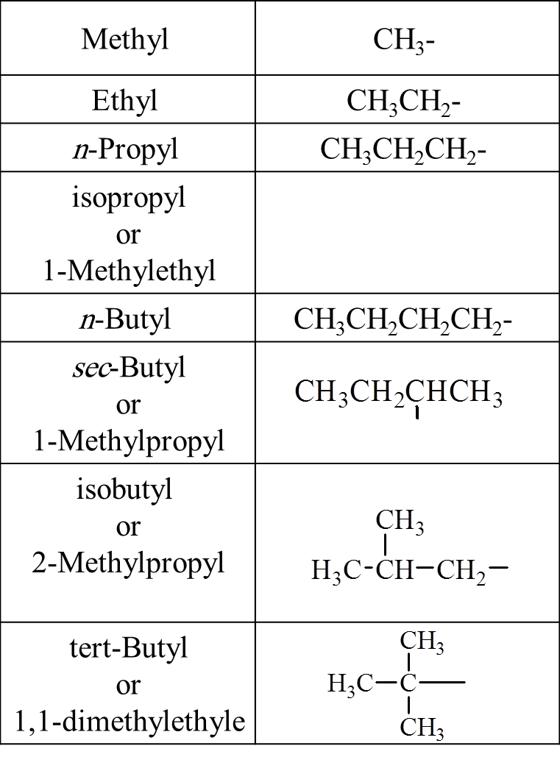
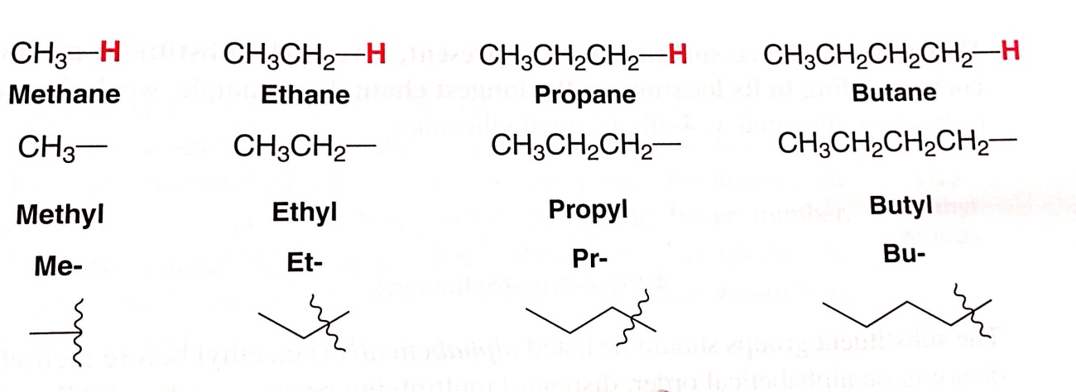
Alkyl Groups
-ane
-yl
C_{n}H_{2n+2}
C_{n}H_{2n+1}

Slide 8
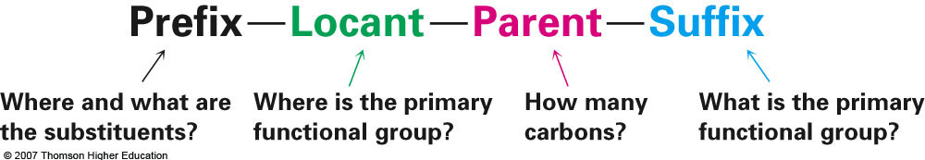
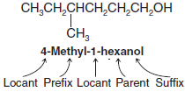
The IUPAC System of Nomenclature
Compounds are given systematic names by a process that uses:
Examples:

Slide 9
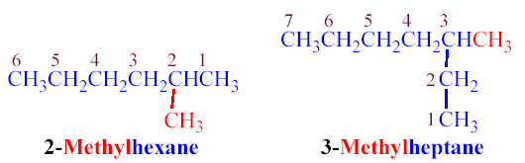
Follows specific rules:
1. Identifying the parent hydrocarbon chain
(the longest one)
2. Numbering the chain
(starting at the end that a side chain is nearer from )
3. Listing the side-chains before the of parent chain
(in alphatbetical order, giving the number of the carbon atom of the parent chain)
Examples:

Slide 10
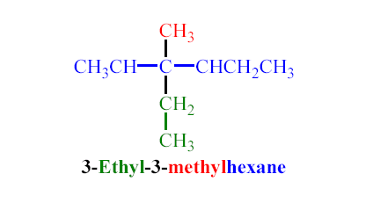
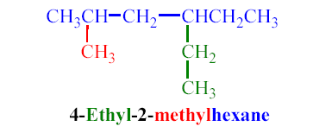
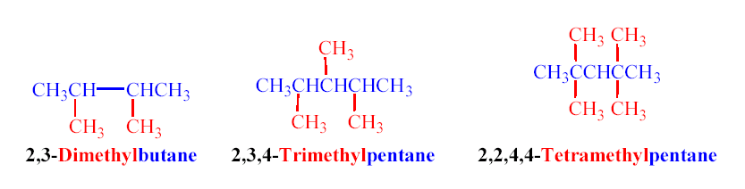
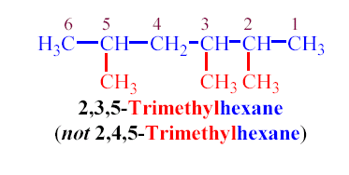
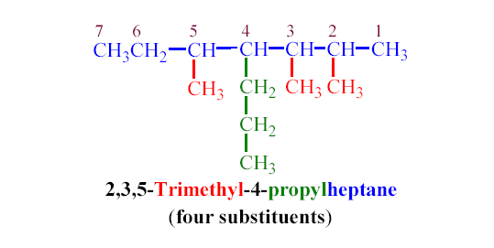

Slide 11
If any other substituents are found on the parent chain, all these substituents are arranged alphabetically.
    -NO₂ nitro
    - NH₂ amino
    -CN cyano
    - Cl Chloro
    -Br bromo
    - I iodo
    -F floro
    -alkoxy e.g: -OCH₃ methoxy, OCH₂CH₃ ethoxy…etc

Slide 12
Examples:
Ethyl chloride
n-Propyl bromide
isobutyl chloride
tert-Butyl bromide

Slide 13
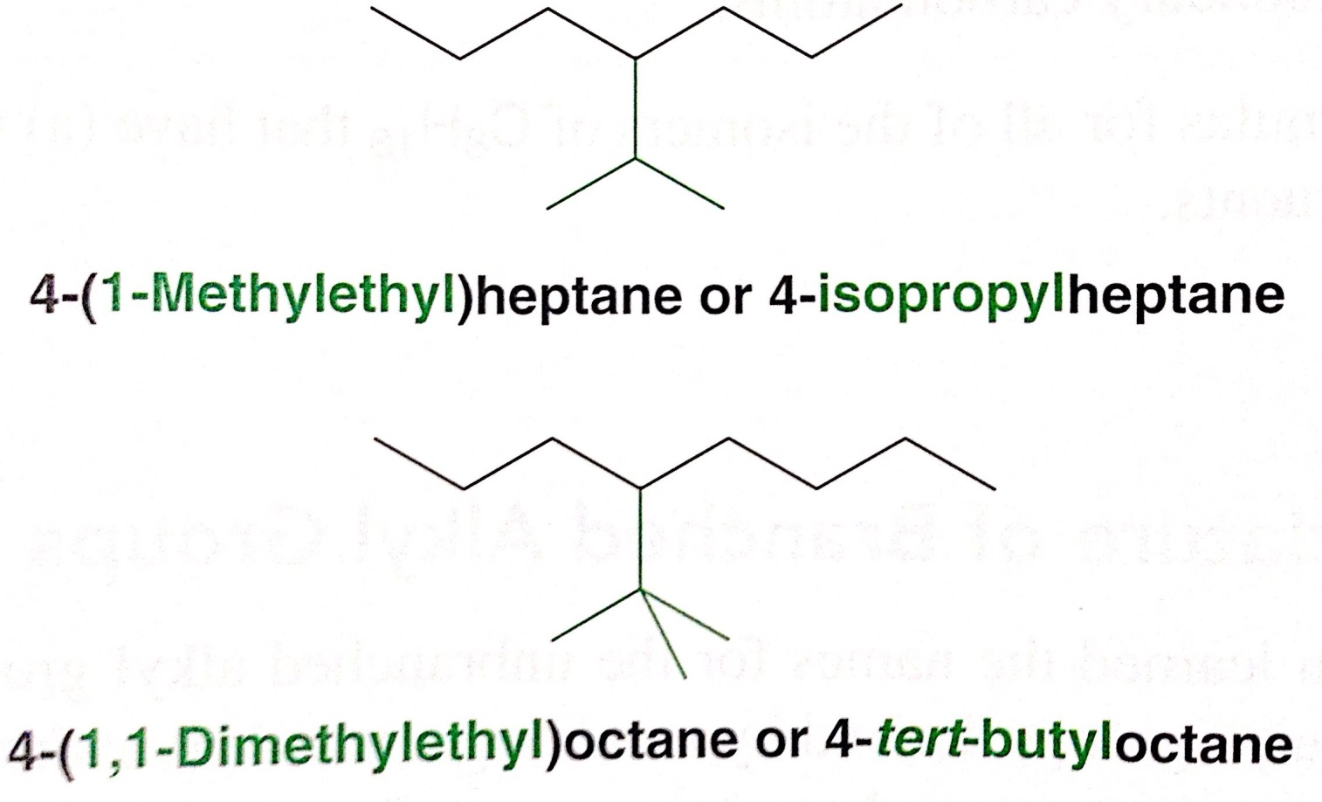
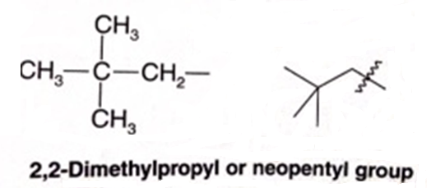
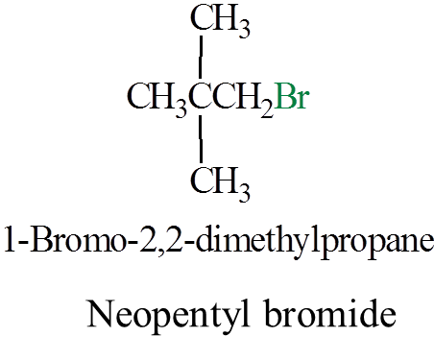

Slide 14
Physical properties of alkanes
A Physical States and Solubilities
C₁-C₄
colorless gases
C₅-C₁₇
liquids with characteristic odor
C₂₀ and more
odorless waxy materials
Alkanes are nonpolar compounds. Thus alkanes are soluble in
the nonpolar solvents such as carbon tetrachloride (CCl₄) and
benzene (C₆H₆), but they are insoluble in polar solvents such as water.

Slide 15
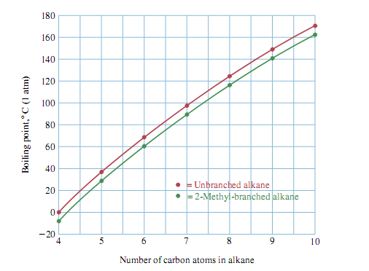
B Boiling Points
The boiling points of the normal alkanes increase with increasing molecular weight.
Branching of the alkane chain lowers the boiling point.
Example:
C Melting Points
Generally, melting point increases as molecular weight increases, but with no particular pattern.

Slide 16
Sources of Alkanes and Cycloalkanes
The primary sources of alkanes are natural gas and petroleum.
natural gas is especially rich in methane and also contains ethane and
propane, along with smaller amounts of other low-molecular-weight alkanes.
Petroleum is a liquid mixture containing hundreds of substances, including approximately 150 hydrocarbons, roughly half
of which are alkanes or cycloalkanes. Distillation of crude oil gives
a number of fractions such as kerosene and gas oil find wide use as fuels for diesel engines and furnaces, and the nonvolatile residue can be processed to give lubricating oil, greases, petroleum jelly, paraffin wax, and asphalt.

Slide 17
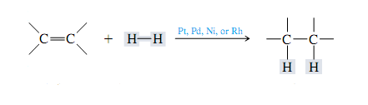
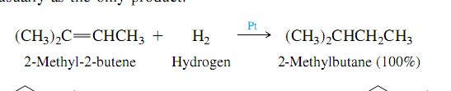
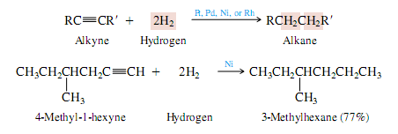
Preparation of alkanes
(1) From Alkenes & Alkynes
Catalytic Hydrogenation

Slide 18
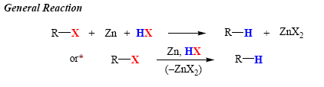
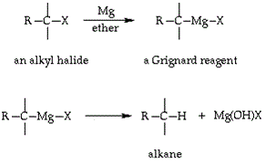
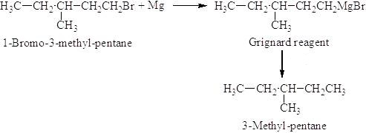
2 (2) From alkyl Halides
A) Reduction of alkyl halides
B) Hydrolysis of Grignard Reagent
H₃O⁺
H₃O⁺

Slide 19

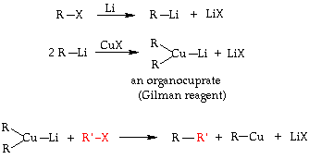
C) Wurtz-Fitting Reaction
D) Corey-House (Gilman reagent)

Slide 20
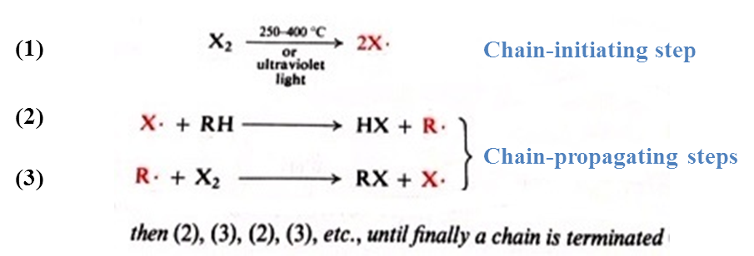
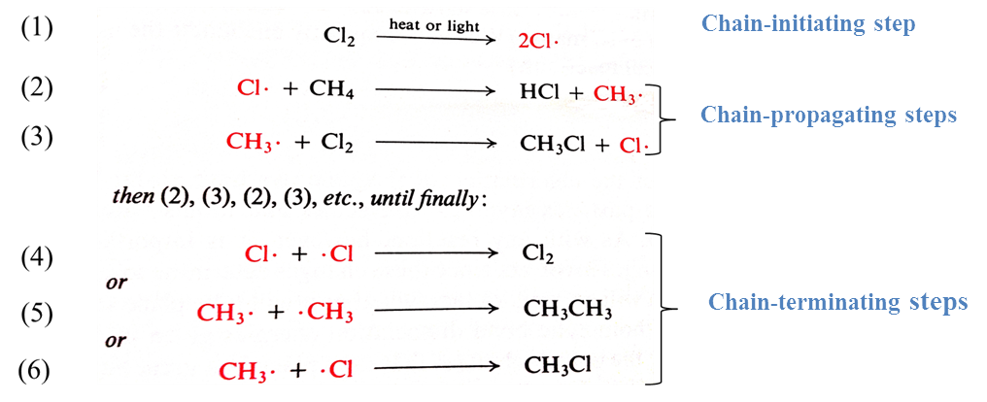
Reactions of alkanes
Reactions of alkanes
(1) Halogenation
Mechanism:
Example:

Slide 21
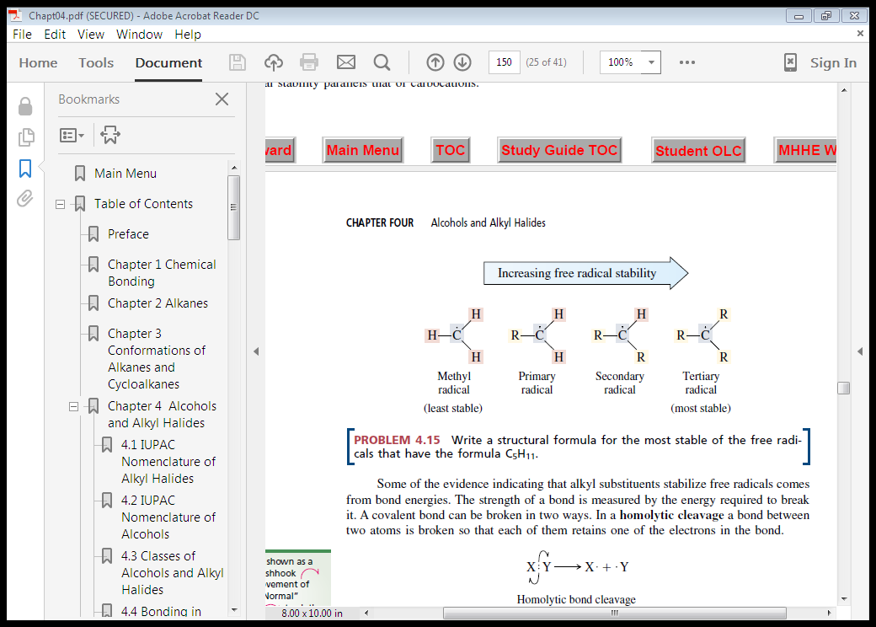
Selectivity in Halogenation Reactions
Ease of abstraction of hydrogen atoms

Slide 22

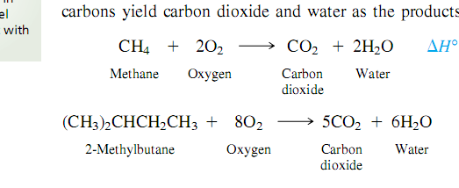
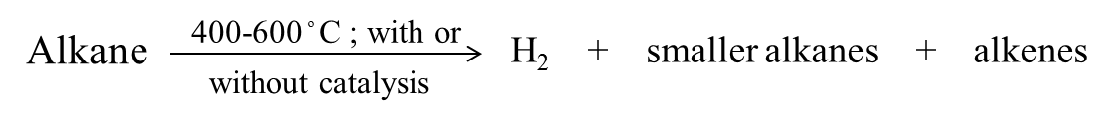
(2) Combustion
Examples:
(3) Pyrolysis ( cracking )

Slide 23
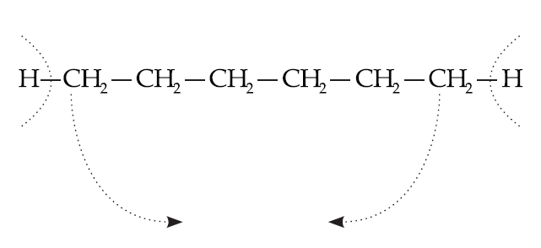
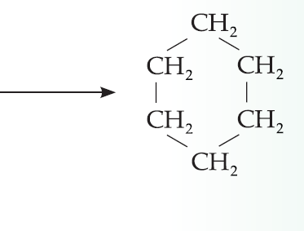
Cycloalkanes
C_{n}H_{2n}
containing a single ring
C_{n}H_{2n+2}
C_{n}H_{2n}

Slide 24
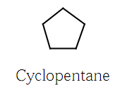
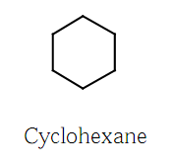
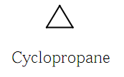
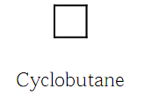
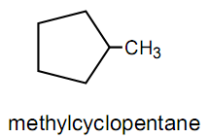
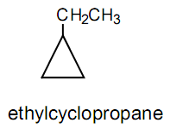
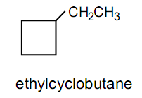
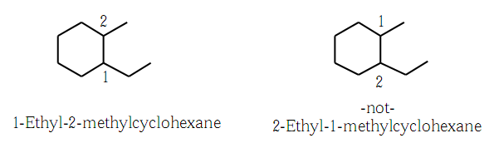
Nomenclature of Cycloalkane
cycol-

Slide 25
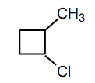
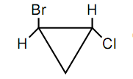


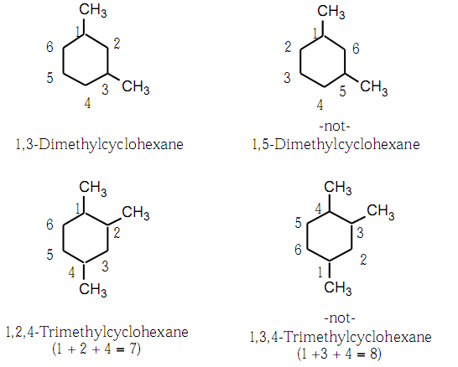
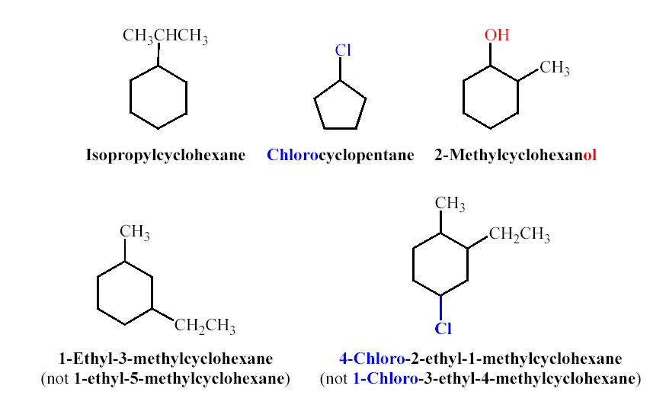
1-tert-Butyl-4-methylcyclohexane
4-isopropyl-1-cyclopropylheptane
1-Cyclobutylhexane
1,3-Dicyclohexylpropane
Cyclopentylcyclohexane

Slide 26
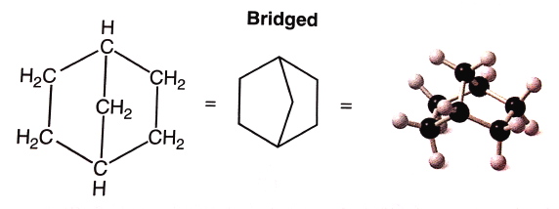
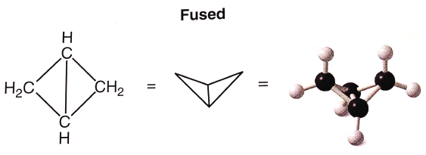
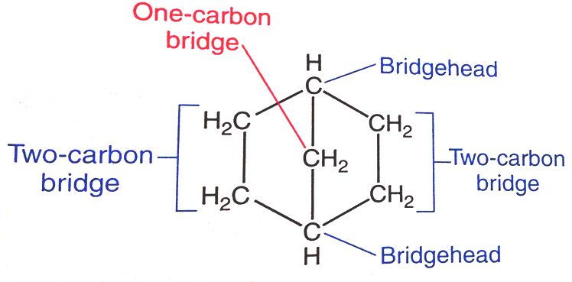
Nomenclature of Bicycloalkane
Bicycloalkanes: compounds containing two fused or bridged rings
Bicyclo-
Bicyclo[2.2.1]heptane
Bicyclo[1.1.0]butane

Slide 27
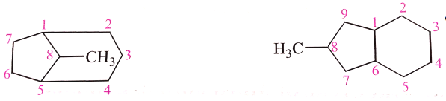
Examples:
Bicyclo[4.2.0]octane
8-Methylbicyclo[4.3.0]nonane
8-Methylbicyclo[3.2.1]octane
5-Chloro-bicyclo[2.1.1]hexane

Slide 28




Reaction of cycloalkanes
Ring less stable 3 and 4
Ring more stable 5 and 6

Slide 29

Geometric Isomerism in Cycloalkane
Cis-Trans Isomerism
Ring structures like C=C restrict rotation and therefore can result in cis and trans isomers.
The trans-isomer is the molecule with branches on OPPOSITE sides of the ring.
The cis-isomer is the molecule with branches on the SAME side of the ring.
These cis-trans isomers are also stereoisomers.
The physical properties of cis-trans isomers are different; they have different melting points, boiling points, and so on.
cis-1,2-Dimethylcyclopropane
trans-1,2-Dimethylcyclopropane

Slide 30


Examples:

Slide 31


Slide 32

Conformations and Conformational Analysis of Alkanes
Tow groups bonded by only a single bond can undergo rotation about that bond with respect to each other.
The temporary molecular shapes that result from such a rotation are called conformations of the molecule.
Each possible structure is called conformer.
An analysis of the energy changes that occur as a molecule undergoes rotations about single bonds is called a Conformational analysis.
The certain types of structural formulas are:
Newman projection formula
Sawhorse formula

Slide 33





Conformational Analysis in Ethane
Ethane is the simplest hydrocarbon that can have distinct conformations.
Two, the staggered conformation and the eclipsed conformation.
Staggered Conformation
Eclipsed Conformation

Slide 34


Conformational Analysis in Butane

Slide 35



Conformational Analysis in Cyclohexane
Chair conformation
most stable
Boat conformation
6 kcal/mol

Slide 36






Drawing the Axial and Equatorial Hydrogens
Axial bond (a)
Equatorial bond (e)
Completed cyclohexane

Slide 37

Conformational Mobility of Cyclohexane
Chair conformations readily interconvert, resulting in the exchange of axial and equatorial positions by a ring-flip

Slide 38

Conformations of Monosubstituted Cyclohexanes
Determining the position of a substituent in the most stable conformer.
1,3-Diaxial Interactions

Slide 39

Cis-trans isomerism and Conformational Structure of
Disubstituted Cyclohexane

Slide 40




1,4-dimethylcyclohexane

