Slide 1
Insect outer morphology and structure of insect mouth parts
Lab. 311
Presented by: hessa alobaid

Slide 2
Insect morphology
Insects possess segmented bodies supported by an exoskeleton, a hard jointed outer covering made mostly of chitin.
The segments of the body are organized into three distinctive but interconnected units; a head, a thorax, and an abdomen.

Slide 3
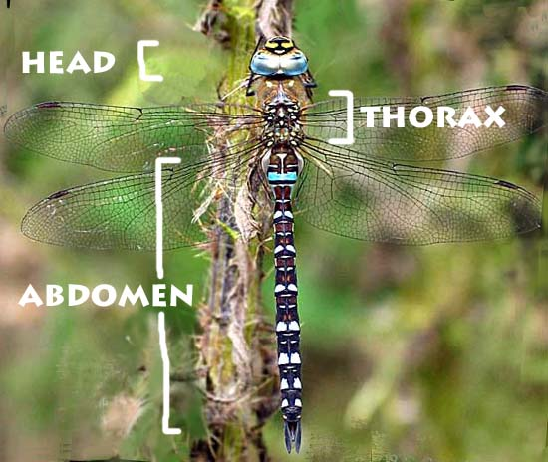
head
The head supports a pair of sensory antennae, a pair of compound eyes, if present, one to three simple eyes and three sets of variously modified appendages that form the mouthparts.

Slide 4
Thorax
The thorax has six segmented legs (one pair each for the prothorax, mesothorax and the metathorax segments making up the thorax) and two or four wings (if present in the species).

Slide 5
Abdomen
The abdomen (made up of eleven segments some of which may be reduced or fused) has most of the digestive, respiratory, excretory and reproductive-internal structures.
There is considerable variation and many adaptations in the body parts of insects especially wings, legs, antenna, mouth-parts etc.

Slide 6
Mouthparts
Labrum is a simple fused sclerite, often called the upper lip and moves longitudinally which is hinged to the clypeus.
Mandibles (jaws) are a highly sclerotized pair of structures that move at right angles to the body; used for biting, chewing and severing food.
Maxillae are paired structures that can also move at right angles to the body and possess segmented palps.
Labium (lower lip) is the fused structure that moves longitudinally and possesses a pair of segmented palps.
hypopharynx is a somewhat globular structure, arising from the base of the labium. It assists swallowing

Slide 7
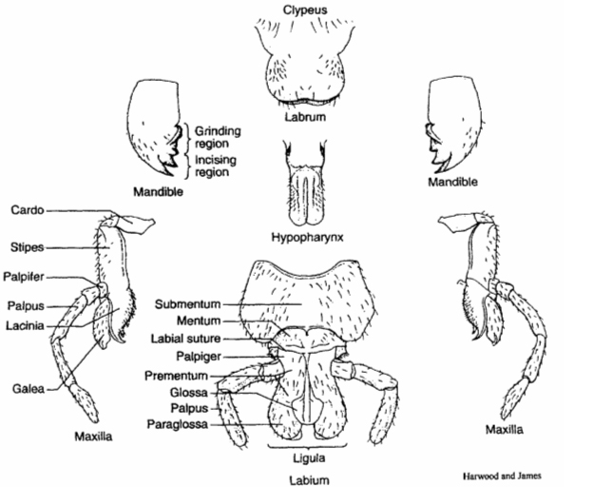

Slide 8
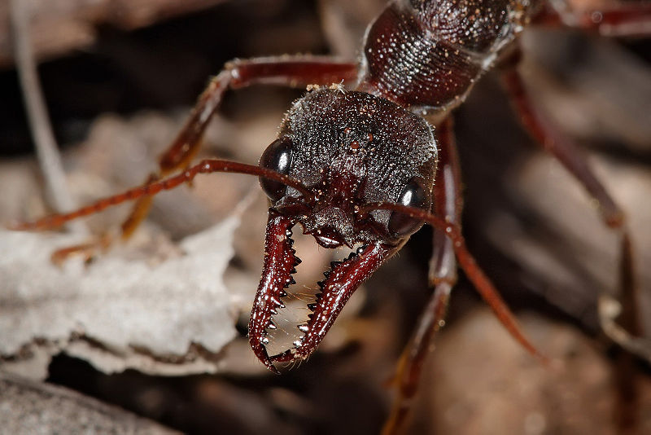
types of mouth parts:
Chewing mouth parts: These forms of mouthparts are among the most common in insects, which are used for biting and grinding solid foods.
Examples of chewing insects include dragonflies, grasshoppers and beetles.

Slide 9
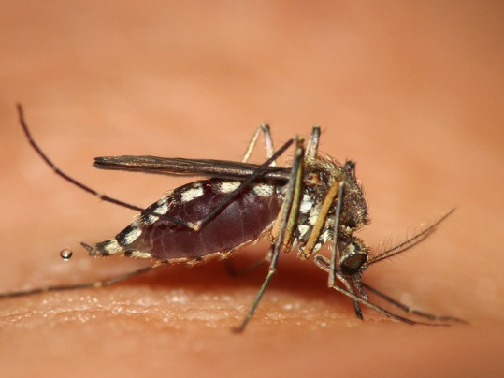
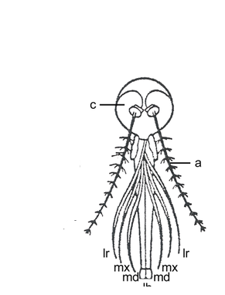
Piercing-sucking
These forms of mouthparts are used to penetrate solid tissue and then suck up liquid food.
The defining feature of the order Hemiptera is the possession of mouthparts where the mandibles and maxillae are modified into a proboscis, sheathed within a modified labium, which is capable of piercing tissues and sucking out the liquids.

Slide 10
In female mosquitoes, all mouthparts are elongate.
The labium encloses all other mouthparts like a sheath.
The labrum forms the main feeding tube, through which blood is sucked.
Paired mandibles and maxillae are present, together forming the stylet, which is used to pierce an animal's skin.
During piercing, the labium remains outside the food item's skin, folding away from the stylet.
Saliva containing anticoagulants, is injected into the food item and blood sucked out, each through different tubes.

Slide 11
Sponging
These forms of mouthparts are used to sponge and suck liquids and lack stylets (e.g. most Diptera).
The housefly is the typical sponging insect.

Slide 12
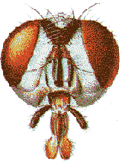
The labium gives the description, being articulate and possessing at its end a spongelike labellum. Paired mandibles and maxillae are present, but much reduced and non-functional.
The labium forms a proboscis which is used to channel liquid food to the esophagus.

Slide 13
The housefly is able to eat solid food by secreting saliva and dabbing it over the food item.
As the saliva dissolves the food, the solution is then drawn up into the mouth as a liquid.
The labellum's surface is covered by minute food channels, formed by the interlocking elongate hypopharynx and epipharynx, which form a tube leading to the esophagus. The food channel draws liquid and liquified food to the esophagus by capillary action

Slide 14
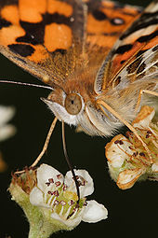
Siphoning
These forms of mouthparts lack stylets and are used to suck liquids, which are commonly found among species of Lepidoptera.
A few adult Lepidoptera lack mandibles, with the remaining mouthparts forming an elongated sucking tube, the proboscis.

Slide 15
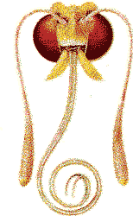
One of the more defining characteristics of lepidopterans is their coiled proboscis.
It is held coiled under the head when not in use.
During feeding, however, it is extended to reach the nectar of flowers.
The proboscis is a long tube that is formed by heavily modified maxillae, specifically the galea

Slide 16
Any question

