Slide 1
Microscopy

Slide 2
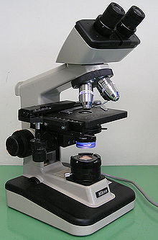
Microscope
is an instrument used to see objects that are too small for the naked eye.

Slide 4
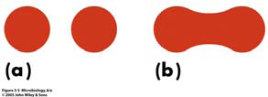
Function of microscope:
Magnification: to magnify (enlarge) the object being examined.
Resolution: its ability to differentiate two objects when you view them on a specimen slide.

Slide 5
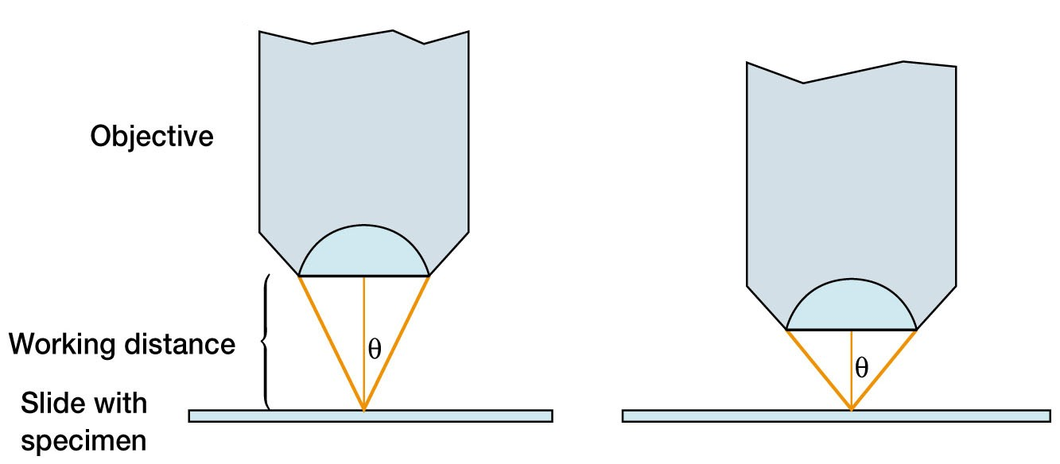
Terms Related To Microscopes
Working distance: The distance between the objective and the object when the object is in focus.
Parfocal: When move from one objective lens to another you are still in approximate focusing.

Slide 6
Types of light microscope:
Bright field microscope
Dark field microscope
Phase contrast microscope
Inverted microscope
Dissecting microscope

Slide 7
Bright field microscope
Produces a dark image against a brighter background
Has several objective lenses
Uses ordinary bulb light as source of light.
Total magnification is 1000x
The resolution is 0.2µm
It is mainly used to examine stained preparations.

Slide 8
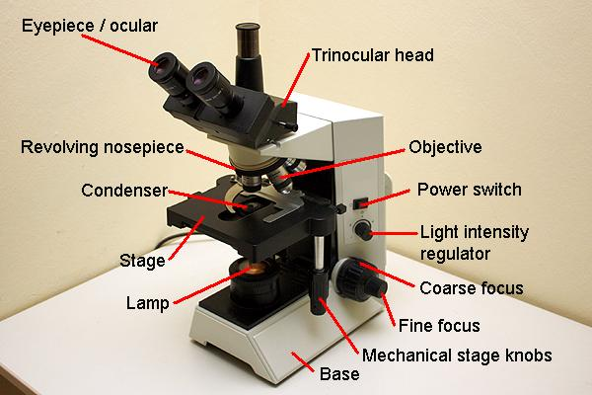
Bright field Microscope parts

Slide 9
Microscope parts
1) Ocular Lens/Eyepiece
Magnifies the specimen image 10x
2) Nose piece
The Nose Piece holds the objective lenses and can be turned to increase the magnification
3) Arm
Used to support the microscope when carried. Holds the body tube, nose piece and objective lenses

Slide 10
4) Objective lenses: To produce a magnified image with different magnification. (X4, x10, x20, x40, and x100).
X100 objective lens: called Oil immersion objective.
To calculate the total magnification of the microscope:
Total mag. = objective lens mag. X ocular lens mag.
The lowest mag. = 4 X 10 = X40
The highest mag. = 100 X 10 = X1000

Slide 11
5) Slide holder: To hold the slide and prevent it from moving.
6) Stage
Supports the slide/specimen
7) Stage control knobs
It moves stage forwards, backwards.
It moves stage right to left to adjust slide under objective lens.

Slide 12
8) Condenser: To collect the light in a cone shape from the light source to the object.
When using X40 or X100 lens raise the condenser up.
9) Iris diaphragm: Control the intensity of light that goes to the condenser.
When using X100 lens open iris diaphragm.

Slide 13
10) Course adjustment knob: Move the stage up and down rapidly to get approximate focusing.
11) Fine adjustment knob: move the stage slowly to get fine focusing.

Slide 14
Immersion Oil
Microscope specimen is on a glass slide.
• Light passes through glass slide air lens.
the light gets refracted
• At high magnification, this refraction of the light blurs the image
• To eliminate refraction between slide and lens:
Eliminate the air, replace with immersion oil
(Immersion oil same index of refraction as glass)

Slide 16
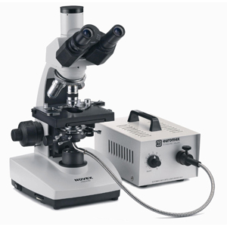
Dark field microscope
The condenser condenses the light on the object or specimen but out of the objective.
The result is dark background and bright object.
Used:
to see the motility of bacteria.

Slide 18
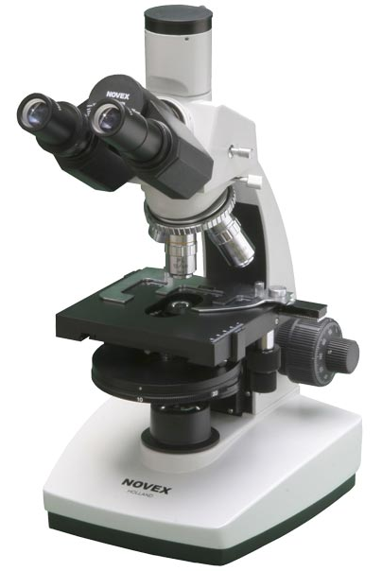
Phase contrast microscope
Produce contrast between the cell and the background.
The cells appear darker against a brighter background.

Slide 19
Phase contrast microscope
It has special condenser and phase-plate which retards light waves that go through cells in specimen. This makes contrast between cells and background. The cells appear darker against a brighter background.
Used:
Excellent way to observe living cells in wet preparations.

Slide 20
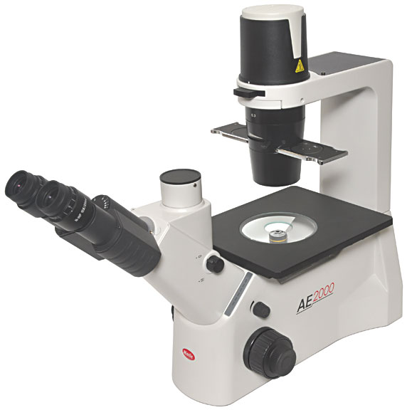
Inverted microscope
There is a bigger working distance to allow use of cell culture flasks.
There is a bigger working distance to allow use of cell culture flasks.
Used:
to see the effect of virus on the cells (cell culture flasks).

Slide 21
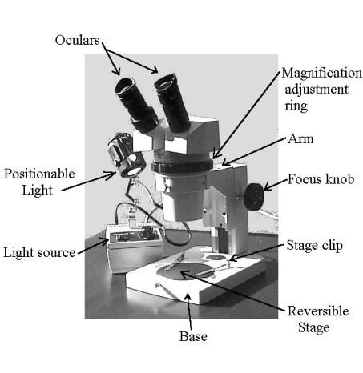
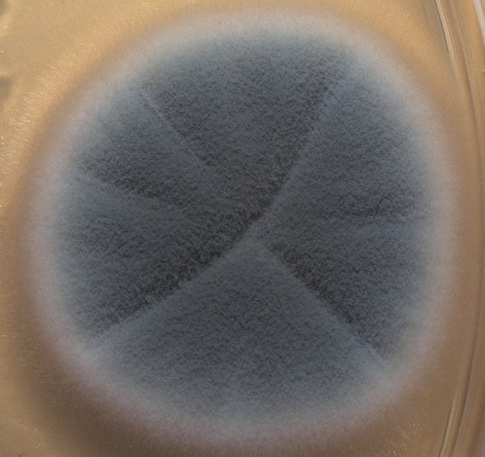
Dissecting microscope
It is a simple microscope.
It has oculars and stage only.
It magnifies x10 only
Used:
in mycology to see the plate of fungi + dissecting of insect.

Slide 22
Non-light microscope
Fluorescent microscope
Electron microscope (E.M)

Slide 23
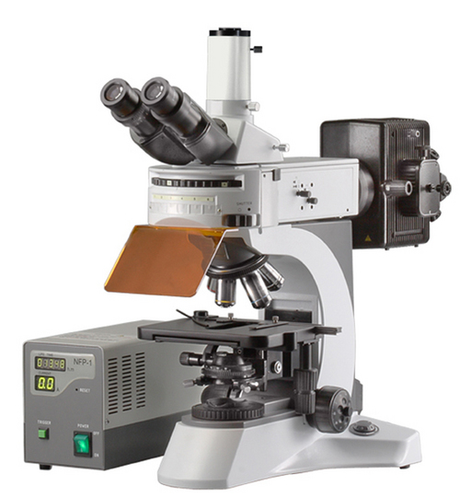
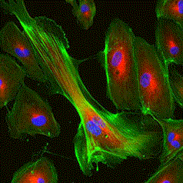
Fluorescent microscope
Produce ultra violet light.
The slides stained with fluorochrome.
Used: in immunology.

Slide 24
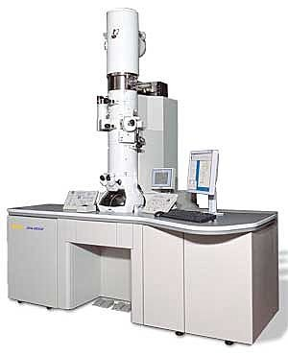
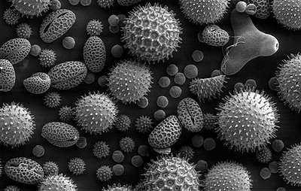
Electron microscope (E.M)
Produce electrons (electron beam).
Magnification= X100 000- X300 000
Resolution= 0.0003 µm
Used:
to see viruses and the cell ingredients.

Slide 25
Caring of Microscope
Clean only with a soft cloth/tissue
Make sure it’s on a flat surface
Be gentle with the microscope
Carry it with 2 HANDS…one on the arm and the other on the base

Slide 26
Thank You

